Slide 1
Bike Sharing- Hourly Forecast
By Ujjawal kumar

Slide 2
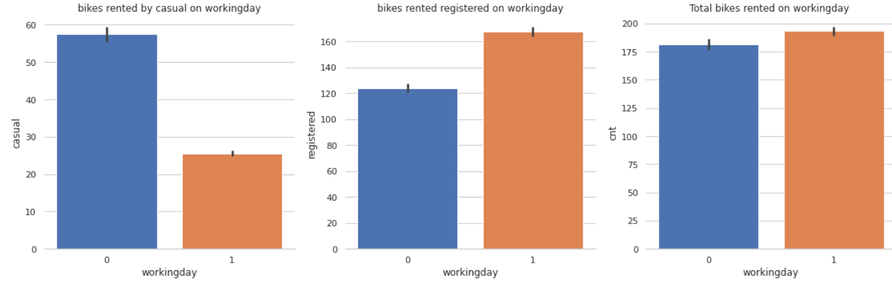
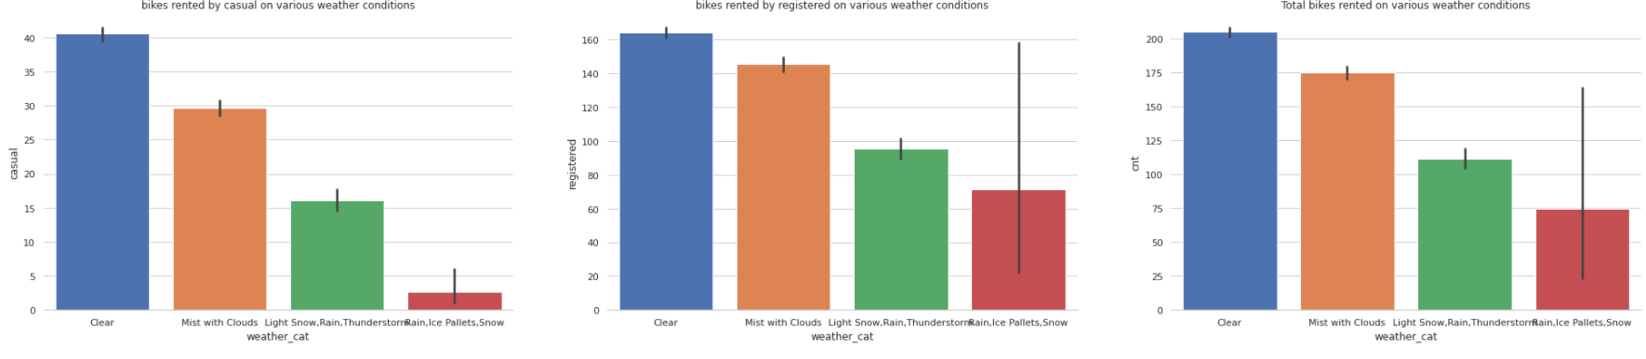
Data ANALYSIS
Casual rented bikes more on non working days and registered are regular commuters
Clear with little clouds and mist with clouds are most preferred season for renting

Slide 3
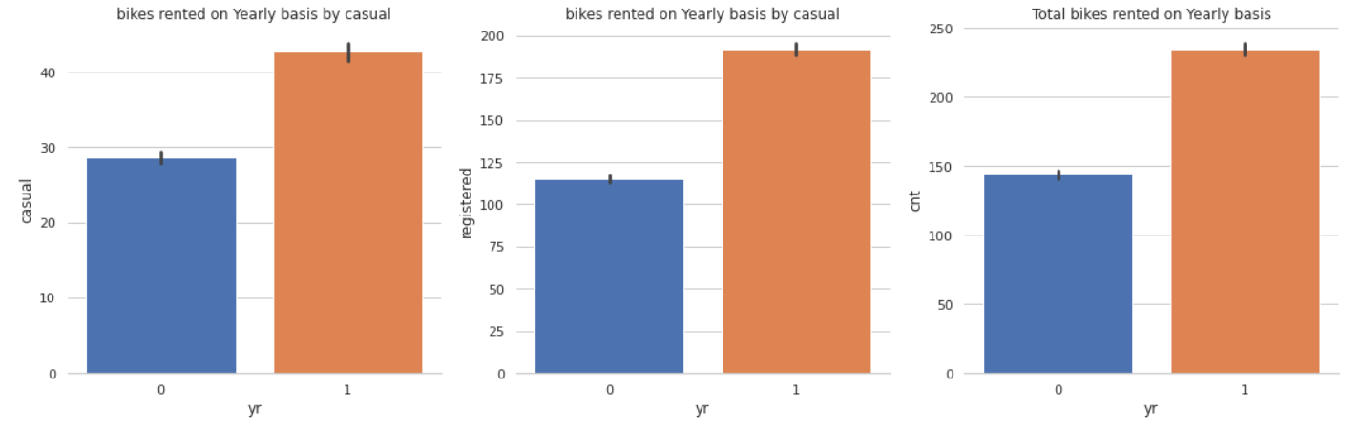
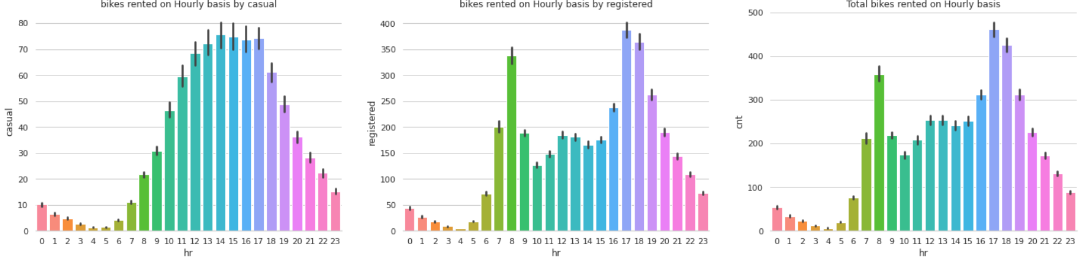
ANALYSIS Continued
In 2012 there has been significant spike in sharing
the highest demand is in hours from say 7-10 morning and the from 15-1900 hrs(more by casuals)
1700-1800 peak office time hour

Slide 4
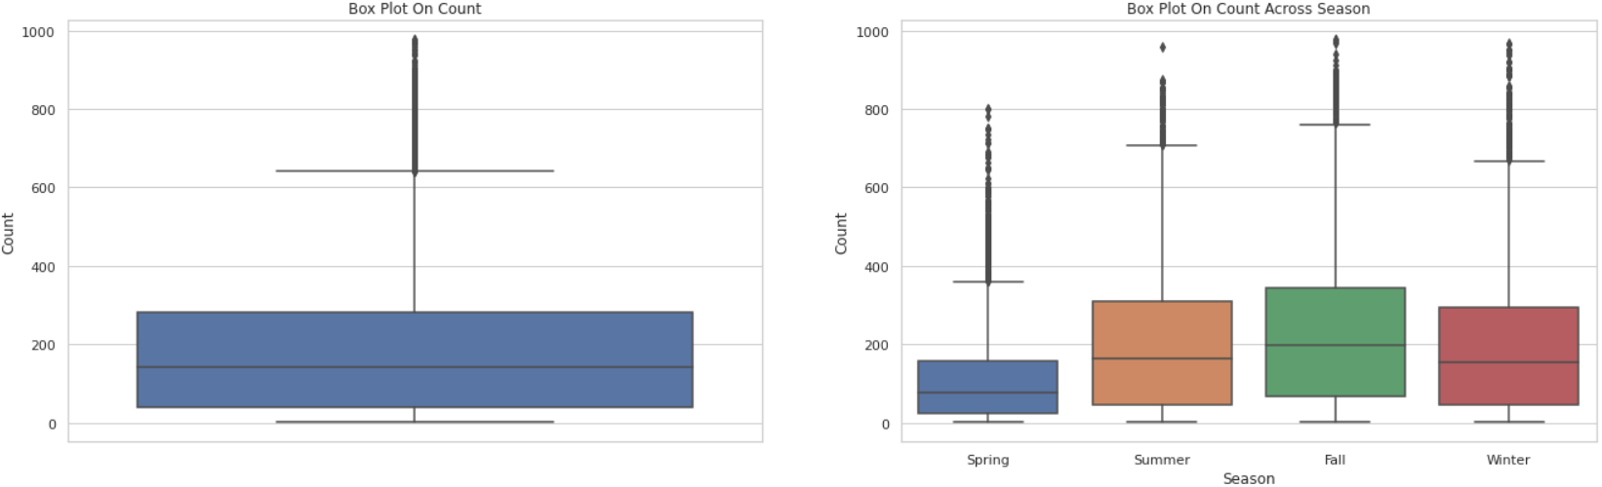
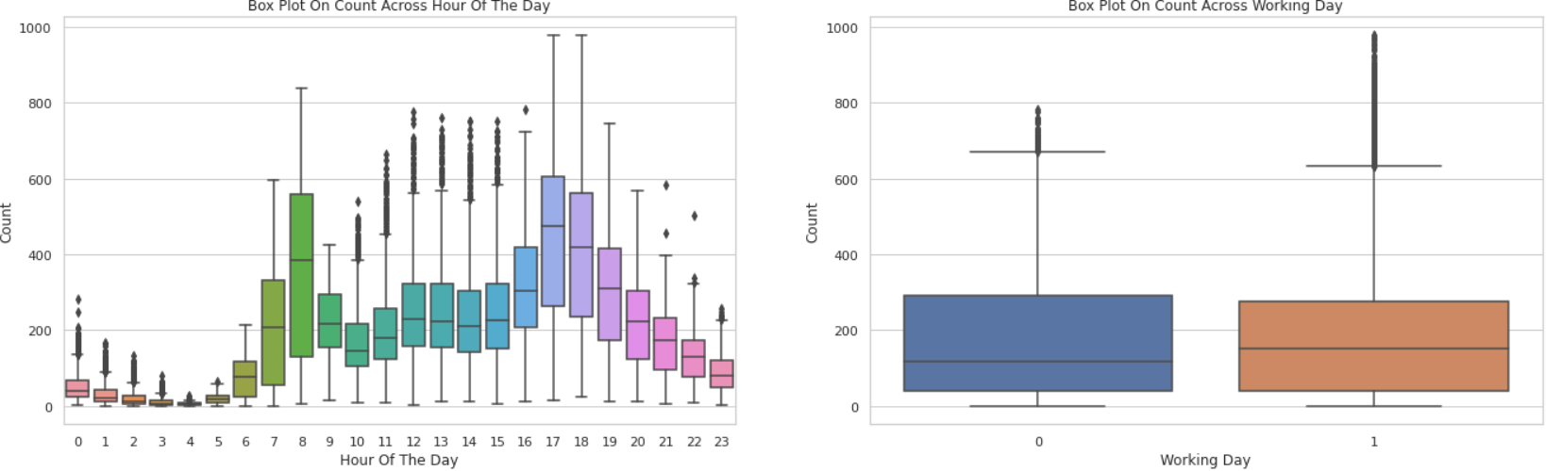
ANALYSIS Continued
Visualizing the distribution, shows how tightly data is grouped during spring
Spring season has got relatively lower count. The dip in median value in boxplot gives evidence for it
The boxplot with "Hour Of The Day" shows the median value are relatively higher at 7AM - 8AM and 5PM - 6PM. It can be attributed to regular school and office users at that time.
Most of the outlier points are mainly contributed from "Working Day" than "Non Working Day".

Slide 5
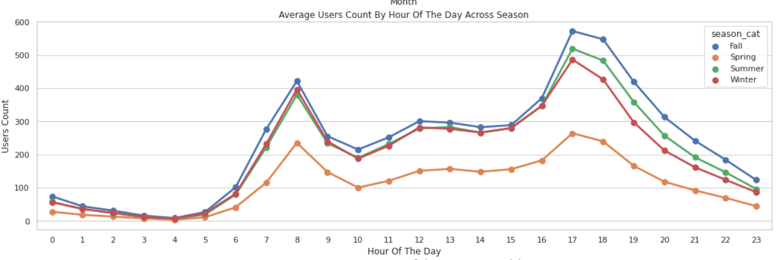
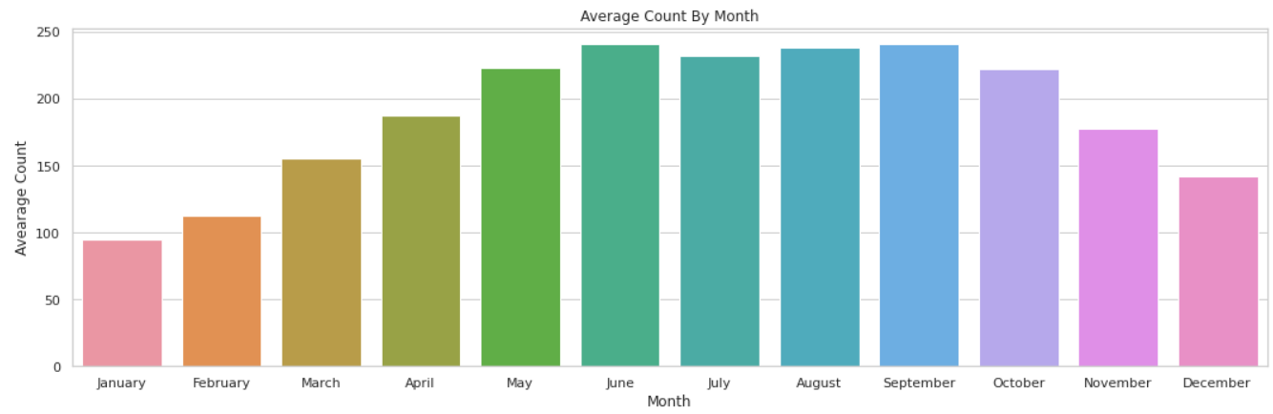
ANALYSIS Continued
More bike shared during autumn season across all the hours
Average share is high in summer(June-sept) and least bike share in January and feb due to harsh winter
On weekdays more people tend to rent bicycle around 7AM-8AM and 5PM-6PM. As we mentioned earlier this can be attributed to regular school and office commuters

Slide 6
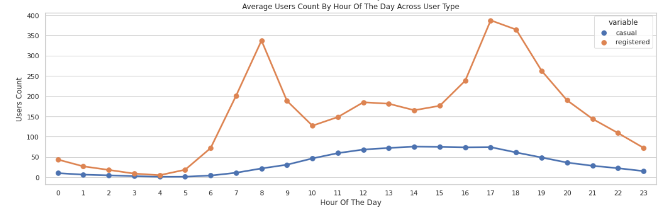
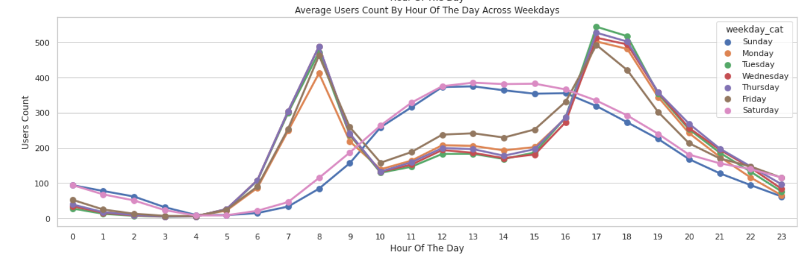
ANALYSIS Continued
The peak user count around 7AM-8AM and 5PM-6PM is purely contributed by registered user
Weekend and weekdays have separate trend , below graph gives the evidence of it

Slide 7
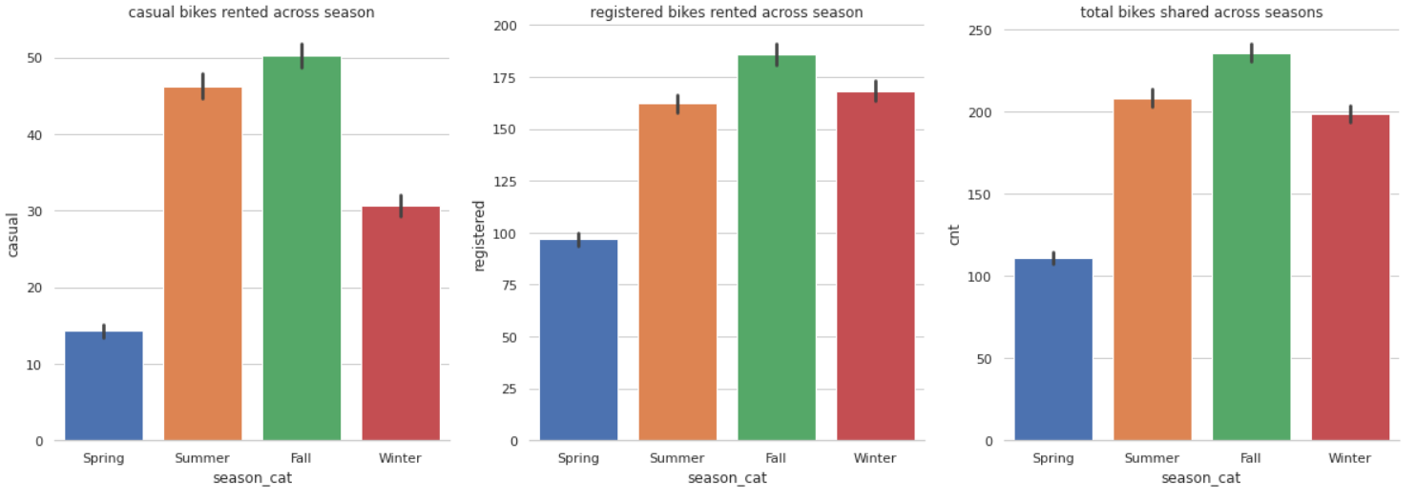
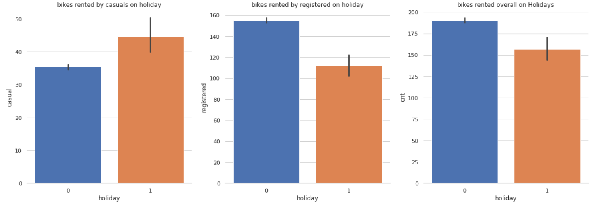
ANALYSIS Continued
It is quiet obvious that people tend to rent bike during summer and fall season since it is really conducive to ride bike at that season
More casuals bikes were rented on holidays

Slide 8
Model selection and result
Bike Sharing dataset is a classical business problem of multivariate time series where more than one variable is time dependent, and we use these variables to try to estimate a target variable count of bike share. I will share my modelling result below:
My Goal is to do horizon style forecasting, to forecast the count of bike sharing for next 24 hrs., lets say an entire day .
With Neural networks (LSTMs and other deep learning methods) with huge datasets offer ways to divide it into several smaller batches and train the network in multiple stages. LSTMs are equipped to learn long term correlations in a sequence, they can model complex multivariate sequences however, LSTM is undoubtedly more complicated and difficult to train and in most cases do not exceed the performance of a simple ARIMA model. However on Bike sharing dataset, LSTM has out performed, Traditional Time series algorithm sarimax, Regression models random forest and xgboost by significant margin.
I have taken mean absolute error as loss metric to select best model among the candidates models .All deep learning candidates models have been trained for last 7 days or 168 hrs. to predict next 24 hrs. and traditional and regression model are chain trained to predict next 24 hrs, all models are validated on same multiple time frame.
I have selected most robust one which can perform better on future time frame, as we can see
LSTM and GRU both performed well to forecast on next future date in the table , as well
Lstm’s performance is consistent throughout for next 2 weeks, that’s the reason lstm will be the
Model that i can productionize and continue training with new data on bi-weekly basis
Models implemeted | MAE
LSTM | 11.65
Bidirectional LSTM | 26.22
GRU | 11.41
Autoencoder LSTM | 53
SARIMAX | 149.28
Random Forest | 64.94
XgBoost | 35.76

Slide 9
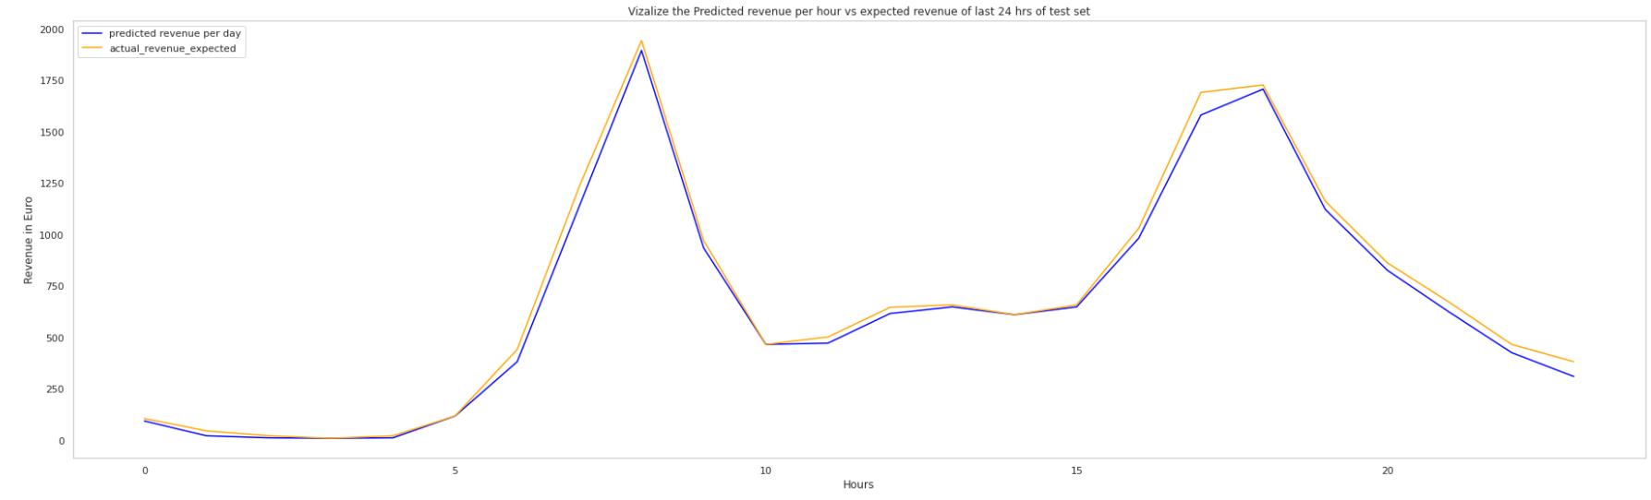
Model Simulation of the forecast with actuals
Let’s say , a bike can be rented 4 times in an hour and revenue each bike generates is 12 euros and 10 euros of cost per rental, below graph is the simulation of the predicted revenue that is forecasted value would have generated on a particular day/24hrs against the actual revenue and we can see how well Lstm model has performed and picked up the trend so accurately .

Slide 10
Part 2 Plan for production solution that would be able to scale up to several terabytes
Well for time series, it is almost always the case that the development data set and the production data set are not from the same distribution, because real world business time series data are not stationary, but bike sharing dataset is stationary which means statistical (mean and std) properties of the distribution will not change in production as well, though my data pipeline will keep track of it and I can re-train on new data weekly instead of on fly (retraining a new model from scratch every time i want to generate a new forecast), called as continues learning.
Assuming our platform is in AWS or GCP, I will use TensorFlow extended, pipeline will start with Data Ingestion, validation(data schema hasn’t changed, statistics of our new datasets still align with statistics from our previous training datasets), preprocessing(Avoiding a potential training-serving skew) , training, TensorFlow model analysis, model deployment with Serving. For pipeline orchestration, I prefer Kubeflow platform over Airflow because it provides great features, including Pipeline Lineage Browser, TensorBoard Integration, and the ability to view TFDV and TFMA visualizations. Furthermore, it leverages the advantages of Kubernetes, such as autoscaling of computation pods, persistent volume, resource requests, and limits, to name just a few. I have 2 yrs of experience of setting up two Kubeflow pipeline, first setup can be used with almost any managed Kubernetes service, such as AWS Elastic Kubernetes Service or Microsoft Azure Kubernetes Service. The second setup can be used with Google Cloud’s AI Platform. I also have knowledge of Mlflow though couldn’t implemented on real time.
I do have knowledge of processing time series streaming data using Apache beam, workflow would start from converting to TFB format, fed into pipeline, get prediction using our lstm model, can be a batch prediction as well.

Slide 11
Thank you

