Slide 1
Assignment
Sales Insights

Slide 2
Contents
Project Management Tool – AIMS Grid
Tool use for Analysis – Power BI
Important Sales Metrics
Integrating Sales data into Power BI
Creating Sales Dashboard
Sales Dashboard
Sales Insights
Other Performance Metrics

Slide 3
Project Management Tool : AIMS Grid
Purpose
To unlock sales insights that are not visible before sales team for decision support & automate them to reduce time spent in data gathering
Stakeholders
Sales Team
Marketing Team
Customer Service Team
Data & Analytics Team

Slide 4
Project Management Tool : AIMS Grid(Contd.)
End Result
An automated dashboard providing quick & latest sales insights in order to support data driven decision making
Success Criteria
Dashboards uncovering sales order insights with latest data available
Sales team able to take better decisions & proves 10% cost savings of total spend

Slide 5
Tool used for Analysis : Power BI
Why use Power BI for data analytics ?
Easy data integration from various sources(csv,excel,sql)
Interactive & real time reporting
Advanced Analytical & AI capabilities
User friendly and customizable dashboards

Slide 6
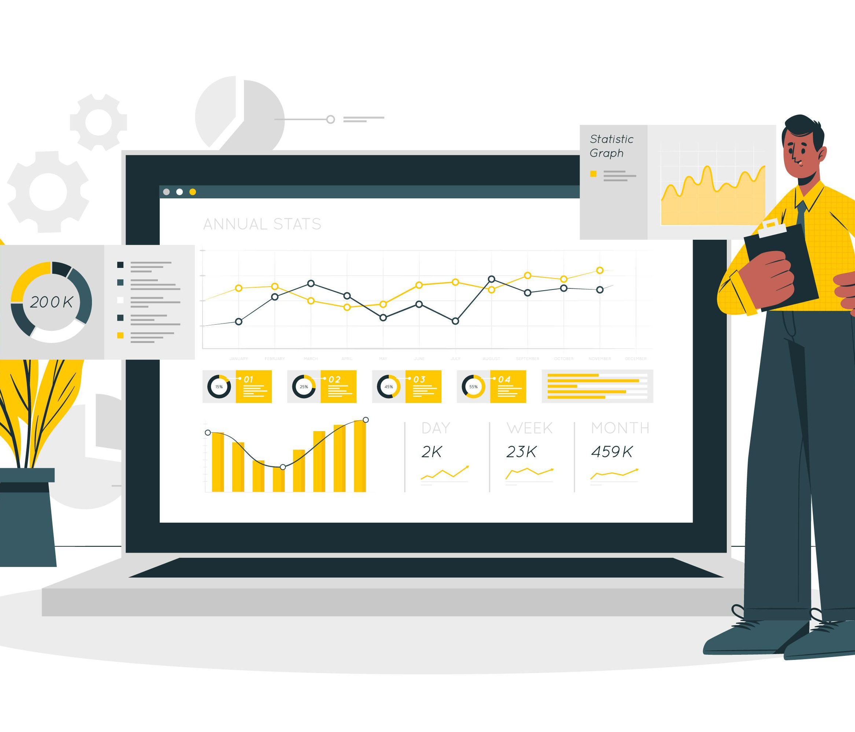
Important Sales Metrics
Total Revenue
Sales Growth
Customer Acquisition Cost
Sales Conversion Rate
Qualified Leads
Lead to Customer Conversion Rate
Customer Retention Rate
New Customer Count

Slide 7
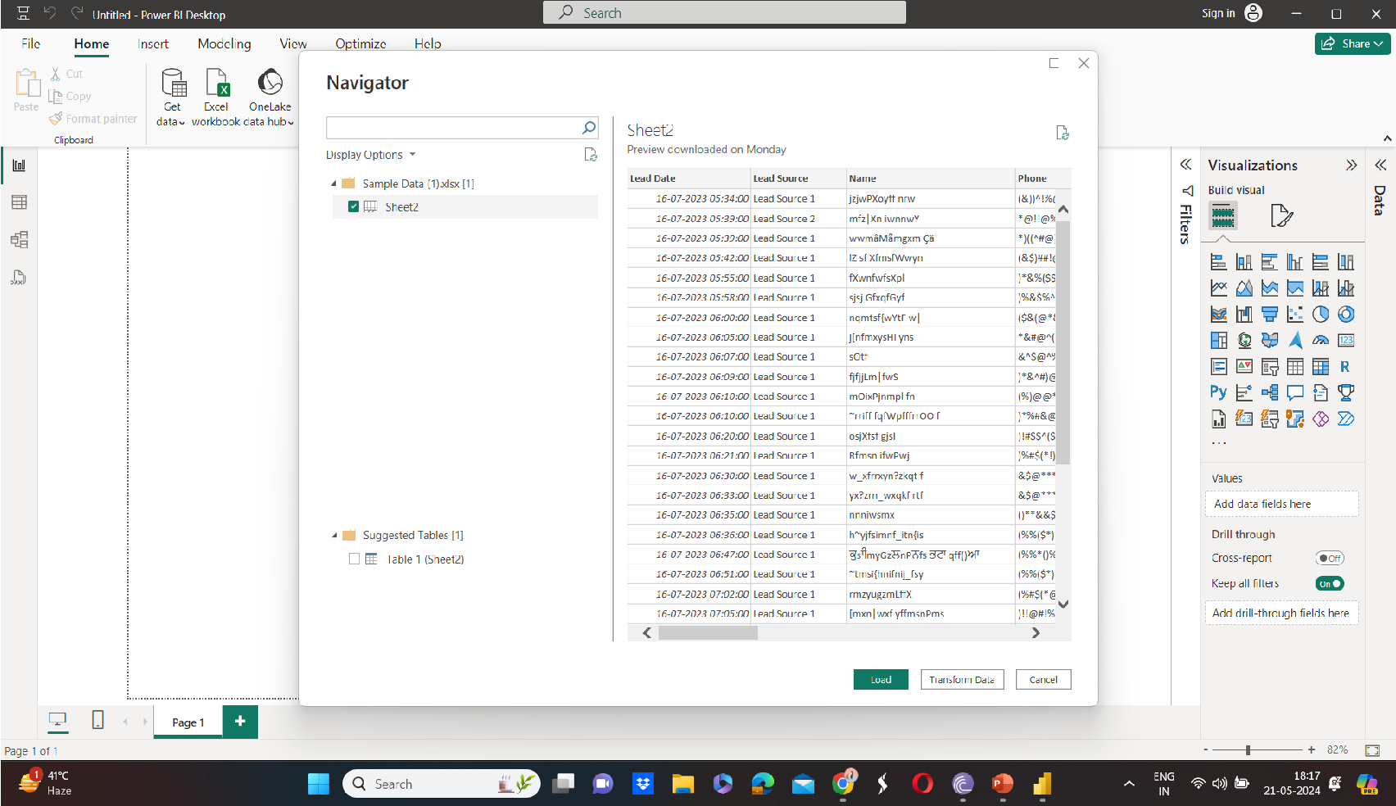
Integrating Sales Data Into Power BI
Connected to data sources(loaded sample.xlsx file)
Used Power Query for data cleaning and data transformation
Ensured data quality & consistency

Slide 8
Creating Sales Dashboard
Use of visual charts like line chart, column and bar chart
Best Practices for designing a dashboard
Use DAX functions to create measures and calculated columns
DAX Function:- SUM, COUNT, and IF

Slide 9
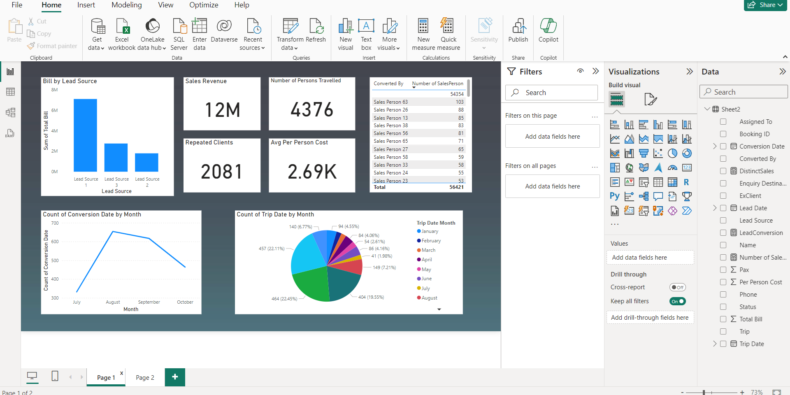
Sales Dashboard

Slide 10
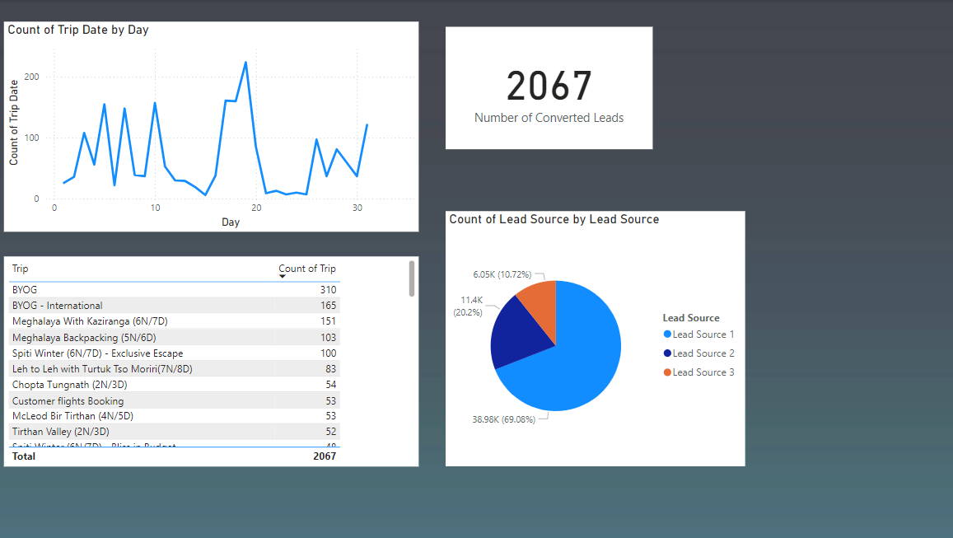
Sales Dashboard(Contd.)

Slide 11
Sales Insights
Sales Revenue :- 12Million
Number Of Clients Repeated – 2081
Average Per Person Cost – 2690 or 2.69K
Number Of Persons Travelled – 4376
Column Chart shows the number of leads the lead source gives.
Lead Source 1 gives the maximum leads and Lead Source 2 gives
Minimum leads

Slide 12
Sales Insights(Contd.)
Line chart shows that in the month August the conversion of leads to trips are maximum and in July is minimum .This helps us in getting to know that in which month we get most of the leads.
Table shows that total the maximum leads are converted by the Sales Person 63 with 103 number of converted leads.
Highest sales is given by Sales Person 33 which is 489K.
Total Number of Converted Leads – 2067
BYOG is the top trip type with 310 count of trips

Slide 13
Sales Insights(Contd.)
Lead Conversion Rate is 3.66%
Most Number of trips are being done on the 19th date of any month

Slide 14
Other Performance Metrics
Customer Satisfaction(CSAT)
It measures how satisfied customers are with the services provided
High CSAT Score can indicate a positive customer experience and chances of retention of the customer increases.
Cancellation Rate
The percentage of booking cancelled. High Cancellation rates can indicate issues with customer satisfaction or booking processes and may require intervention

Slide 15
Other Performance Metrics(Contd.)
First Response Time
The average time takes to respond to customer enquiries. Faster response times can enhance customer satisfaction and reduce churn.
Website Conversion Rate
The percentage of website visitors who complete a booking for the trip. It indicates the effectiveness of the website in converting visitors into customers.

Slide 16
Other Performance Metrics(Contd.)
Gross Margin
It indicates the financial health and efficiency of company in managing its production cost
Customer Acquisition Cost
This is how much a company spends on both marketing and sales strategies to convert a lead into a customer. Ideally, this number should be as close to zero as possible

