Slide 1


Slide 2
ABOUT ME
• Passionate about data analysis and solving real-world financial problems.
• Experienced in extracting insights and presenting them visually.
• Interested in roles blending product strategy and analytics.

Slide 3
ABOUT BOAT
• One of India’s fastest-growing electronics brands.
• Dominates in audio products and smartwatches.
• Appeals to youth with trendy, value-for-money tech.

Slide 4
BOAT VS NOISE
Ujjawal Singh | Product Analyst

Slide 5
COMPETITION: NOISE
• Major competitor in wearables and earbuds.
• Known for product innovation and tech-forward features.
• Competes aggressively on price and updates.

Slide 6
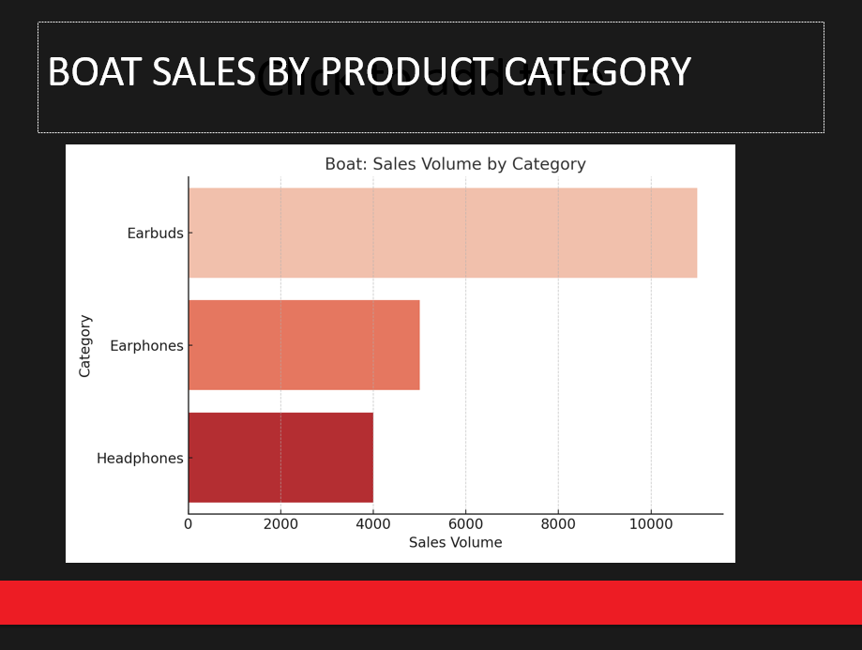
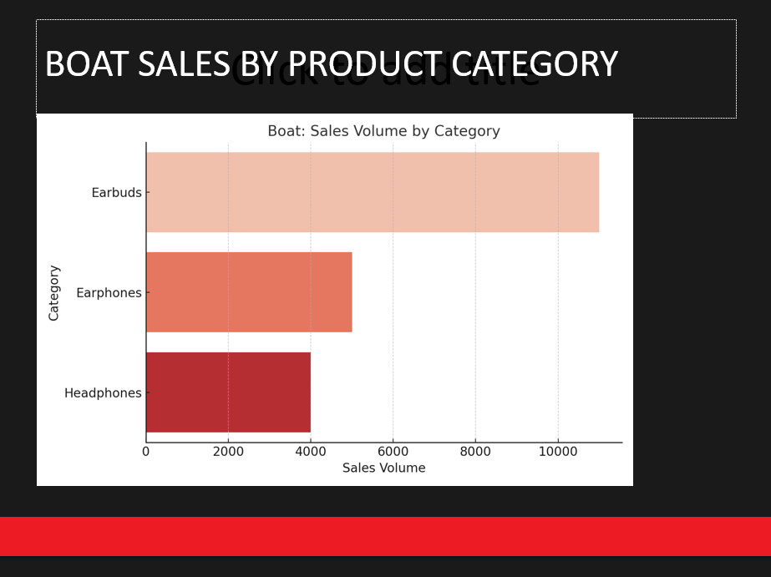
BOAT SALES BY PRODUCT CATEGORY

Slide 7
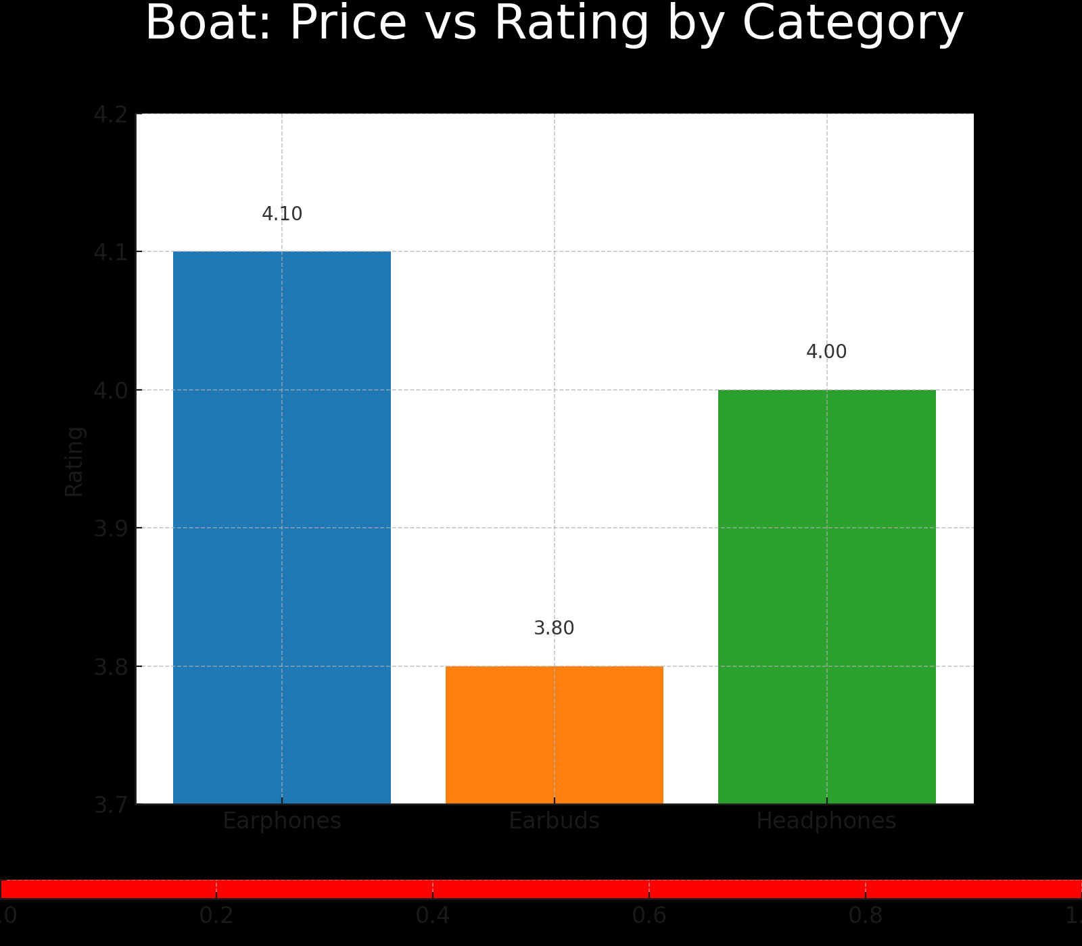
BOAT: PRICE VS RATING BY CATEGORY

Slide 8
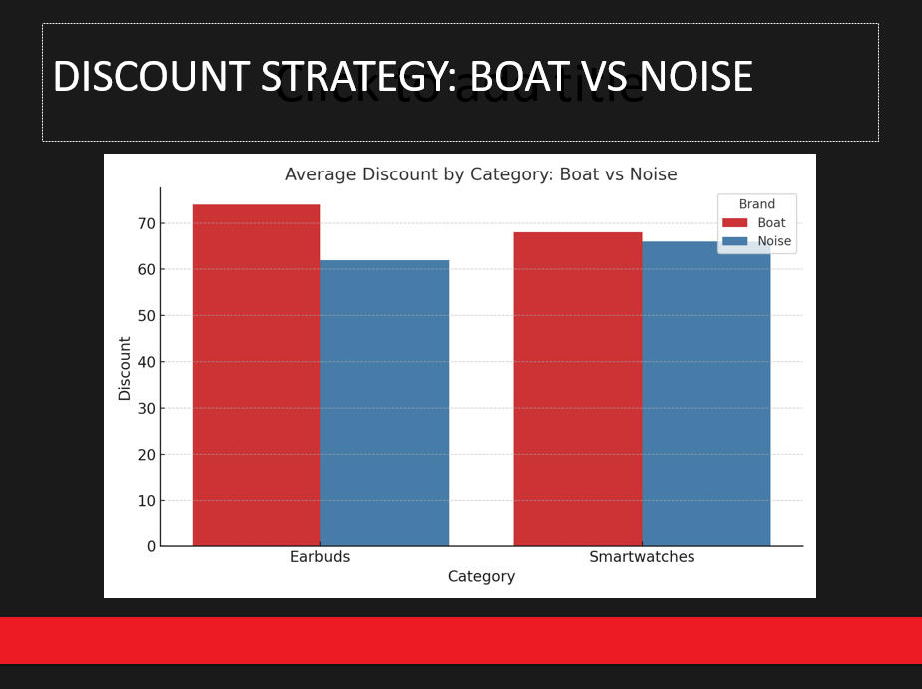
DISCOUNT STRATEGY: BOAT VS NOISE

Slide 9
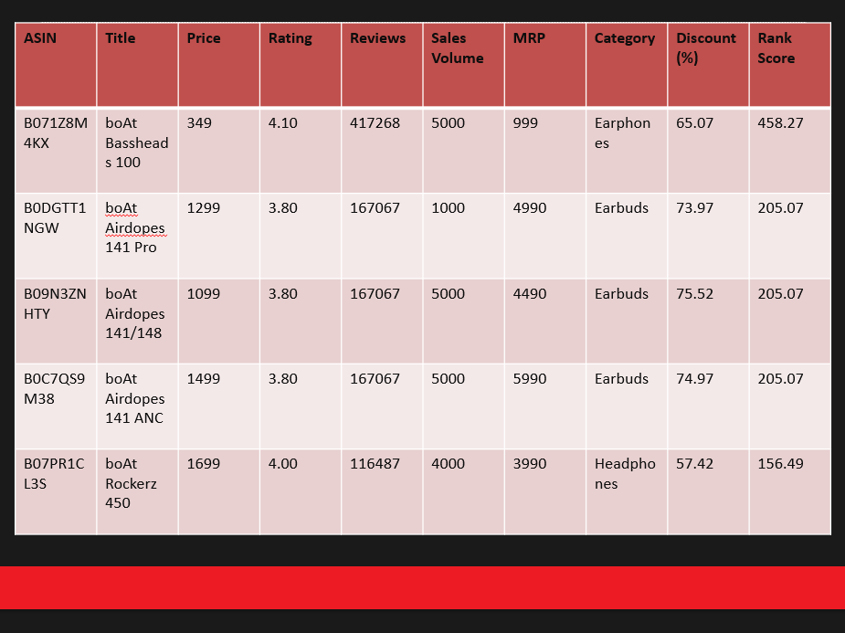
TOP BOAT PRODUCTS (PERFORMANCE SUMMARY)
ASIN | Title | Price | Rating | Reviews | Sales Volume | MRP | Category | Discount (%) | Rank Score
B071Z8M4KX | boAt Bassheads 100 | 349 | 4.10 | 417268 | 5000 | 999 | Earphones | 65.07 | 458.27
B0DGTT1NGW | boAt Airdopes 141 Pro | 1299 | 3.80 | 167067 | 1000 | 4990 | Earbuds | 73.97 | 205.07
B09N3ZNHTY | boAt Airdopes 141/148 | 1099 | 3.80 | 167067 | 5000 | 4490 | Earbuds | 75.52 | 205.07
B0C7QS9M38 | boAt Airdopes 141 ANC | 1499 | 3.80 | 167067 | 5000 | 5990 | Earbuds | 74.97 | 205.07
B07PR1CL3S | boAt Rockerz 450 | 1699 | 4.00 | 116487 | 4000 | 3990 | Headphones | 57.42 | 156.49

