Slide 1

Expenditure Data Analysis

Slide 2

Objective
To run government, it is important to manage expenses.
It’s a way by which any government can handle its economy.
So, in this project we are going to analyze some key features that describes, how well a state government is in managing its economy.
For this purpose, we will get our data from NITI Aayog.
The NITI Aayog is a public policy think tank of the Government of India, established with the aim to achieve sustainable development goals with cooperative federalism by fostering the involvement of State Governments of India in the economic policy-making process using a bottom-up approach.

Slide 3

Benefits
To monitor government expenses.
To dilute average expenses of various departments.
To make decision for future Budget allotment.
Profitability review

Slide 4

Architecture
Data Transformation
Unpivoting wide data to long data.
Data Cleaning
Removing Blanks, dashes and others.
Data Visualization
Making insightful structures.

Slide 5
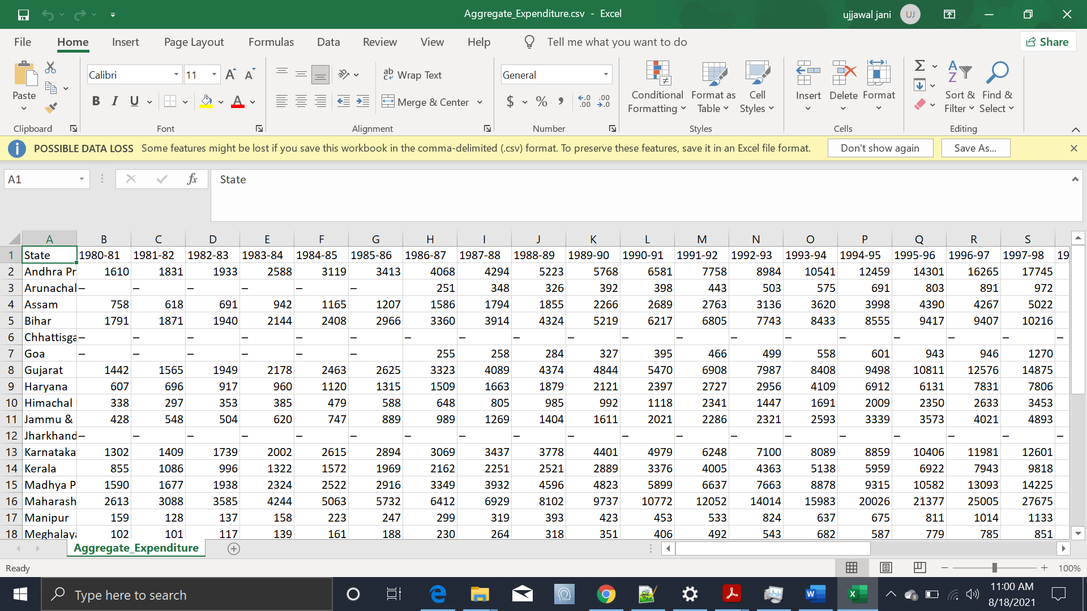
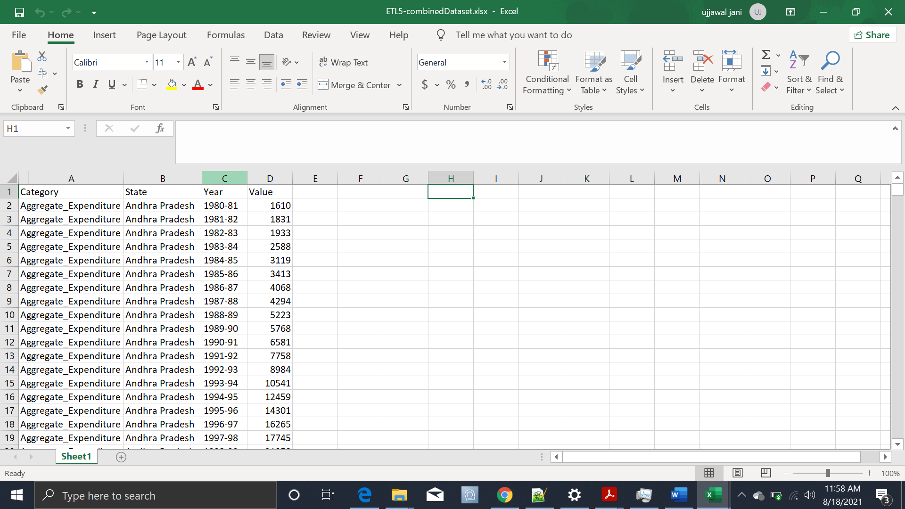
Data Preparation
In the Preparation Process, we will convert our original datasets with other necessary attributes format.
As you all can notice that format of the data we have is not good to analyze and visualize. So, we need to reconstruct the structure of the dataset.
As this is a pivoted data set, we need to unpivot it. That’s the only way by which we can make meaningful insights from it. This process is know as converting wide data to long data.
We will be using only MS Excel for data restructuring and cleaning purpose.

Slide 6

Data validation
The data we have contains blank or “-” values. We have to fill them with Zero(0) to make values column a proper numerical column.
In Excel we can do that by selecting the whole column,
1. Click on “Find and select” and then “Find” to replace all “-” values with “0”.
2. Click on “Find and select” and then “Go To Special” to replace all Blanks with “0”.
Next, In the years column some data points have extra text. To remove them, we can create a new column with formula “=Right(C2,7)” and apply it for whole column to select only year range from Years column and replace it with original Years column.

Slide 7

Make the MS Excel connection and set up the data source
Configuring Tableau
1. After you open Tableau, under Connect, click Excel.
2. Select the Excel workbook you want to connect to, and then click Open.
3. On the Data Source page, click the sheet tab to start your analysis.

Slide 8
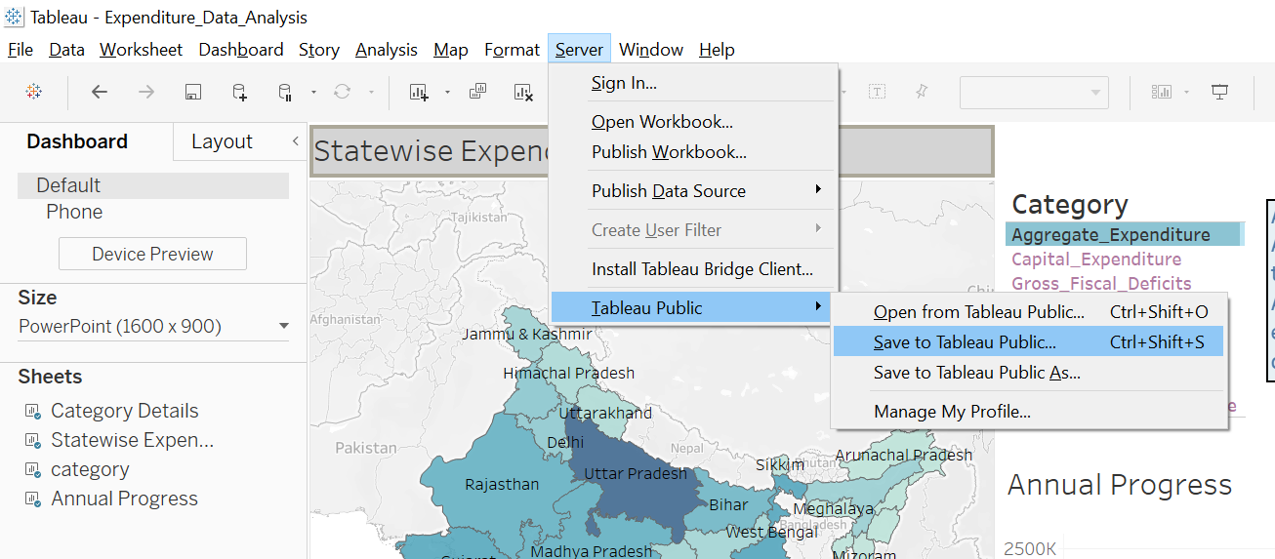
Deployment
1. Once you’ve completed your dashboard, follow these steps: Server, Tableau Public, Save to Tableau Public As
2. You may be prompted to log into your Tableau Public profile first if this is your first-time publishing.

Slide 9
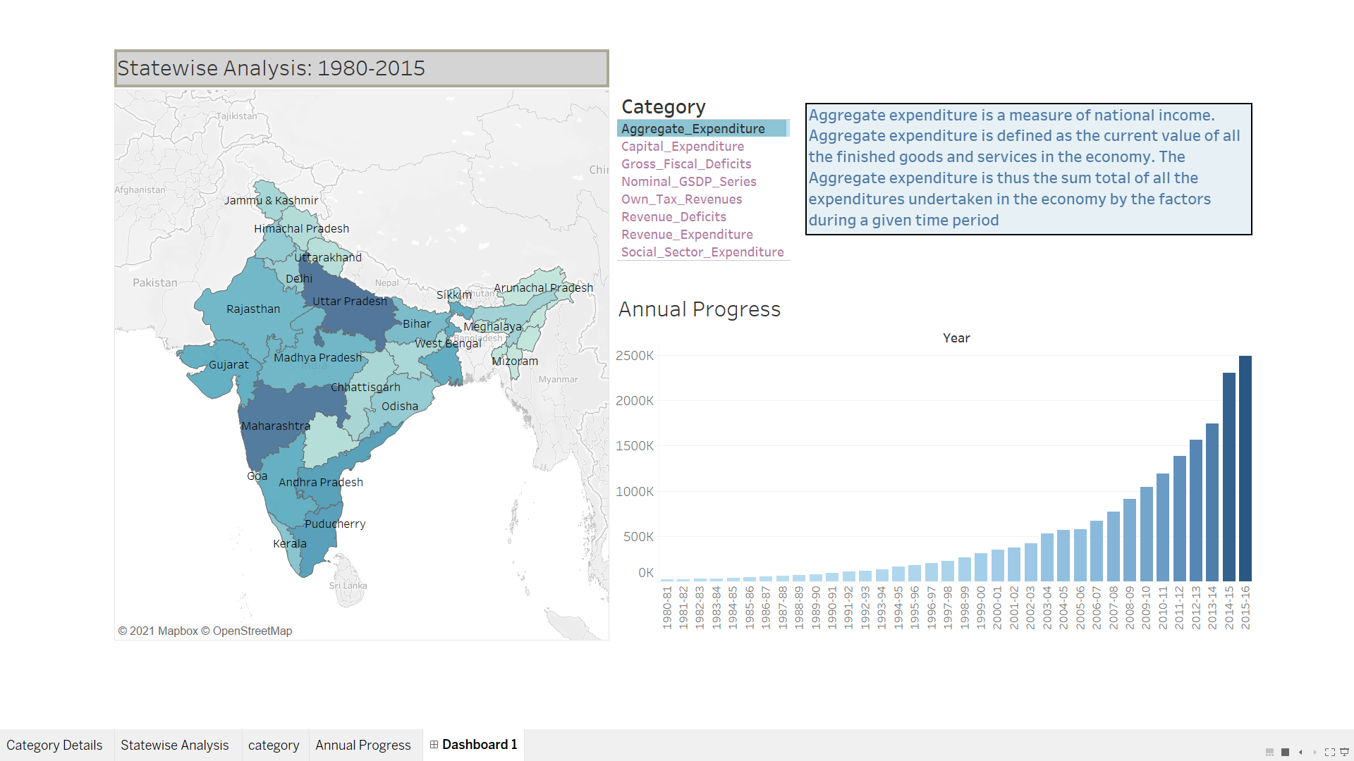
Final Dashboard
Link to Tableau Public

