Slide 1






PERM LABOR CERTIFICATION PREDICTION
Capstone Project
Spring 2022
Meron Metaferia & Ujjwal Oli

Slide 2
TABLE OF CONTENTS
INTRODUCTION
* Background
* Problem Statement
* Motivation
LITERATUREREVIEW
METHODOLOGY
*Dataset Description
* Data Preprocessing
* Exploratory Data Analysis
RESULTS AND ANALYSIS
References
CONCLUSION
* Now
* Future Research
* Relevant Research

Slide 3
Introduction
Program Electronic Review Management (PERM) is the system used for obtaining Labor Certification for certain foreign nationals in obtaining an employment-based immigrant visa (Green Card)
PERM process requires the petitioning employer to conduct a series of recruitment activities to test the labor market before filing the application.
Motivation
Curious regarding PERM application process (as an international student)
Understanding factors that influence PERM case decision

Slide 4
Problem Statement and SCope
Acceptance of Program Electronic Review Management (PERM) is the first step for certain foreign in obtaining an employment-based Green Card. Employees and employers wait months, if not years, to get a decision for their application, whether denial or approval.
This situation not only have jeopardized foreign nationals to lose their legal status but has also put US employer in dilemma upon recruiting highly skilled immigrants. Even though Zhang & Associates, P.C. law firm mentioned that employer documentation, local area employment, wage and workforce ratio are some factors that play into the role for acceptance of PERM, we are curious about what factors mainly affect the likelihood that a PERM application will be approved or denied[1].
Scope
Analysis & visualization of historical PERM applications by utilizing plotly dashboard
Use of machine learning models to classify the outcome of a case status based on user input
https://www.hooyou.com/lc/perm_factor.html
https://www.dol.gov/agencies/eta/foreign-labor/performance

Slide 5
Literature review
Sources | Goal | Method | Key Takeaway
Sundararaman et al | to analyze the petitions filed from 2011-16 and classify them as positive or negative, indicating whether the petition is highly skilled or not. | Random Forest | Random Forest
Chada et al | to predict the outcome of H-1B visa by making use of machine learning models and creating a fusion model for enhancing the results | Random Forest XGBoost Bagging Classifier | Bagging Classifier XGboost
Vegesana | develop a supervised inductive learning model which adopts methods of classification to predict the results of the filed applications | Random Forest, K-Nearest Neighbors, Logistic Regression, Gaussian Naïve Bayes | KNN
Khaterpal et al | to predict the outcome of H-1B visa applications based on the attributes of the applicant using machine learning and Artificial Neural Networks | KMeans clustering Random Forest Logistic Regression ANN | Random Forest

Slide 6
METHODOLOGY
Dataset Collection and Description
Data Cleaning and Preprocessing
Data Modeling and Visualizations

Slide 7

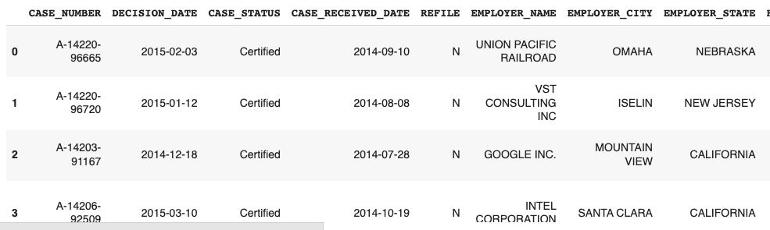
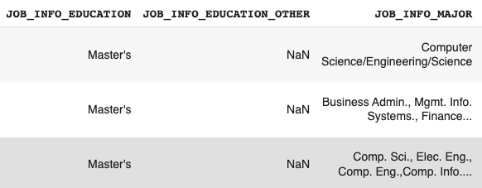
DATASET
Source:
U.S. Department of Labor (2015 -2019) | Dataset Link
Original data info: > 500000 rows and > 150 columns
Features:
Categorical
Case Status
Employer Information
SOC Title (job title)
Employee Education
Employee’s Citizenship
Numerical
Wage
Date Time
Case Receive and Decision Date

Slide 8
Data Cleaning
Cleaned dataset: 500000 rows and 17 columns
Conversion of time dates (Received date, Decision date)
Dropping repeated columns (Employer State, Job State)
Creating different groups and categories (Employer, Occupations)
Treating null values and missing values
Merging multiple columns (Unit of pay and Wages)

Slide 9
Data Preprocessing
Label encoding X and Y variable (CASE STATUS)
Splitting X and Y —- >> Splitting training and testing (70%, 30%)
Applying SMOTE for oversampling on training data (90.74%, 5.56%)
Implementation of machine learning models

Slide 10
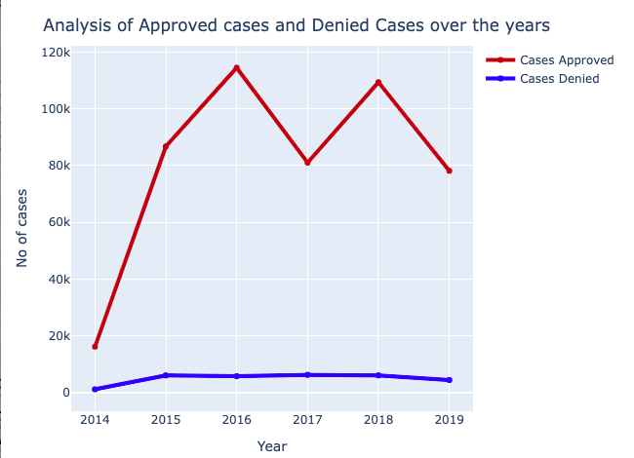
KEY VISUALIZATIONs
*** Visualizations are displayed on a dashboard ***
Total number of cases accepted and denied / case status over time
Country with highest number of perm applications
Visa class with highest number of perm applications
Average time period of cases being approved and denied
Top sponsoring employers over different years
Acceptance and denial ratio for education level / wage category

Slide 11
Model implementation & WHY?
Random Forest:
Leverages the power of multiple decision trees, handle large datasets efficiently trees, endorsed by literature review
Avoids over-fitting of the data
Parameters used: max_depth = 35 and estimators = 100.
K- Nearest Neighbors Classifier (KNN)
KNN is a supervised machine learning algorithm
Versatile and robust in classifying data of various natures
KNN classifier adopts the technique of forming a majority vote among the K most similar instances of a data set; similarity between these data points is usually measured using the Euclidean distance formula.
Parameters: n_neighbors : 1

Slide 12
Model implementation & WHY?
XGBoost
XGBoost stands for Extreme Gradient Boosting
Scalable, highly accurate implementation distributed gradient-boosted decision tree (GBDT)
Provides parallel tree boosting for classification problems.
Designed for expedition and efficient performance
It follows a level-wise strategy, scanning across gradient values and using these partial sums to evaluate the quality of splits at every possible split in the training set
Parameters: learning rate: 0.5, n_estimators: 200
Bagging Classifier
Bagging classifier fits the base classifiers on arbitrary subgroups of the original dataset
then synthesize their outcomes either by voting or by averaging to form an outcome.
It reduces the black-box variance.
Parameters: n_estimators = 10, base_estimator: Decision Tree

Slide 13
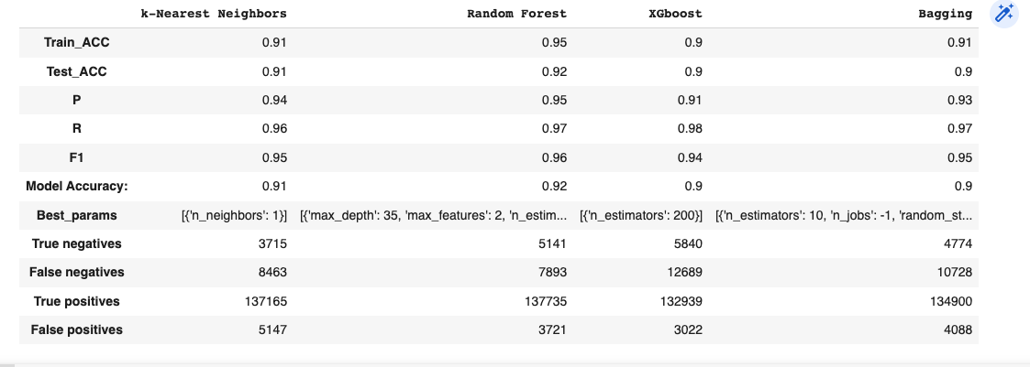
Model RESULT COMPARISON

Slide 14
resultS AND aNALYSIS
Models | Literature Review Source | Suggested Prediction Accuracy | Suggested F1 Score | Our Prediction Accuracy | Our F1 Score
Random Forest | Vegesna; Chada (SMOTE-oversampling); Sundararaman | 0.96; 0.88; 0.99 | 0.91; 0.89 N/A | 0.92 | 0.96
KNN | Vegesna; | 0.92; | 0.76 | 0.91 | 0.95
XG-boost | Chada (SMOTE-oversampling) | 0.87 | 0.88 | 0.90 | 0.94
Bagging Classifier | Chada (SMOTE-oversampling) | 0.90 | 0.89 | 0.90 | 0.95

Slide 15
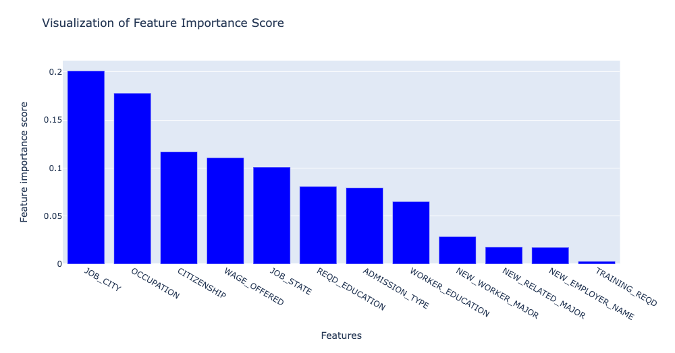
FEATURE IMPORTANCE

Slide 16
Dashboard Demo……. http://192.168.1.158:8080/

Slide 17
CONCLUSION
NOW
Implemented models - Random forest, KNN, XGBoost, Bagging Classifier
The best model, random forest, has a prediction accuracy of 0.92 and f1 score of 0.96
The feature Job City has the most weight in determining the outcome of a case
Project Limitation
Google colab provides limited computational resources (free version)
Web application / Dashboard deployment
Future Work
Build a website for users to see their PERM certification prediction upon entering their information
Attempt fusion models to enhance prediction results

Slide 18
References
Predicting the Outcome of H-1B Visa Applications CS229 Term Project Final Report
http://cs229.stanford.edu/proj2017/final-reports/5208701.pdf
A Hybrid Machine Learning Model Approach to H-1B Visa
https://ieeexplore.ieee.org/abstract/document/9664747?casa_token=G4Ez7qqsYXUAAAAA:NbhwCdn-7j0WYcKPM_KSXuKG27pqRBWSnzLOv8rs7uNvjclpunmqB4dAbw_8bc0n2opeaVDXEQ
An Analysis if nonimmigrant work visas in the USA using Machine Learning
https://dhanasekar-s.github.io/research/3paper.pdf
Predicting the outcome of H-1B visa using ANN algorithm
https://www.ijrte.org/wp-content/uploads/papers/v9i1/A2917059120.pdf
Predictive analytics for classification of immigration visa applications: A discriminative machine learning approach
https://krex.k-state.edu/dspace/bitstream/handle/2097/38822/SharmilaVegesana2018.pdf?sequence=1&isAllowed=y
An allotment of H1B work visa in USA using machine learning
https://www.sciencepubco.com/index.php/ijet/article/view/12642
Prediction of H1B Visa Using Machine Learning Algorithms
https://ieeexplore.ieee.org/abstract/document/8933628?casa_token=pL6BjNyXWBcAAAAA:YfYKAgOGU8Dm_1Val5DqF0v1gdxMoFLX5S5lZNrwYN8CbiUGJhfSNNtrticM-NYUpfvrAefFXQ

Slide 19

DO YOU HAVE ANY QUESTION?

