Slide 1

PulseHR OS
Autonomous Multi-Agent Human Capital Management & Talent Lifecycle Platform
5-Agent Autonomous Swarm • Bias-Mitigated Screening • Real-Time Burnout & Retention Telemetry
BITSoM Vertex Pitch Fest 2026 (BPF 2026) | Idea Submission Deck
Founder: Ujjwal Kumar Bhowmick | Email: ujjwalkumarbhowmick30@gmail.com

Slide 2
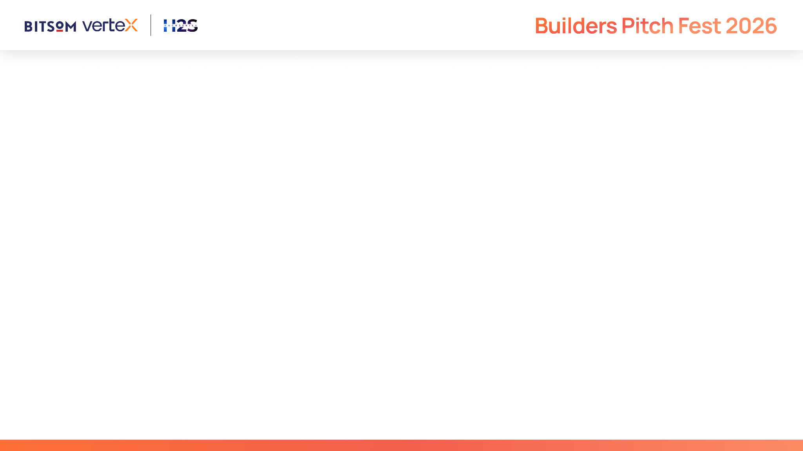
IMPORTANT
This submission deck is designed to help you present your startup in a structured and consistent manner. It enables reviewers to evaluate your solution across product, technology, AI innovation, business viability, customer validation, and enterprise readiness.
Strong submissions will demonstrate:
A clearly validated customer problem and market opportunity
Meaningful and responsible application of AI to solve the problem
Technical depth through a scalable and well-designed architecture
Product maturity supported by customer validation and measurable traction
A sustainable business model with a clear go-to-market strategy
A compelling vision for growth through the BITSoM Vertex incubation programme
Guidelines
This is not a traditional fundraising pitch deck.
Focus on demonstrating the reasoning behind your decisions rather than making marketing claims.
Wherever applicable, support your responses with evidence, metrics, customer insights, product screenshots, architecture diagrams, user journeys, and other relevant visuals.
Not every question may be applicable to every startup. Answer the questions that are most relevant to your solution and provide sufficient context to help reviewers understand your approach.

Slide 3
Startup Snapshot
What problem are you trying to solve?
• People Operations Fragmentation: Enterprise HR is trapped in disconnected silos (ATS, HRIS, review tools). Teams spend 60% of their bandwidth on manual resume triage, chaotic onboarding checklists, and repetitive policy tickets.
• Preventable Silent Attrition: Companies lose top performers to silent burnout because organizational sentiment is assessed reactively via annual surveys rather than through continuous early-warning telemetry.
What inspired you to work on this problem?
• The Multi-Agent Swarm Breakthrough: Instead of another static HR portal, employee lifecycle stages require dedicated, specialized autonomous AI agents collaborating as a synchronized team to empower HR leaders and employees.
• The Solution: PulseHR OS coordinates 5 specialized agents across screening, onboarding, burnout telemetry, 360 performance reviews, and policy assistance.

Slide 4
Problem Understanding
What problem are you solving, and who experiences it most acutely?
• Acutely experienced by Chief People Officers (CPOs), Heads of Talent Acquisition, HRBPs, and People Managers battling high turnover and administrative overload.
• Cost of Turnover: Replacing an enterprise employee costs 1.5x to 2x their annual salary. Average time-to-hire exceeds 44 days with significant recruiter friction.
• Cognitive Appraisal Bias: 360-degree reviews suffer from recency bias, anecdotal evaluations, and lack of objective multi-source competency telemetry.
What research, observations, or evidence validate this opportunity?
• Gallup's State of the Global Workplace reveals employee disengagement and burnout drain $8.9 Trillion globally in lost productivity.
• Over 76% of HR leaders report administrative overhead prevents them from executing strategic talent retention and leadership development.
• Over 30% of new hires leave within 90 days due to unstructured onboarding experiences.

Slide 5
Customer & Opportunity
Who is your ideal customer, and who would make the buying decision?
• Ideal Customers: Mid-to-Large Enterprises (500–10,000 employees) in Technology, BFSI, Healthcare, and Professional Services.
• Economic Buyers: Chief Human Resources Officers (CHRO), Chief People Officers (CPO), VP of Talent, and Chief Operating Officers (COO).
• End Users: HRBPs, Talent Recruiters, Hiring Managers, Team Leads, and Employees.
How large is the opportunity if your assumptions prove correct?
• Global TAM: $38.4 Billion HR Tech and Talent Management Software market (growing at 10.4% CAGR).
• India & APAC SAM: $4.2 Billion regional addressable spend on recruitment automation, engagement telemetry, and appraisal systems.
• Immediate SOM: ₹240 Crores ($29M ARR) targeting high-growth technology companies and enterprise employers across India.

Slide 6
Proposed Solution
What is your proposed solution, and how does it address the identified problem?
• PulseHR OS is an enterprise multi-agent operating system coordinating 5 specialized autonomous agents across recruitment, onboarding, burnout telemetry, 360 performance reviews, and employee policy assistance.
What are the key capabilities you envision?
• TalentScout Agent: Multi-vector semantic scoring across skills, culture, and retention with blind algorithmic DEI audits to mitigate demographic bias.
• OnboardPilot Agent: Automated 30-60-90 day milestone roadmap with mentor matching and IT provisioning workflows.
• PulseSentinel Agent: Real-time team sentiment analysis, meeting load fatigue tracking, and proactive managerial burnout alerts.
• Elevate360 Agent: Synthesizes multi-stakeholder feedback into 5-axis competency radars and calibrated promotion indices.
• PeopleAdvisor Agent: 24/7 conversational employee desk citing company policy handbooks with exact section references.
What measurable value do you expect the solution to deliver?
• 65% Reduction in recruitment screening and interview scheduling cycle times.
• 40% Faster new hire ramp to full productivity | 30% Decrease in preventable employee turnover.

Slide 7
Technology & AI Approach
What role will AI play in your proposed solution, and why is it essential?
• AI acts as an autonomous collaborative workforce: synthesizing candidate qualifications, diagnosing organizational sentiment patterns, generating personalized onboarding paths, and interpreting nuanced policy documents.
What technologies, AI models, or frameworks do you plan to use, and why?
• Agentic Orchestration Core: Multi-agent state machine powered by Google Gemini 2.5 Flash / Vertex AI with streaming responses and structured JSON contracts.
• Modern Stack: React 18, TypeScript, Tailwind CSS, Lucide icons, Recharts visualization, and resilient offline simulation fallback.
What makes you feel your product is a genuine AI product, and not an AI wrapper?
• PulseHR OS coordinates an interconnected multi-agent state graph where each agent produces structured artifacts (competency radars, DEI audits, 30-60-90 roadmaps) passed downstream across the employee lifecycle.

Slide 8
Competitive Landscape
What alternatives currently exist?
• Legacy HRIS Suites (Workday, SAP SuccessFactors): Monolithic, complex, and lack generative multi-agent collaboration or real-time sentiment telemetry.
• Point ATS Platforms (Greenhouse, Lever): Limited strictly to applicant tracking without lifecycle continuity into onboarding and appraisal.
• Lagging Survey Tools (Culture Amp, Lattice): Rely on periodic quarterly surveys rather than continuous real-time burnout telemetry and proactive playbooks.
Why do you believe your approach is better suited to solving this problem?
• PulseHR OS delivers an end-to-end, proactive multi-agent collective covering the complete employee lifecycle from first interview to executive promotion.

Slide 9
Business Model & Go-To-Market
Who do you expect will pay for your solution?
• B2B SaaS Subscription (PEPM - Per Employee Per Month):
• Growth Tier: $5 / employee / month (for companies with 200–1,000 employees).
• Enterprise Tier: $8 / employee / month (includes full 5-agent swarm, custom handbook fine-tuning, and priority integrations).
• Custom Enterprise SLA: Private VPC and on-premise deployments for highly regulated BFSI/Healthcare clients.
How do you plan to acquire your first customers?
• Design Partner Program: Engage 4 mid-market tech companies (300–800 headcount) as pilot partners to benchmark attrition reduction.
• CHRO & HRBP Communities: Thought leadership campaigns demonstrating DEI audit and burnout mitigation playbooks.
• BITSoM Vertex Network: Engage corporate partners and alumni enterprise leaders for executive sponsor introductions.

Slide 10
Development Roadmap
What are the next major milestones toward building your MVP?
• Current Status (Phase 0): Fully functional, interactive production prototype with all 5 specialized agents, live candidate evaluation sandbox, sentiment telemetry, and policy assistant (Completed & Verified).
• Phase 1 (Months 1–3): Native ATS/HRIS bi-directional sync (Workday, BambooHR, Slack, Microsoft Teams).
• Phase 2 (Months 4–6): Predictive workforce planning and compensation benchmarking engine.
• Phase 3 (Months 7–12): Enterprise SOC2 Type II, GDPR, and ISO 27001 data residency compliance.
What resources or support will be most critical during this journey?
• Enterprise Design Partnerships: Access to active HR teams for feedback on candidate rubrics and appraisal calibration.
• Executive HR Advisory: Guidance from seasoned Chief People Officers on compliance and change management.
• Cloud Infrastructure Support: Google Cloud / Vertex AI enterprise scaling credits.

Slide 11
Team
Why is your team uniquely positioned to solve this problem?
• Strong technical capabilities in multi-agent orchestration, full-stack enterprise web development, and human-centric software design.
• Demonstrated execution speed in architecting complex, production-grade applications with clean UI and resilient AI pipelines.
What relevant domain or technical expertise does the team possess?
• Ujjwal Kumar Bhowmick (Founder & Lead AI Engineer):
• Specialized in Multi-Agent AI system design, TypeScript, React 18, Tailwind CSS, and Google Gemini / Vertex AI integrations.
• Deep understanding of organizational psychology, enterprise HR workflows, and bias mitigation algorithms.

Slide 12
Why BITSoM Vertex?
Why have you applied to the BITSoM Vertex programme?
• Enterprise Networking: BITSoM's premier business network and executive leadership ecosystem provide direct access to corporate CHROs and enterprise HR decision-makers.
• GTM & Business Mentorship: Vertex provides the exact strategic framework required to transition an enterprise multi-agent prototype into high-velocity B2B enterprise contracts.
What is the biggest challenge preventing you from building your MVP?
• The prototype is fully built and operational! The primary objective now is enterprise customer pilots: securing enterprise sandbox access, refining organizational telemetry against live HRIS data, and scaling our GTM funnel. BITSoM Vertex is the ideal partner.

Slide 13
Supporting Material
Key Links & Prototype Validation:
• Working Prototype: Fully functional local environment (React 18 / TypeScript on :5173 with 5-agent swarm, talent screening sandbox, 30-60-90 ramp, burnout radar, and HR policy assistant).
• GitHub Repository: https://github.com/ujju2020/HR-Automation-Agents (Complete source code, agent schemas, and documentation).
• Demo Explainer Video: 2-minute comprehensive walkthrough of TalentScout, OnboardPilot, PulseSentinel, Elevate360, and PeopleAdvisor in action.
• Contact: Ujjwal Kumar Bhowmick | ujjwalkumarbhowmick30@gmail.com | India

Slide 14

PulseHR OS
Empowering Enterprise Teams Through Autonomous Multi-Agent Human Capital Intelligence
Thank You! Open for Questions & Evaluation.
Founder: Ujjwal Kumar Bhowmick | ujjwalkumarbhowmick30@gmail.com

