Slide 1
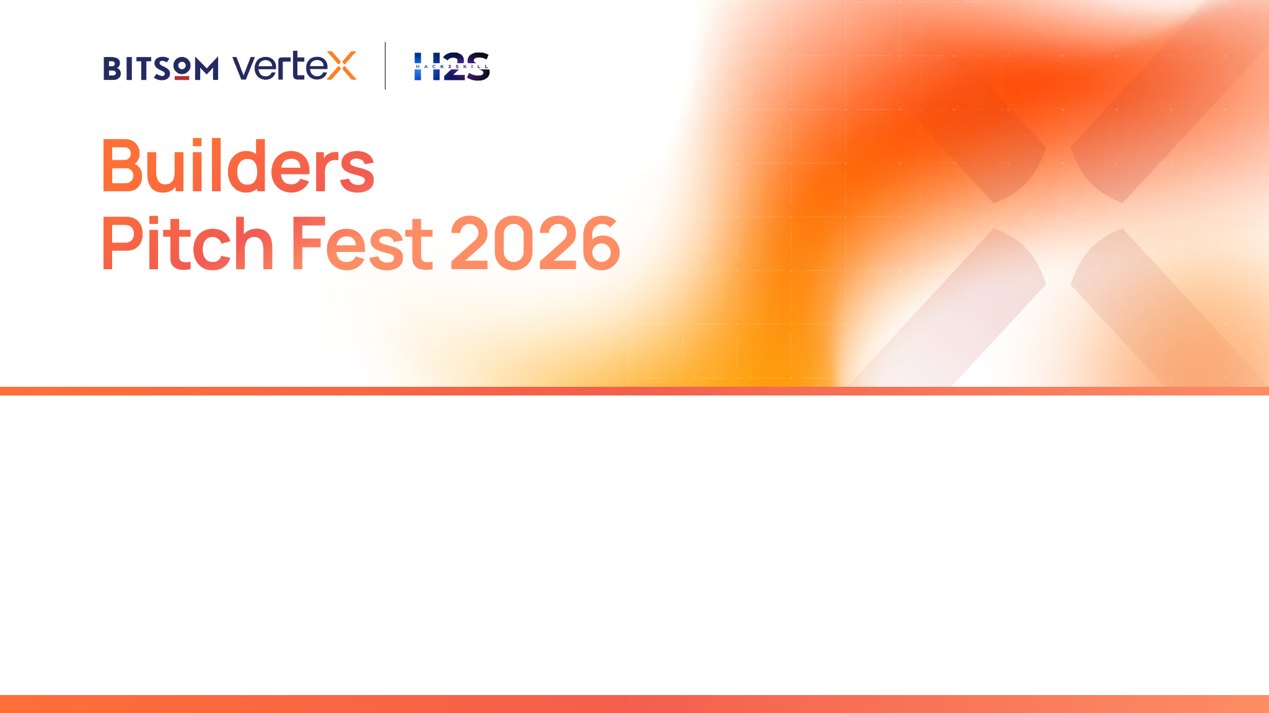
CogniDeal AI
Autonomous B2B Deal Desk & Contract Risk Intelligence Swarm
5-Agent Enterprise Swarm • Contract Liability Redlining • Gross Margin Guardrails
BITSoM Vertex Pitch Fest 2026 (BPF 2026) | Idea Submission Deck
Founder: Ujjwal Kumar Bhowmick | Email: ujjwalkumarbhowmick30@gmail.com

Slide 2
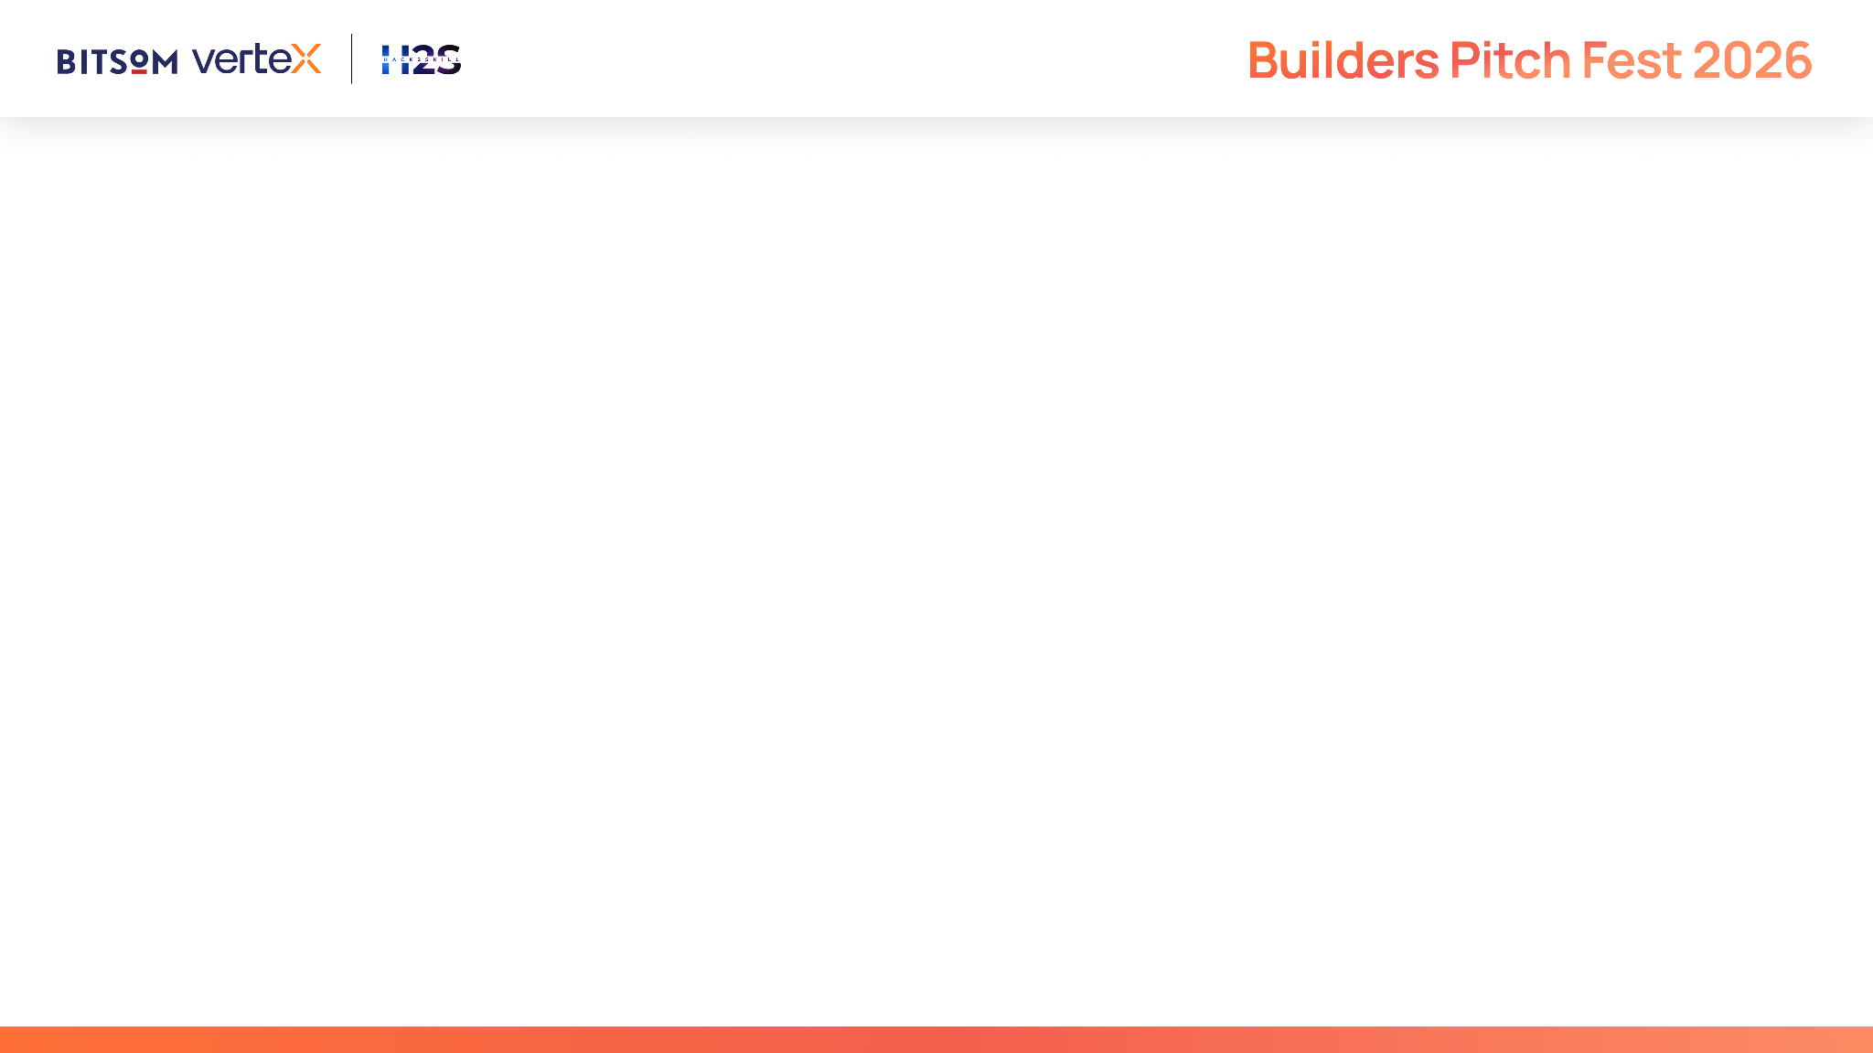
IMPORTANT
This submission deck is designed to help you present your startup in a structured and consistent manner. It enables reviewers to evaluate your solution across product, technology, AI innovation, business viability, customer validation, and enterprise readiness.
Strong submissions will demonstrate:
A clearly validated customer problem and market opportunity
Meaningful and responsible application of AI to solve the problem
Technical depth through a scalable and well-designed architecture
Product maturity supported by customer validation and measurable traction
A sustainable business model with a clear go-to-market strategy
A compelling vision for growth through the BITSoM Vertex incubation programme
Guidelines
This is not a traditional fundraising pitch deck.
Focus on demonstrating the reasoning behind your decisions rather than making marketing claims.
Wherever applicable, support your responses with evidence, metrics, customer insights, product screenshots, architecture diagrams, user journeys, and other relevant visuals.
Not every question may be applicable to every startup. Answer the questions that are most relevant to your solution and provide sufficient context to help reviewers understand your approach.

Slide 3
Startup Snapshot
What problem are you trying to solve?
• The 3-Week Enterprise Deal Chokehold: B2B enterprise deals take weeks to close due to grueling manual RFP analysis, protracted legal redlining cycles, rogue sales discounting, and repetitive 200-question security assessments.
• Catastrophic Contractual Liabilities: Over 42% of corporate legal disputes originate from uncapped indemnity, IP transfer, or punitive SLA damages that slipped past overworked legal teams.
What inspired you to work on this problem?
• The Deal Desk Disconnect: Sales wants to close fast; Legal and Finance must protect risk and margin. We built CogniDeal AI to unite legal, pricing, compliance, and sales into a synchronized autonomous intelligence swarm that compresses deal cycles from 21 days to under 48 hours.
• The Solution: CogniDeal AI coordinates 5 specialized agents across RFP bid drafting, contract redlining, margin guardrails, security questionnaires, and C-suite deal briefs.

Slide 4
Problem Understanding
What problem are you solving, and who experiences it most acutely?
• Acutely experienced by Chief Revenue Officers (CROs), General Counsels (GCs), Heads of Deal Desk, and Sales Operations leaders at enterprise software and services firms.
• Revenue Drag: Prolonged deal cycles lead to 28% quarter-end deal slippage. Sales reps spend up to 35 hours per month on non-selling redlining tasks.
• Margin Bleed: Uncontrolled discounting erodes corporate gross margins by 400–800 basis points per deal.
What research, observations, or evidence validate this opportunity?
• World Commerce & Contracting (WorldCC) data shows poor contract management erodes 9.2% of a typical enterprise's annual bottom line.
• Corporate legal teams spend over 70% of their bandwidth reviewing low-to-medium risk boilerplate clauses rather than high-stakes strategic negotiations.
• Enterprise vendor onboarding security audits stall deals for an average of 45 days.

Slide 5
Customer & Opportunity
Who is your ideal customer, and who would make the buying decision?
• Ideal Customers: Mid-to-Large B2B Enterprise Companies (SaaS, Cloud Infrastructure, IT Services, Consulting) selling six-figure and seven-figure annual contracts.
• Economic Buyers: Chief Revenue Officers, General Counsels, VP of Sales Operations, and Chief Financial Officers.
• End Users: Account Executives, Deal Desk Analysts, In-House Corporate Lawyers, and Compliance Officers.
How large is the opportunity if your assumptions prove correct?
• Global TAM: $26.4 Billion Enterprise Contract Lifecycle Management (CLM) and Deal Desk Software market (growing at 13.8% CAGR).
• Global SAM: $3.1 Billion addressable spend in B2B contract risk automation, RFP intelligence, and deal desk optimization.
• Immediate SOM: ₹190 Crores ($23M ARR) targeting top 300 Indian and US enterprise software/IT vendors.

Slide 6
Proposed Solution
What is your proposed solution, and how does it address the identified problem?
• CogniDeal AI is an autonomous deal desk intelligence swarm that unites RFP digestion, contract liability redlining, pricing guardrails, security questionnaire automation, and executive deal synthesis into a single cockpit.
What are the key capabilities you envision?
• DealScout (RFP Architect): Ingests multi-page RFPs, generates compliance matrices, and produces tailored competitive bid drafts.
• LexiGuard (Contract Risk & Redline): Scans contracts for predatory terms (uncapped liabilities, IP loss) and generates balanced substitute clauses.
• MarginPilot (Pricing Guardrails): Real-time margin waterfall modeling, volume discount boundaries, and automated CFO escalation routing.
• TrustVertex (Security Auditor): Instantly auto-fills enterprise security questionnaires (SOC2, ISO 27001, GDPR) with exact knowledge citations.
• DealDesk Copilot: Multi-turn strategic negotiation copilot and 1-click executive deal brief generator.
What measurable value do you expect the solution to deliver?
• 80% Reduction in enterprise deal turnaround time (from 3 weeks down to under 48 hours).
• 95% Faster Contract Redlining and liability auditing | 350 bps Gross Margin Protection through discount boundaries.

Slide 7
Technology & AI Approach
What role will AI play in your proposed solution, and why is it essential?
• AI operates as an autonomous multi-agent deal team: parsing dense legal syntax, balancing conflicting corporate clauses, calculating pricing elasticities, and formulating strategic negotiation talk tracks.
What technologies, AI models, or frameworks do you plan to use, and why?
• Reasoning & Legal Intelligence Core: Google Gemini 2.5 Flash / Vertex AI for massive 1M+ token context windows capable of digesting entire 100-page enterprise contracts in a single pass.
• Modern Stack: React 18, Vite, TypeScript, Tailwind CSS, Lucide system icons, and full offline simulation resilience.
What makes you feel your product is a genuine AI product, and not an AI wrapper?
• CogniDeal AI coordinates a multi-agent state graph where each agent validates legal risk thresholds, pricing floors, and compliance requirements through formal rule engines before prompting AI for synthesis.

Slide 8
Competitive Landscape
What alternatives currently exist?
• Legacy CLM Software (Ironclad, Icertis, DocuSign CLM): Monolithic document repositories requiring 6-month setups that lack autonomous multi-agent deal desk orchestration.
• Point RFP Tools (Loopio, Responsive): Isolated Q&A databases that cannot evaluate contract liability, margin impact, or security questionnaires.
• Manual Spreadsheets & Email Chains: Fragmented, error-prone communication between Sales, Legal, and Finance.
Why do you believe your approach is better suited to solving this problem?
• CogniDeal AI is the only unified platform orchestrating Legal, Finance, Security, and Sales agents simultaneously to close deals securely at record speed.

Slide 9
Business Model & Go-To-Market
Who do you expect will pay for your solution?
• B2B SaaS Tiered Platform Licensing:
• Growth Deal Desk: $1,500 / month for up to 10 active sales and legal seats.
• Enterprise Swarm: $4,500 / month for unlimited seats, dedicated custom contract playbook fine-tuning, and private VPC security.
• Annual Enterprise Contract: $50,000–$120,000 / year for global enterprise deployments.
How do you plan to acquire your first customers?
• High-Velocity Sales Ops Outreach: Target B2B SaaS companies experiencing rapid hiring and contract bottlenecks.
• Free Contract Risk Audit: Offer enterprise prospects a free 1-click liability scan of their standard MSA to demonstrate immediate value.
• BITSoM Vertex Ecosystem: Leverage BITSoM corporate partnerships and alumni networks across enterprise B2B companies in Mumbai.

Slide 10
Development Roadmap
What are the next major milestones toward building your MVP?
• Current Status (Phase 0): Fully functional, interactive production prototype with 5 agents, live RFP parser, redline engine, margin calculator, and deal dossier export (Completed & Verified).
• Phase 1 (Months 1–3): Native Salesforce, HubSpot CRM, and DocuSign bi-directional API integrations.
• Phase 2 (Months 4–6): Microsoft Word and Google Docs redlining add-in for real-time in-line contract edits.
• Phase 3 (Months 7–12): Enterprise SOC2 Type II compliance and multi-jurisdictional legal playbook libraries (US, UK, India, EU).
What resources or support will be most critical during this journey?
• Corporate Legal Advisory: Access to senior general counsels to calibrate standard balanced redline playbooks.
• Enterprise Sales Pilots: B2B SaaS partner cohorts to test deal velocity improvements in live quarterly cycles.
• Cloud Infrastructure Credits: Vertex AI credits for processing high volumes of multi-page PDF documents.

Slide 11
Team
Why is your team uniquely positioned to solve this problem?
• Deep technical expertise in multi-agent LLM systems combined with a rigorous understanding of enterprise sales mechanics, contract law fundamentals, and SaaS unit economics.
• Demonstrated ability to ship production-grade, highly intuitive enterprise software within accelerated timeframes.
What relevant domain or technical expertise does the team possess?
• Ujjwal Kumar Bhowmick (Founder & Lead AI Engineer):
• Extensive expertise in full-stack TypeScript, React 18, Tailwind, and Google Gemini / Vertex AI multi-agent architectures.
• Specialized in structured contract data parsing, financial margin modeling, and enterprise compliance systems.

Slide 12
Why BITSoM Vertex?
Why have you applied to the BITSoM Vertex programme?
• Premier B2B Enterprise Launchpad: BITSoM's Mumbai campus is situated at the epicenter of India's corporate headquarters, providing direct access to enterprise revenue and legal leaders.
• Commercialization Mentorship: Guidance from top business strategists on enterprise sales compensation, customer acquisition, and enterprise pricing models.
What is the biggest challenge preventing you from building your MVP?
• The MVP is built, polished, and operational! The primary objective now is enterprise pilot validation: deploying CogniDeal AI in live deal desks, measuring cycle compression, and securing commercial contracts. BITSoM Vertex provides the ideal network.

Slide 13
Supporting Material
Key Links & Prototype Validation:
• Working Prototype: Fully functional local environment (React 18 / TypeScript on :5173 with RFP breakdown, contract liability redlines, margin calculator, and C-suite deal dossier export).
• GitHub Repository: https://github.com/ujju2020/Open-AI-Innovation (Complete source code, multi-agent schemas, and setup instructions).
• Demo Explainer Video: 2-minute walkthrough showing DealScout, LexiGuard, MarginPilot, TrustVertex, and DealDesk Copilot in action.
• Contact: Ujjwal Kumar Bhowmick | ujjwalkumarbhowmick30@gmail.com | India

Slide 14

CogniDeal AI
Transforming Enterprise B2B Commerce Through Autonomous Deal Desk Intelligence
Thank You! Open for Questions & Evaluation.
Founder: Ujjwal Kumar Bhowmick | ujjwalkumarbhowmick30@gmail.com

