Slide 1
Gators-ISOM
Antheo Fernandes
Anu Abraham Thudianplackel
Dharmil Sanghavi
Jose Iglesias Colina
Roman Zabaleta
Sathish Kumar Desingh
Ujjual Ramachandran

Slide 2
Part 1:
Koko’s Canine Pet Club

Slide 3
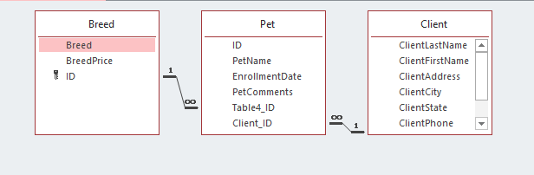
ERD: Koko’s Canine Pet Club

Slide 4
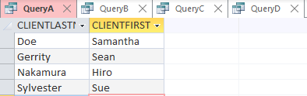
Query A: Which clients are in Round Rock? Provide their last and first names
SELECT CLIENTLASTNAME, CLIENTFIRSTNAME
FROM CLIENT
WHERE CLIENTCITY='ROUND ROCK';

Slide 5
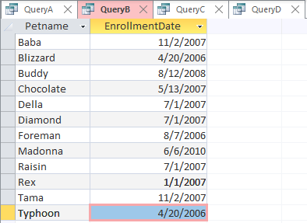
Query B: Which pets are beagles? List the pet’s name and enrollment date.
SELECT DISTINCT (pet.Petname), pet.EnrollmentDate
FROM Pet AS Pet_1, Breed INNER JOIN Pet ON Breed.ID = Pet.Table4_ID
WHERE breed="beagle";

Slide 6

Query C: How many total clients does Ms. Hannah have?
SELECT count(*) AS No_ofClients
FROM Client
WHERE clientlastname in (SELECT DISTINCT(CLIENTLASTNAME) FROM CLIENT)
and clientfirstname in (SELECT DISTINCT(clientfirstname) FROM CLIENT);

Slide 7
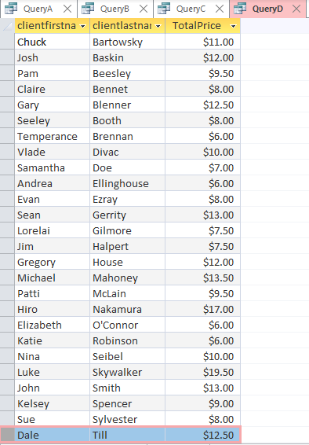
Query D: What are the total pet-walking fees charged to each client? Show the client’s first and last names and the total fees charged to him or her.
SELECT clientfirstname, clientlastname, sum(breedprice) AS TotalPrice
FROM Client INNER JOIN (Breed INNER JOIN Pet ON Breed.ID = Pet.Table4_ID) ON Client.ID = Pet.Client_ID
GROUP BY clientlastname, clientfirstname;

Slide 8
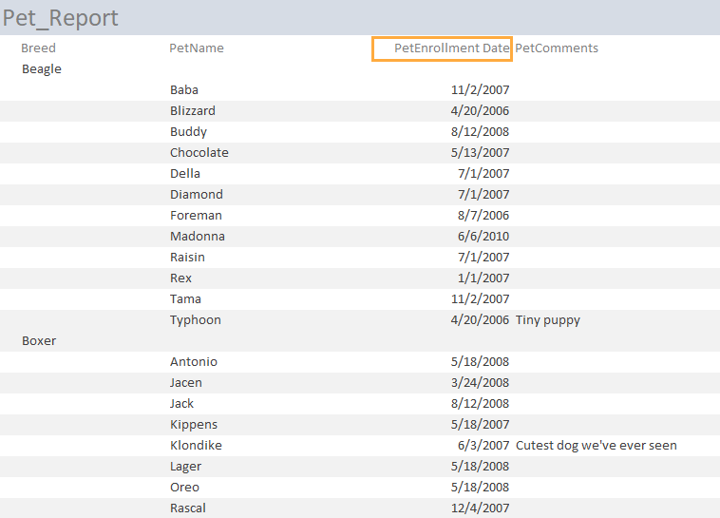
Report Wizard: Report showing all her pets

Slide 9
Part 2:
Jennifer Christie’s Physical Therapy Specialists Clinic

Slide 10

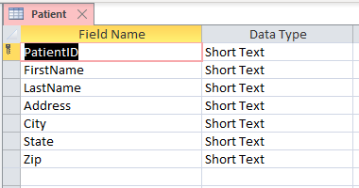
Patient Table

Slide 11
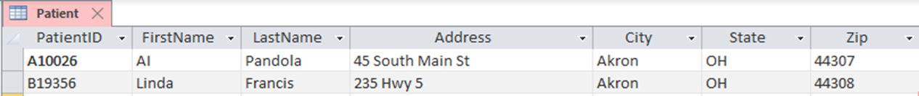

Best Fit
Original
Best Fit

Slide 12
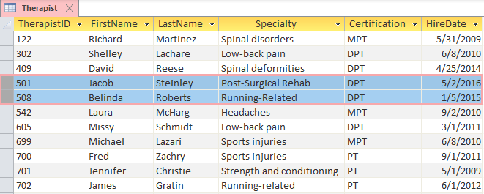
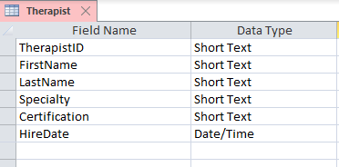
Therapist Table

Slide 13
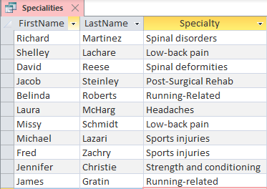
Query with FirstName, Last Name, and Specialty fields

Slide 14
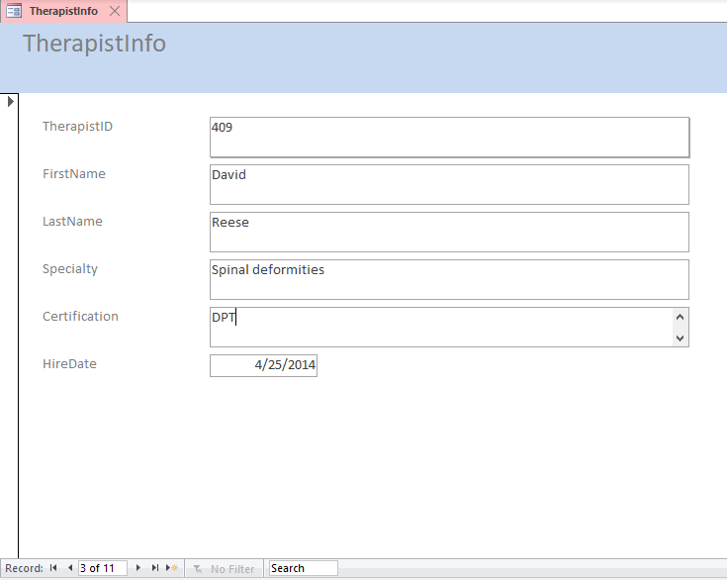
Form Tool: Therapist Info (DPT)

Slide 15
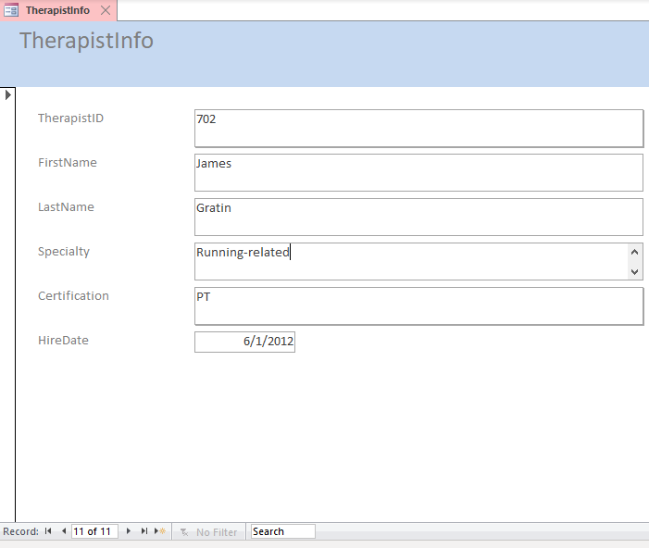
Therapist Info (Running Related)

Slide 16
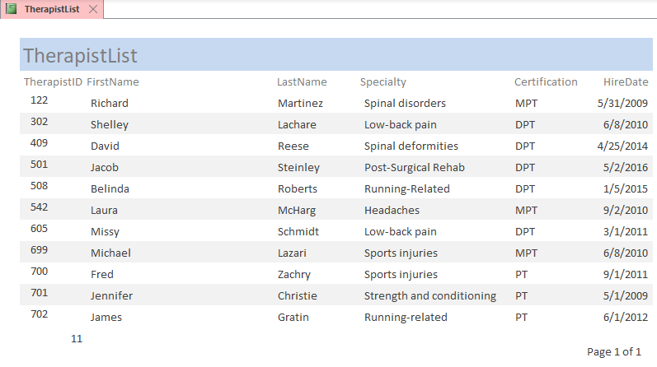
Report Tool: Therapist List

Slide 17
THANK YOU !!

