Slide 1

Computer Engineering Department
A.P. Shah Institute of Technology
G.B.Road,Kasarvadavali, Thane(W), Mumbai-400615
UNIVERSITY OF MUMBAI
Academic Year 2020-2021

Slide 2
A Project Report on
Behavioral Analysis of Internet Messaging And Malicious activity Detection. Submitted in partial fulfillment of the degree of
Bachelor of Engineering(Sem-7)
in
Computer Engineering
By
Ujjwal Jain(17102027)
Bhavik Jain(17102058)
Rishabh Mehta(17102039) Shrinath Suryawanshi(17102012)
Under the Guidance of
Prof .Shafaque Syed

Slide 3
1.Project Conception and Initiation

Slide 4
1.1 Abstract
Social media plays a very important role in everyone’s life. We can’t leave without it but it can be very dangerous for youth as they could become a victim of social trapping and psychological depressions. Internet messaging is having adverse effects on youth and the country. Misuse of “chatting” has become a common phenomenon and people are widely using it for some unusual activities. On social networking sites like Facebook, WhatsApp where teenagers communicate through explicit messages and trap the opposite gender which can be worst. In this paper, the methodology for dealing with such types of messages is discussed. Initially, text messages are processed through the classifier algorithm which would predict the behavior of the users, and the system will alarm if any malicious activity is detected.

Slide 5
1.2 Objectives
To help the people who are unable to communicate with their closed ones
about any threats or cyberbullying.
To help the people from the threats or blackmailing
To detect some unusual activities conducted via chats.
To help the users from not getting into any unwanted activities which
can mislead them.

Slide 6
1.3 Literature Review
It considers one of the actual threats of the Internet of things related to the transmission of malicious messages between user. Methods of the transmitted data automatic verification and filtering by some set of features in Internet systems of things are analyze. It proposes an approach to the intelligent detection of unnatural conversation between user, which could minimize the likelihood of the implementation of threats. The major problem in Instant Messengers, much of sensitive and personal information, disclosed through socio-engineered text messages for which solution is proposed but, detection of words using chatting technique in Instant Messengers is not yet done which is the motivating factor to carry out the work. Online criminal's now-a-days adapted technique along with text message and wraps out personal information leads to threat and hindrance for privacy

Slide 7
1.3 Literature Review
Psychological health disorders pose a growing threat to society. Disorders such as Depression, Post-Traumatic Stress Disorder (PTSD), and mild Traumatic Brain Injury (mTBI), are often under-diagnosed and under-treated. Crisis hotlines are often the last resort for people who, from the lack of proper treatment, are considering suicide or intend to harm themselves or others.
Harassment by cyberbullies is a significant phenomenon on the social media. Existing works for cyberbullying detection have at least one of the following three bottlenecks. First, they target only one particular social media platform (SMP). Second, they address just one topic of cyberbullying. Third, they rely on carefully handcrafted features of the data. Knowledge learned by these models on one dataset can be transferred to other datasets. To the best of our knowledge, this is the first work , systematically analyzes cyberbullying detection on various topics across multiple SMPs using deep learning-based models and transfer learning.

Slide 8
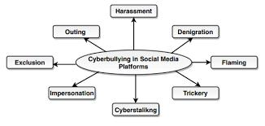
1.4 Problem Definition
An outburst of Social networking pages, without proper monitoring, highly endangers personal security especially of teens and youth who are highly exposed to many inhumane activities. They get addicted to the internet Messaging over social networking sites presenting the serious threat of getting beguiled into extreme and even horrendous acts like Trapping, girl-Trafficking, motivation to become extremists, and other evils. Also, cyberbullying, blackmailing and threats given on social media can lead to anxiety, depression, and even suicide in some cases.

Slide 9
1.5 Scope
It became quite popular to bully a person by sending harmful messages on social media that can be disturbing for them. It can lead to stress, anxiety, depression, and even suicide in some cases. The Same goes with the threats as people are ready to do anything inappropriate due to threats given to them. Also, sometimes blackmailing leads to the above problems and it is dangerous. It is very damaging to adolescents and teens. Also, things may never get disappear once circulated on the internet. So, to overcome these issues, detecting the activity as malicious or not is very important which will help to stop cyberbullying, blackmailing, and threats given on social media.

Slide 10
1.6 Technology stack
Languages:
Python
HTML/CSS
JavaScript
Techniques:
Random Forest Classifier
Decision Tree Classifier
KNN
Pipeline
TF-IDF
Flask

Slide 11
1.7 Benefits for environment & Society
The idea of this project is concerned with the new generation as well as the present generation, this system will be very helpful for both of the generations. It will be mainly helpful for the women around us. We know and have knowledge about the cybercrimes and threats given on Social media and the victims are not able to express themselves due to many reasons. So, our system will send an alert notification to their responsible guardian on the behalf of the victim. So, they can get support from their guardians during tough times and we hope that our system will help in reducing Cybercrime rates.

Slide 12
2. Project Design

Slide 13
2.1 Proposed System
As we are seeing on social media and news that many young adults are becoming the victim of blackmailing, cyber bullying and threats given on social media platforms.
So, this problem encourages us to make this system as our system will compare the message retrieved from the online chatting with the already created database.
The main advantage of our system is that our system will detect the meaning of chats using the frequency of curse/abusive words used in that chat and it will alert the respected guardian that your child is in some trouble.
It will help in reducing suicide rates as victim is not able to tell their guardians about their problems in personal life.
This cyber-trapping which is very difficult to catch can be easily handled using our system.

Slide 14
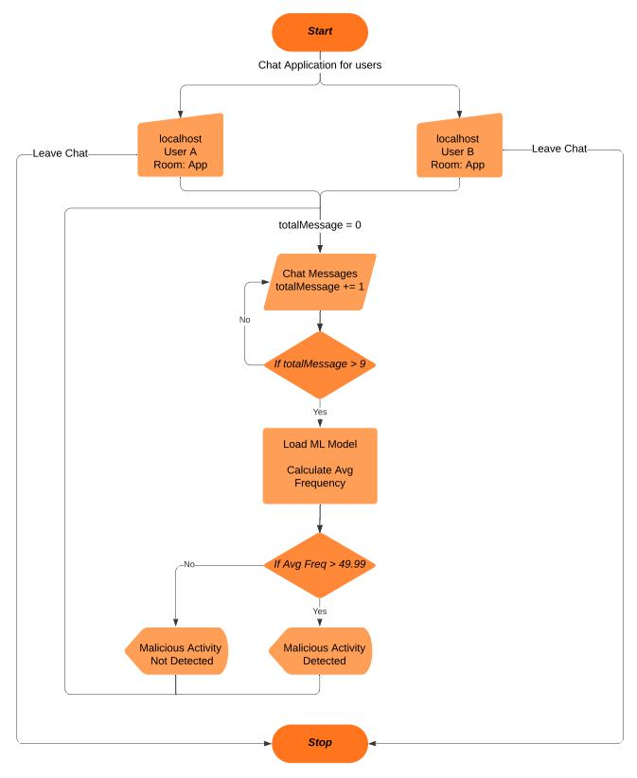
2.2 Design(Flow Of Modules)

Slide 15
2.3 Description Of Use Case
Initially User will get the chat application on their browser where they can chat with each other. They have to enter the username and room name in the input fields which will be used to validate and will provide the chatting interface to the user. Room name should be the same for the user to chat with each other else they will be able to chat but not with each other as they are logged in different rooms.
We have declared a empty list which will contain the message of the users. As soon as the length of the list is greater than 9 i.e. if the length is equal to 10 it will use the pickle file from which the ML Model will be loaded and it will predict the frequency of each sentences. Further it will calculate the average frequency which will be compared with the threshold frequency and if it is greater than threshold frequency so it will display malicious activity detected else it will display malicious activity not detected.

Slide 16
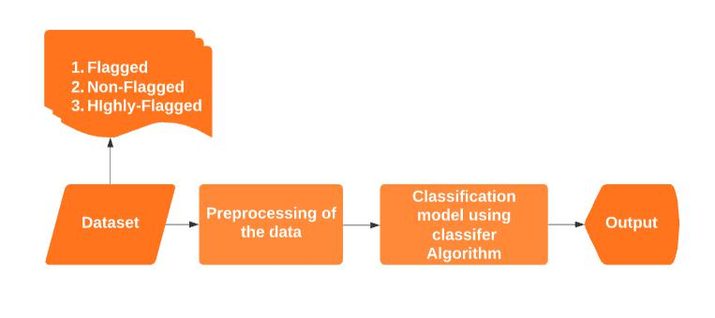
2.4 Class Diagram

Slide 17
2.5 Module-1
Data Gathering
We had manually made the database by mutually chatting within ourselves.
Also, we had taken the data from some online datasets available for free.
Some curse/abusive words and their synonyms from the online tools.
There are two columns in the dataset as Comments which are having the text messages and Frequency which is having the specific frequency provided to each sentence which belongs to flagged (50), Non-flagged (0) and Highly-flagged (100).
Our Dataset contains total 35,523 sentences in which 10,205 sentences belong to Non-flagged, 14,417 sentences belong to Flagged and 10,901 sentences belong to Highly-flagged.

Slide 18
Module-2
Preprocessing
We had removed Stop words which are used for forming the sentences which are grammatically correct but it has no use in our ML classification model as it doesn’t add any meaning to the sentences.
Also, we are keeping the data which has alphabetic characters and other extra characters, special characters as well as digits are removed from the dataset.
All the data has been converted to lower case as mixed-case occurrences of the data can be sometimes not be able to effectively learn the data correctly and it provides different output for different words (e.g., ‘Canada’ vs. ‘canada’). This issue can be solved by lowercasing the whole dataset.

Slide 19
Module-3
Building ML Model Classifier
We had compared different classifier models for prediction on our dataset mainly the Random forest classifier, decision tree classifier, and K-nearest neighbors classifier.
Random forest fits several decision tree classifiers on various randomly selected samples of the dataset and based on the averages it improves the predictive accuracy.
The Decision tree uses tree representation to solve the problem and knn uses the given data and classifies new data based on the similarity measures.
For checking the importance of the word, we have used the Tf-idf vectorizer which calculates tf and idf separately for each word and gets the tf-idf score based on the product of tf and idf scores.
Also, to reduce the time taken for building our model and makes the process easier we had defined a pipeline that consists of both classifier and vectorizer. We are calculating accuracy for different no. of features for which we’ll apply fit on training dataset using a pipeline.

Slide 20
Module-4
Predicting the Output using Flask
For the evaluation of our model and predicting the output based on the text messages, we are using the python framework called flask which provides libraries such as SocketIO and Session using which we can connect our ML model with an online chatting system and the session can be used to store the cookies. Initially, we have loaded the ML Model using the pickle load function and we are creating the flask instance object. We have used session type as a filesystem for storing our text messages on folders and not on the server. We have created 5 functions for our flask application which are as follows:
Index ()
Chat ()
Join ()
Text ()
Left ()

Slide 21
3.Implementation

Slide 22
3.1 Proposed system
As we are seeing on social media and news that many young adults are becoming the victim of blackmailing, cyber bullying and threats given on social media platforms.
So, this problem encourages us to make this system as our system will compare the message retrieved from the online chatting with the already created database.
The main advantage of our system is that our system will detect the meaning of chats using the frequency of curse/abusive words used in that chat and it will alert the respected guardian that your child is in some trouble.
It will help in reducing suicide rates as victim is not able to tell their guardians about their problems in personal life.
Also, victims are threatened for not involving their loved ones, so this system will help in that case.

Slide 23
3.1.2 Algorithms
Random Forest Algorithm
Decision Tree Algorithm
K-Nearest Neighbours (KNN) Algorithm
TF-IDF Algorithm

Slide 24
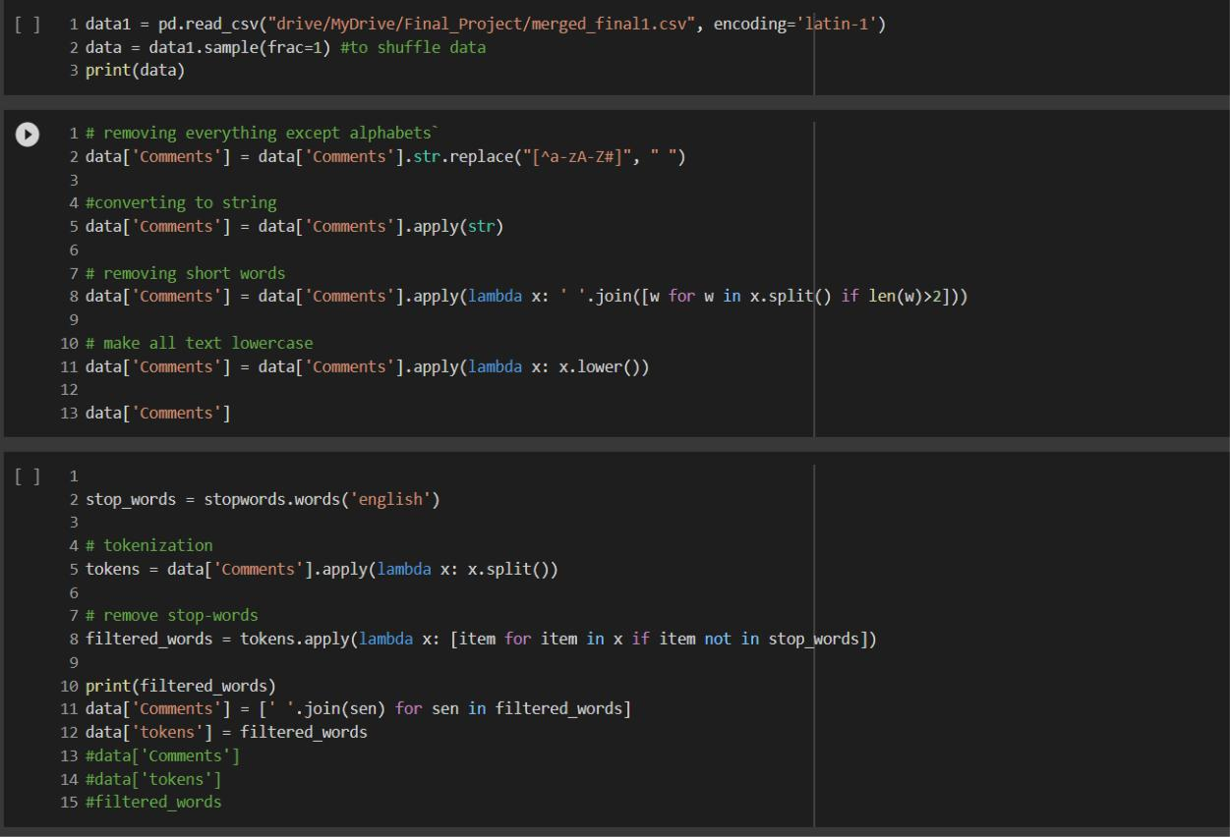
3.1.3 Pseudo code
Preprocessing

Slide 25
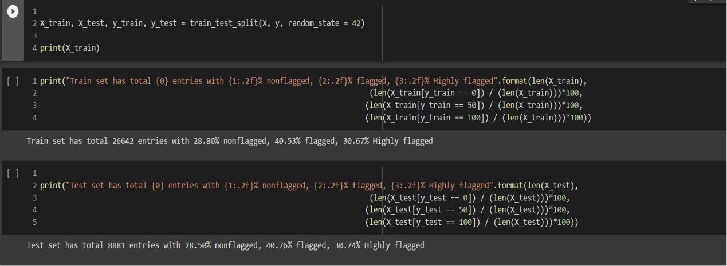
Dataset Splitting

Slide 26
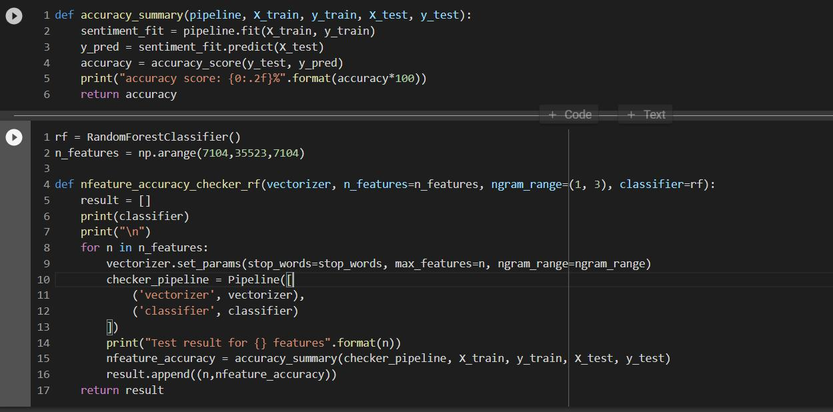
Random Forest

Slide 27
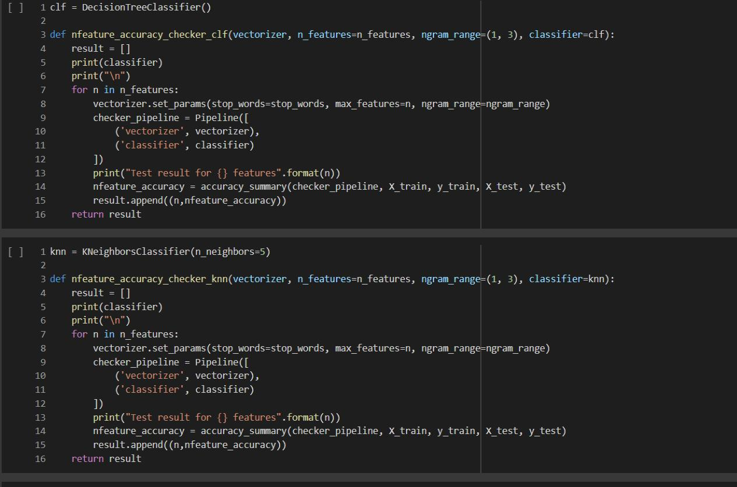
Decision Tree and KNN

Slide 28
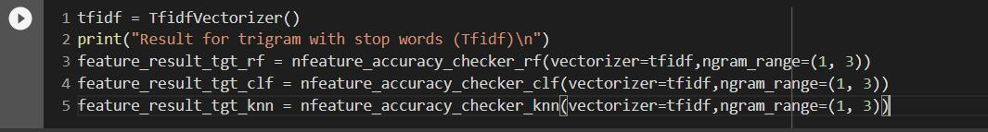

TF-IDF
Model dumped in Pickle file

Slide 29
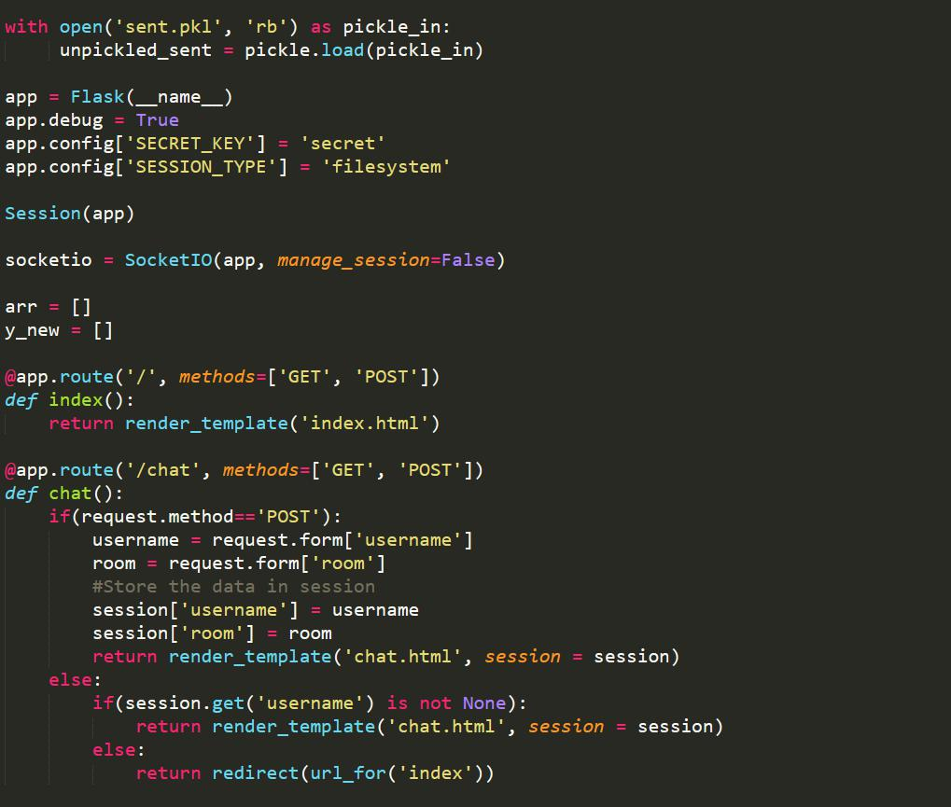
Flask imports and display functions

Slide 30
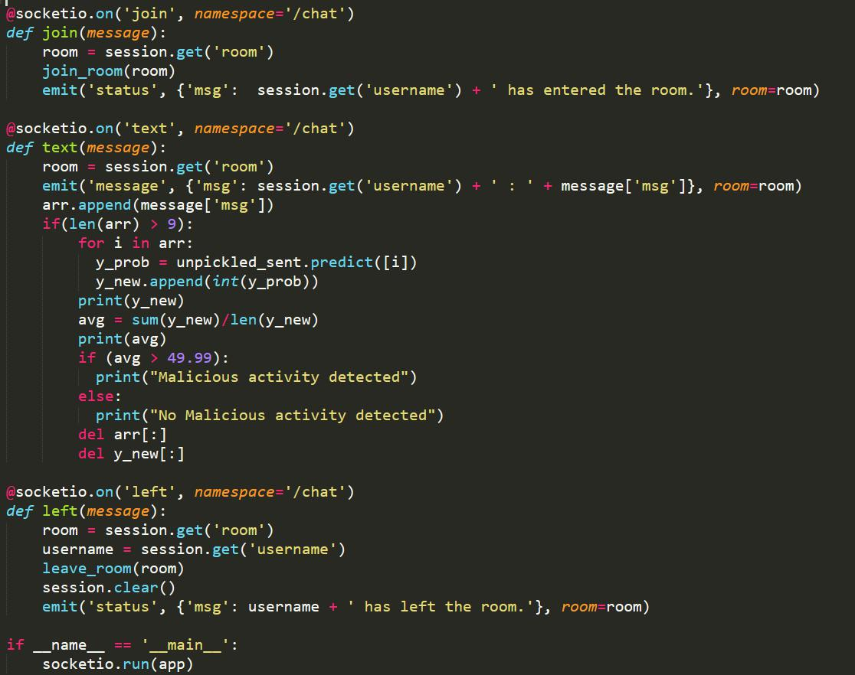
Flask Prediction using ML

Slide 31
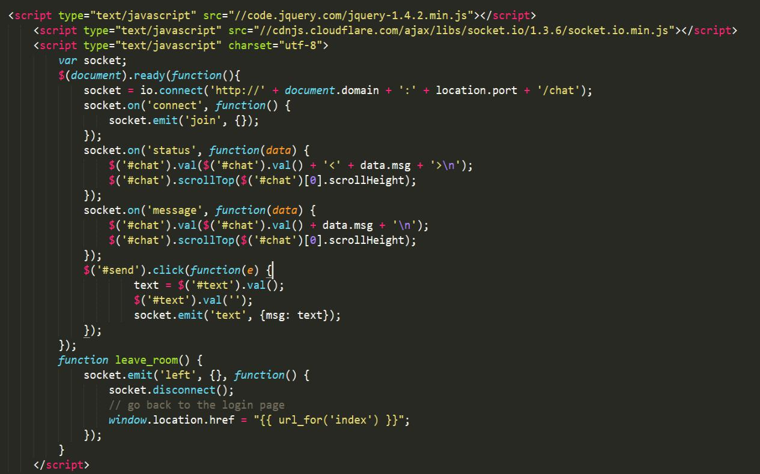
JavaScript Code for Client-Side

Slide 32
3.1.4 Platforms for execution
Google Colaboratory
Localhost for Browser

Slide 33
4. Results
Sr. No. | Algorithm | Accuracy
1. | Random Forest | 95.03%
2. | Decision Tree | 93.47%
3. | KNN | 44.95%
Random Forest achieves highest accuracy among all the classifier algorithm. It gives accuracy of 95.03% as compared to 93.47% by decision tree and 44.95% by KNN. So, we have used random forest for generating our classification report and also for predicting the output.

Slide 34
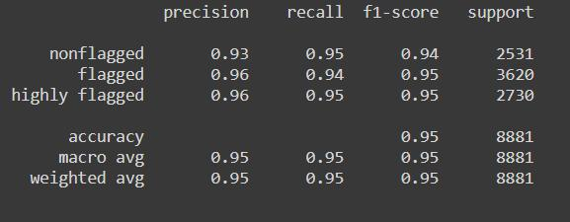
This is the Classification report of our model which shows average precision, average recall and average F1-score as 95%.

Slide 35
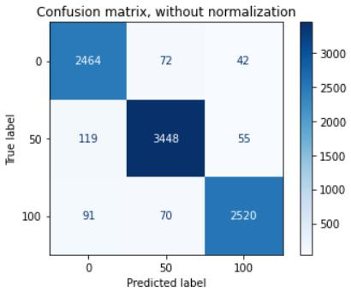
Confusion Matrix shows that our model has correctly predicted 2464 of 2531 Non-flagged sentences, 3448 of 3620 Flagged sentences and 2520 of 2730 Highly-flagged sentences.

Slide 36
5. Conclusion & Future Scope
Conclusion
Our system is used for the betterment of the People and it is widely used for young age who are more prone to involve in these activities. It will give a chatting interface for the users where several users can chat with each other having a common room. From that text field, we will extract the message and if the count of the message is 10 so it will apply the ML model and predict the frequency for each sentence. Finally, it will calculate the average of all the frequencies and will be compared with the threshold frequency i.e., we have set the threshold frequency as 49.99. If the average frequency is greater than 49.99 it will display malicious activity detected else it will display malicious activity not detected. For the classification model, we have used a random forest classifier which creates no. of decision trees using random samples and based on voting it gives output.

Slide 37
Future Scope
We’ll create the system where the user needs to log in using his contact number and also need to enter the guardian contact number where we can send the notification as some malicious activity is there. Also, the GUI of the chatting system will be made attractive as well as responsive for all the window sizes and will add more functionality where users can share images and other media like other chatting systems.
As of now, we are running our chatting system on localhost, but in the future, we’ll try to convert our application to a website as well as a mobile app that can be directly downloaded from the play store and can be used for chatting

Slide 38
6. References
Behavioral analysis of internet messaging and malicious activity detection, K. Srividya, A. Mary Sowjanya, 2016 International Conference on Advances in Human Machine Interaction (HMI), Doddaballapur, India
Automatic search of the malicious messages in the internet of things systems on the example of an intelligent detection of the unnatural agents requests, Anastasia Iskhakova, Roman Meshcheryakov, 2017 Second Russia and Pacific Conference on Computer Technology and Applications (RPC), Vladivostok, Russia
Automatic detection of psychological distress indicators and severity assessment in crisis hotline conversations, Maciej Pacula, Talya Meltzer, Michael Crystal, Amit Srivastava, Brian Marx, 2014 IEEE International Conference on Acoustics, Speech and Signal Processing (ICASSP), Florence, Italy
Deep Learning for Detecting Cyberbullying Across Multiple Social Media Platforms, Sweta Agrawal, Amit Awekar, Accepted for ECIR 2018

Slide 39
7.Bibliography
Sentiment Classification with Python, Susan Li, Sep 8, 2018, Toronto, Canada.
Random Forest Algorithm-An overview, Great Learning Team, Feb19, 2020
Getting into Random Forest Algorithms, Nibin, April 30, 2021.
Split your dataset with scikit-learn, Mirko Stojiljkovic, Nov 23, 2020.
Decision Tree Algorithm for Classification. Akshay Sharma, Feb 25, 2021.
Tf-idf Vectorizer scikit-learn, Mukesh Chaudhary, April 20, 2020.
Introduction to K-Nearest Neighbours, Tavish Srivastava, March 25, 2018.
Natural Language processing feature engineering using tfidf, Cory Maklin, May 5, 2019

Slide 40
Thank You

