Slide 1
Percentage, Profit and Loss
Topic to be covered
1. Percentage equivalent of fractions
2. Importance of Base value in percentages.
3. Percentage change
4. Percentage Point change
5. Successive change in percentages
6. Profit and Loss
7. Partnership
8. Stocks and shares

Slide 2
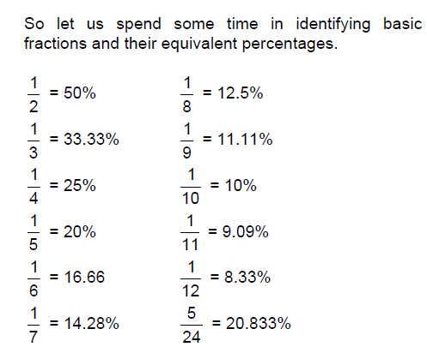
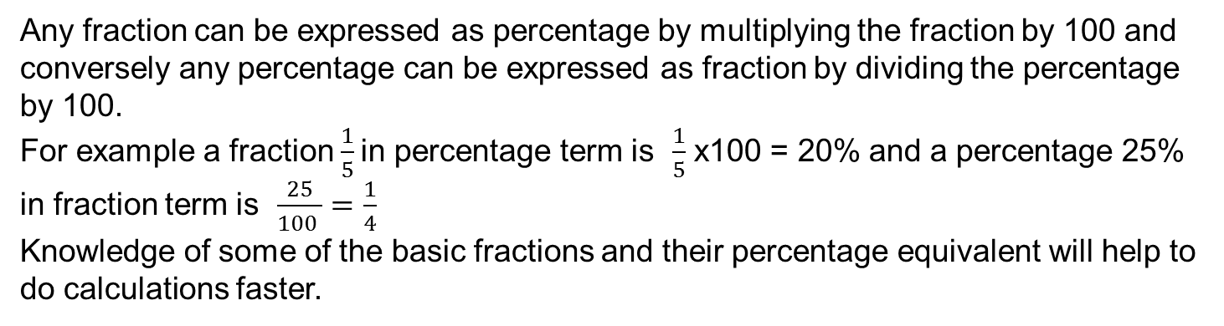
PERCENTAGE EQUIVALENT OF FRACTIONS
Any fraction can be expressed as percentage by multiplying the fraction by 100 and conversely any percentage can be expressed as fraction by dividing the percentage by 100.
For example a fraction $\frac{1}{5}$in percentage term is $\frac{1}{5}$ x100 = 20% and a percentage 25% in fraction term is $\frac{25}{100 }=\frac{1}{4}$
Knowledge of some of the basic fractions and their percentage equivalent will help to do calculations faster.

Slide 3
IMPORTANCE OF BASE VALUE IN PERCENTAGES
Let's consider a statement; A is taller than B by 25%.
It is 25% of A or B?
It will be 25% of B.
In this case B is considered as base value. Means B is assumed as 100%. Hence, if B = 100 then A = 125.
Consider an another example:
A's Height is 90% of B's height
In the above statement again B will considered as a base and A’s height will be 90% of B's height. Hence, if B’s height = 100, then A’s height = 90.
In such cases one has to remember that base value. (value that is considered as 100%) will be the value that occurs after "than" or "of" in the question

Slide 4
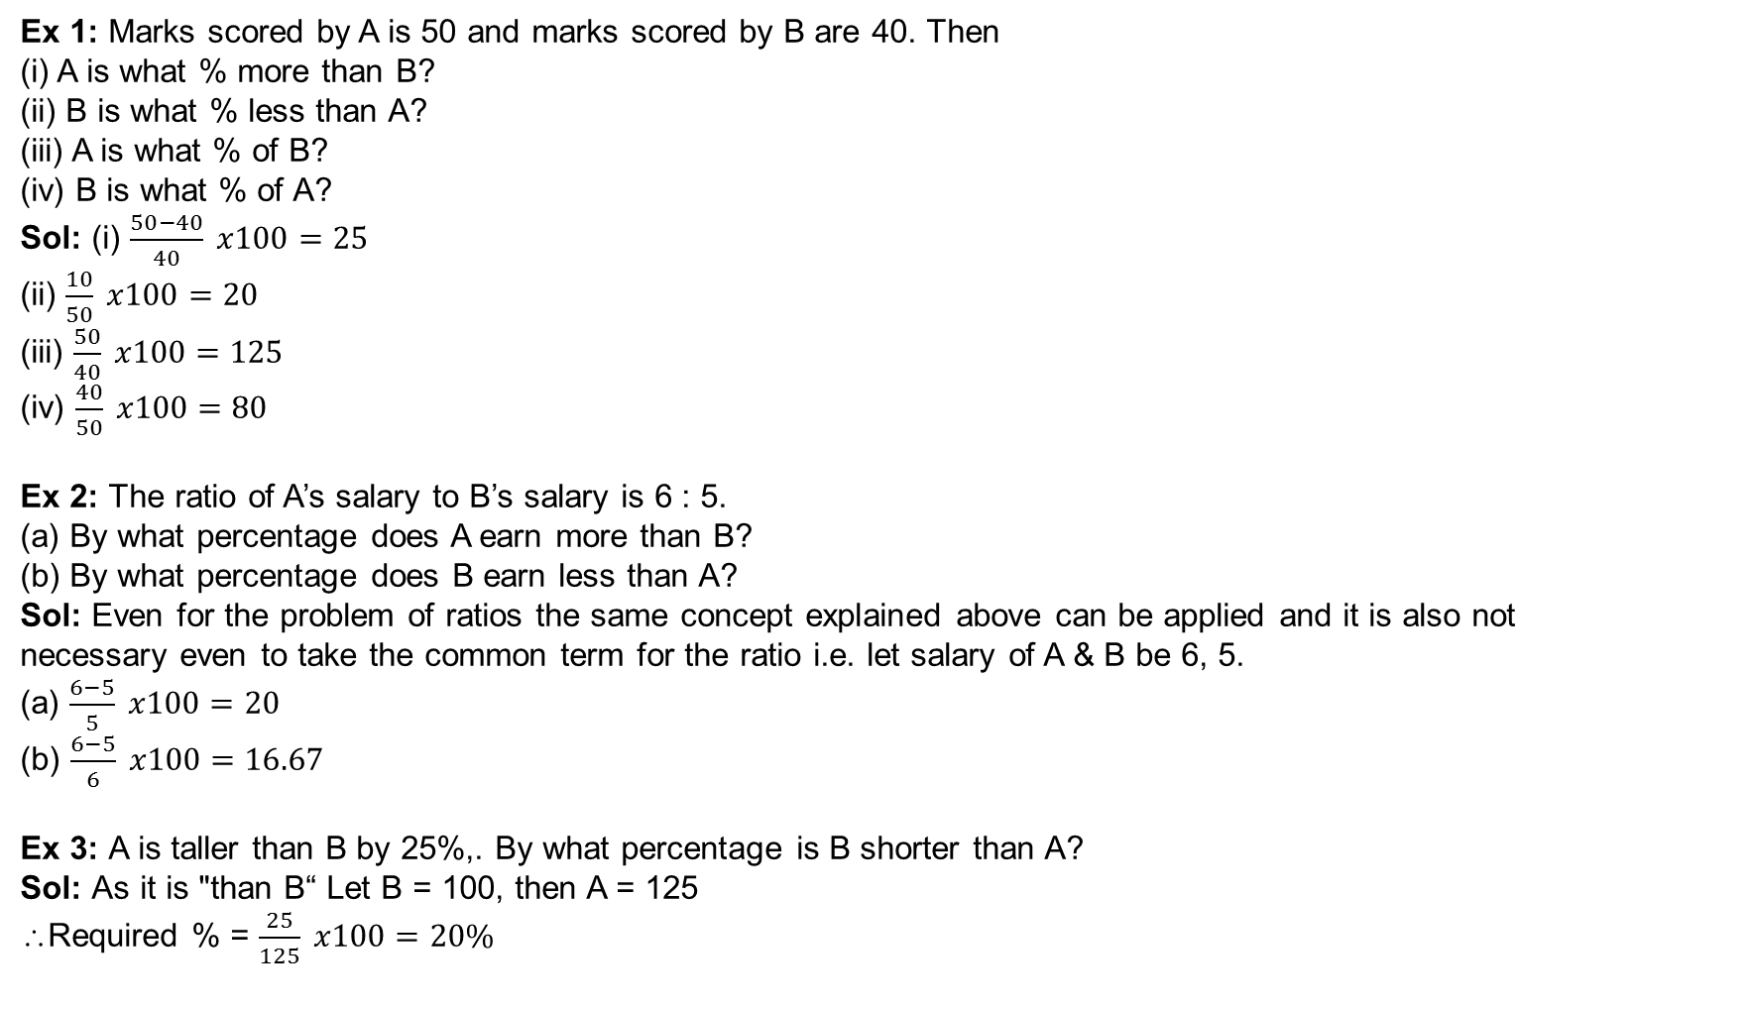
Examples
Ex 1: Marks scored by A is 50 and marks scored by B are 40. Then
(i) A is what % more than B?
(ii) B is what % less than A?
(iii) A is what % of B?
(iv) B is what % of A?
Sol: (i) $\frac{50−40}{40} x100=25$
(ii) $\frac{10}{50} x100=20$
(iii) $\frac{50}{40} x100=125$
(iv) $\frac{40}{50} x100=80$
Ex 2: The ratio of A’s salary to B’s salary is 6 : 5.
(a) By what percentage does A earn more than B?
(b) By what percentage does B earn less than A?
Sol: Even for the problem of ratios the same concept explained above can be applied and it is also not
necessary even to take the common term for the ratio i.e. let salary of A & B be 6, 5.
(a) $\frac{6−5}{5} x100=20$
(b) $\frac{6−5}{6} x100=16.67$
Ex 3: A is taller than B by 25%,. By what percentage is B shorter than A?
Sol: As it is "than B“ Let B = 100, then A = 125
∴Required % = $\frac{25}{125} x100=20\%$

Slide 5
Examples
Ex 4: Income of A is more than B. A spends 30% of income on food and B spends 25% of his income on food. Who spends more on food?
Sol: Income of A is more than B and he spends higher % of income. (as 30% > 20%) on food. Hence A spends more on food than B.
Ex 5: In the above example if income of A is less than B then who spends more on food?
Sol: As a percentage, 30% > 25%. But here we are taking higher % (i.e., 30%) of lower base (i.e., in A) may be more or less than 25% of B. Hence, the answer cannot be determined

Slide 6
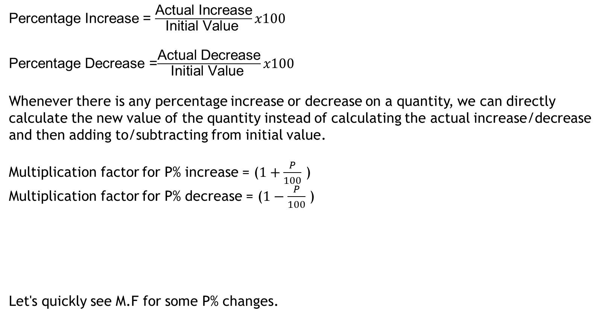
PERCENTAGE CHANGE & M.F.(Multiplication Factor)
Percentage Increase = $\frac{\text{Actual} \text{Increase}}{\text{Initial} \text{Value} }x100$
Percentage Decrease =$\frac{\text{Actual} \text{Dec}\text{rease}}{\text{Initial} \text{Value} }x100$
Whenever there is any percentage increase or decrease on a quantity, we can directly calculate the new value of the quantity instead of calculating the actual increase/decrease and then adding to/subtracting from initial value.
Multiplication factor for P% increase = ($1+\frac{P}{100}$ )
Multiplication factor for P% decrease = ($1−\frac{P}{100}$ )
Let's quickly see M.F for some P% changes.
% Change | M.F.
30% Increase | 1.3
70% Increase | 1.7
8% Increase | 1.08 (not 1.8)
10% Decrease | 0.9
40% Decrease | 0.6
7% Decrease | 0.93

Slide 7
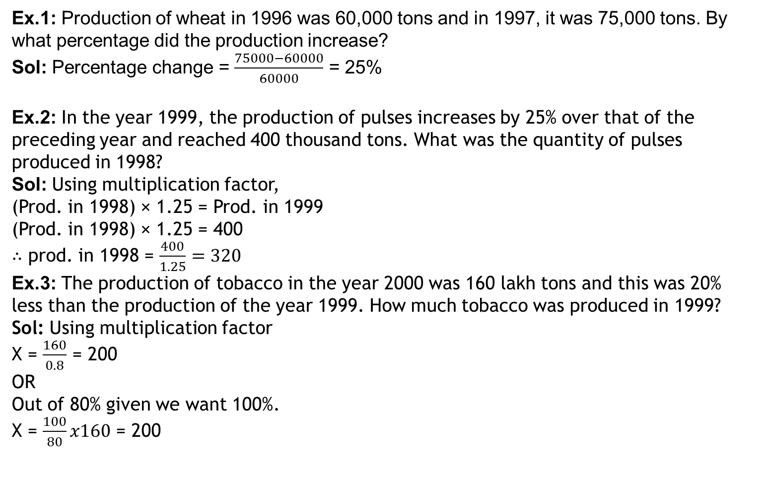
Examples
Ex.1: Production of wheat in 1996 was 60,000 tons and in 1997, it was 75,000 tons. By
what percentage did the production increase?
Sol: Percentage change = $\frac{75000−60000}{60000}$ = 25%
Ex.2: In the year 1999, the production of pulses increases by 25% over that of the preceding year and reached 400 thousand tons. What was the quantity of pulses produced in 1998?
Sol: Using multiplication factor,
(Prod. in 1998) × 1.25 = Prod. in 1999
(Prod. in 1998) × 1.25 = 400
∴ prod. in 1998 = $\frac{400}{1.25}=320$
Ex.3: The production of tobacco in the year 2000 was 160 lakh tons and this was 20% less than the production of the year 1999. How much tobacco was produced in 1999?
Sol: Using multiplication factor
X = $\frac{160}{0.8}$ = 200
OR
Out of 80% given we want 100%.
X = $\frac{100}{80}x160$ = 200

Slide 8
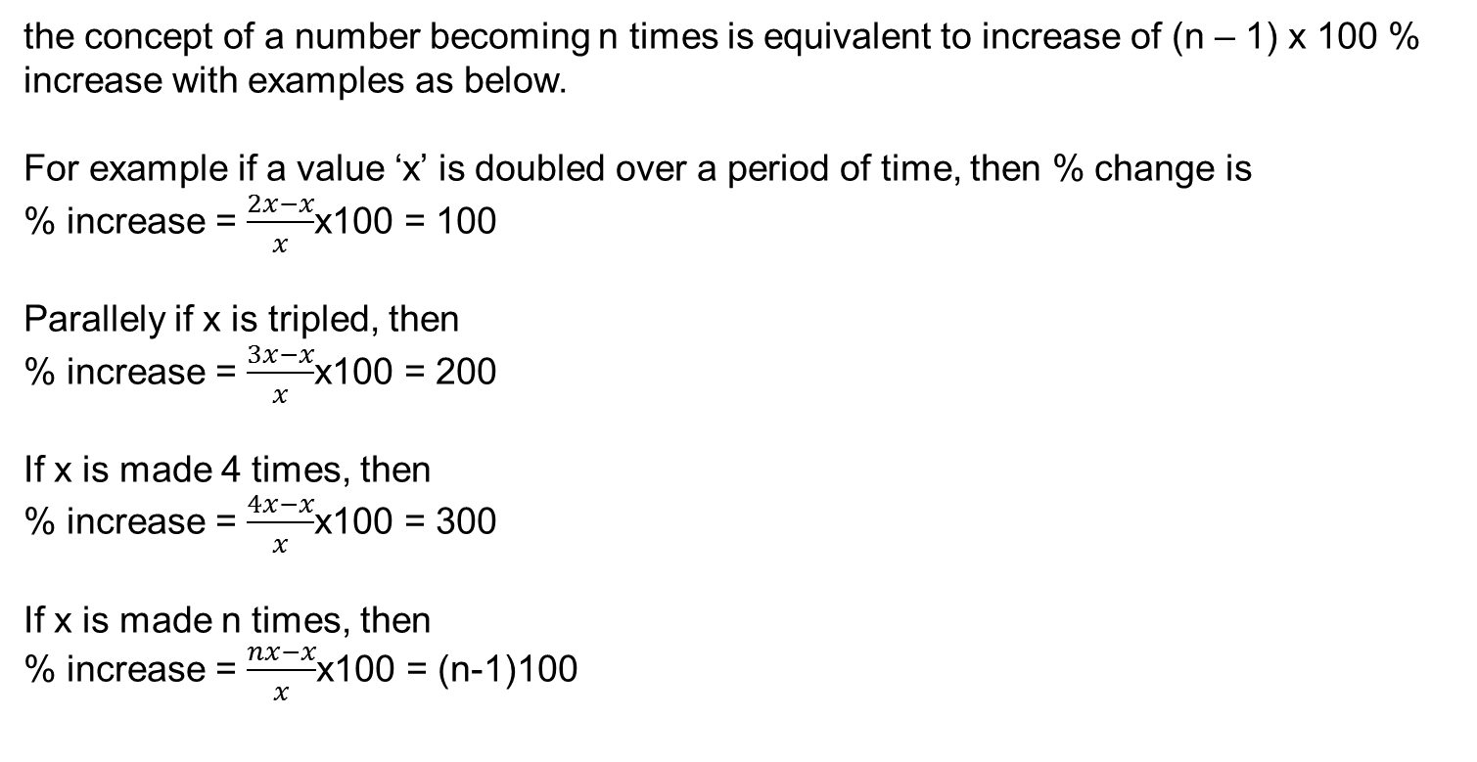
the concept of a number becoming n times is equivalent to increase of (n – 1) x 100 % increase with examples as below.
For example if a value ‘x’ is doubled over a period of time, then % change is
% increase = $\frac{2x−x}{x}$x100 = 100
Parallely if x is tripled, then
% increase = $\frac{3x−x}{x}$x100 = 200
If x is made 4 times, then
% increase = $\frac{4x−x}{x}$x100 = 300
If x is made n times, then
% increase = $\frac{nx−x}{x}$x100 = (n-1)100

Slide 9
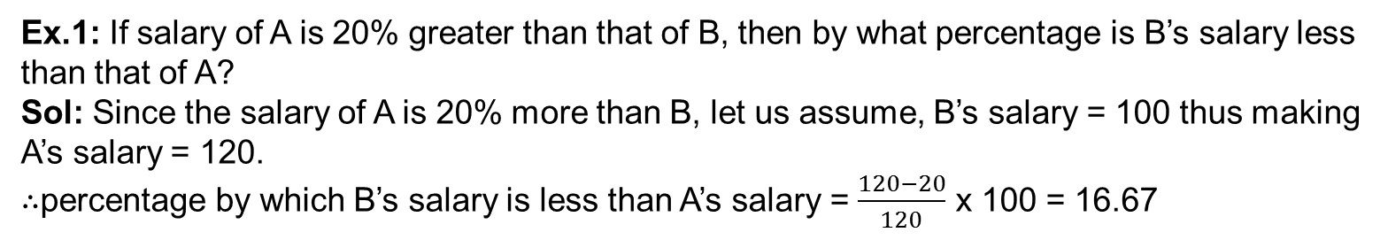
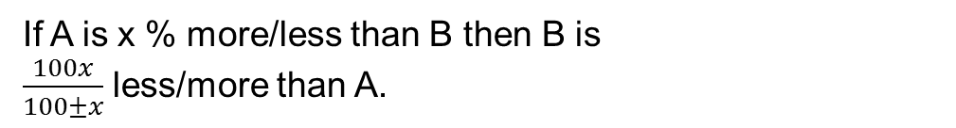
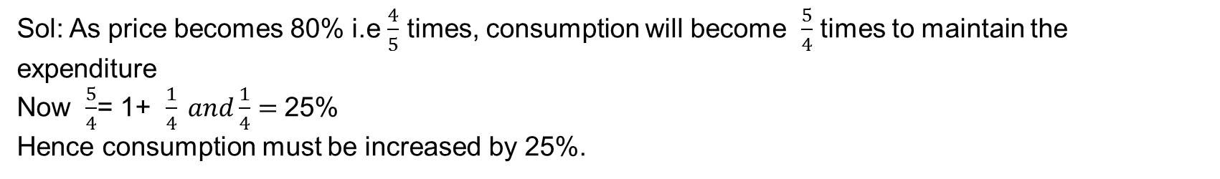
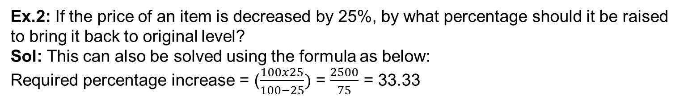
PERCENTAGE INCREASE/DECREASE
If A is x % more/less than B then B is
$\frac{100x}{100±x}$ less/more than A.
Ex.1: If salary of A is 20% greater than that of B, then by what percentage is B’s salary less than that of A?
Sol: Since the salary of A is 20% more than B, let us assume, B’s salary = 100 thus making A’s salary = 120.
$∴$percentage by which B’s salary is less than A’s salary = $\frac{120−20}{120}$ x 100 = 16.67
Ex.2: If the price of an item is decreased by 25%, by what percentage should it be raised to bring it back to original level?
Sol: This can also be solved using the formula as below:
Required percentage increase = ($\frac{100x25}{100−25})$ = $\frac{2500}{75}$ = 33.33
Ex.3: If the price of tea is decreased by 20%, then by what percentage should the consumption be increased in order to maintain constant expenditure?
Sol: As price becomes 80% i.e $\frac{4}{5}$ times, consumption will become $\frac{5}{4}$ times to maintain the expenditure
Now $\frac{5}{4}$= 1+ $\frac{1}{4} and\frac{1}{4}=$25%
Hence consumption must be increased by 25%.

Slide 10
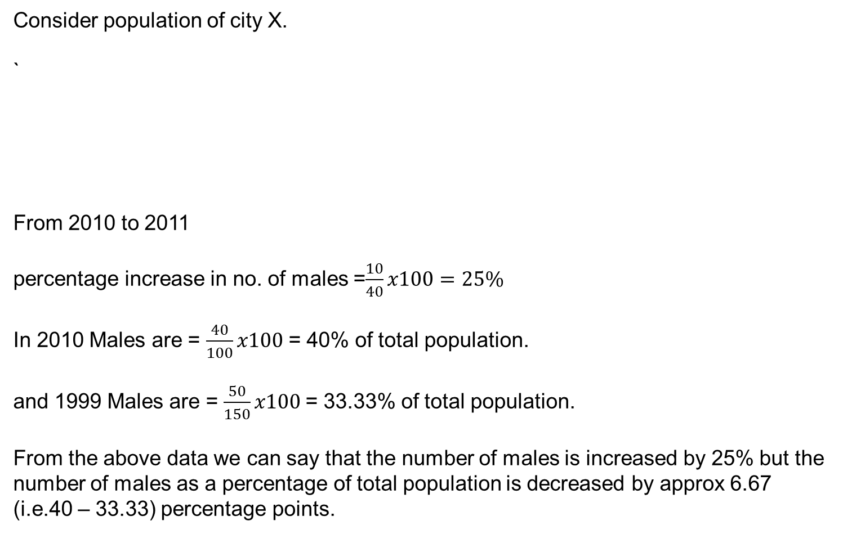
PERCENTAGE POINT CHANGE
Consider population of city X.
`
From 2010 to 2011
percentage increase in no. of males =$\frac{10}{40}x100=25\%$
In 2010 Males are = $\frac{40}{100}x100$ = 40% of total population.
and 1999 Males are = $\frac{50}{150}x100$= 33.33% of total population.
From the above data we can say that the number of males is increased by 25% but the number of males as a percentage of total population is decreased by approx 6.67 (i.e.40 – 33.33) percentage points.
Year | Males | Females | Total Population
2010 | 40 | 60 | 100
2011 | 50 | 100 | 150

Slide 11
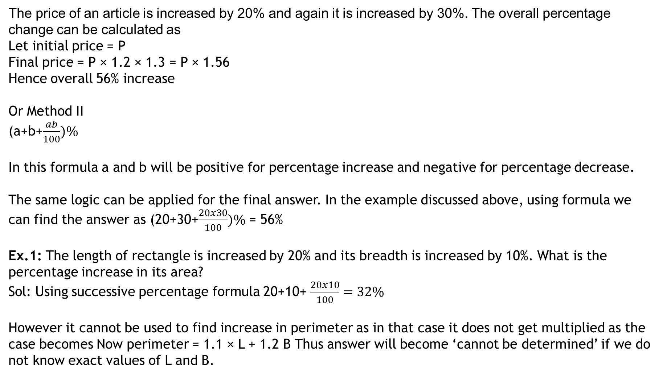
SUCCESSIVE CHANGE IN PERCENTAGES
The price of an article is increased by 20% and again it is increased by 30%. The overall percentage change can be calculated as
Let initial price = P
Final price = P × 1.2 × 1.3 = P × 1.56
Hence overall 56% increase
Or Method II
(a+b+$\frac{ab}{100})\%$
In this formula a and b will be positive for percentage increase and negative for percentage decrease.
The same logic can be applied for the final answer. In the example discussed above, using formula we can find the answer as (20+30+$\frac{20x30}{100})\%$ = 56%
Ex.1: The length of rectangle is increased by 20% and its breadth is increased by 10%. What is the percentage increase in its area?
Sol: Using successive percentage formula 20+10+ $\frac{20x10}{100}=32\%$
However it cannot be used to find increase in perimeter as in that case it does not get multiplied as the case becomes Now perimeter = 1.1 × L + 1.2 B Thus answer will become ‘cannot be determined’ if we do not know exact values of L and B.

Slide 12
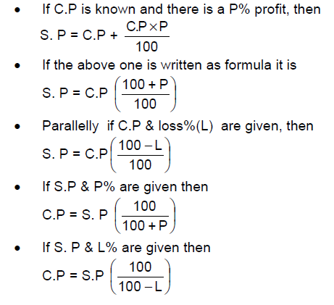
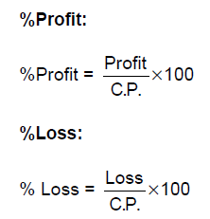
Profit and Loss
The price at which an item is purchased is called the Cost Price (CP).
The Price at which an item is sold is called the Selling Price (SP).
Profit:
One incurs a profit when selling price (S.P) is more than cost price (C.P). Hence
Profit = S.P – C.P
Loss:
One has a loss when selling price is less than cost price .Hence
Loss = C.P – S.P
Profit or Loss percentage are always
calculated on the Cost Price

Slide 13

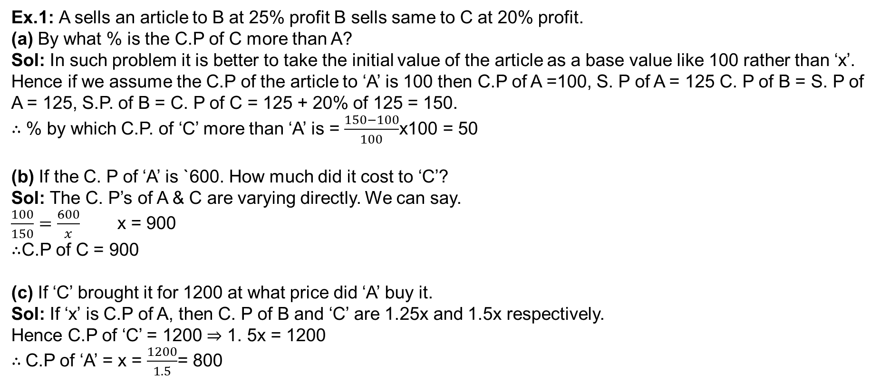
Examples
Ex.1: A sells an article to B at 25% profit B sells same to C at 20% profit.
(a) By what % is the C.P of C more than A?
Sol: In such problem it is better to take the initial value of the article as a base value like 100 rather than ‘x’.
Hence if we assume the C.P of the article to ‘A’ is 100 then C.P of A =100, S. P of A = 125 C. P of B = S. P of A = 125, S.P. of B = C. P of C = 125 + 20% of 125 = 150.
$∴$ % by which C.P. of ‘C’ more than ‘A’ is = $\frac{150−100}{100}$x100 = 50
(b) If the C. P of ‘A’ is `600. How much did it cost to ‘C’?
Sol: The C. P’s of A & C are varying directly. We can say.
$\frac{100}{150}=\frac{600}{x}$ x = 900
$∴$C.P of C = 900
(c) If ‘C’ brought it for 1200 at what price did ‘A’ buy it.
Sol: If ‘x’ is C.P of A, then C. P of B and ‘C’ are 1.25x and 1.5x respectively.
Hence C.P of ‘C’ = 1200 ⇒ 1. 5x = 1200
$∴$C.P of ‘A’ = x = $\frac{1200}{1.5}$= 800
$$⇒$$

Slide 14
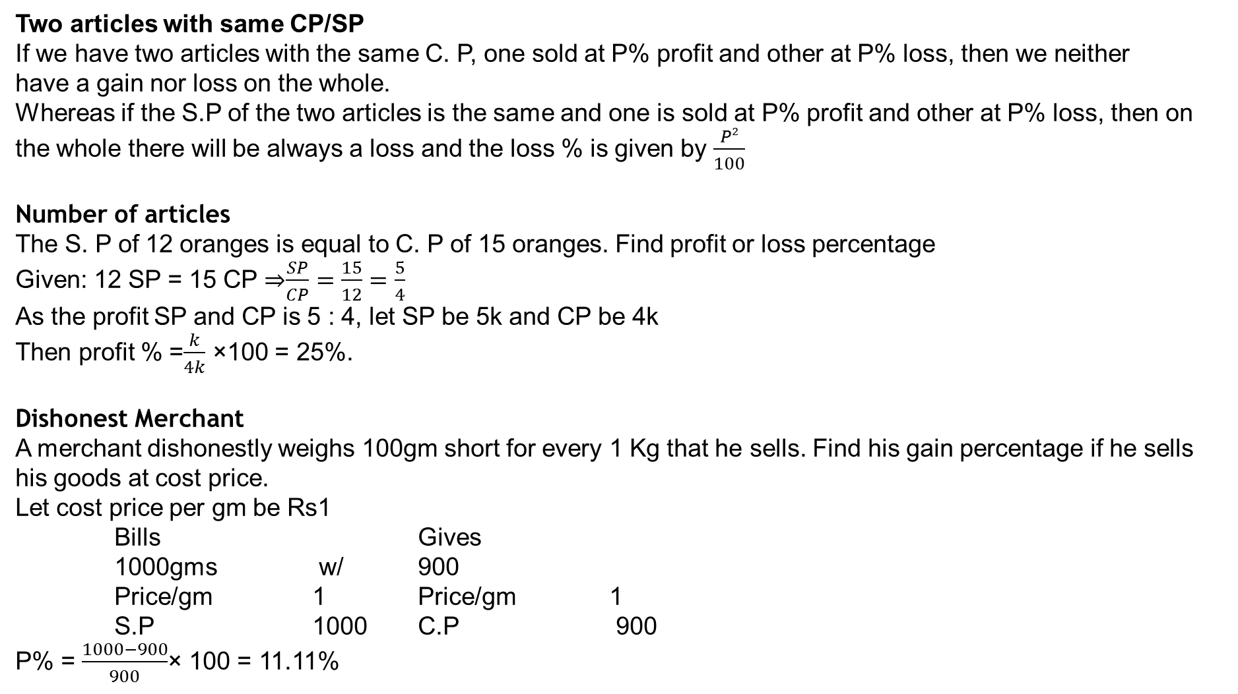
Two articles with same CP/SP
If we have two articles with the same C. P, one sold at P% profit and other at P% loss, then we neither
have a gain nor loss on the whole.
Whereas if the S.P of the two articles is the same and one is sold at P% profit and other at P% loss, then on
the whole there will be always a loss and the loss % is given by $\frac{P2}{100}$
Number of articles
The S. P of 12 oranges is equal to C. P of 15 oranges. Find profit or loss percentage
Given: 12 SP = 15 CP ⇒$\frac{SP}{CP}=\frac{15}{12}=\frac{5}{4}$
As the profit SP and CP is 5 : 4, let SP be 5k and CP be 4k
Then profit % =$\frac{k}{4k}$ ×100 = 25%.
Dishonest Merchant
A merchant dishonestly weighs 100gm short for every 1 Kg that he sells. Find his gain percentage if he sells his goods at cost price.
Let cost price per gm be Rs1
Bills Gives
1000gms w/ 900
Price/gm 1 Price/gm 1
S.P 1000 C.P 900
P% = $\frac{1000−900}{900}$× 100 = 11.11%

Slide 15
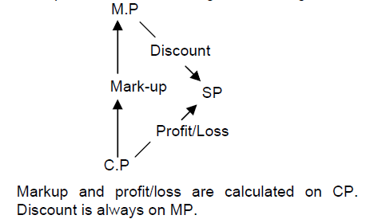
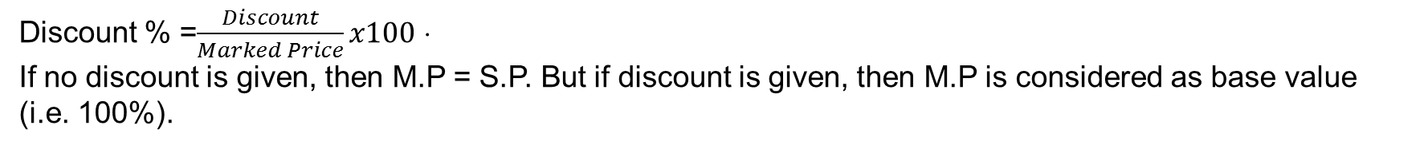
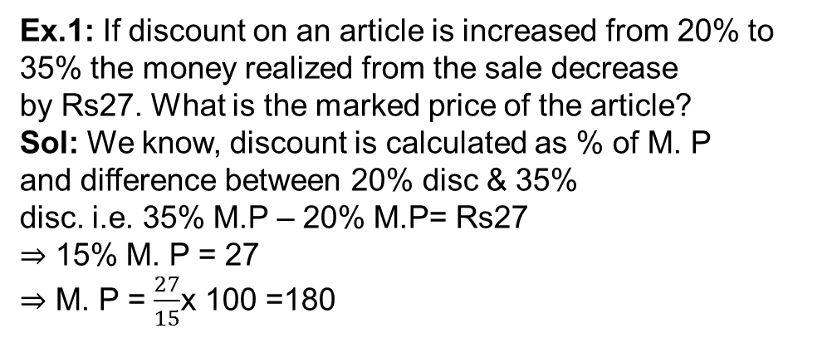
MARKED PRICE/LIST PRICE & DISCOUNT
Discount % =$\frac{Discount}{Marked Price}x100$ ⋅
If no discount is given, then M.P = S.P. But if discount is given, then M.P is considered as base value (i.e. 100%).
Ex.1: If discount on an article is increased from 20% to
35% the money realized from the sale decrease
by Rs27. What is the marked price of the article?
Sol: We know, discount is calculated as % of M. P
and difference between 20% disc & 35%
disc. i.e. 35% M.P – 20% M.P= Rs27
⇒ 15% M. P = 27
⇒ M. P = $\frac{27}{15}$x 100 =180
Ex.2. If the cost of a ball pen reduces by 20%, Raj can buy 90 more ball pens for Rs3600. Find the cost of a ball pen.
Sol: Let the cost price be Rs c. Then the number of pens purchased will be 3600/c
We have 3600 = .8c x (3600/c + 90)
Solving gives c = Rs10

Slide 16
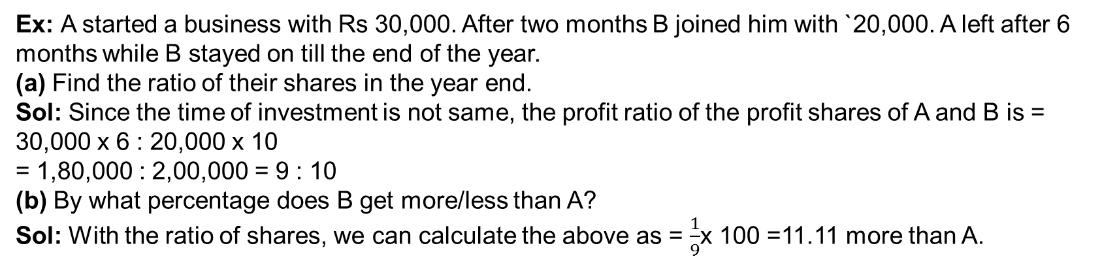
PARTNERSHIP
When two or more persons jointly do a business by investing some amount , then such a business model is termed as partnership business the profits at the end of the year are shared according to the following rules.
• If the time period for which all the persons invested is the same then the profit is divided in the
ratio of investments.
• If the time period is not the same then the profit is divided in the ratio of their product of time and
Investment.
• If one of the investors involves in day-to-day activities of the business, then he is called
working partner, and not sleeping partner
Ex: A started a business with Rs 30,000. After two months B joined him with `20,000. A left after 6
months while B stayed on till the end of the year.
(a) Find the ratio of their shares in the year end.
Sol: Since the time of investment is not same, the profit ratio of the profit shares of A and B is =
30,000 x 6 : 20,000 x 10
= 1,80,000 : 2,00,000 = 9 : 10
(b) By what percentage does B get more/less than A?
Sol: With the ratio of shares, we can calculate the above as = $\frac{1}{9}$x 100 =11.11 more than A.

