Slide 1
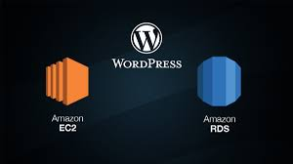
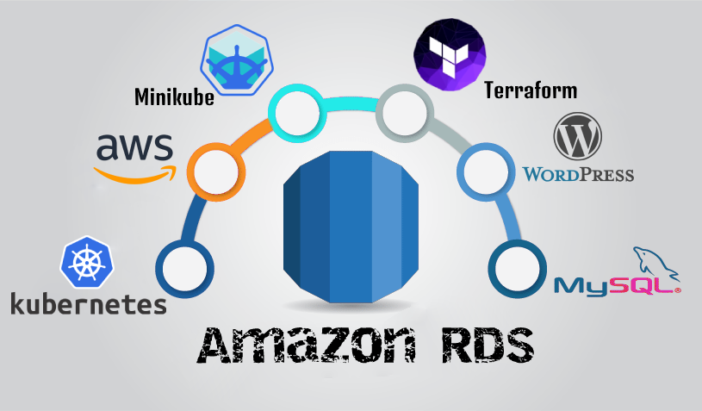
By-
Ujjwal dixit

Slide 2
Task-6
Deploy the Wordpress application on Kubernetes and AWS using terraform including the following steps;
1. Write an Infrastructure as code using terraform, which automatically deploy the Wordpress application
2. On AWS, use RDS service for the relational database for Wordpress application.
3. Deploy the Wordpress as a container either on top of Minikube or EKS or Fargate service on AWS
4. The Wordpress application should be accessible from the public world if deployed on AWS or through workstation if deployed on Minikube.
Try each step first manually and write Terraform code for the same to have a proper understanding of workflow of task.

Slide 3
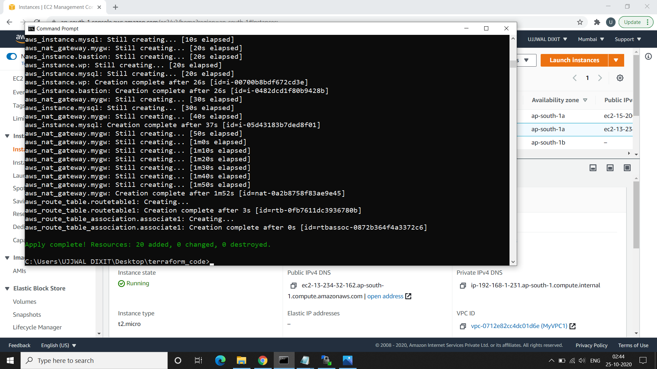
CODE Reference : https://github.com/ujjwal61/hybridcloud-task6.git
Output for the task:
1st – “terraform apply” – it will execute and resources will be added

Slide 4
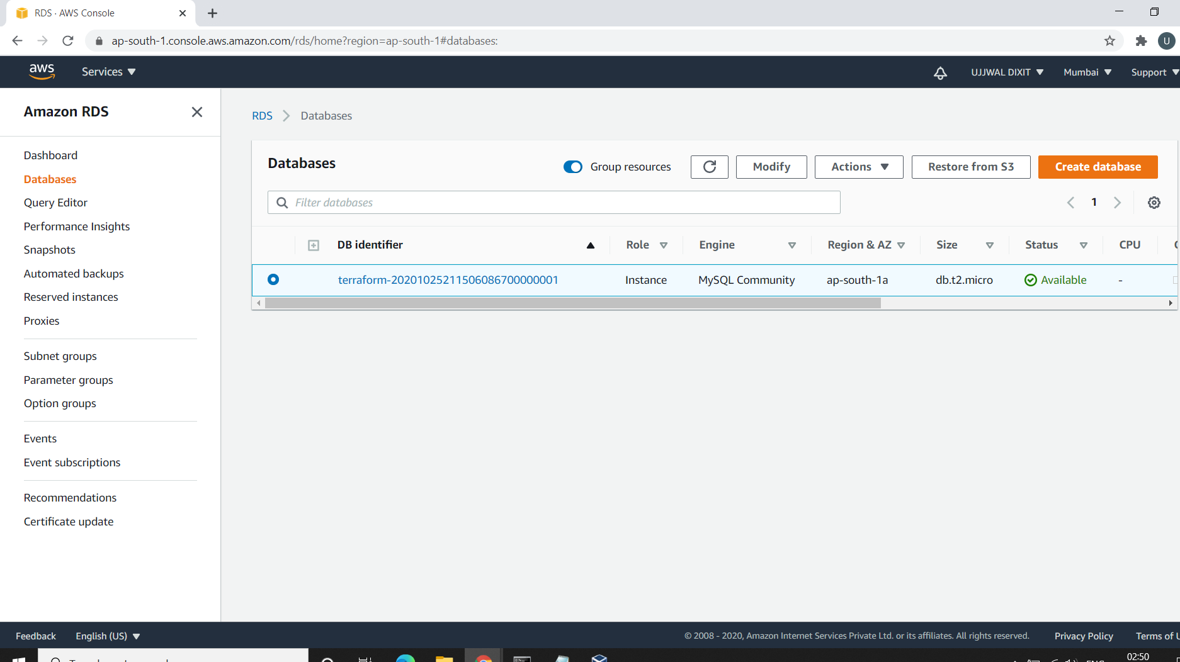
2nd- Create RDS on top of AWS
Mysql database is creates in RDS

Slide 5
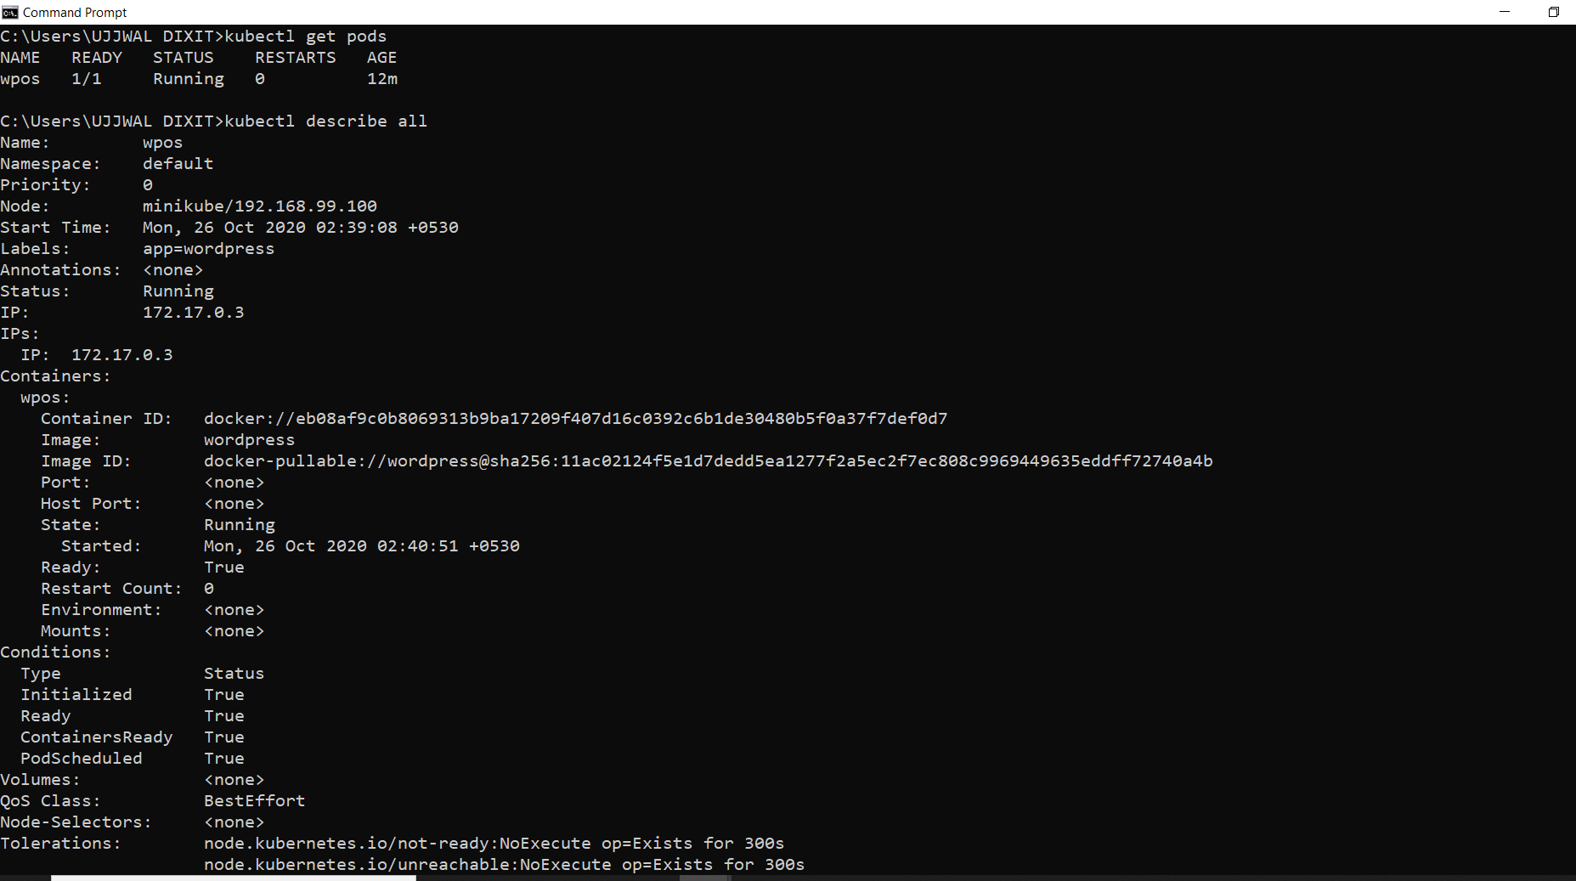
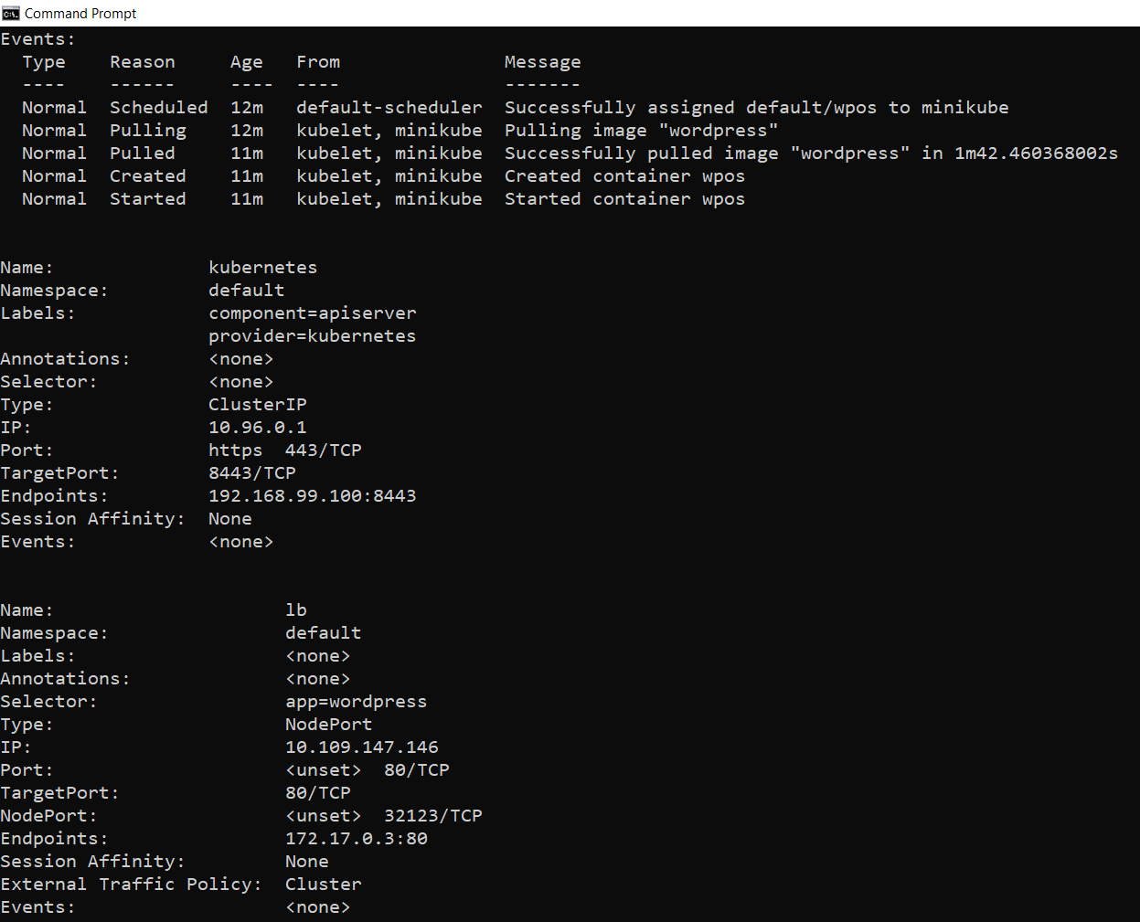
3rd-kubectl describe all

Slide 6
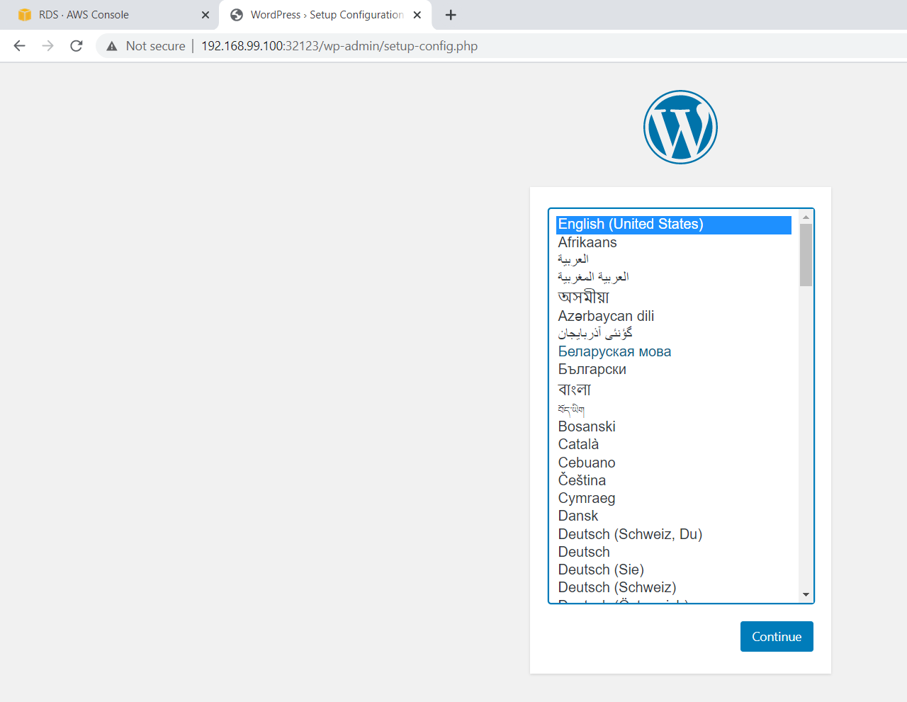
4th- Wordpress is launched

Slide 7
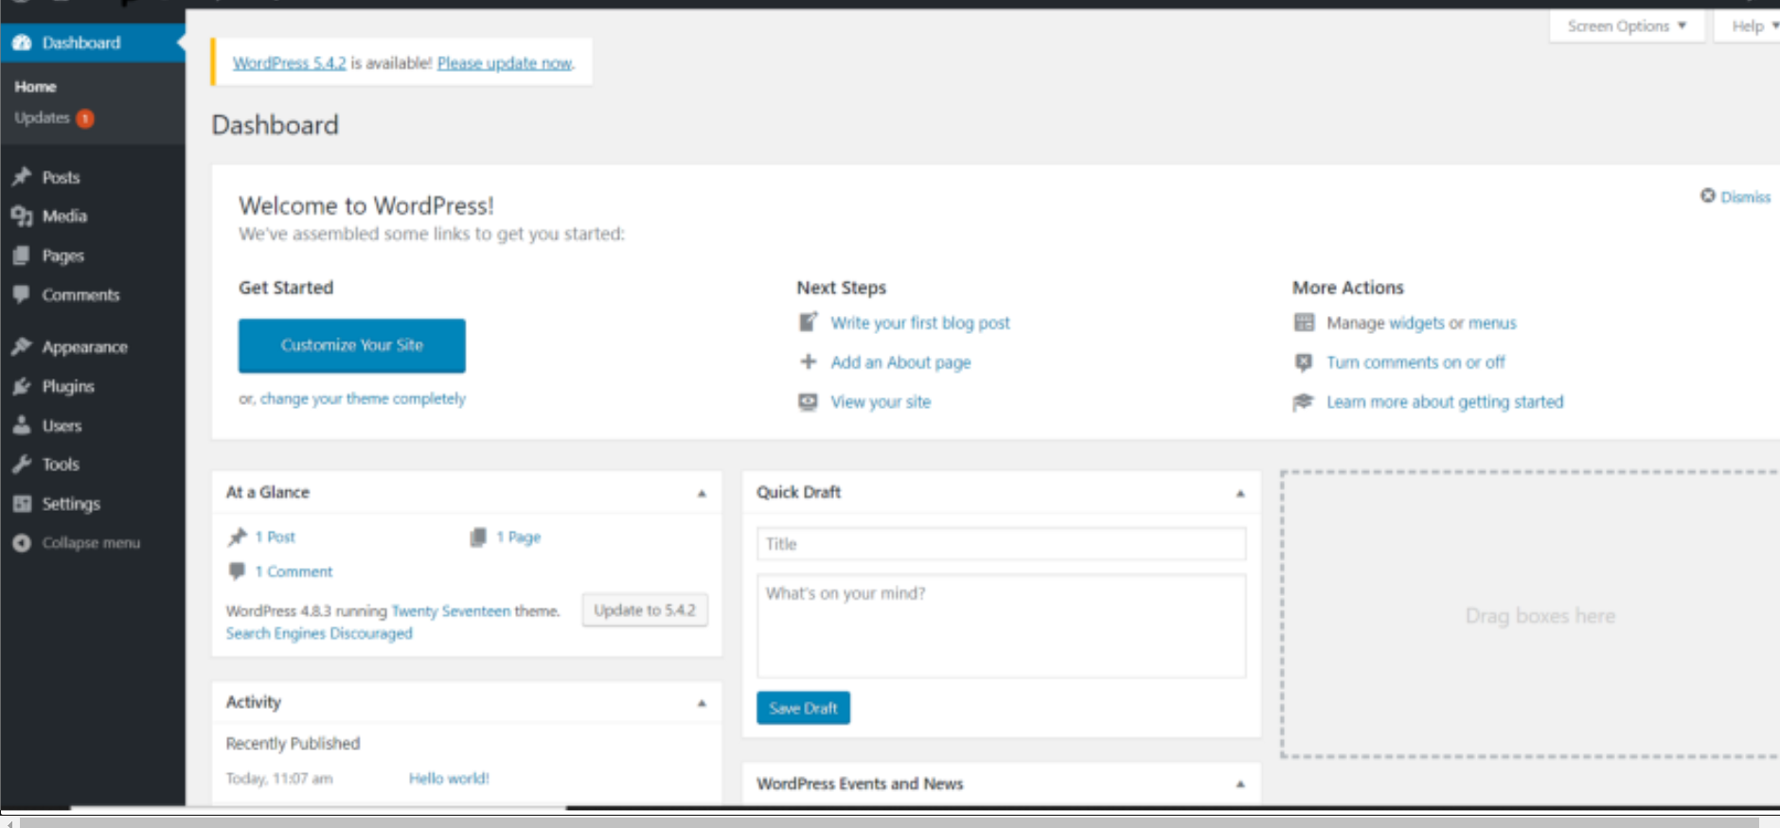
Final output

Slide 8
Thank You☺

