Slide 1
TARGETING THE RIGHT CUSTOMERS FOR EFFECTIVE TELE-MARKETING USING CLASSIFICATION ALGORITHMS TO INCREASE REVENUE
Mentor :
Ms. Vidhya K.
Team Members:
Mukesh Kumar Thakur
Lalit Sharma
Devesh Pareek
Ujjwal Kumar Sriwastva
Aniket Bhuwalka

Slide 2
PROBLEM DEFINITION
Business Problem
There has been a revenue decline for the Portuguese bank and they would like to know what actions to take. After investigation, they found out that the root cause is that their clients are not depositing as frequently as before. Knowing that term deposits allow banks to hold onto a deposit for a specific amount of time, so banks can invest in higher gain financial products to make a profit. In addition, banks also hold better chance to persuade term deposit clients into buying other products such as funds or insurance to further increase their revenues. As a result, the Portuguese bank would like to identify existing clients that have higher chance to subscribe for a term deposit and focus marketing effort on such clients.
Value additions planned for the Project
Key insights about the Customers
Relationship between various attributes of data
Significant attributes and its inferences contributing to the actual problem
Explain the final model in client specific manner.

Slide 3
DATA FINDINGS AND IMPLICATIONS
Suggested Solution:
For this problem, the customers who will subscribe for a term deposit needs to be picked out and targeted in order to focus on those customers to increase the bank’s revenue.
To resolve the problem, we used Machine Learning Classification algorithms to predict which clients are more likely to subscribe for term deposits.
Data set Considered:
Bank Marketing Data - https://datahub.io/machine-learning/bank-marketing
Data Pre-processing:
Shape of Data:
Rows:- 45211
Columns:-17
Data Description:
Data set columns are shown divided into numerical and categorical columns. Our Target Variable is Categorical with Binary Class.
Numerical Columns:
age
balance_amount
last_contact_day
duration
campaign
passed_days
previous_contact

Slide 4
DATA FINDINGS AND IMPLICATIONS
Categorical Columns:
job
nuptial
education
defaulter_presence
house_loan
personal_loan
contact_via
last_contact_month
poutcome
'y’ (Target Variable)
Null Values Detection:
Primarily , we didn’t encounter any null values. But, after some data understanding we noticed that there are some unknown values present in columns like Job, Education, Contact_via, poutcome.
Unknown Values Treatment:
As we have unknown values in the education and job columns, based on each category the unknown values have been imputed.
“Contact_via” column has unknown values and those unknown values are imputed with mode.

Slide 5
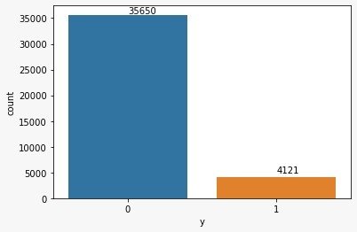
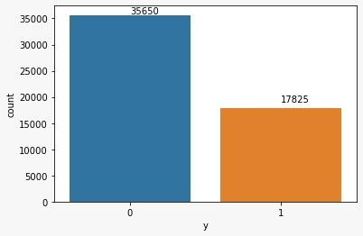
DATA FINDINGS AND IMPLICATIONS
Removing Insignificant Features:
“Poutcome” column has unknown values more than 80% we had removed that column.
Outliers Detection:
Extreme Outliers where found in the region of whisker level 3 in the features such as previous_contact, balance_amount,
campaign, duration.
These Outliers have to be treated . Here, we used IQR method for the outlier treatment.
Imbalanced Data:
The Target class variable of the dataset is heavily imbalanced. This is the cause for poor performance with
traditional machine learning models and evaluation metrics that assume a balanced class distribution.
We used SMOTE – Oversampling Technique with sampling strategy 0.5 to overcome this issue.
Before: 85:15
After: 66:34

Slide 6
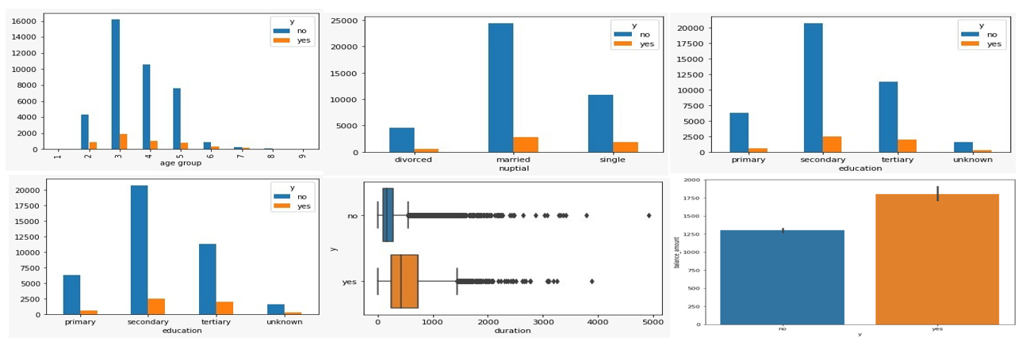
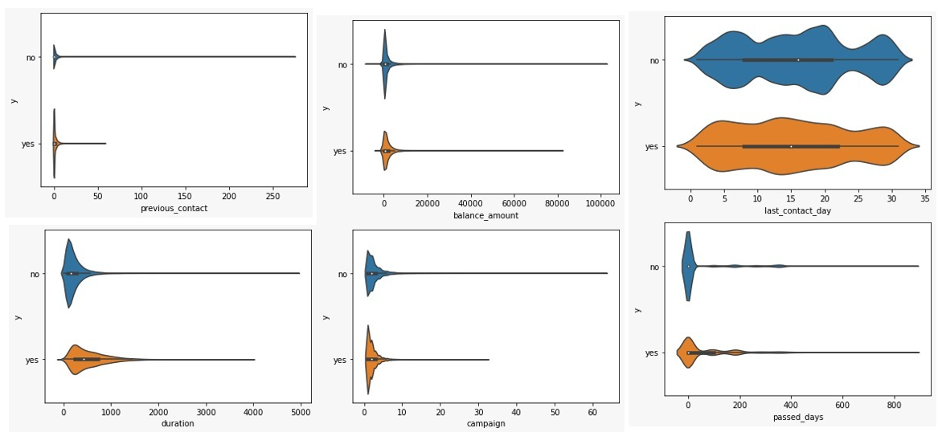
EXPLORATORY DATA ANALYSIS
Categorical Features with Target Column:
From this Categorical columns plotted with Target column, we can observe that the ‘1’ (i.e.) ‘yes’ count is very less.
This states about the imbalance in the data
Numerical Features with Target Column:
From this Numerical columns plotted with Target column , we can observe the distribution of each variable with respect to each class of the target column.
From this plot, we can state that ‘previous_contact’, ‘last_contact_day’,’passed_days’, ’campaign’, ’duration’ and ‘balance_amount’ columns are heavily skewed on the positive side.

Slide 7
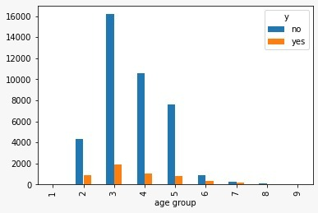
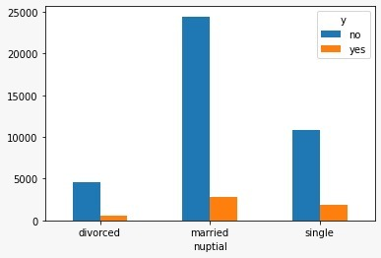
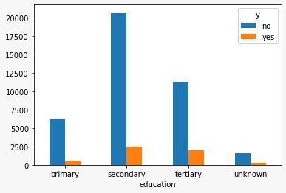
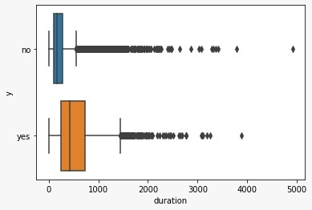
EXPLORATORY DATA ANALYSIS
Inferences:- Nuptial Customers are more likely to subscribe the term deposit, they saves money for their children education, marriage etc, it is a long term investment.
Inferences:- Customers in age group 3 are more likely to subscribe the term deposit. Because They age range from 31-40, who can be professional with high paying jobs and this possible are high because of their experience.
Inferences:- Customers with ‘’Secondary’’ & ‘’Tertiary’’ educations are more likely to subscribe the term deposit, its is mainly due to they have clarity about financial education and knows the value of long term investment.
Inferences:- Customers with high call durations are more likely to subscribe the term deposit, from the call duration we can understand they are interested to know about the plans

Slide 8
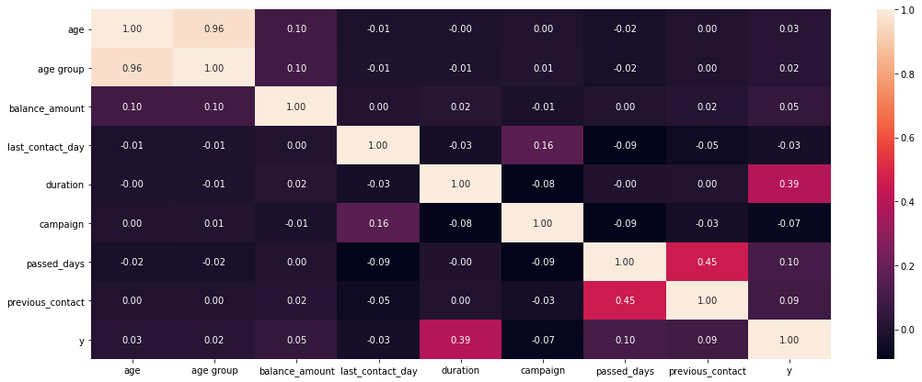
EXPLORATORY DATA ANALYSIS
Inferences:
Age & Age group are related with each other (corr= 0.96) – High Multicollinearity
Passed_days & Previous_contact are related with each other (corr= 0.45)
Duration has positive relation with y(target) (corr=0.39)

Slide 9
FEATURE EVALUATION
Feature Engineering:
Using feature engineering We have converted “Age” Column to “Age_group”
We grouped the values of “Passed_days” column in 4 groups.
Statistical Test for Significance:
The Chi-square test of independence was used to determine whether the independent categorical variables are related to target or not.
INFERENCE: (Pval ≥0.05, Fail to reject H0 ), All columns are significant & have relation with target
Note: Significance value of 0.05 is considered for Statistical testing.
Multicollinearity Check:
To check whether multi-collinearity is present or not we have used VIF and we have found that all the columns are significant features except “age” column (>5 VIF).
Encoding:
We used Label encoding for the models.
Splitting and Scaling:
Train test split has been done with the test size of 30%.
In many machine learning algorithms, to bring all features in the same standing, we need to do scaling so that one significant number doesn’t impact the model just because of their large magnitude.We have done Standard scaler for the data.

Slide 10
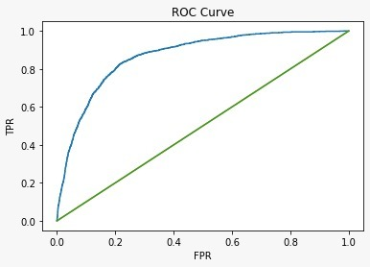
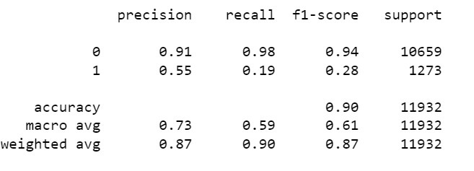
ALGORITHM USED
Logistic Regression Without ‘SMOTE’:-
Inferences:-
ROC Curve is showing that ROC AUC score is closer to 1 with suggest model is good.
The ROC AUC Score is equals to 0.86.

Slide 11
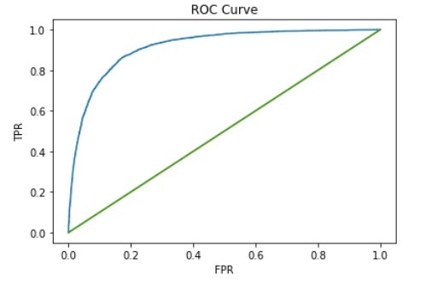
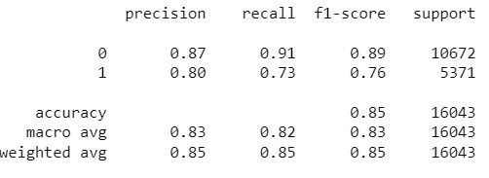
Logistic Regression With ‘SMOTE’ :-
Inferences:-
ROC Curve is showing that ROC AUC score is closer to 1 with suggest model is good.
The ROC AUC Score is equals to 0.91.

Slide 12
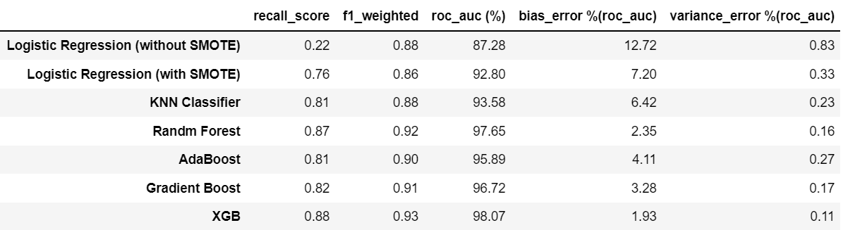
NON_PARAMETRIC MODEL EVALUATIONS
Train and Test scores for all the models considered:-

Slide 13
LOGISTIC REGRESSION MODEL
Model Interpretations:
1) We observed that the McFadden R square (Pseudo R square) is 0.45 and the model fitness is good (Suggested 0~1).
This McFadden approach is one minus the ratio of two log likelihoods. The numerator is the log likelihood of the
logit model selected and the denominator is the log likelihood if the model with just had an intercept (Null model).
2) The LLR p-value is less than 0.05, implies that the model is significant..
Model Explanation:
As Balance increases by 100 Euros, the odds of Customer subscribes the product increases by 19%.
As Duration increases by 100 Seconds, the odds of Customer subscribes the product increases by 134%.
As Campaign calls increases by 1 unit, the odds of Customer subscribes the product decreases by 28%.
As Previous_contact calls increases by 1 unit, the odds of Customer subscribes the product decreases by 28%.

Slide 14
RECOMMENDATIONS
Recommendations:
Based on the key influencers from Logit model, following recommendations are suggested to enhance our Business motive “Identifying the right Customers and Increase the odds of subscribing our Term Deposit”.
As Balance increases by 100 Euros, the odds of Customer subscribes the product increases by 19%. We can track stable Customers who maintains good Balance, target them with Loans and other products.
As Duration increases by 100 Seconds, the odds of Customer subscribes the product increases by 134%. We can hire employees with good communication & marketing skills and maintain maximum call duration with Customers.
As Campaign calls increases by 1 unit, the odds of Customer subscribes the product decreases by 28%. We can very well infer that, as no of calls increases per Customer, they might not want to subscribe to our product. Target is to make one call per with more efficiency.
As Previous_contact calls increases by 1 unit, the odds of Customer subscribes the product decreases by 28%. We can very well infer that, as no of calls increases per Customer, they might not want to subscribe to our product. Target is to make one call per with more efficiency.

Slide 15
RECOMMENDATIONS
Recommendations:
Based on the key influencers from XGB model, following recommendations are suggested to enhance our Business motive “Identifying the right Customers and Increase the odds of subscribing our Term Deposit”.
Customers with less “passed_days“ (Frequently contacted from the previous campaign) will definitely know about the latest Term deposit schemes as they are being contacted more frequently.
Minimising the “passed_days“ is essential to make customers subscribe our Term deposit.
Customers who do not prefer any “housing_loans” and “personal_loans” are more likely to subscribe our Term deposit.
Customers with more “previous_contact” (No of contacts performed) will definitely know about the latest Term deposit schemes as they are being contacted more frequently.
Maximising the “previous_contact” is essential to make customers subscribe our Term deposit.

Slide 16
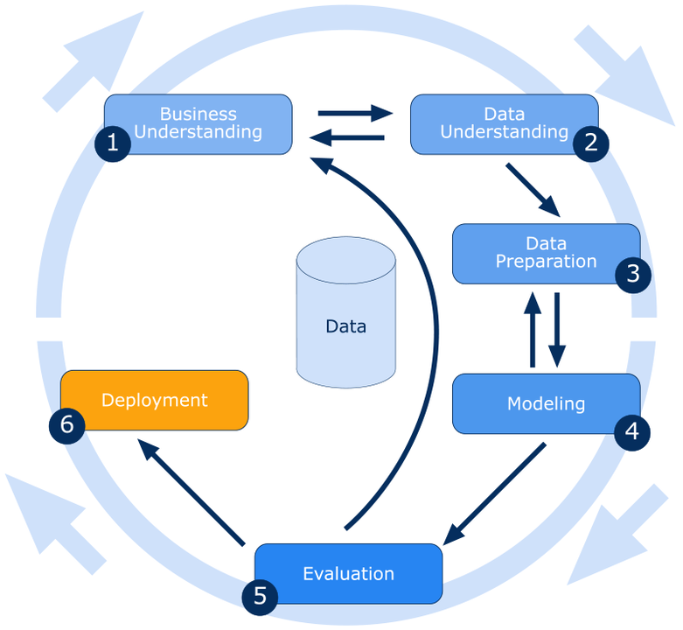
LIMITATIONS OF OUR SOLUTION
We have not implemented Step.6 (Deployment). Thus, the model behaviour in real-time production environment is unknown.
The Final Model(s) was chosen to be Logistic Regression & Extreme Gradient Boosting Model by considering the explain-ability & all the model performance metrics. Our final Model was tuned with only ‘max-depth’.
This final model was not a generalized model but this was business oriented model that is specifically designed to be used for targeting the customers who would subscribe to the term deposit. This Model will not be used for all the market analysis problems.
We have used ‘recall’ as the important metric to determine the model performance which decreases the false negatives in the data specifically to correctly classify the customers who are possible to subscribe the product but were wrongly classified as not possible for subscription.

Slide 17
SCOPE AND CONCLUSION
Future Scope:
Probability of customers who takes the term deposit can be increased by deploying this model and this helps banks to cut costs involved in campaigns by focusing only on the potential customers.
Banks can invest the saved amount in future campaigns, or can give gift vouchers, coupons to those who invest in term deposit, this will helps to attract the customers.
Data of the non potential customers details can be stored for the future applications.
Conclusion:
The best models chosen from the previous section are Logistic Regression & XGBOOST. Hence it can be taken into production where a different set of test data will be used and the classification can be performed with the obtained confidence as told by the model’s metrics.
Hence we can expect our model to classify the customers who are about to take the term deposit with the confidence of 76 & 88%.
From the analysis, it allows the bank to better anticipate and address the potential customers and improving their strategic marketing in future campaigns.

Slide 18
THANK YOU!!!

