Slide 1


PREDICTING DROUGHTS & THEIR INTENSITIES IN CALIFORNIA
Bansari K. Shah, Shikha C. Patel, Ujjwal, Nicholas Ogbonna
Under the guidance of Dr. Huthaifa Ashqar
DATA 601 – Intro to Data Science
University of Maryland, Baltimore County

Slide 2




Team Members
Bansari K. Shah
ZH92730
Shikha C. Patel
JF14891
02
Ujjwal
PF10610
Nicholas Ogbonna
OT32817

Slide 3







Droughts
General Definition
Creeping Phenomenon
No single definition
Deficiency of precipitation water shortage
Slowly impacts economy Operates on different timescales
Difficult to define 150 published definitions in 1980s
03

Slide 4

Drought Classification
Based on both physical and socioeconomic factors:
METEOROLOGICAL DROUGHT
AGRICULTURAL DROUGHT
HYDROLOGICAL DROUGHT
SOCIOECONOMIC DROUGHT
precipitation deficit over a prolonged period of time
When dry weather patterns dominate an area
deficit in soil moisture
affects plant production and crop yield
04
deficit of surface runoff, streamflow, reservoir, or groundwater level
When the supply and demand of various commodities is affected by drought

Slide 5
Drought Classification
CLIMATE VARIABILITY
METEOROLOGICAL DROUGHT
Precipitation Deficit
High Temperature
Reduced Runoff, infiltration
Increased Evaporation
AGRICULTURAL DROUGHT
Reduced Soil Moisture
Human Activity
HYDROLOGICAL DROUGHT
Reduced Streamflow
SOCIOECONOMIC DROUGHT
Plant Stress
Social Impacts
Economic Impacts
05

Slide 6

Meteorological Droughts in California
Highest Agricultural Contribution : 12 % approx.
$50 billion in cash receipts in 2019
20-year average : 59.54% during the winter and 63.40% in the fall
06
D0 - Abnormally Dry : 100.0 % of CA
D1 - Moderate Drought : 97.5 % of CA
D2 - Severe Drought : 92.9 % of CA
D3 - Extreme Drought : 73.3 % of CA
D4 - Exceptional Drought : 5.4 % of CA
California

Slide 7
Problem Statement
What has been the trend of drought intensities in various California counties from 2014-2020?
How strong is the correlation present between droughts and meteorological data?
How effectively can drought be predicted using meteorological indicators?
Which of these indicators are significant in drought predictions?
07

Slide 8
Dataset
NASA Earth Science/Applied Science Program
NASA Langley Research Center (LaRC) POWER Project
Kaggle
SOURCE
FEATURES
PRECTOT
PS
QV2M
TS
WS50M
WS50M_MIN
WS50M_MAX
WS50M_RANGE
WS10M
WS10M_MIN
WS10M_MAX
WS10M_RANGE
T2M
T2M_MIN
T2M_MAX
T2M_RANGE
T2MDEW
T2MWET
08
LABELS
1 - Abnormally Dry ( D0 )
2 - Moderate Drought ( D1)
3 – Severe Drought ( D2 )
4 - Extreme Drought ( D3)
5 - Exceptional Drought ( D4 )
0 – No Drought

Slide 9
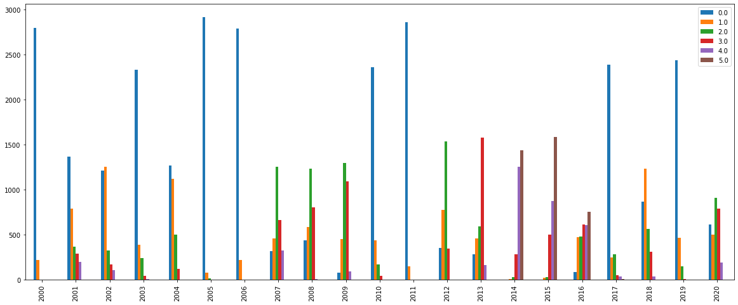
Analysis of Drought trends 2000-2020
Drought Intensity
Frequency
09
Year

Slide 10
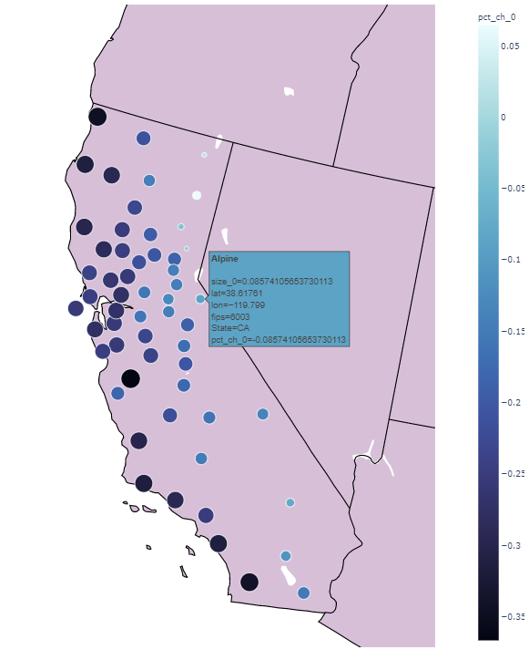
‘No drought’ trend
Out of 58 CA counties:
+ve change : 3 Counties
-ve change : 55 Counties
2000-2013
&
2014-2020
10
Out of 58 CA counties:
+ve change : 57 Counties
-ve change : 1 Counties
2007-2013
&
2014-2020

Slide 11
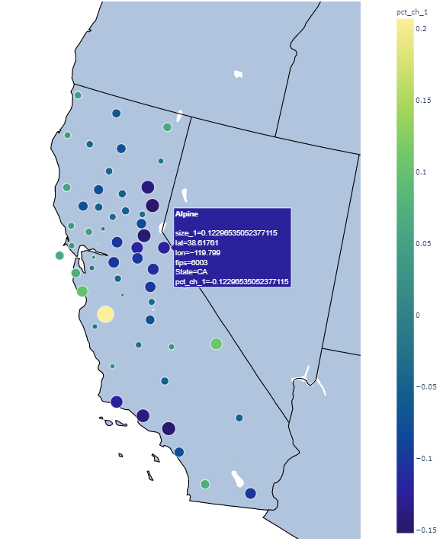
‘Drought intensity 1’ trend
Out of 58 CA counties:
+ve change : 16 Counties
-ve change : 42 Counties
2000-2013
&
2014-2020
11
Out of 58 CA counties:
+ve change : 48 Counties
-ve change : 10 Counties
2007-2013
&
2014-2020

Slide 12
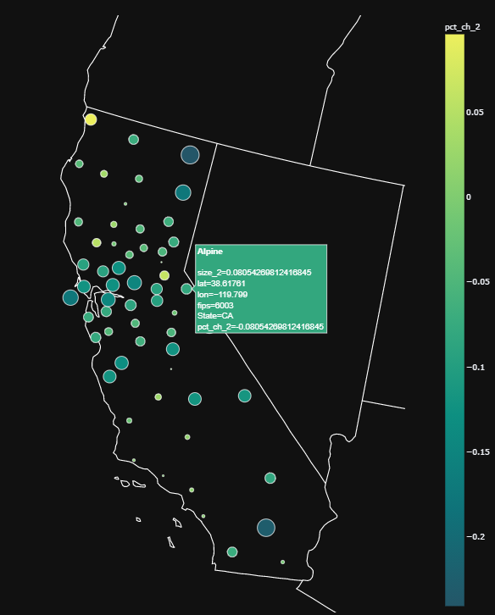
‘Drought intensity 2’ trend
Out of 58 CA counties:
+ve change : 10 Counties
-ve change : 48 Counties
2000-2013
&
2014-2020
12
Out of 58 CA counties:
+ve change : 19 Counties
-ve change : 39 Counties
2007-2013
&
2014-2020

Slide 13
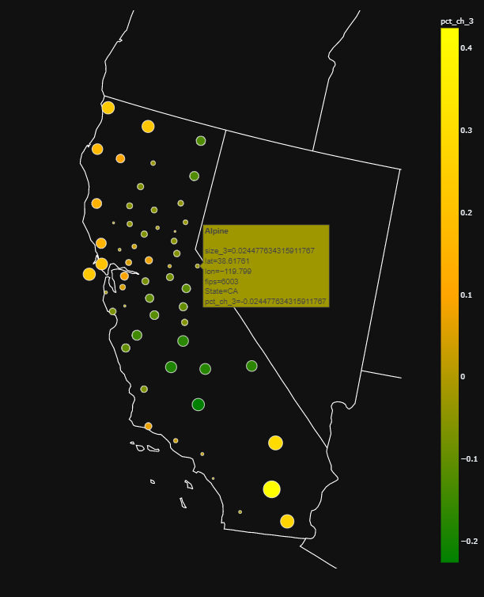
‘Drought intensity 3’ trend
Out of 58 CA counties:
+ve change : 22 Counties
-ve change : 36 Counties
2000-2013
&
2014-2020
13
Out of 58 CA counties:
+ve change : 25 Counties
-ve change : 33 Counties
2007-2013
&
2014-2020

Slide 14
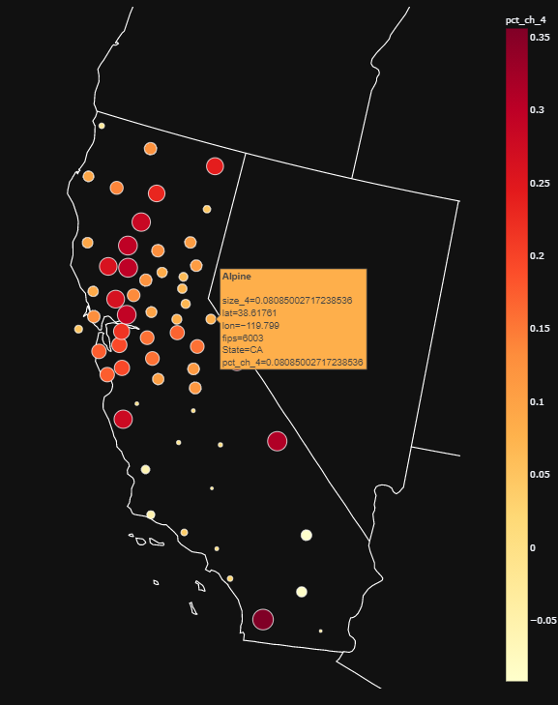
‘Drought intensity 4’ trend
Out of 58 CA counties:
+ve change : 50 Counties
-ve change : 8 Counties
2000-2013
&
2014-2020
14
Out of 58 CA counties:
+ve change : 52 Counties
-ve change : 6 Counties
2007-2013
&
2014-2020

Slide 15
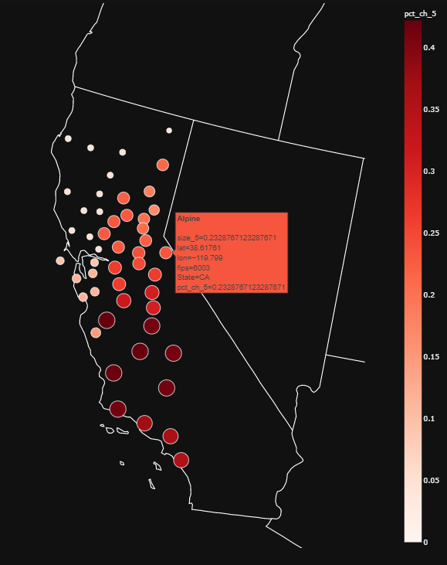
‘Drought intensity 5’ trend
Out of 58 CA counties:
+ve change : 58 Counties
-ve change : 0 Counties
2000-2013
&
2014-2020
15
Out of 58 CA counties:
+ve change : 58 Counties
-ve change : 0 Counties
2007-2013
&
2014-2020

Slide 16
Methodology
Initial Dataset
Drought
Or
Not
Intensity
Of
Drought
RandomForest
18 meteorological
Features
Daily recorded
1 Drought intensity
Label
Weekly recorded
Different
RandomForest
models
Data Normalization
90 days aggregated dataset
Data Split
16
One
Vs
Rest
VotingEnsemble
(Soft)
Summary Statistics
Correlations
SVM, LogisticRegression,
KNN, XGBoost, RandomForest
Result Analysis
Remove
Highly Collinear
Features
Remove Similar
Features
Data Filtering
Model Selection
Ensemble

Slide 17
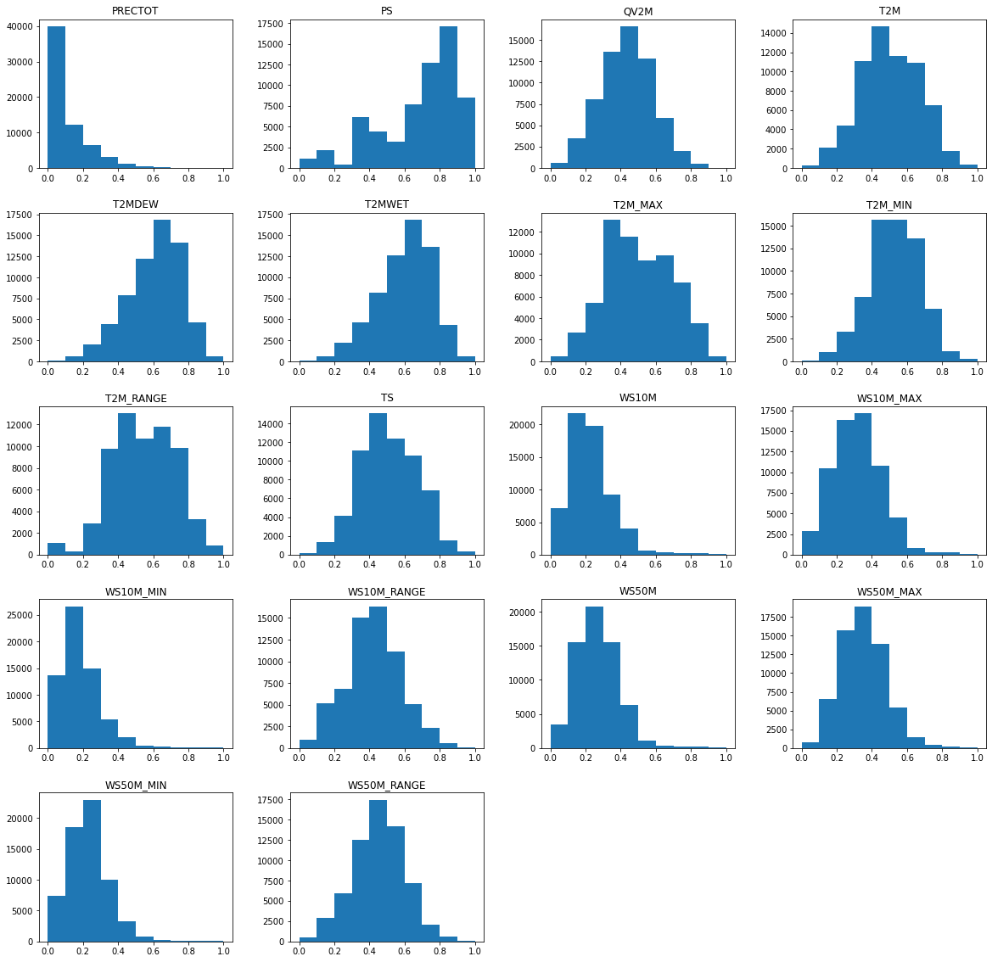
Distribution Graphs: Features & Labels
17

Slide 18
Distribution Graphs: Features & Labels
18

Slide 19
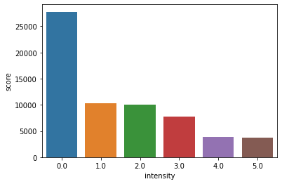
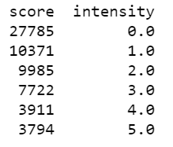
Distribution Graphs: Features & Labels
Frequency Intensity
Frequency
19

Slide 20
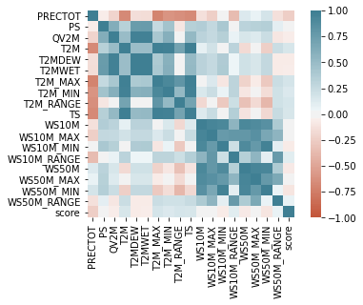
Correlations
20

Slide 21
RESULTS
21

Slide 22
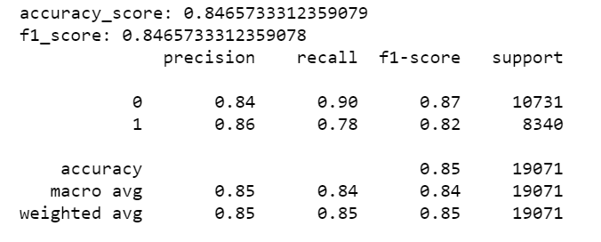
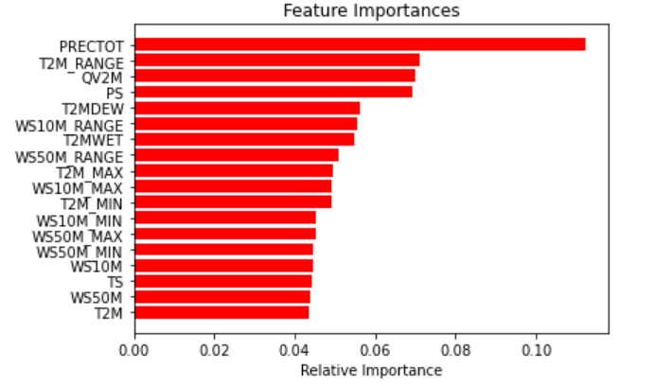
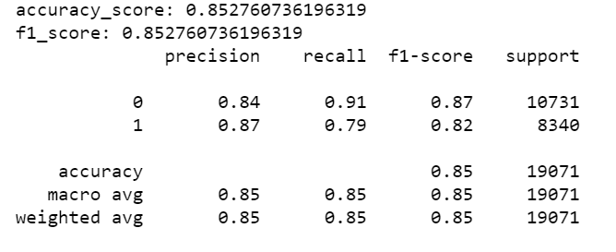
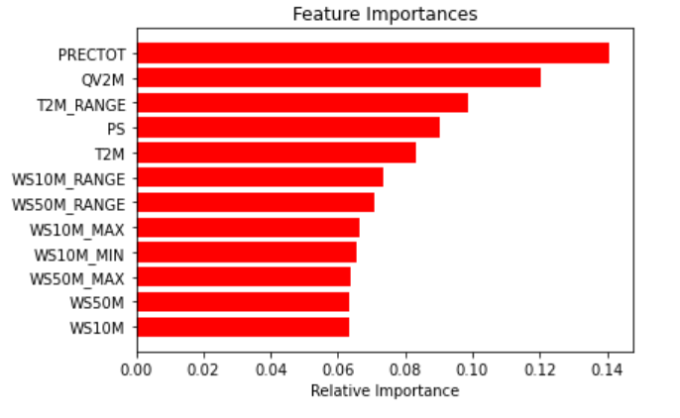
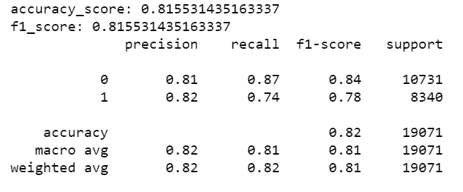
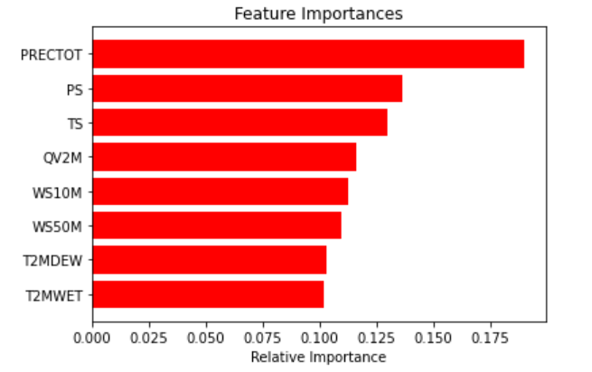
Drought Or Not Prediction
Without Removing Any Features
22
After Removing Highly Collinear Features
After Removing Similar Features

Slide 23
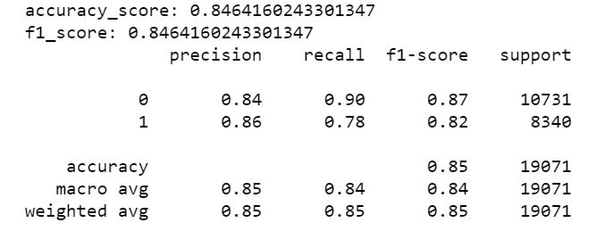
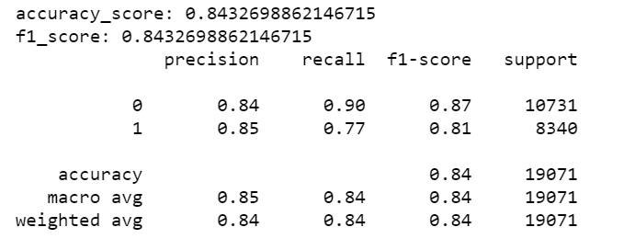
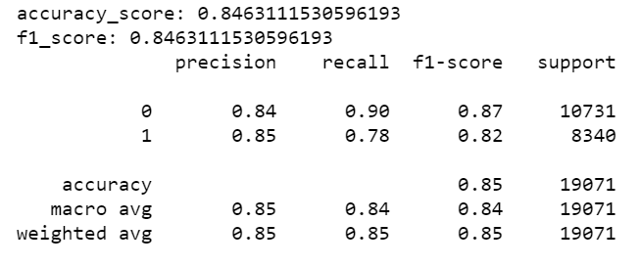
Drought Or Not Prediction
RandomForest 1
RandomForest 2
23
VotingEnsemble (Soft) of RandomForest1, RandomForest2 and RandomForest3.
RandomForest 3

Slide 24
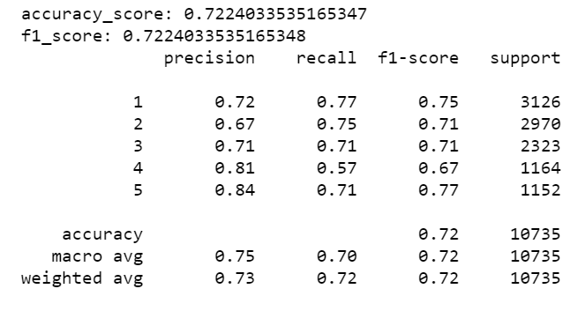
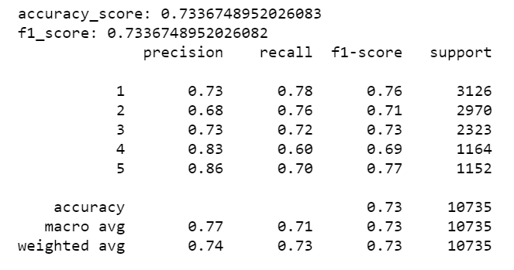
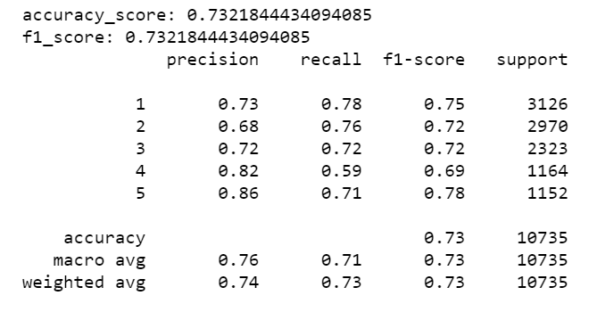
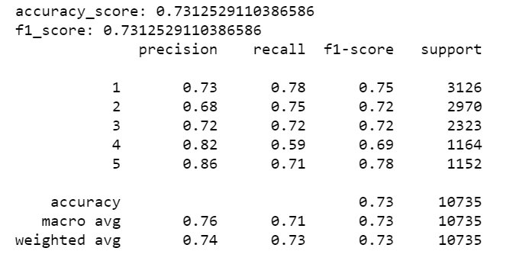
Drought Intensity Prediction
RandomForest 1
RandomForest 2
24
VotingEnsemble (Soft) of RandomForest1, RandomForest2 and RandomForest3.
RandomForest 3

Slide 25
Conclusions
Drought is persistent
Meteorological data is useful for predicting droughts
Precipitation (PRECTOT), Surface Pressure (PS) and Earth Skin Temperature (TS) are the most significant
25

Slide 26
Future Scope of Work
Days aggregation can be varied
Location data can be used
Time series trends can be incorporated
Scope can be expanded to analyse all US states
26

Slide 27
THANK YOU
Do you have any questions?

