Slide 1
How Helpful Meteorological Indicators Are In Predicting Drought Intensity?
BANSARI K. SHAH, FNU UJJWAL, NICHOLAS OGBONNA, SHIKHA C. PATEL, TRACEY LOOS
UNDER THE GUIDANCE OF DR. HUTHAIFA ASHQAR
UNIVERSITY OF MARYLAND
BALTIMORE COUNTY
DATA 601 – INTRODUCTION TO DATA SCIENCE

Slide 2
PROBLEM STATEMENT
What has been the trend of drought intensities in various CA counties from 2014-2020?
How has the meteorological indicators varied during this time?
How strong is the correlation present between droughts and meteorological data?
How effectively can drought be predicted using meteorological indicators?
Which of these indicators are significant in drought predictions?

Slide 3
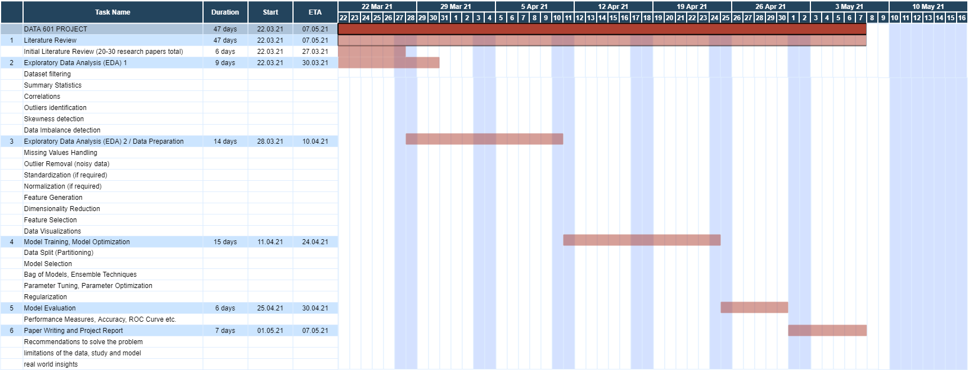
TASKS UPDATE
In process
Almost complete
Yet to be started

Slide 4
PROBLEM STATEMENT
What has been the trend of drought intensities in various CA counties from 2014-2020?
How has the meteorological indicators varied during this time?
Visualizations
Distribution plots of 18 meteorological indicators and drought intensity (PDSI) score [All CA counties together][19 plots]
Distribution plots of 18 meteorological indicators and drought intensity (PDSI) score [Each CA county][19 x 58 plots]
Time series plots of 18 meteorological indicators and drought intensity (PDSI) score [All CA counties together][19 plots]
Time series plots of 18 meteorological indicators and drought intensity (PDSI) score [Each CA county][19 x 58 plots]
Box plots and violin plots of 18 meteorological indicators and drought intensity (PDSI) score [All CA counties together][19 plots]
Box plots and violin plots of 18 meteorological indicators and drought intensity (PDSI) score [Each CA county][19 x 58 plots]

Slide 5
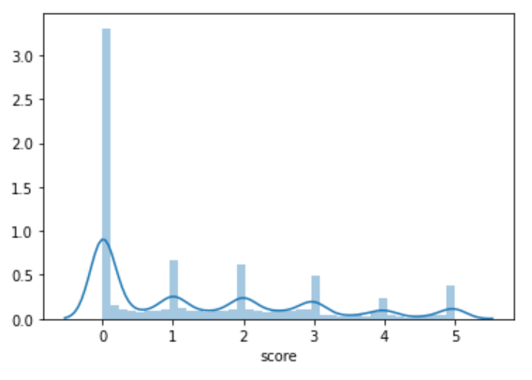
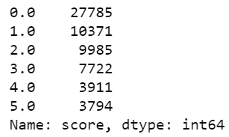
Final datasets : 62872 data rows, 18 meteorological indicators, 1 drought intensity score
58 CA counties data
1084 data rows per CA county
First task : Whether the CA region is drought hit or not
Second task : To predict the intensity of the drought hit region

Slide 6
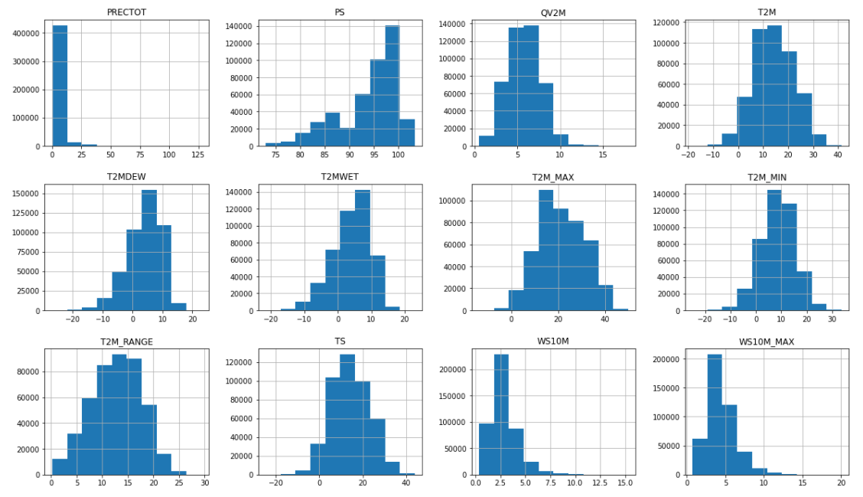

Slide 7
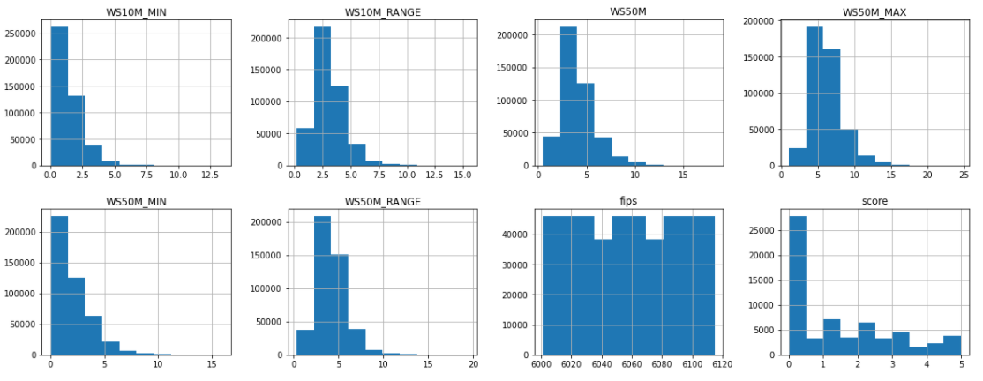

Slide 8
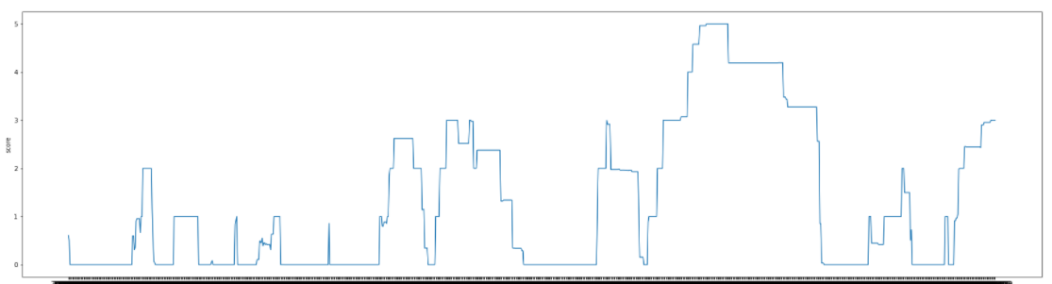

Slide 9
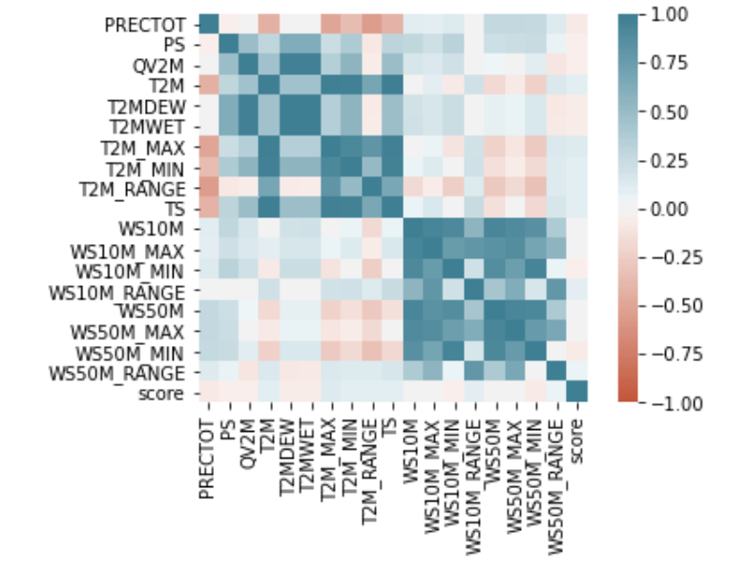
PROBLEM STATEMENT
How strong is the correlation present between droughts and meteorological data?

