Slide 1
DiabeteXpert
DATA MINING
GROUP 22 -
UJJWAL DUBEY
SRESHTA REDDY N
KAVYASREE NANDURU
TEJASVI KARTHIK
LUDDY SCHOOL OF INFORMATICS, COMPUTING, AND ENGINEERING

Slide 2

Problem Statement
Diabetes is a chronic disease that occurs when the blood glucose level becomes high, which ultimately leads to other health problems such as heart diseases, kidney disease, etc.
This is mainly caused due to the consumption of highly processed food, bad consumption habits, etc.
According to WHO, the number of people with diabetes has been increased over the years.

Slide 3
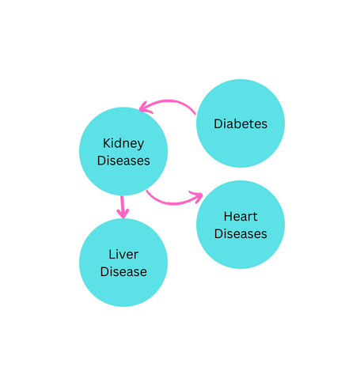
Make the Connection
According to center for disease control and prevention ,
approximately 1 in 3 adults with diabetes have chronic
kidney disease.
When the kidneys don’t work well, more stress is put
on the heart. When someone has CKD, their heart
needs to pump harder to get blood to the kidneys.
This can lead to heart disease, the leading cause of
death in the United States.
According to National Institute of Health -national center for biotechnology information, about 30% of patients with cirrhosis have diabetes.

Slide 4
Solution
DiabeteXpert is used to create a user-friendly web application that predicts the likelihood of an individual developing diabetes based on their medical history, lifestyle choices, and other relevant factors.
While also providing information on the risk of heart, liver, and kidney disorders, the primary focus of the application is to provide personalized diabetes risk assessment and recommendations for prevention and management.
The goal is to empower individuals to take control of their health and reduce their risk of developing diabetes, while also providing valuable insights into other potential health risks.

Slide 5
Dataset Description
To forecast diabetes, heart disease, kidney disease, and liver disease, we have 4 separate datasets.
The desired column names for the datasets are "Outcome," "HeartDisease," "classification," and "Result," accordingly.
These datasets, which contain several thousands of user entries, are particularly important for training machine learning models for prediction, allowing analysis to get insightful knowledge with accurate illness prediction.

Slide 6

Exploratory
Data Analysis and Machine Learning Models

Slide 7
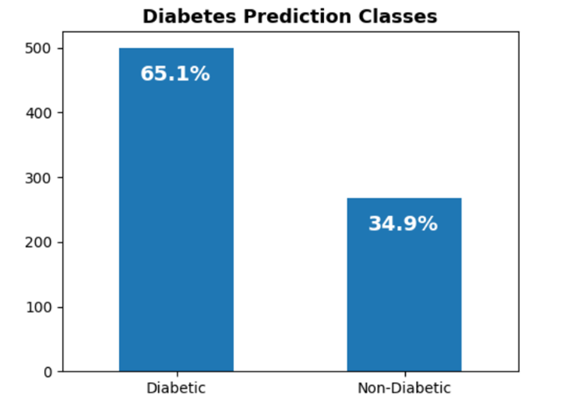
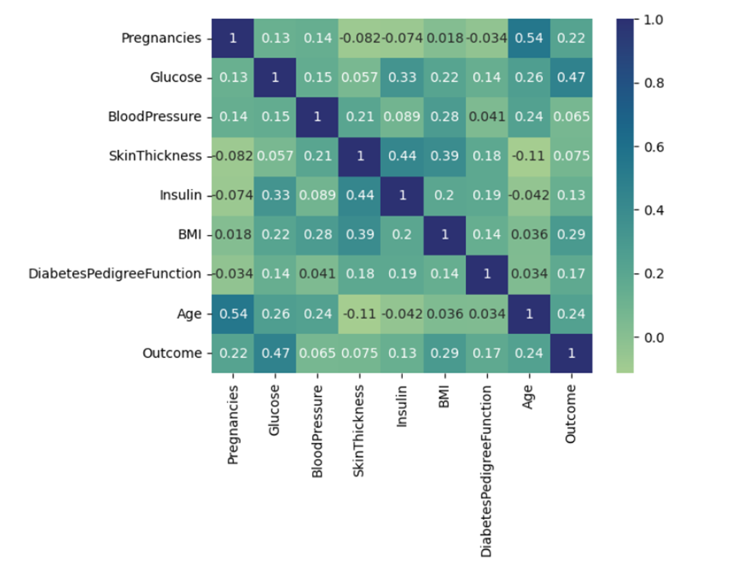
Diabetes Exploratory Data Analysis (EDA)
From the correlation heatmap, we can see that there is a high correlation between Outcome and [Glucose, BMI, Age, Insulin].

Slide 8
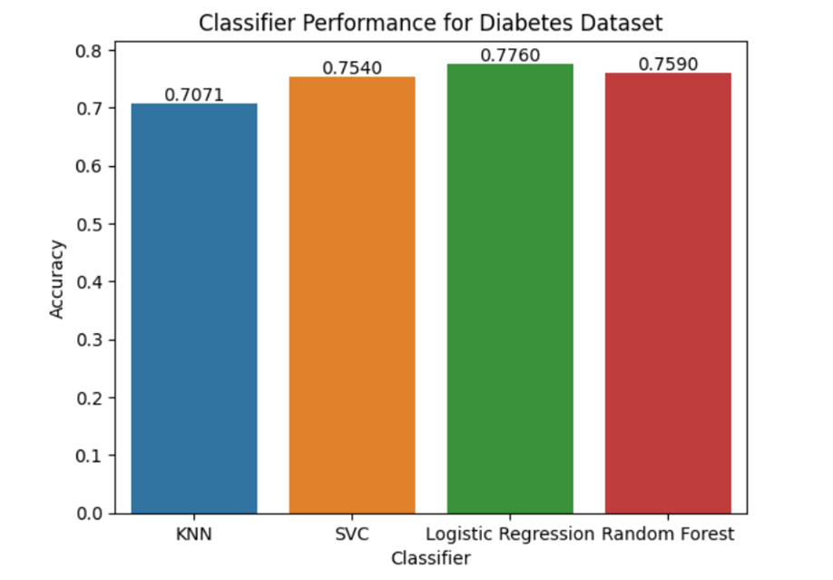
Diabetes Machine Learning Model
Logistic regression is the good choice for diabetes dataset. First, it can be regularized to prevent overfitting, which is important if the dataset is small or has a lot of noise. Second, logistic regression assumes a linear relationship between predictors. Based on the accuracy scores provided, logistic regression has the highest accuracy of 0.7760, making it a good choice for the project. We used L1 (Lasso) and L2(Ridge) penalty functions to improve the model’s generalization performance.

Slide 9
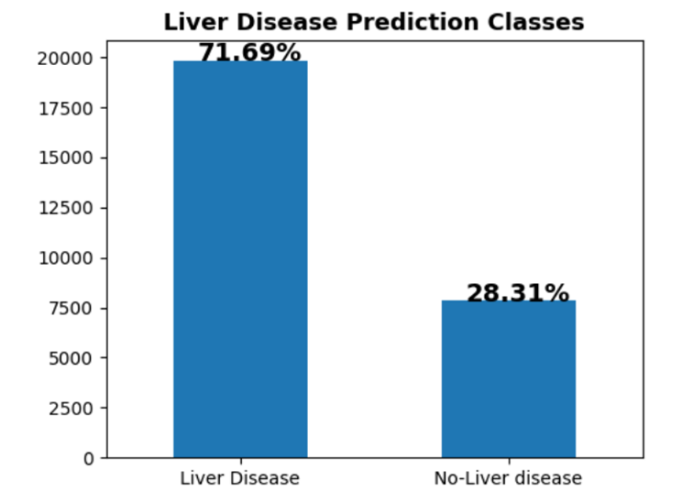
Liver Disease Exploratory Data Analysis (EDA)
Random Forest and Decision Tree were considered for the Liver Dataset because they can handle non-linear relationships between variables effectively, which is common in real-world datasets. They can also capture interactions between features, unlike Logistic Regression, which assumes that the effect of each feature is independent of other features. This makes Random Forest and Decision Tree better choices for complex datasets like Liver Dataset. With Accuracy of 90.01%.

Slide 10
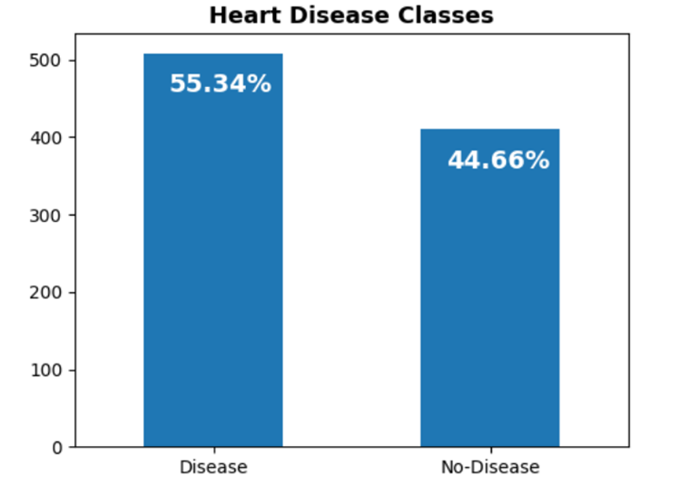
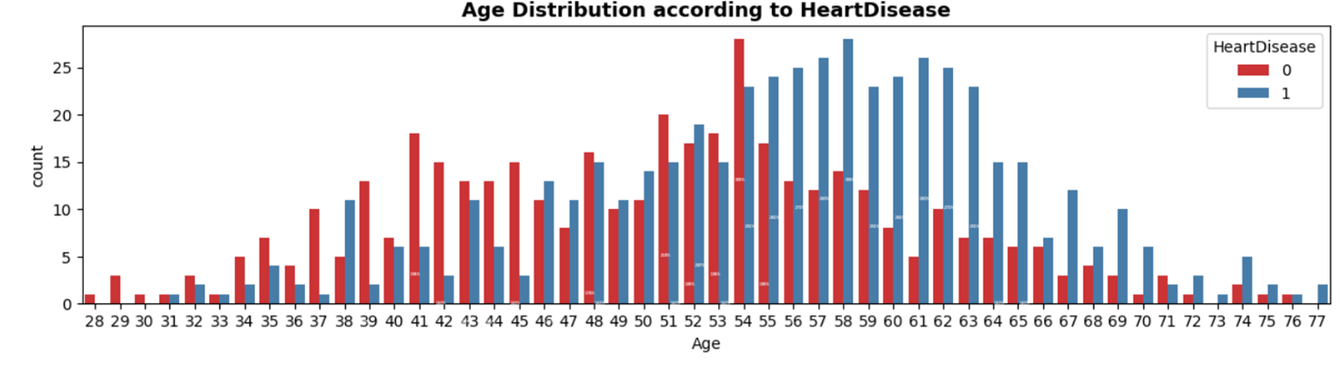
Heart Exploratory Data Analysis (EDA)

Slide 11
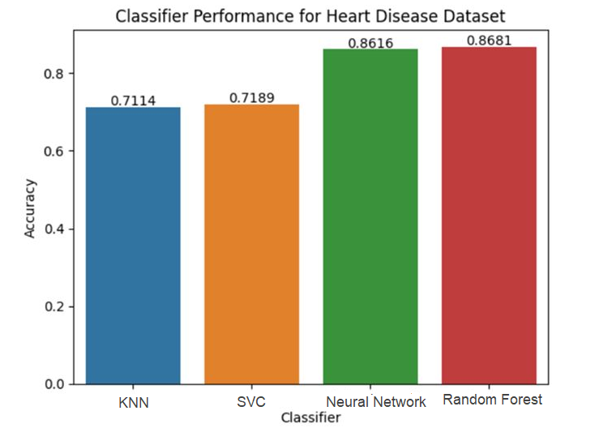
Heart Machine Learning Model
Random Forest is the most accurate model with an accuracy score of 0.8681, making it a good choice since accuracy is important for our project. It can handle complex datasets and avoid overfitting. Random Forest is better suited for complex datasets with nonlinear decision boundaries, while Neural Networks are better for linear decision boundaries. Random Forest also has built-in feature selection, while Neural Networks require manual selection.

Slide 12
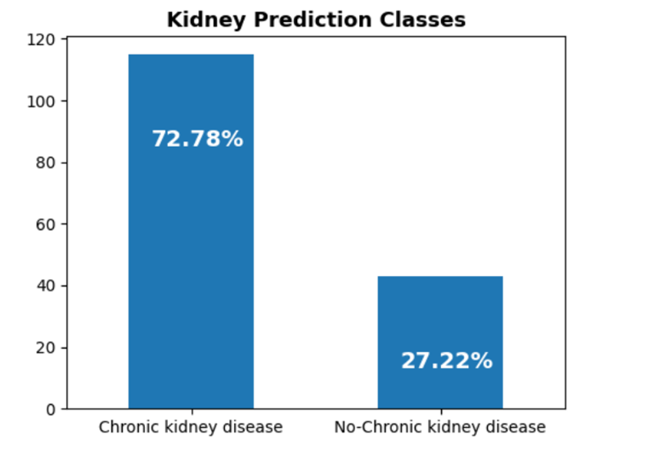
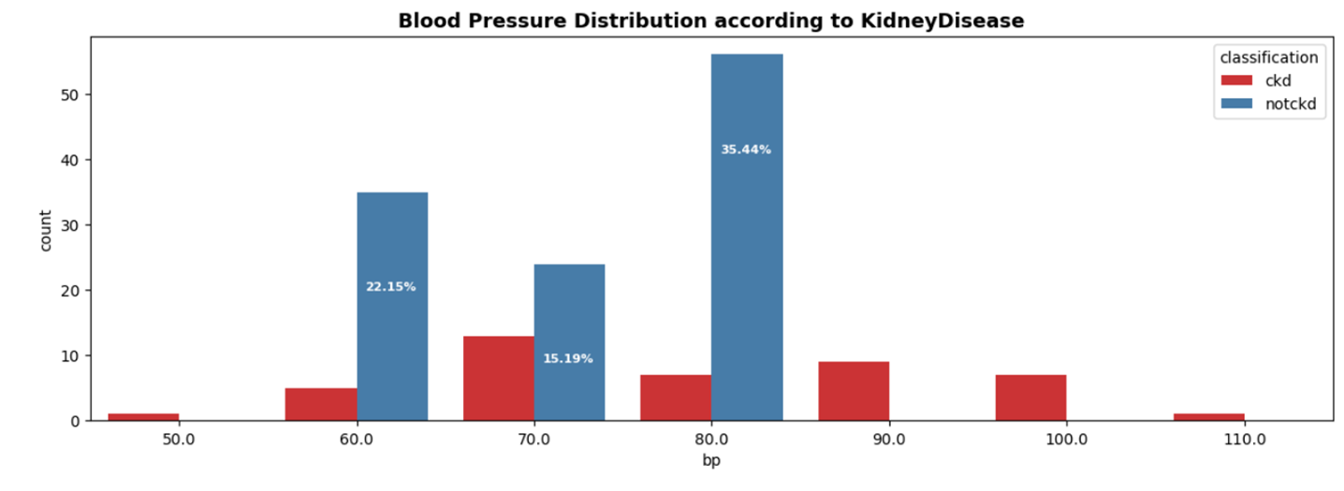
Kidney Disease Exploratory Data Analysis (EDA)
Random Forest gave better results, additionally it was less sensitive for outliers, which overall improved the accuracy of the model with 93%

Slide 13
Kidney Machine Learning Model
Random Forest is better suited for small datasets with fewer features: Neural Networks typically require a large amount of data to train well, and this dataset may not have been large enough for the neural network to generalize well. Random Forest, on the other hand, can work well with small datasets and is less prone to overfitting.
Random Forest is less sensitive to outliers: Random Forest is a collection of decision trees, and the decision at each split is based on a subset of the features. This reduces the impact of outliers on the overall prediction. Neural Networks, on the other hand, are more sensitive to outliers, which can impact the accuracy of the model. It gave an accuracy 93%.

Slide 14
Results

Slide 15


Slide 16
Applications
Physician Assistants
Diabetes Patients
Medical Interns or Trainees

Slide 17

Challenges Faced
Took time to deal with different datasets.
Handling missing values, datasets had categorical values, so had to encode them to numerical values.
Integration of the web application took time and created complex problems.

Slide 18
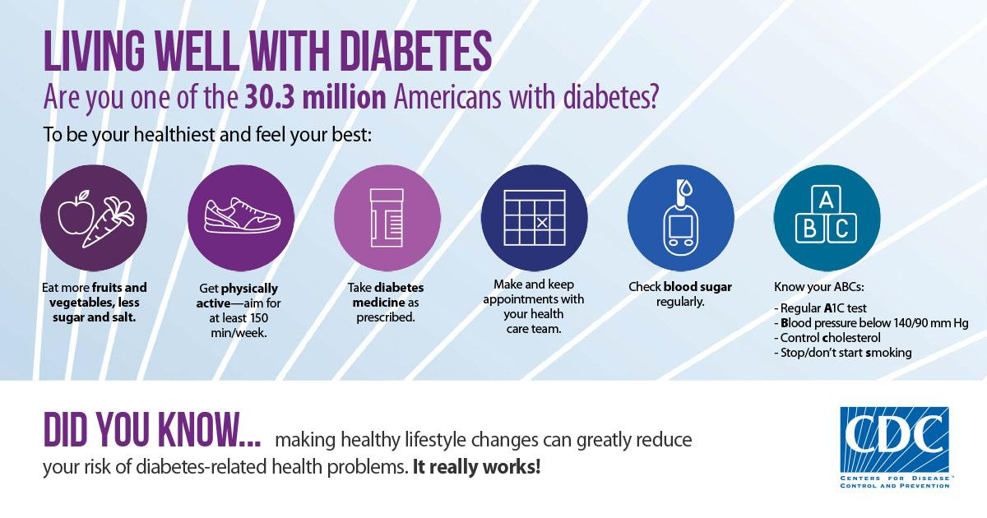
Lifestyle Changes

Slide 19

Thank You

