Slide 1




Risk Assessment for Home Credit Applicants
Indiana University
Bloomington
I526 Applied Machine Learning
Phase 1 – Fall 2021 – Group 14
Rahul Gattu ragattu@iu.edu | Rakesh Narne raknarne@iu.edu | Sadaramana Chowdam schowdam@iu.edu | Ujjwal Dubey ujjdubey@iu.edu

Slide 2
Abstract
The course project is based on the Home Credit Default Risk (HCDR) Kaggle Competition. Our goal is to create a machine learning model that is well optimized and performs efficiently to asses this risk for lender. There are many factors in a person’s life that lenders can use to assess this risk such as previous credit history, occupation, age, location, credit card usage, and others. We will be studying these factors when trying to assess a loan application and provides them with the decision-making guidance they need for a sustainable business operation.
Entire project will be implemented in 3 phases. In Phase 1, We experimented with classification algorithms like Logistic regression and Random Forest as our baseline models with features from 3 out of the 8 available datasets. We have conducted 4 experiments in total in this phase using the above mentioned models and we will walk you through the results in coming sections of this presentation.. We hope to produce a model that will allow Home Credit to successfully predict the likelihood of repayment so that more people can have access to much needed loans.

Slide 3
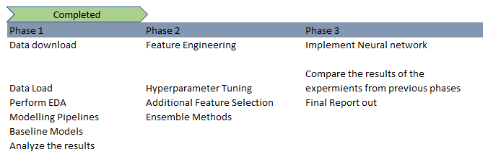
Project Phases and Activities

Slide 4
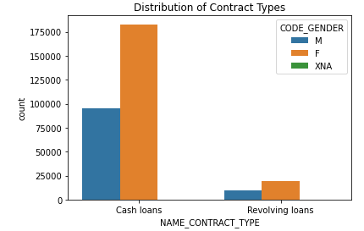
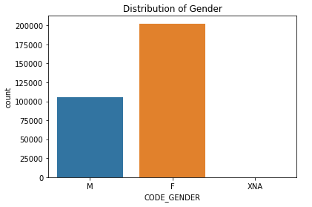
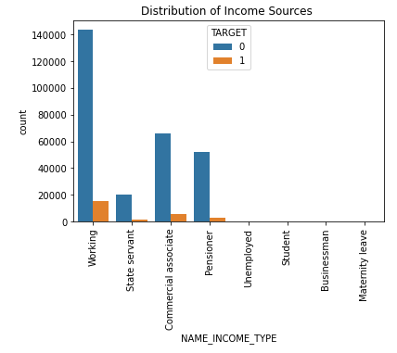
EDA
1
2
Findings
Plot 1: Female applicants are more in both Cash and revolving loans.
Plot 2: Female applicants are more when compare with the male applicants
Plot 3: More people go for cash loans when compare with revolving loans.
Plot 4: Most of the defaulters are working class followed by commercial associates.
3
4

Slide 5
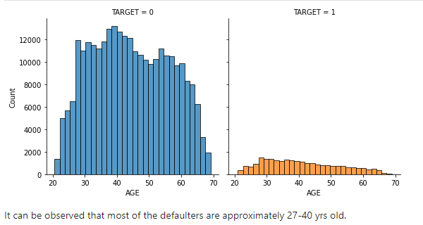
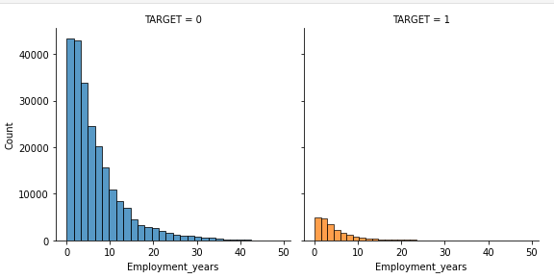
EDA
5
Plot 5: Most of the defaulters between the age 27 to 40 years.
Plot 6: Employee who has less than 2 years of experience are less likely to repay the loan.
6

Slide 6
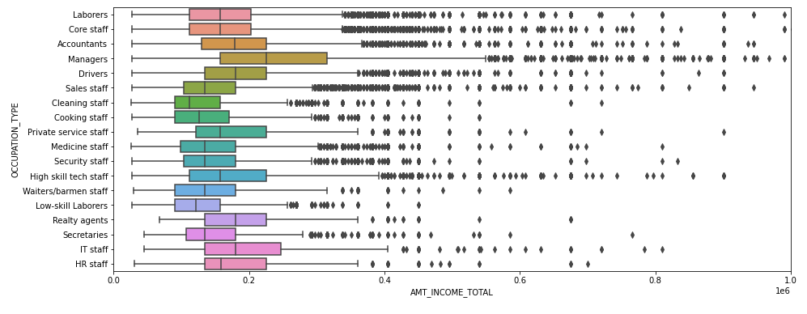
EDA
Applicants with Occupant type as Managers has High income and less likely to default where as applicants with Occupation type as Cleaning staff/Low-skill laborers have less income and more likely to default

Slide 7
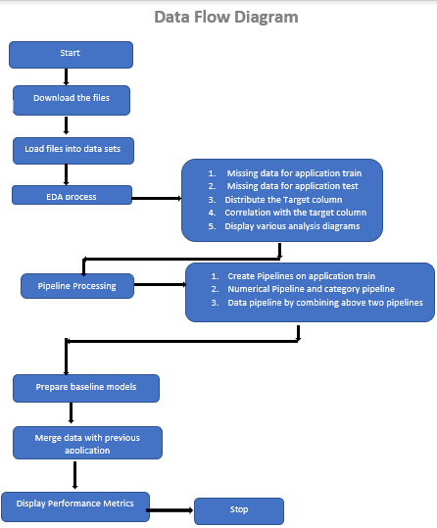
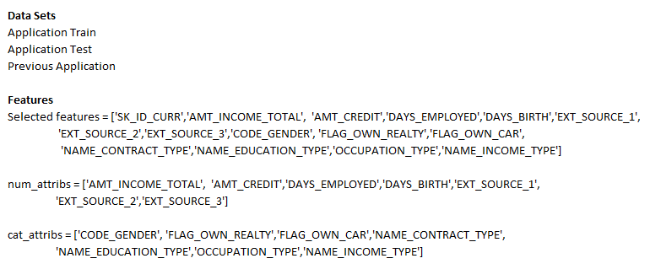
Key Steps and Flow

Slide 8
Pipeline flow
Model training
Random Forest
Download files and create data sets
Distribute and correlate columns
Data Pipeline
Baseline Evaluation
Model evaluation
Kaggle submission
Logistics Regression

Slide 9

Model Evaluation

Slide 10
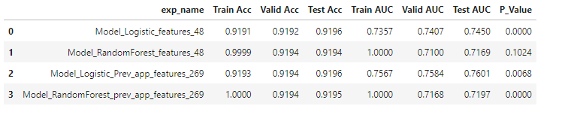
Model Evaluation with Previous application

Slide 11
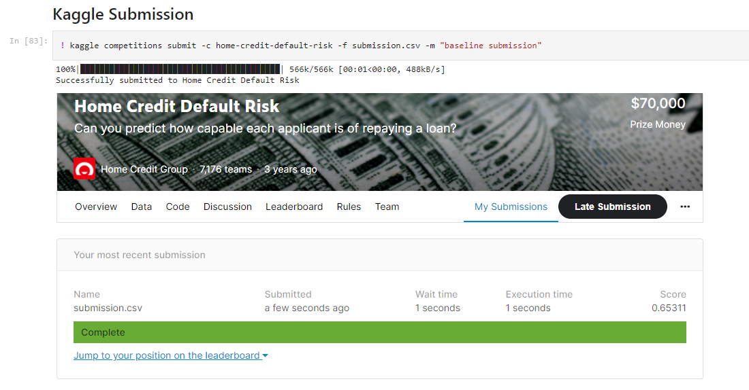
Kaggle Submission

Slide 12
Conclusion
By adding features from previous application data set , we have seen that accuracy improved from 74% to 76% for our baseline Logistic regression model. We haven’t seen the improvement with the Random forest model. This shows the importance of doing EDA on other supporting datasets to find out the right features and use that in our models.
Our focus in the coming phases will be on
Exploring new features
Hyperparameter tuning
Implement new models

