Slide 1




Risk Assessment for Home Credit Applicants
Indiana University
Bloomington
I526 Applied Machine Learning
Phase 2 – Fall 2021 – Group 14
Rahul Gattu ragattu@iu.edu | Rakesh Narne raknarne@iu.edu | Sadaramana Chowdam schowdam@iu.edu | Ujjwal Dubey ujjdubey@iu.edu

Slide 2
Abstract
The course project is based on the Home Credit Default Risk (HCDR) Kaggle Competition. Our goal is to create a machine learning model that is well optimized and performs efficiently to assess this risk for lender. There are many factors in a person’s life that lenders can use to assess this risk such as previous credit history, occupation, age, location, credit card usage, and others. We will be studying these factors when trying to assess a loan application and provides them with the decision-making guidance they need for a sustainable business operation.
Entire project is being implemented in 3 phases. In Phase 1, We experimented with classification algorithms like Logistic regression and Random Forest as our baseline models with features from 3 out of the 8 available datasets. We have conducted 4 experiments in total in this phase using the above-mentioned models and datasets which provides information about client's previous monthly credits, monthly balance of client’s previous loan, monthly data about previous credit cards, and payment history, furthermore, we will walk you through the results in coming sections of this presentation. We hope to produce a model that will allow Home Credit to successfully predict the likelihood of repayment so that more people can have access to much needed loans.

Slide 3
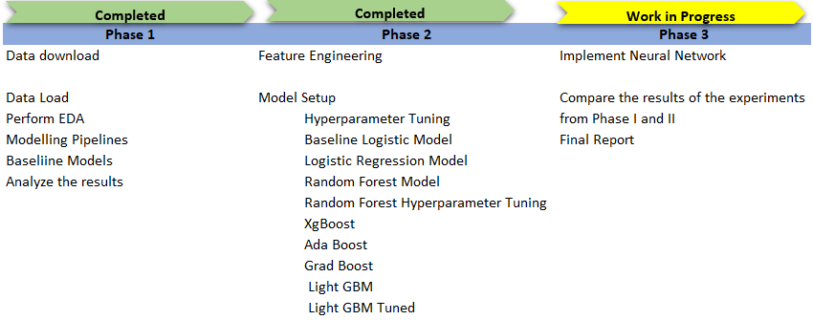
Project Phases and Activities

Slide 4
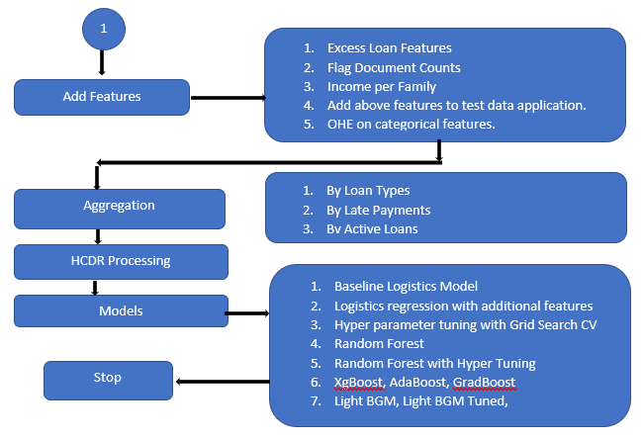
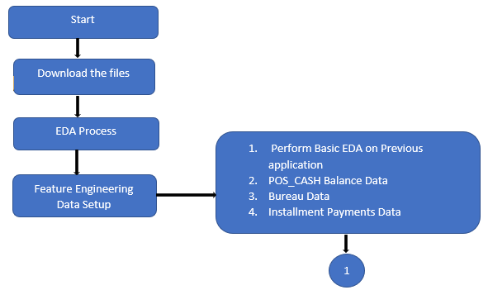
Key Steps and Flow – Feature Engineering Process

Slide 5
Model training
Pipeline flow
Baseline Logistics
Download files and create data sets
Distribute and correlate columns
Data Pipeline
Baseline Evaluation
Logistics Regression
Model evaluation
Kaggle submission
Hyper Parameter
Random Forest
XgBoost, Ada Boost, Grad Boost
Light BGM

Slide 6
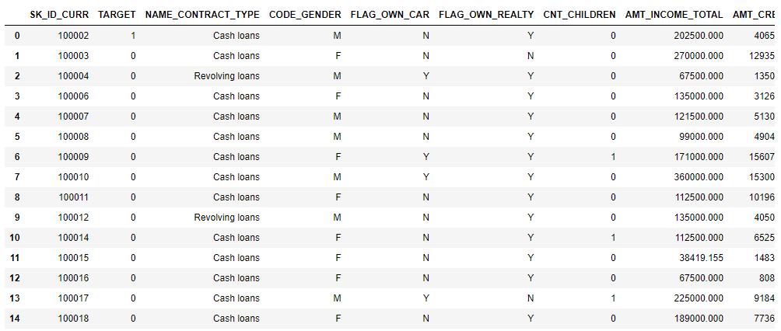
Feature Engineering – Income Per Family

Slide 7
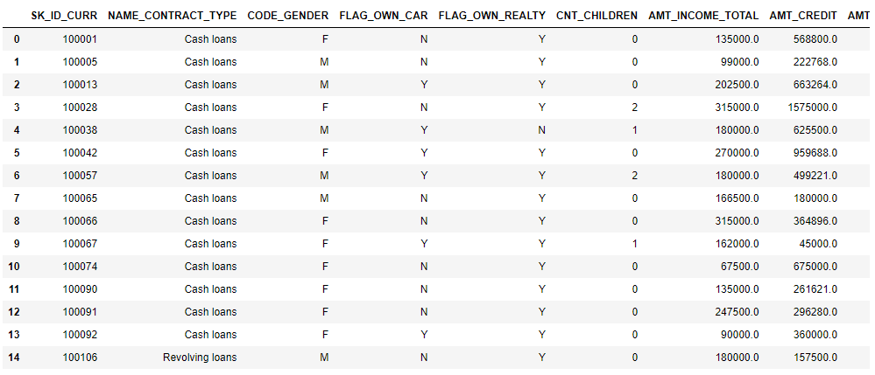
Feature Engineering – Application Test Data After adding features

Slide 8
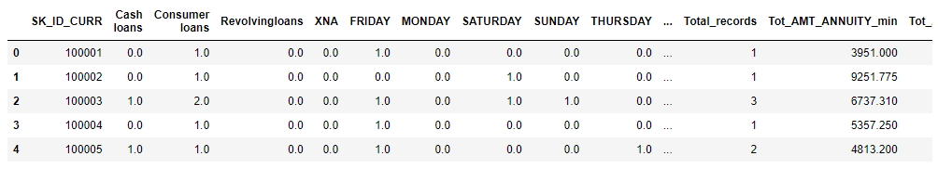
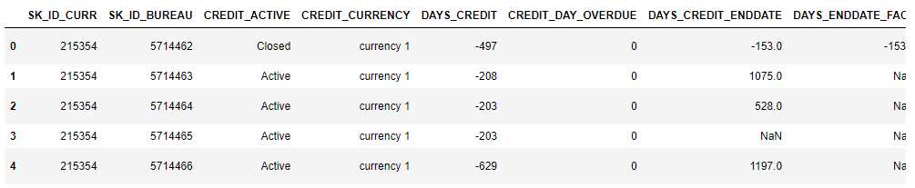
Aggregation – Loan Types
Aggregation – Late Payments

Slide 9
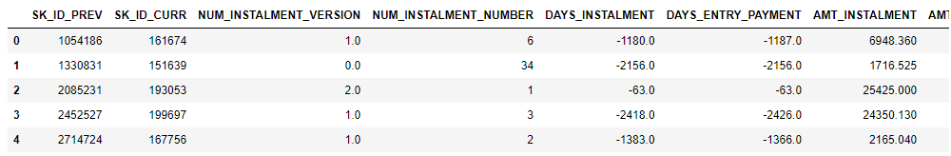
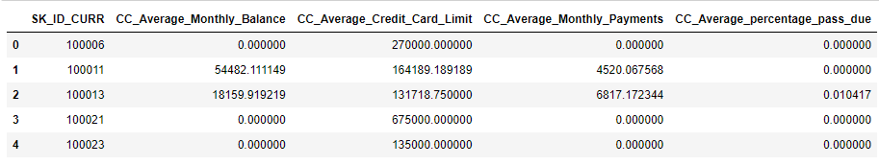
Aggregation – Active Loans
Aggregation – Percent Of Payments

Slide 10
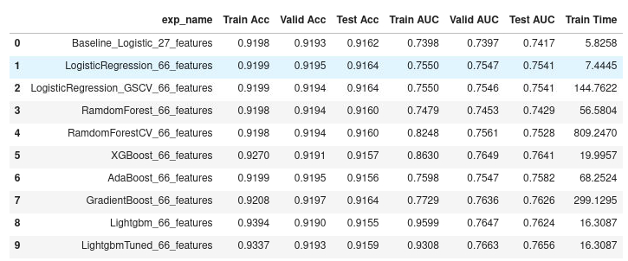
Experimental Results

Slide 11
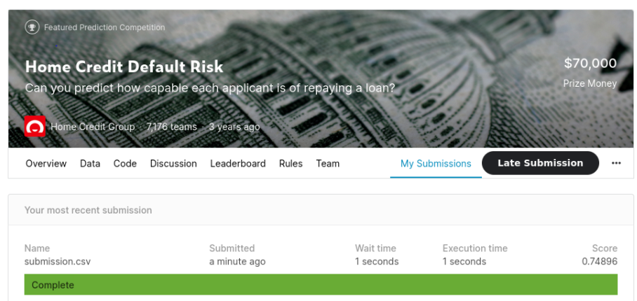
Kaggle Submission

Slide 12
Conclusion
In Phase II of the project, we focused on improving the test accuracy, additional feature engineering, hyperparameter tuning, feature selection, analysis of feature importance, and other ensemble methods. We have seen the test accuracy of 0.76 for XGBOOST, ADA BOOST, and LIGHTBGM with 66 features. Furthermore, LIGHTBGM after tuning has shown slight improvement and got 0.765 AUC. Other observation from the experiments in this phase is that the training times of LIGHTGBM and XGBOOST are much lower when compared to other models. It is very evident that Feature Engineering and Hyperparameter tuning played a crucial role in getting the better results. In the final phase of the project, we will try and do more hyper parameter tuning, implement a neural network model and compare the results from phases I and II.

