Slide 1




Indiana University
Bloomington
I526 Applied Machine Learning
Risk Assessment for Home Credit Applicants
Phase 3 – Fall 2021 – Group 14
Rahul Gattu ragattu@iu.edu | Rakesh Narne raknarne@iu.edu | Sadaramana Chowdam schowdam@iu.edu | Ujjwal Dubey ujjdubey@iu.edu

Slide 2
Abstract
The course project is based on the Home Credit Default Risk (HCDR) Kaggle Competition. Our goal is to create a machine learning model that is well optimized and performs efficiently to assess this risk for lenders. There are many factors in a person’s life that lenders can use to assess this risk such as previous credit history, occupation, age, location, credit card usage, and others. We will be studying these factors when trying to assess a loan application and provide them with the decision-making guidance they need for a sustainable business operation.
The entire project is being implemented in 3 phases. In Phase 3, We extended our experiments by implementing the hyperparameter tuning to XGBoost, ADA Boost, Gradient Boost algorithms to determine the best test accuracy. We further fine-tuned data with Neural Network to alter epochs, learning rate, batch size, optimizers parameters to get the best results. Moreover, Neural Network has also turned out to be one of the best experiments with a test AUC of around 74%.

Slide 3
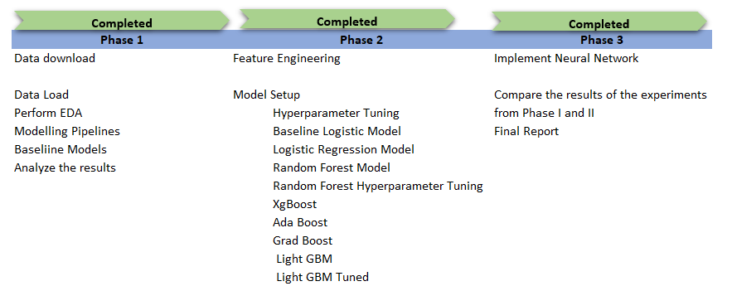
Project Phases and Activities

Slide 4
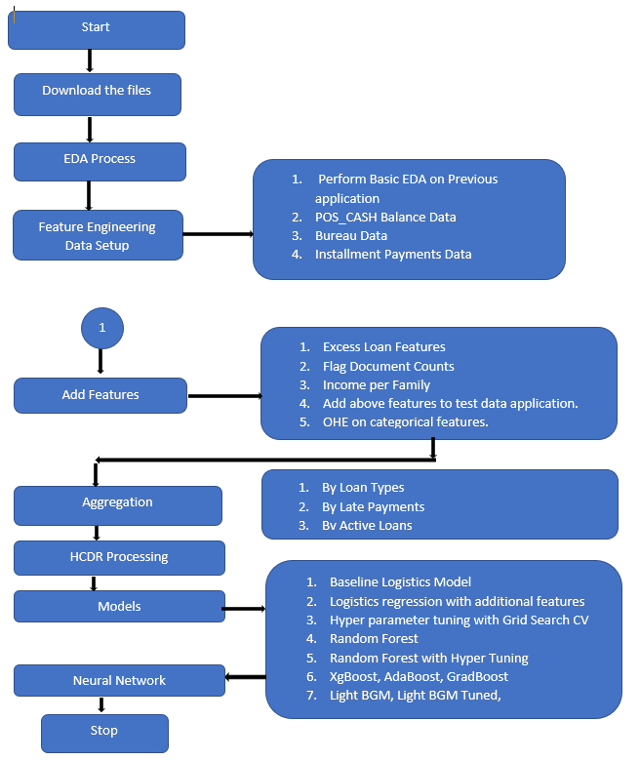
Key Tasks and flow

Slide 5
Model training
Pipeline flow
Baseline Logistics
Download files and create data sets
Distribute and correlate columns
Data Pipeline
Baseline Evaluation
Logistics Regression
Model evaluation
Kaggle submission
Hyper Parameter
Random Forest
XgBoost, Ada Boost, Grad Boost
Light BGM

Slide 6
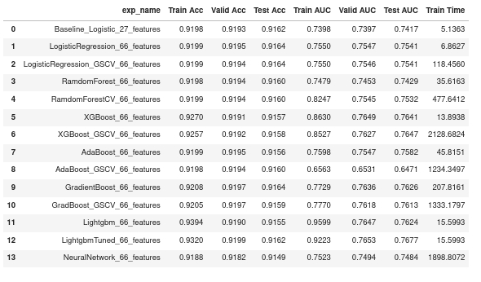
Experimental Results

Slide 7
Results Comparison
Phase | Best AUC | Focus | Best Model | Kaggle Score
Phase1 | 0.74 | Baseline Model | Logistic Regression | 0.65
Phase 2 | 0.76 | Feature Engineering/Tuning | LightGBM | 0.74
Phase 3 | 0.76 | Neural network Model | LightGBM | 0.75
*Our Neural network Model in Phase 3 has less AUC score ( 0.74) when compared to LighGBM model (0.76)in Phase 2

Slide 8
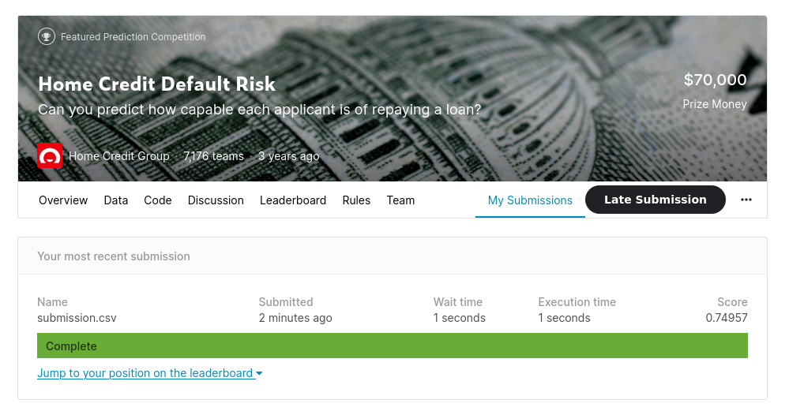
Kaggle Submission

Slide 9
Conclusion
In Phase III of the project, we focused on improving the test accuracy by implementing a Neural network model and also we have extended our work by doing hyperparameter tuning on some ensembled models such as XGBoost, AdaBoost, and GradBoost. However, scores are not better than that of the previous LightGBM_Tuned model. We have seen the test accuracy of 0.74 for our Neural network model. Training time of our neural network model is 200 times more than that of LightGBM_Tuned model and AUC is also around 2% less for Neural network model when compared to LightGBM. Therefore, from all the 14 experiments we have done so far our best model is LightGBM_Tuned model with a training time of around 10 seconds and a test AUC of 76% and our final Kaggle submitting score is 0.75. We would like to extend our work in the future by tuning our neural network model and also do more feature engineering to see if we can achieve better scores.

