Slide 1
T3-Drone
Happily Flying Your Drone

Slide 2
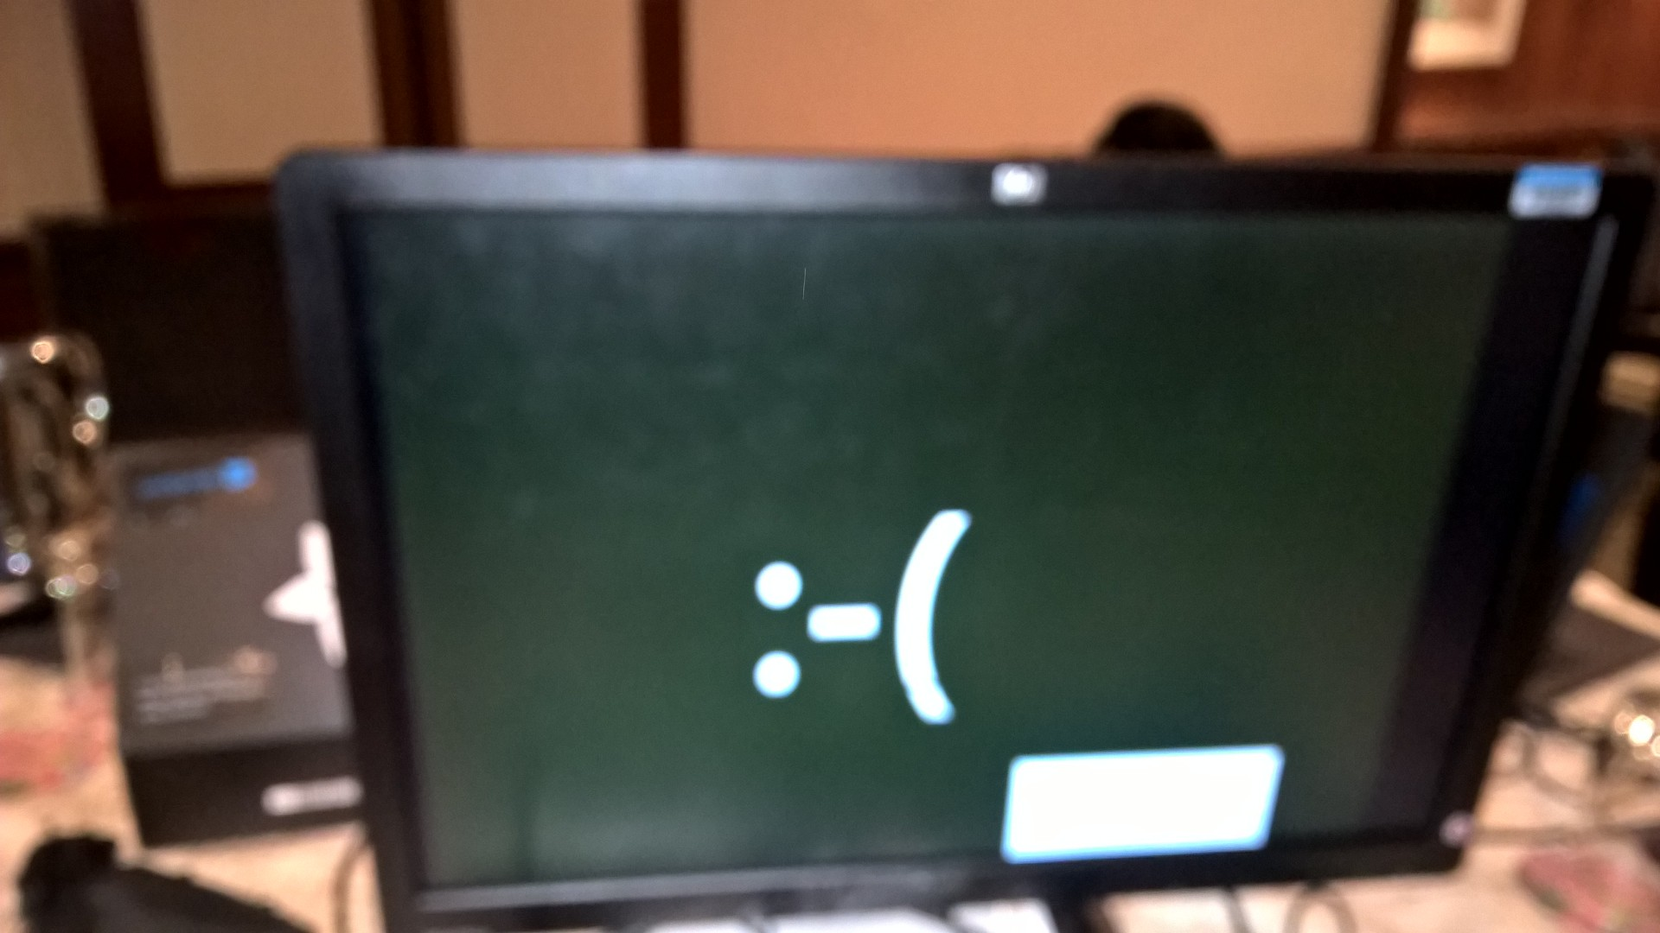
Some Key Takeaways
Internet is very important
We need new monitors ☺, or better dongles
Windows 10 IoT Core is still Windows.
NO Flying indoors
If you don’t have the proper tools,
Improvise using tape and glue

Slide 3
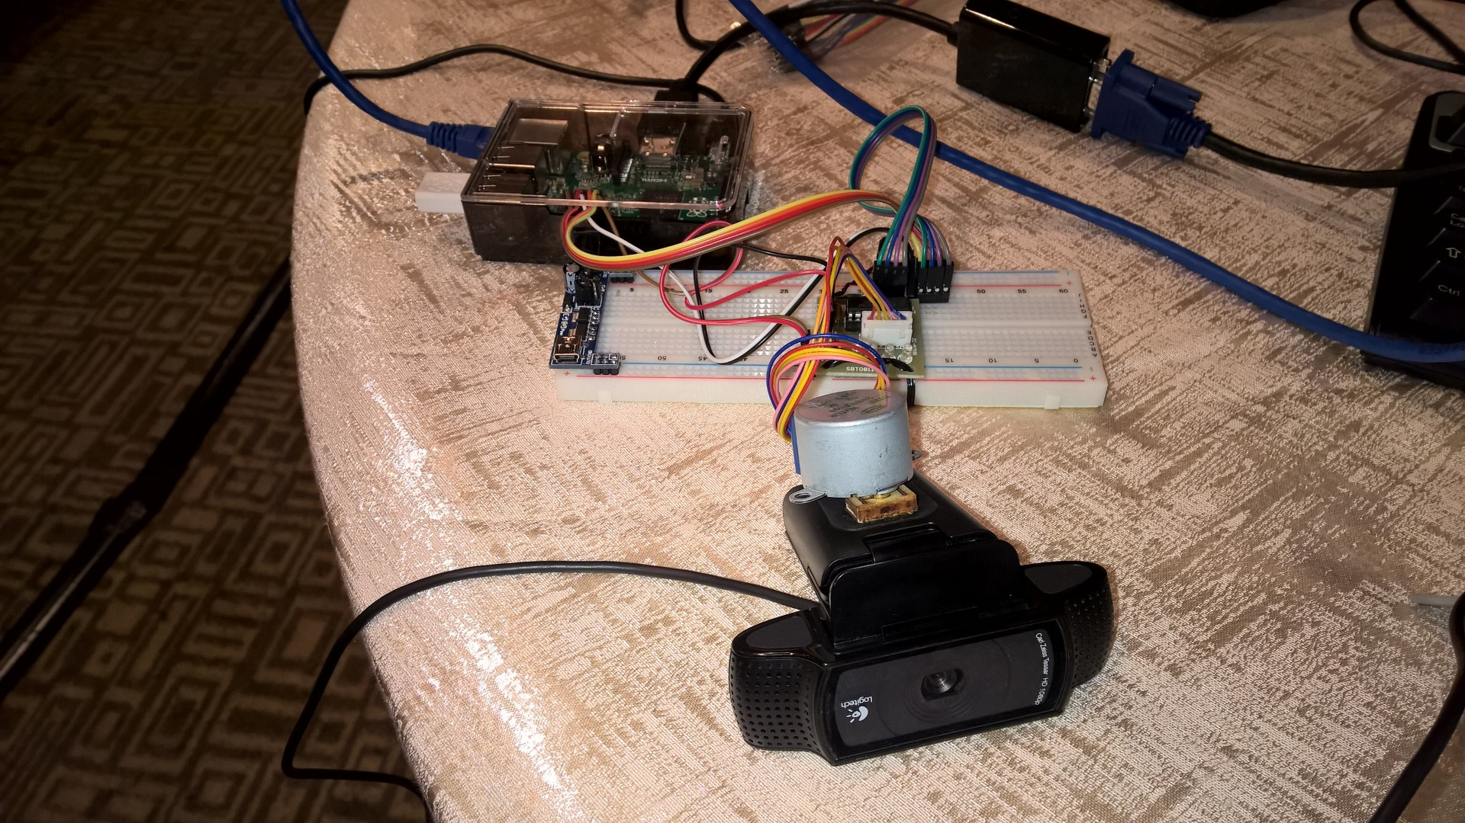
Main Project
Windows 10 IOT Core
Stepper Motor and Controller
WiFi Dongle
Web Cam

Slide 4
Main Project : Features
Tracking of users making use of Windows 10 Face Tracking API
Taking a picture to check emotion when user is dead center in the middle of frame

Slide 5
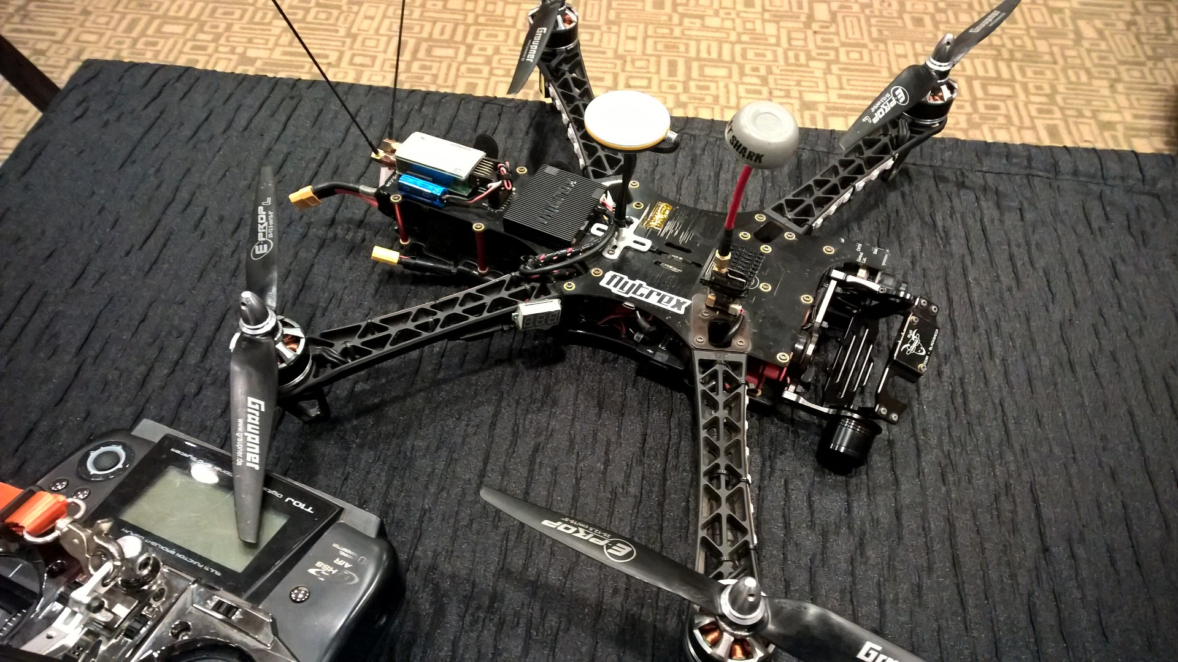
Main Project : Constraints
We needed some parts such as high capacity yet low payload battery to mount on the drone.
Can’t really mount for safety reasons, as currently this is powered by AC adapters

Slide 6
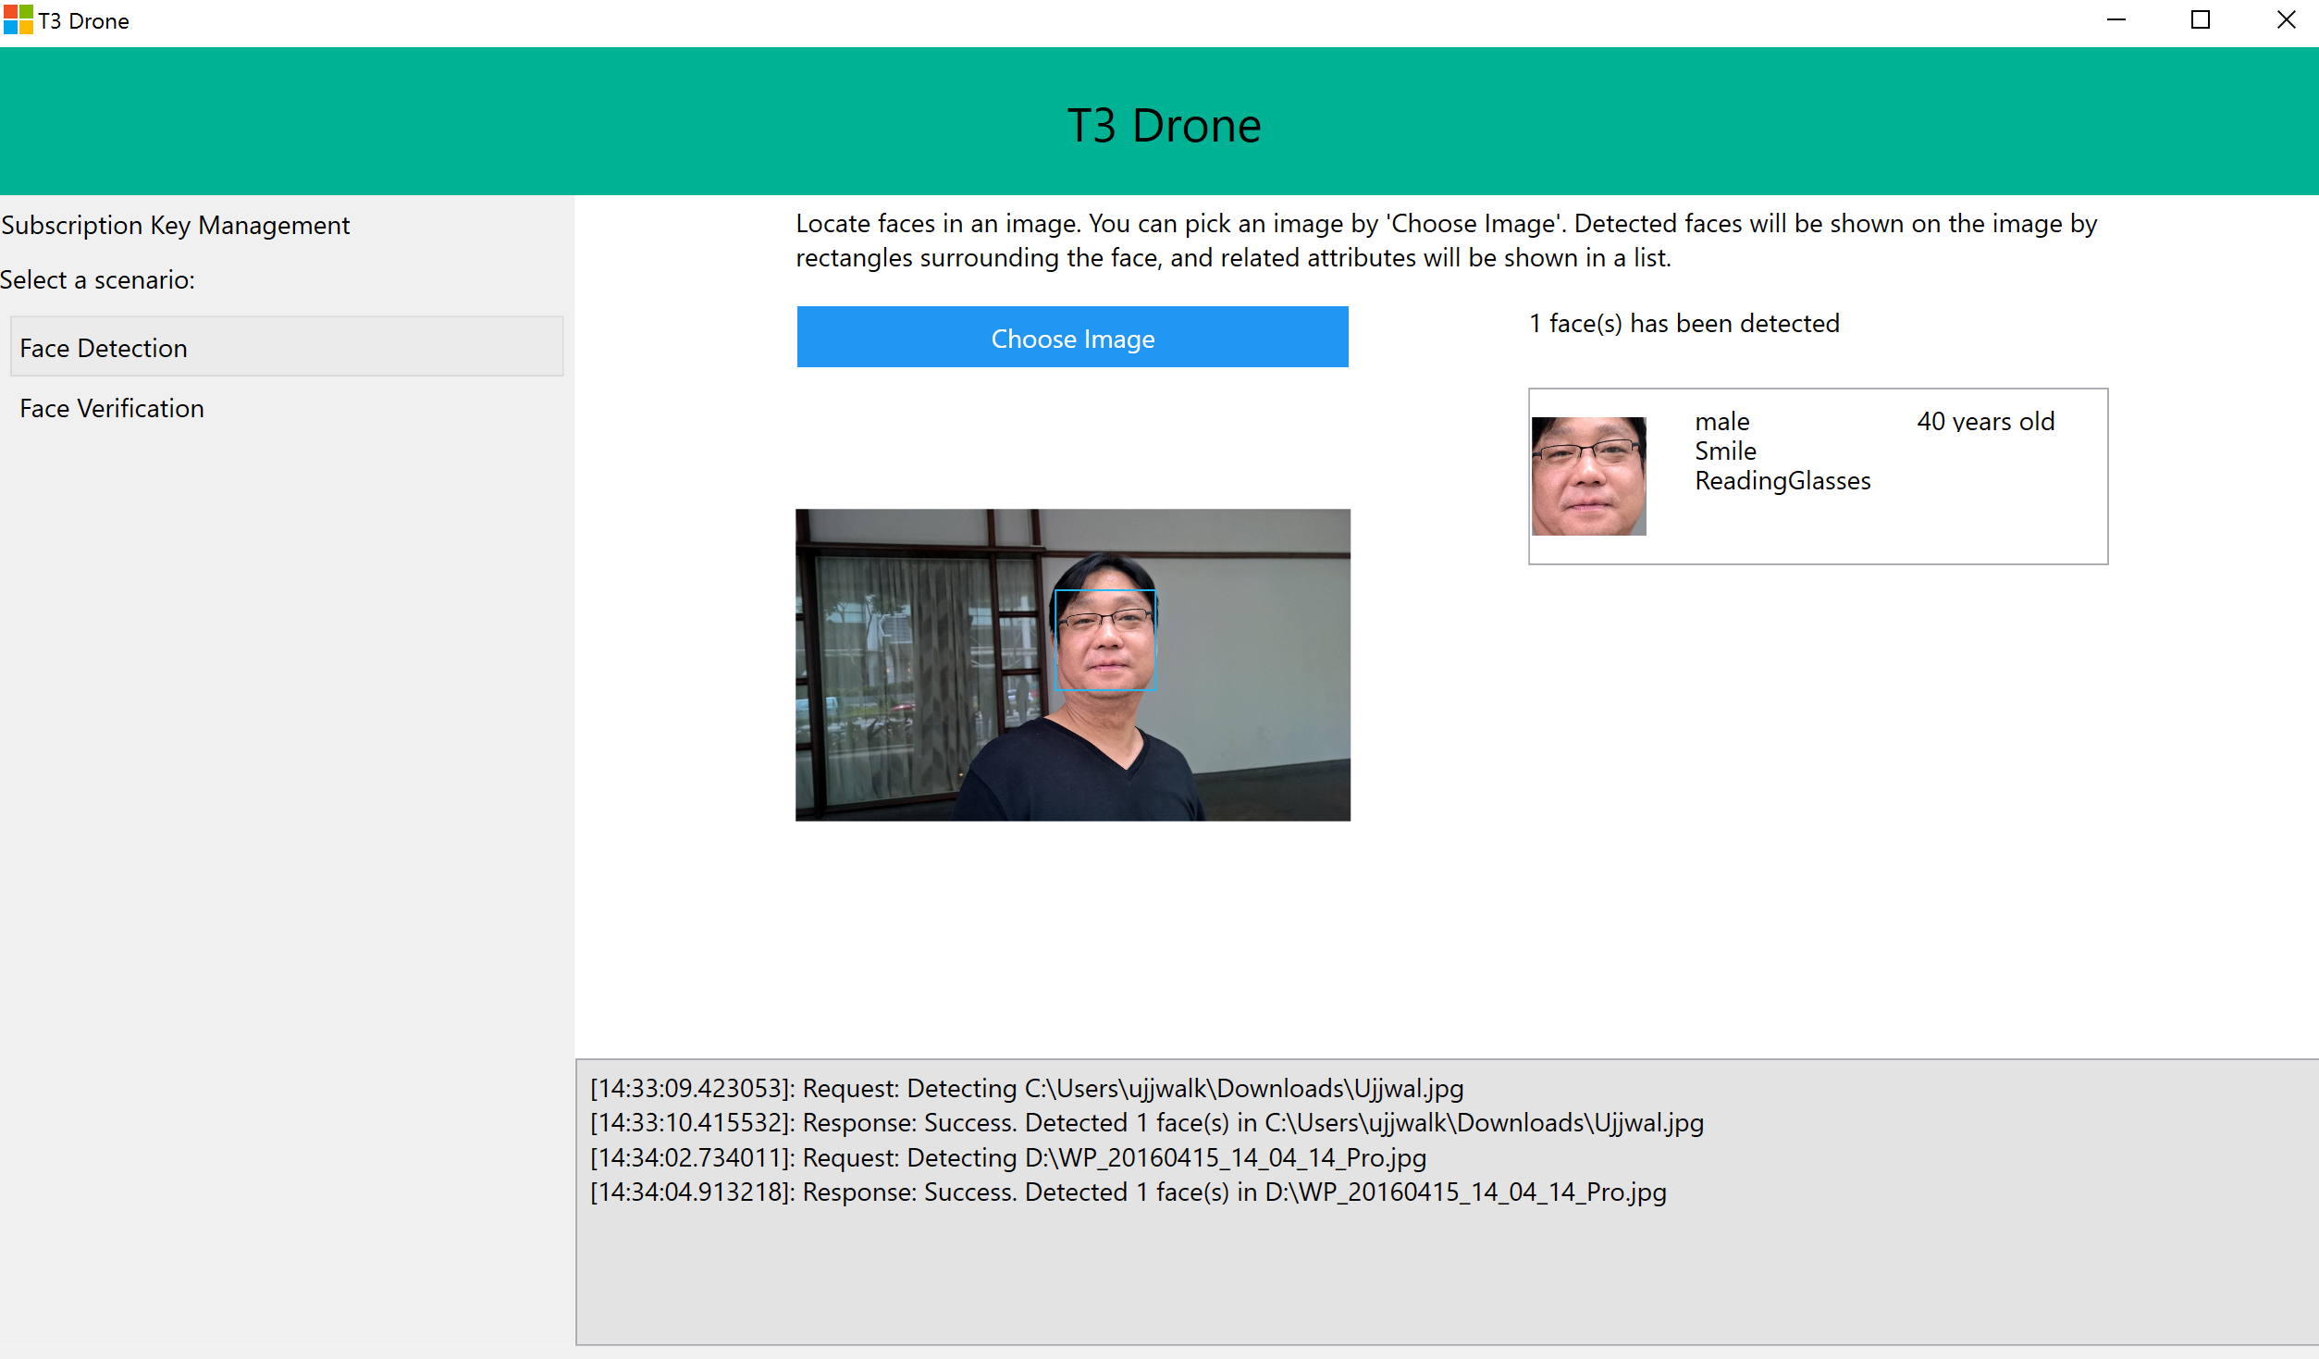
What about machine learning?

Slide 7
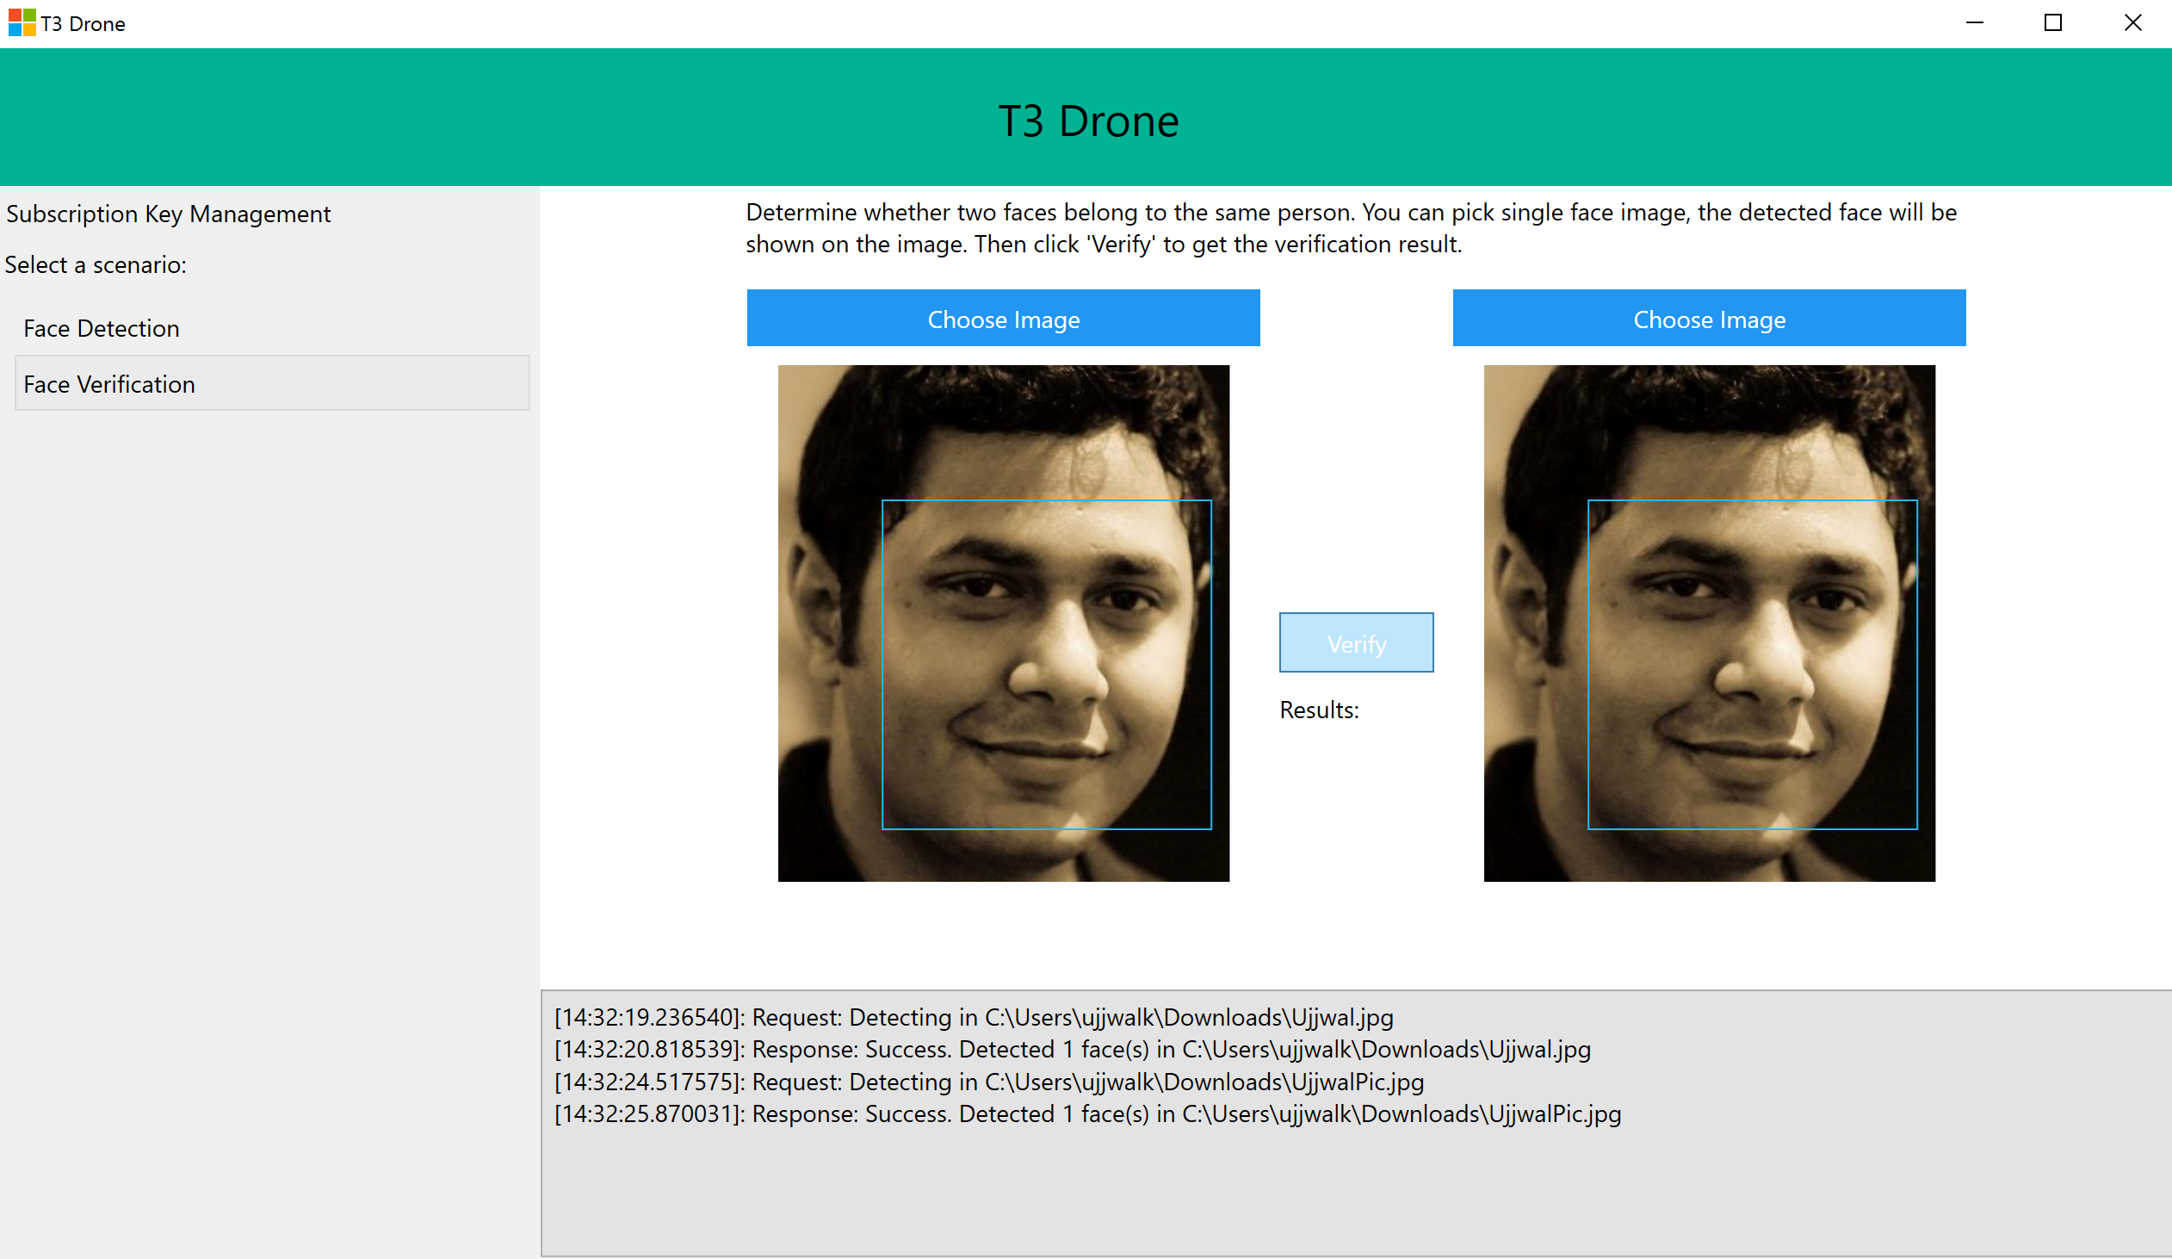
What about machine learning?

Slide 8
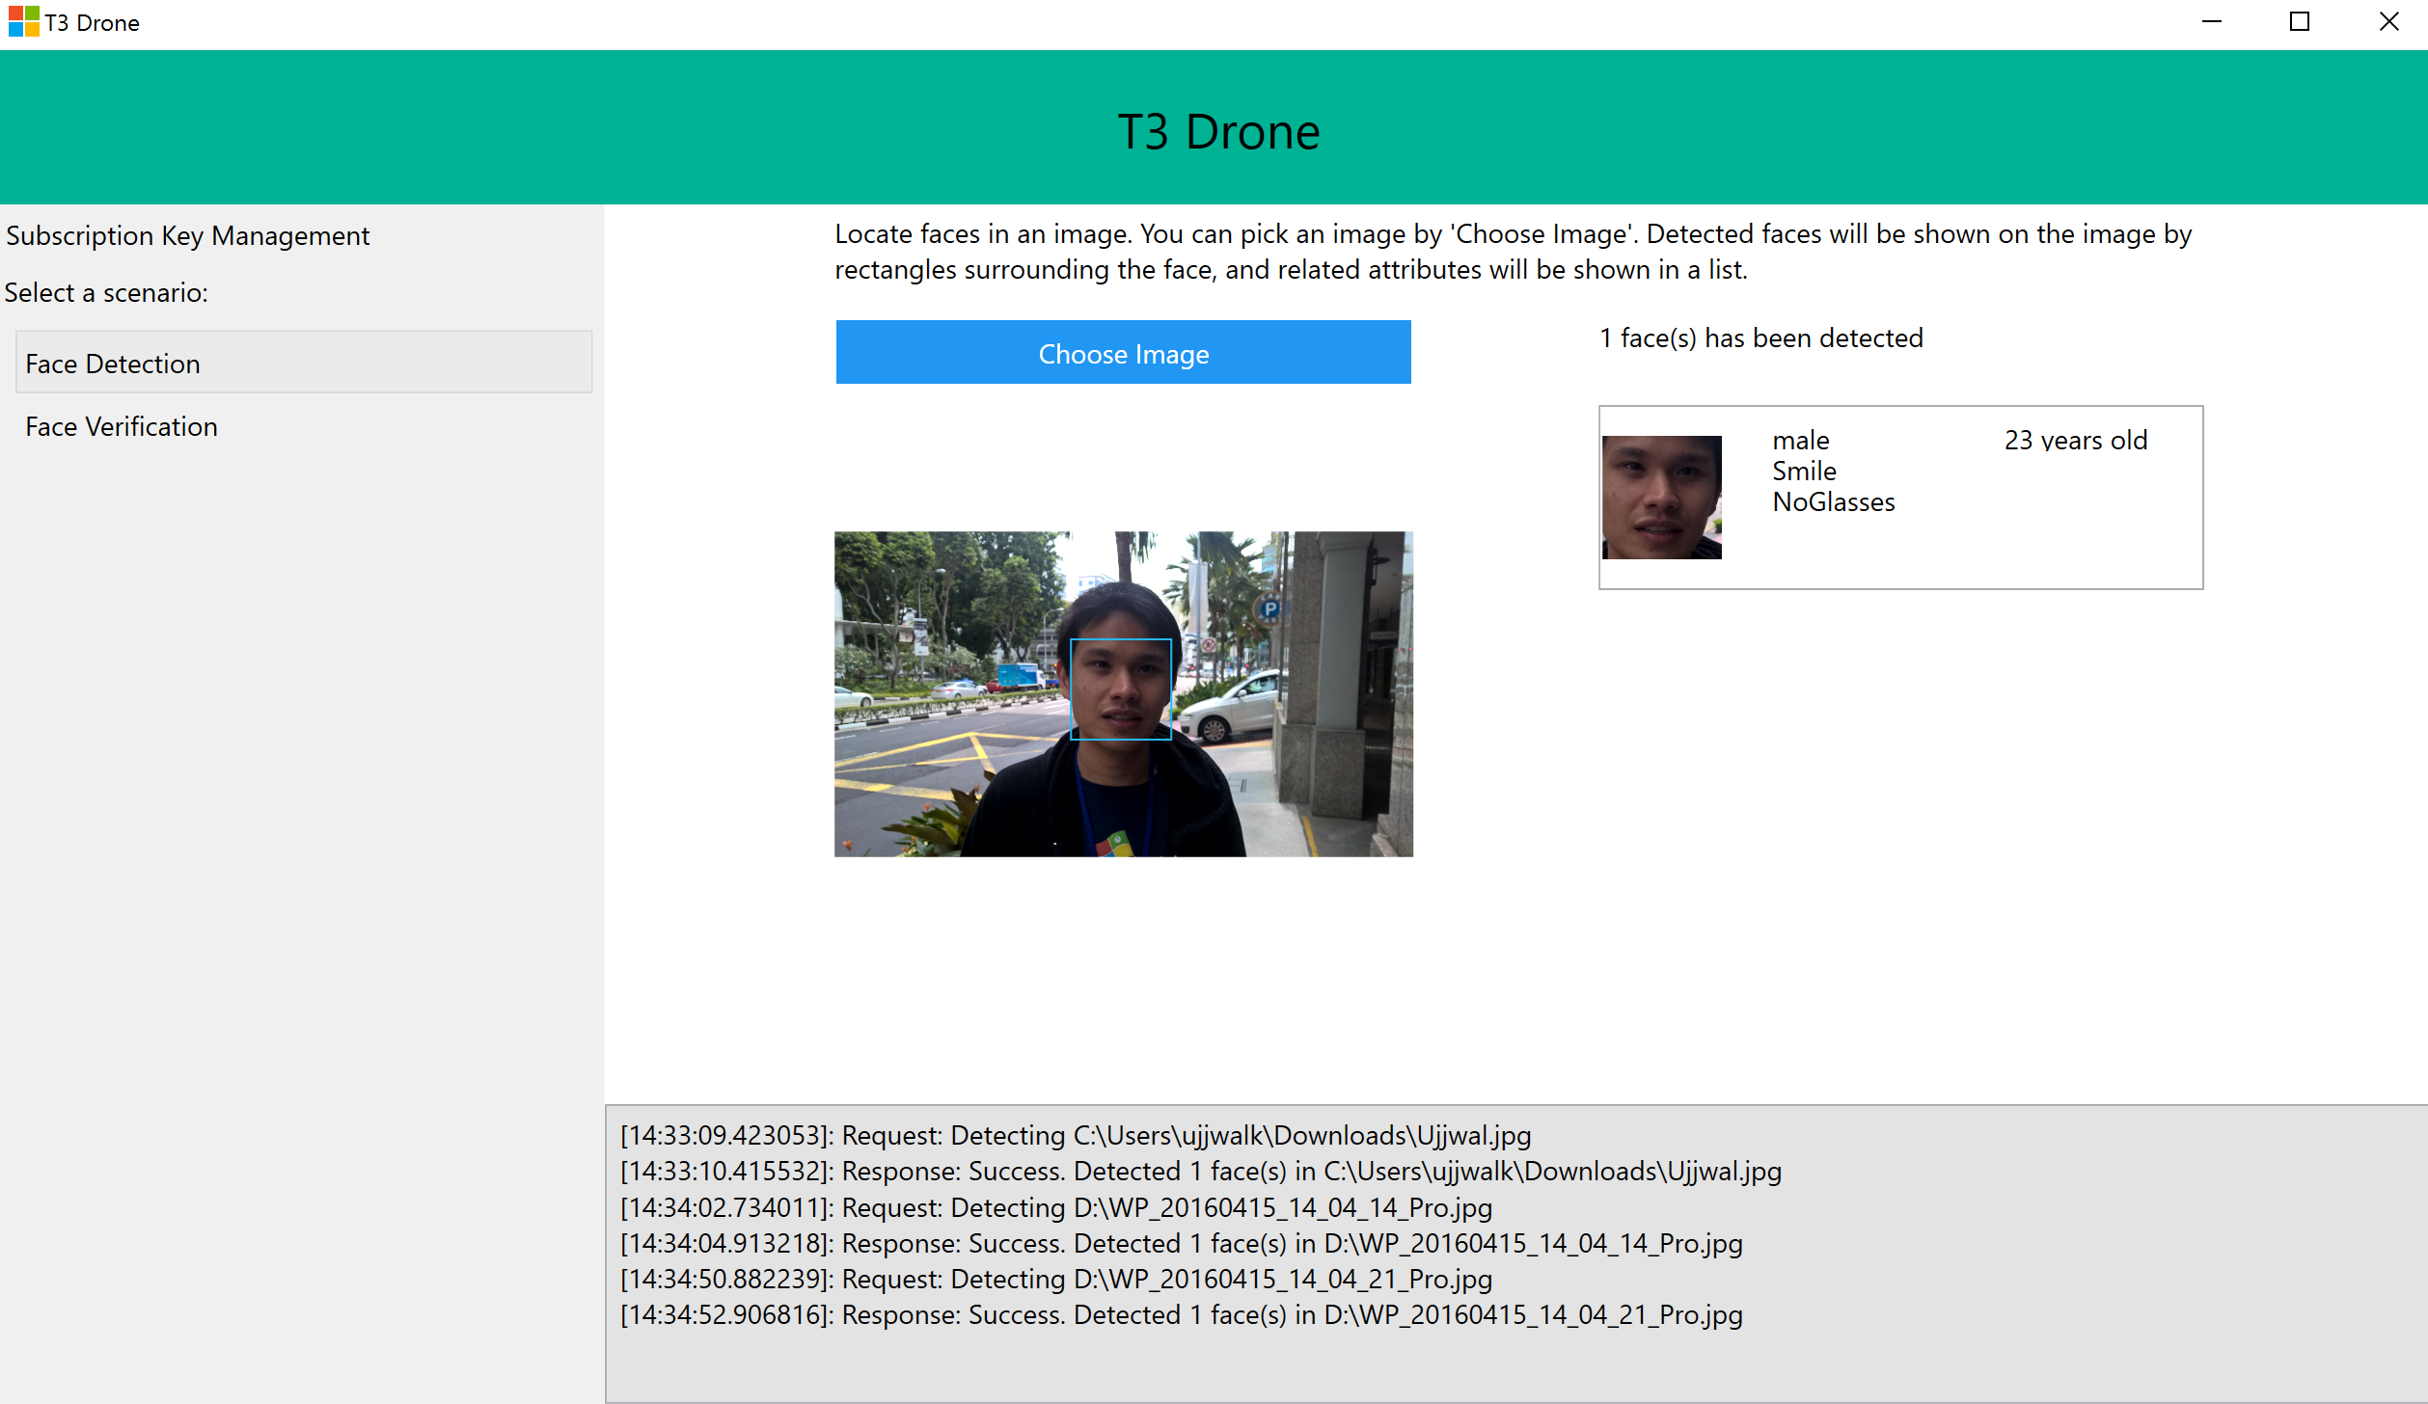
What about machine learning?

Slide 9
Main Project : Addition Features
Tagged Enemy
Tagged Friendly
Tagged Enemy
Selfie Taking for “Friendy”
“Enemy” Chasing
Powered by Oxford

Slide 10
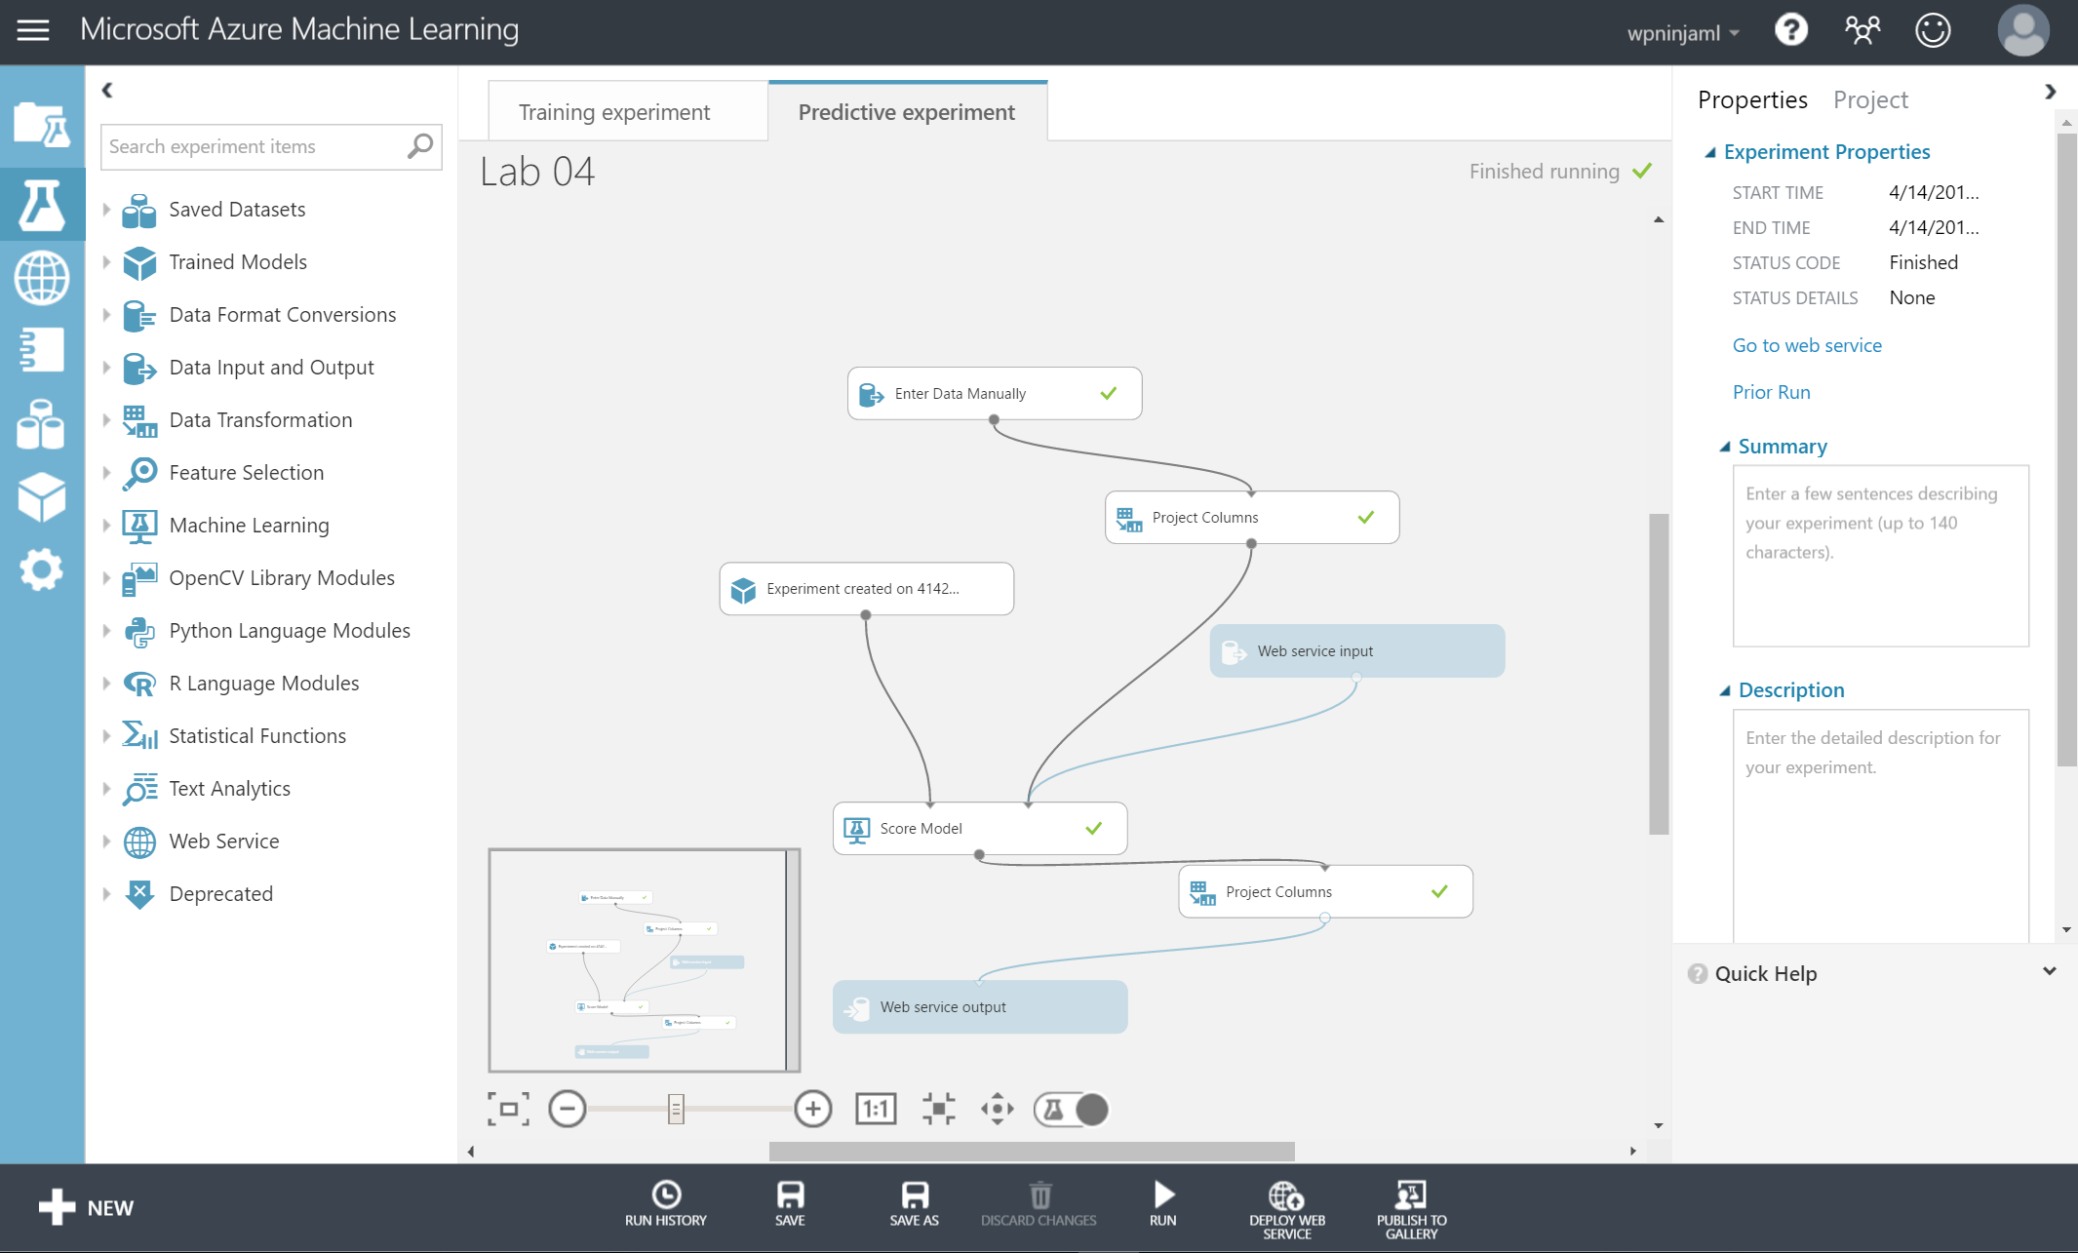
Main Project : Machine Learning (planned)
Using labels of “weather status” and other fields such as month (in number), day (in number) to predict when is a good day to fly
Because it is not always a good day to fly.

