Slide 1

Term Project on Chemical analysis of water and soil samples
Joshua Nodler, Ujjwal Kuikel, Prastut Dahal

Slide 2
Joshua
Workload Distribution
Ujjwal
Prastut
Scatterplot design
Understanding of the data
Line chart design
Extraction of the data
Overall layout
Data abstraction

Slide 3
Goals
To visualize complex data
Identify trends
Compare between data

Slide 4
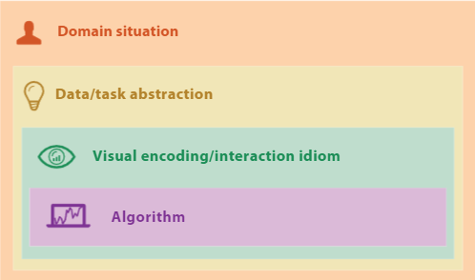
Nested Model
The four nested levels of visualization design
-Tamara Munzner

Slide 5
Domain and Abstraction level
Domain level
Abstraction level
Understanding the audience characteristics
Understanding the goal
Constraint and limitations
Data abstraction
Task abstraction

Slide 6
Encoding & Algorithm level
Encoding level
algorithm level
Bar chart, scatterplot, line chart and map
Dropdowns and click events
D3 js, leaflet
React js
Css

Slide 7
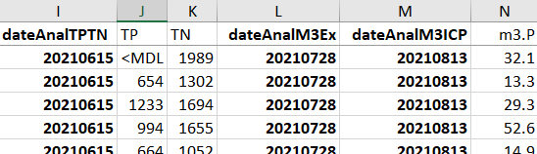
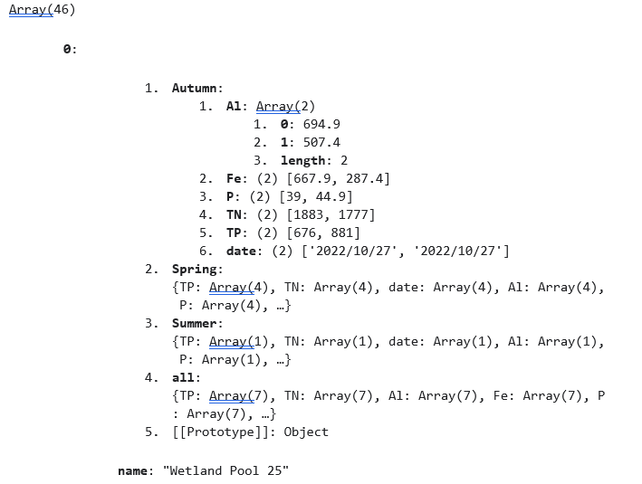
Data Preprocessing
Excel Sheet
Script
JSON File
Util
fn
Extracted Array

Slide 8
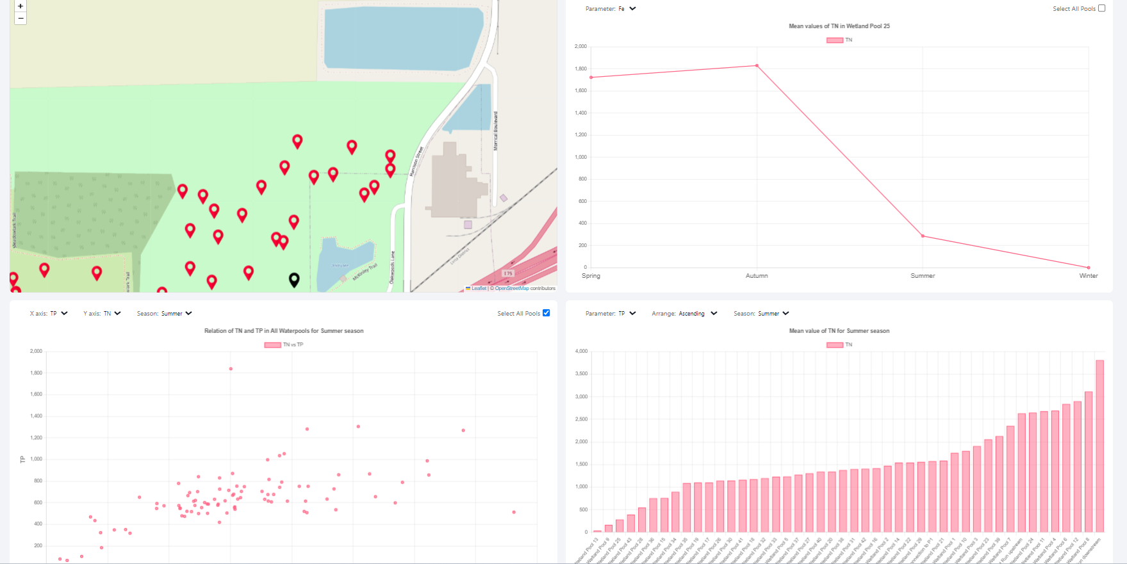
Visualization Demo

Slide 9
Conclusion
Visualization of Soil and water samples
Use of Nested Model
Use of React and d3 JS

