Slide 1
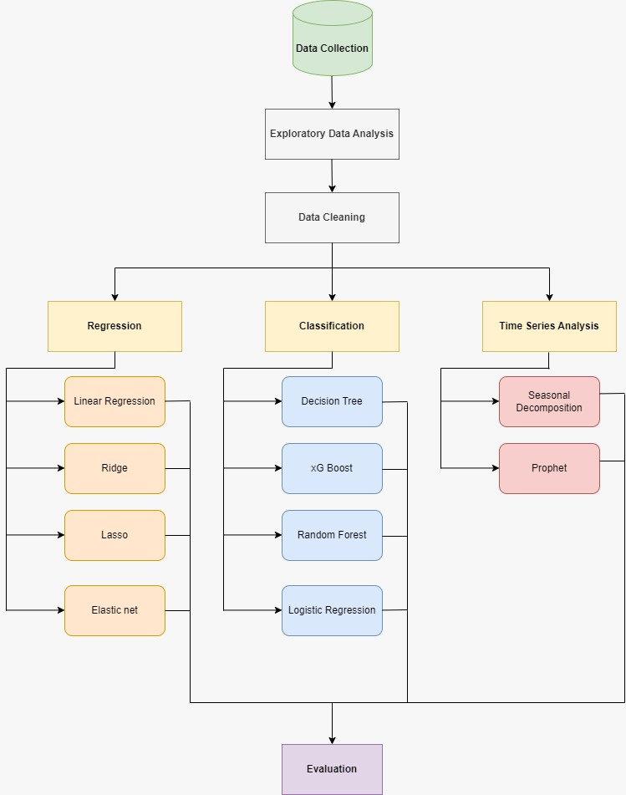
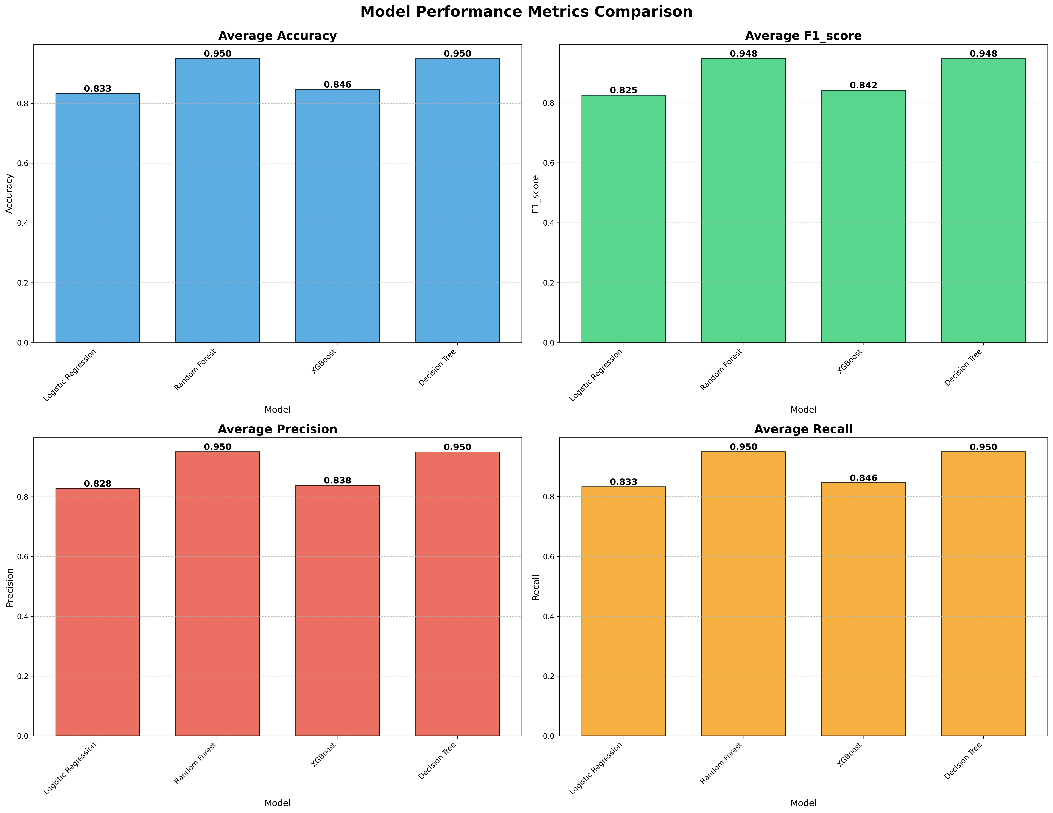
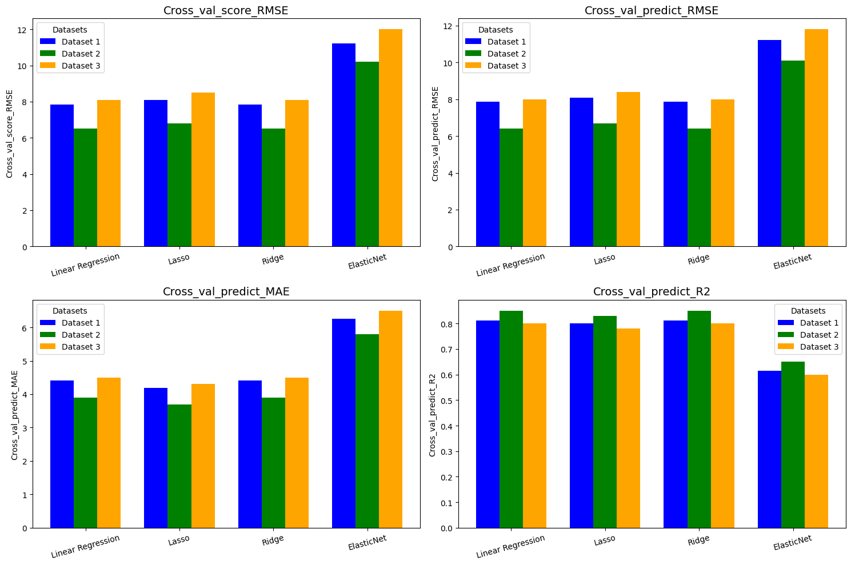
Introduction
Efficient transportation systems are the backbone of urban economies.
Increasing population density leads to traffic congestion and fluctuating ride demands.
NYC heavily relies on its diverse modes of transit, including taxis subways and rideshares.
Motivation
Understanding how transportation operates can improve urban mobility and reduce inefficiencies.
Predicting fares dynamics, transportation patterns and passenger’s behavior can help optimize resource allocation
Insights from this study can support sustainable urban planning and smart transit systems.
Questions?
Can we predict fair amount based on other features like trip distance, passenger count, etc?
Can we predict payment type based on other features?
Can we forecast future demand and revenue based on past data?
Predictive Modeling and Machine learning Insights from NYC Taxi Data
Results
Ridge seems to be the most consistent performer on regression across all datasets, particularly in terms of balancing RMSE, MAE, and R².
Random Forest and Decision Tree consistently perform the best across all metrics, scoring 0.950 in accuracy, precision, and recall, and 0.948 in F1 score.
Prastut Dahal,
Ujjwal Kuikel,
Dipika Bogati
Notes:
Notes:
In Powerpoint, click View > Guides
Keep text within gutter guides.
Author list: Don’t split names onto two lines (e.g., “Jimmy [break] Smith”). If that happens, use a new line, unless you need the space. Bold the first names of anybody who’s presenting in person.
Intro/methods/result: Do not drop below font size 28, but if you have extra space, jack up the font size until the space is full.
Do not use color in the sidebars except in graphs/figures. It’ll pull attention from the center and slow interpretation for passersby.

