Slide 1


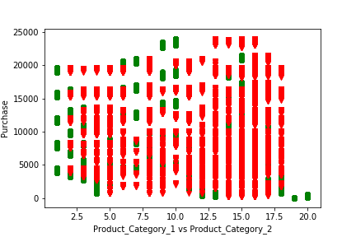


Customer based predictive analytics
Ujjawal Kumar
School of Computer Science and Information Systems, Northwest Missouri State University
Introduction
Results
Conclusions
In any product based business, different offers are kept initially in various products but after some time, based on the analysis of amount of sales in various products purchased by the customer, offers must be kept on the category of products with less amount of sales compared to products in category with more amount of sales.
Feature of average-sales by using different product categories.
Prediction of number of increase in purchase by seeing the category of the product.
To start a business with products in given two categories, one must put offers in products falling in category 1 as the ratio of sales of products falling in category 2 is anyways more.
Materials/Methods
Features:
Average-sales
Product categories
Purchase
Used Decision Tree Classifier to implicitly perform feature selection.
Performed Linear regression to train the model.
Total number of Product sold in different category vs Purchase graph:
The above graph represents the total number of sales of 2 different products
Data in green color represents the total number of sales of Product_Category_1
Data in red color represents the total number of sales of Product_Category_2
From the above data, it can be easily observed that the total number of sales of products in Product_Category_2 is more than the total number of sales of products in Product_Category_2.
This clearly means that people buy more products in Product_Category_2 than products in Product_Category_1, So in products of Product_Category_1, more offers can be kept to increase the sale in that category.
Additional Resources
Acknowledgements
Poster Repository
https://scikit-learn.org/stable/modules/generated/sklearn.tree.DecisionTreeClassifier.html
https://www.dezyre.com/project-use-case/create-personalized-offers
Mentor: Dr. Charles Hoot
https://github.com/ujjwalkumar1212/Machine-Learning_Project

