Slide 1
Complaint Resolution System

Slide 2
Overview
Complaint resolution system is designed to ease customer’s issues and to create a convenient and easy to use application for customer and support team, trying to resolve complaints. The system is based on a relational database with its complaint registration and resolution function.

Slide 3
Intended audience
This project is a prototype for the complaint resolution system and it is restricted within the organization. This project is useful for the customer support team and as well as the customers.

Slide 4
Requirements
Frontend technology | HTML, CSS, JS
Backend technology | JAVA
Database | MySQL
Operating System | Database

Slide 5
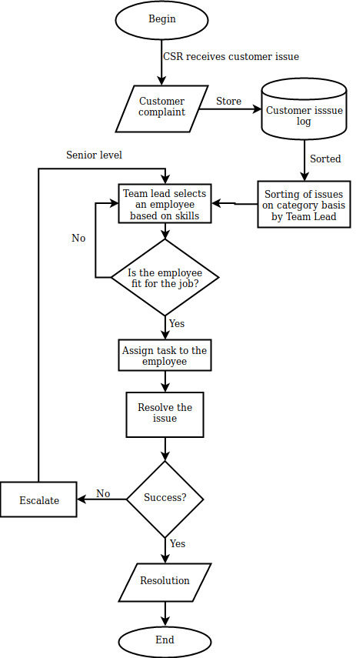
Working

Slide 6
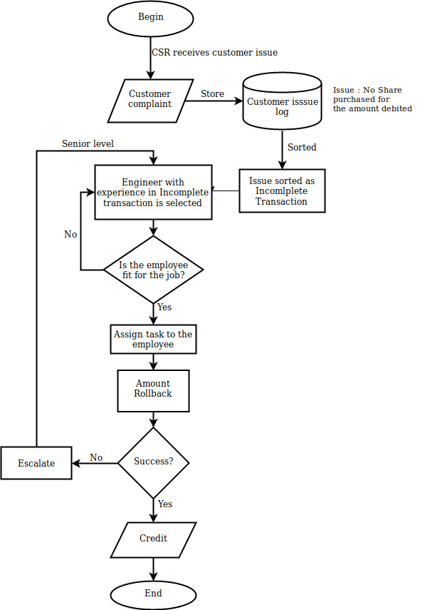
Use Case 1
Incomplete Transcation

Slide 7
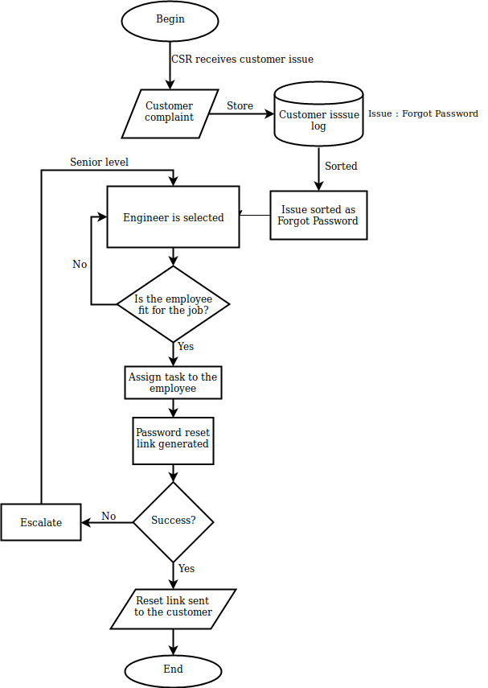
Use Case 2
Login issues-Password

Slide 8
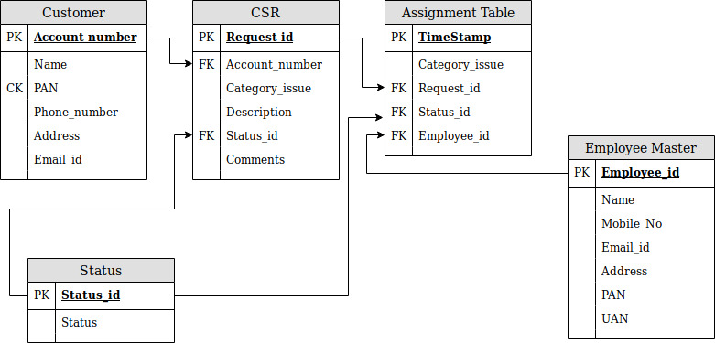
ER Diagram

