Slide 1
Capstone Project-1
Superstore Sales Data
Team Members
Tushar 2210992470
Ujjwal 2210992478 Utsav 2210992484
Vaibhav 2210992488
Notes:
Data

Slide 2
CONTENT
Problem Statement
Objective
Tools Used
Data Summary
Exploratory Data Analysis
Challenges
Recommendations
Conclusions
Q & A

Slide 3
PROBLEM STATEMENT
The Superstore Sales Data consists of various attributes such as order details, customer information, product categories, sales figures, and geographical information. The goal is to leverage this dataset to gain insights that will help improve business performance, optimize operations, and enhance customer satisfaction.

Slide 4
Objectives
Analyze sales trends over time: Investigate patterns and trends in sales figures over different time periods (e.g., daily, monthly, yearly) to identify seasonal variations, growth trends, and potential areas for improvement.
Understand customer segmentation: Explore customer segments based on demographics, purchase behavior, and geographic location. Identify high-value customer segments and tailor marketing strategies to better serve their needs.

Slide 5
Tools Used
Google collab is used as IDE.
Pandas and NumPy are used for Data Manipulation & Pre-processing and Mathematical functions respectively.
Exploratory data analysis is automated by data prep.
For visualization of the plots, Matplotlib, Seaborn, Plotty are used.
GitHub is used as version control system

Slide 6

DATA SUMMARY
Categorical Data
Category
Sub category
State
City
Region
Country
Segment
Ship Mode
Numerical Data
Sales
Order Date
Ship Date
Unique Data
Sales
Row Id
Postal Code

Slide 7
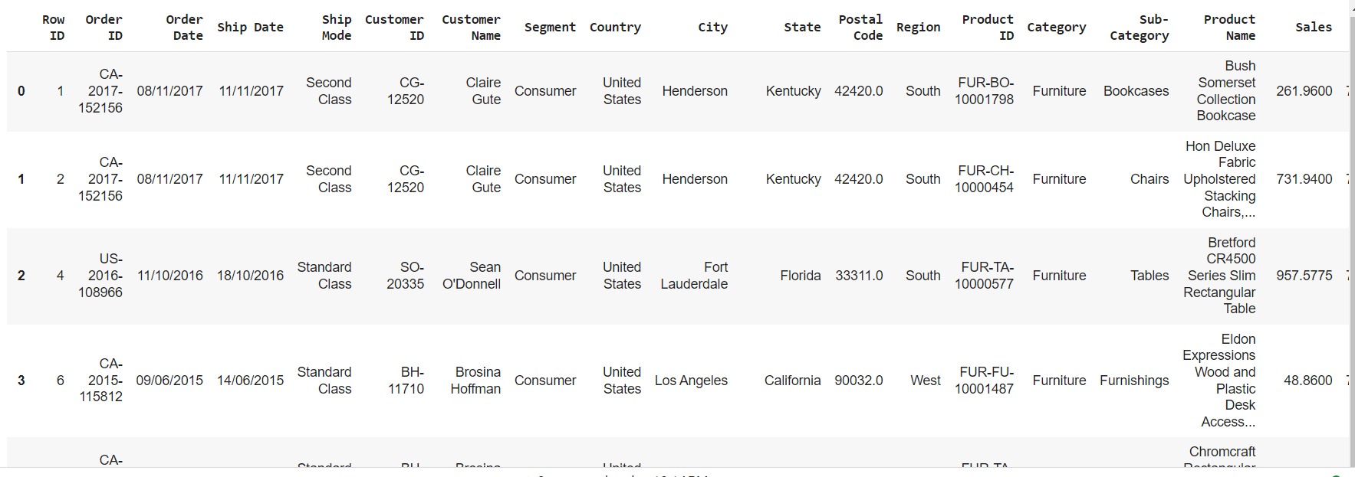
DATA SUMMARY
This is the Superstore Sale dataset. In the below table it shows the top 3 rows

Slide 8
FEATURES DESCRIPTION
Ship Mode': Different modes of shipment such as standard, express, etc.
'Segment': Segmentation of customers into different categories (e.g., consumer, corporate, home office).
'Country': Names of different countries where sales transactions occur.
'City': Names of cities where sales transactions are made.
'State': Names of states or provinces within countries.
'Region': Geographic regions or areas where sales transactions take place.
'Category': Broad categories to which products belong (e.g., office supplies, technology, furniture).
'Sub-Category': Subcategories within product categories (e.g., chairs, tables, phones).
Row ID: Sequential index for dataset organization and management.
Order ID: Unique identifier for tracking individual sales orders.
Order Date: Date when a sales order was placed by a customer.
Ship Date: Date when ordered products are shipped to customers.
Product ID: Unique identifier for individual products in the inventory.
Postal Code: Numerical or alphanumeric code indicating geographic areas for postal delivery.

Slide 9
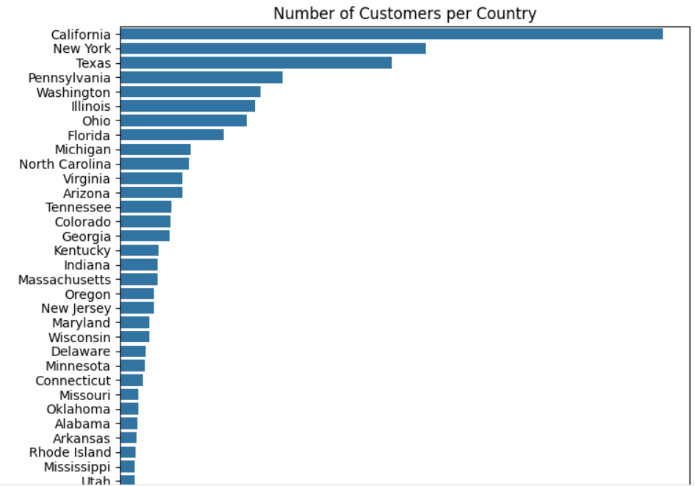
Value Count Of Customers in Each State
We have made graph for Number of Customers per State. From this graph we get to know that our customer segment is most from california and least from wyoming

Slide 10
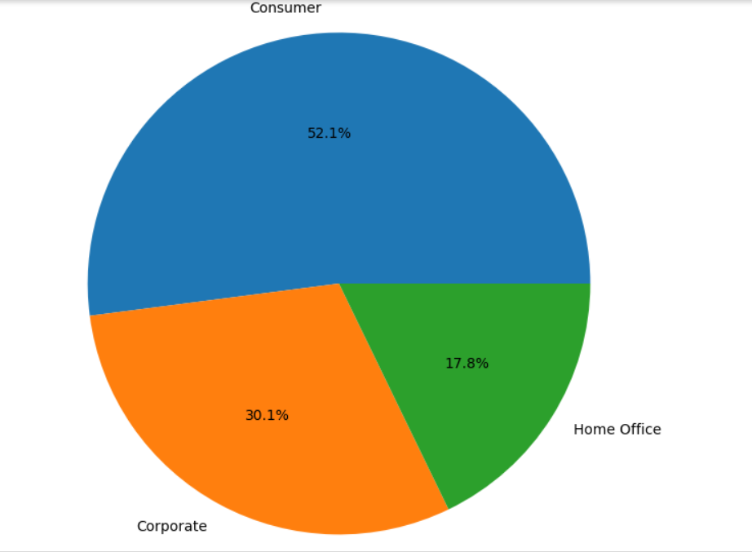
Grouping The Data Frame By Segment and Calculating Value counts
Consumer segmentation is a powerful technique that allows businesses to group customers based on shared characteristics and value count of consumer segment is most.

Slide 11
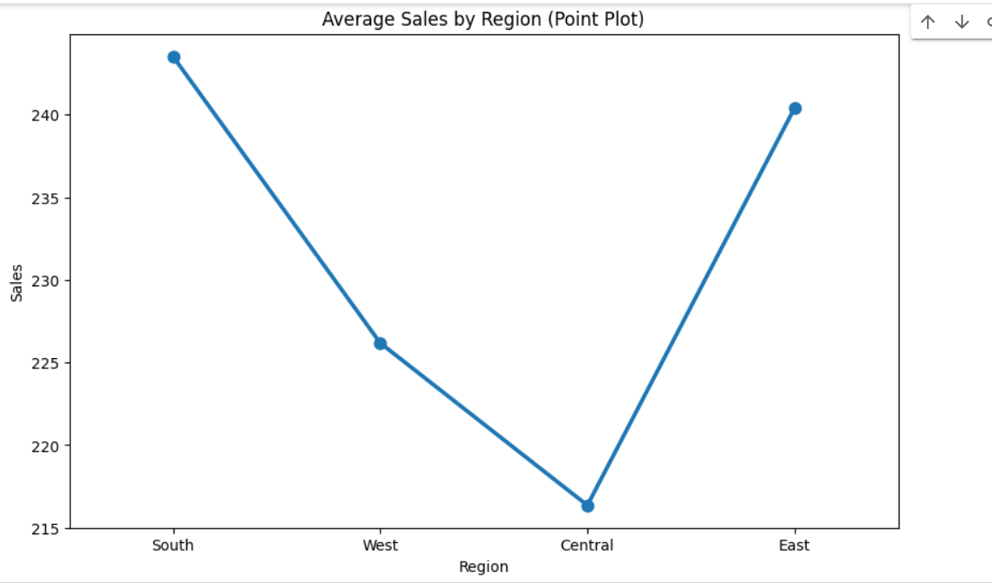
Average Sales By Region
This Graph shows Average Sales by Region (Point Plot).
The central region has lowest average sales and south has highest average sales

Slide 12
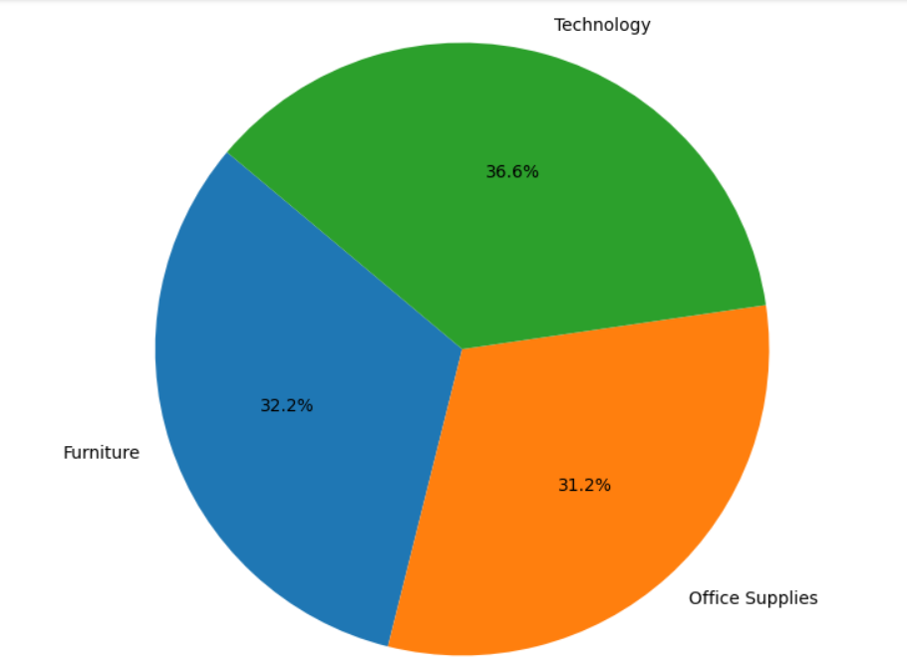
Sales Distribution By Category
We have made sales distribution by region pie chart
The significant contribution of the Technology category suggests that it is a strong revenue driver.
Leveraging this insight, businesses can allocate resources strategically to further enhance sales in this category.

Slide 13
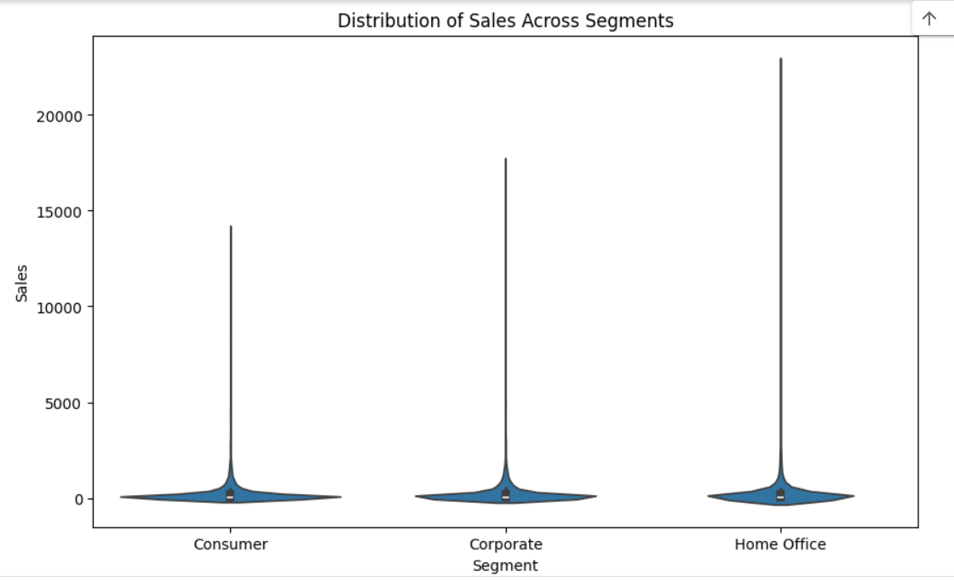
Distribution of Sales Across Segments
We have made violin plot for visualizing the distribution of sales across different segments.
We observed that Density of sales is more for consumer segment.so Consumer segment has contributed most to Sales.
If we compare frequency wise then Home office has highest frequency in segments

Slide 14
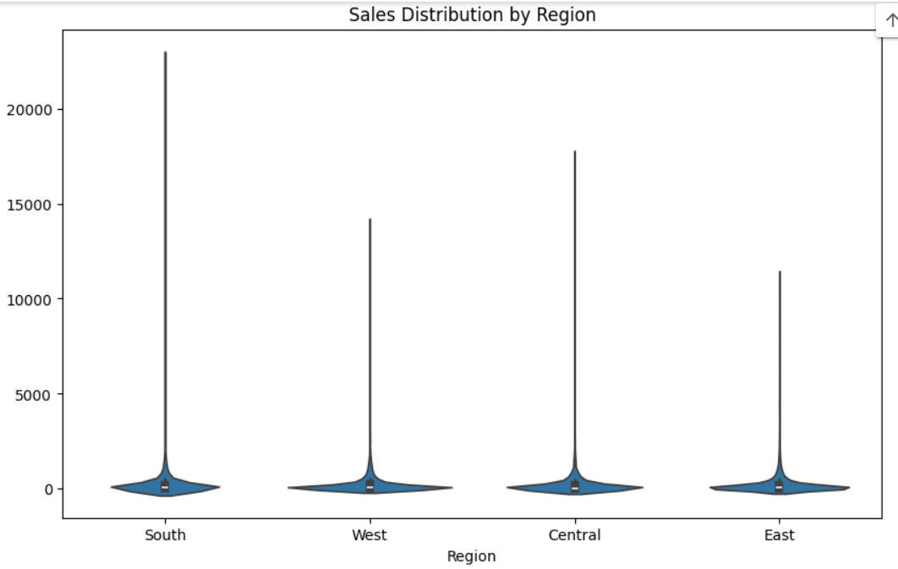
Sales distribution by Region
Each region's sales distribution is displayed side by side, enabling viewers to compare the sales patterns across different regions
we observed that the West region has the highest variability or spread in sales compared to the other regions.

Slide 15
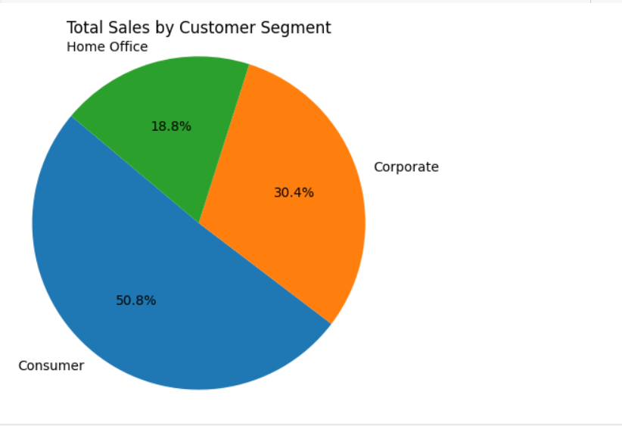
Contribution In Total Sales By Each Customer Segment
We have made pie chart of total sales by each consumer segment
What we observed from Total Sales by Customer Segment pie chart is that consumer segment has contributed most to the sales and Home office has contributed least.

Slide 16
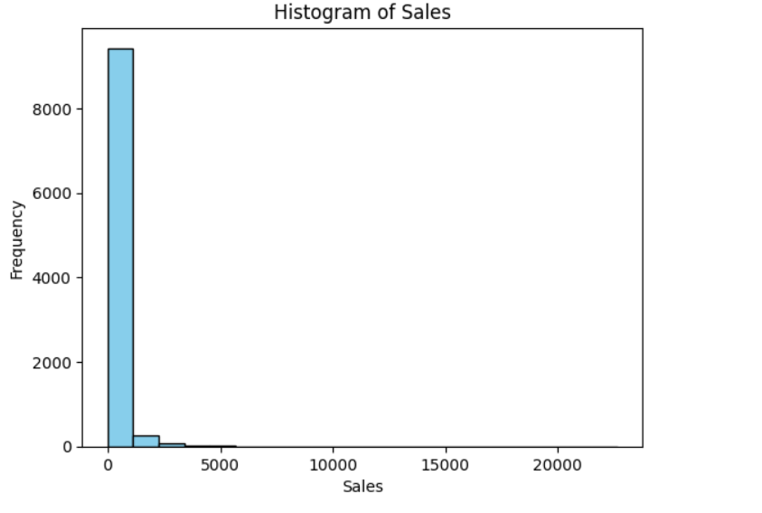
Histogram of Sales
We have made Histogram of Sales.
What we observed from Histogram of sales is that sales less than 5000 have highest frequency and sales are not greater than 5000 in any category

Slide 17
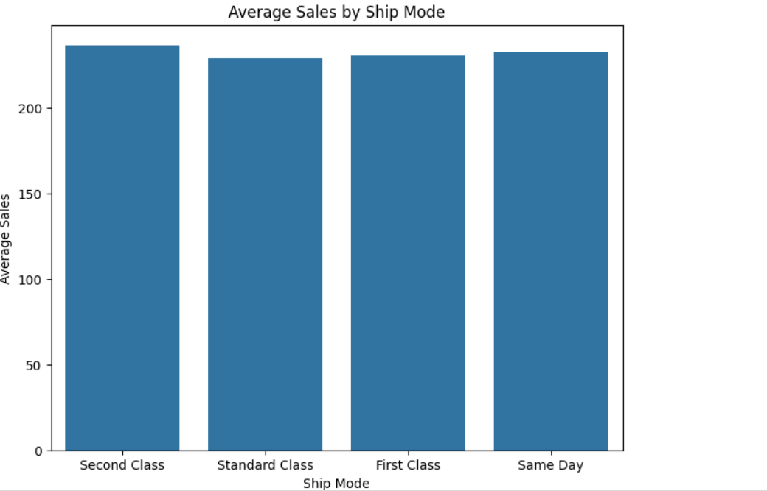
Average Sales By Ship Mode
This graph shows plot for Average Sales by 'Ship Mode'.
We observes that second class ship mode is used most and contribute most to sales and there is very less sales difference between standard class and first class

Slide 18
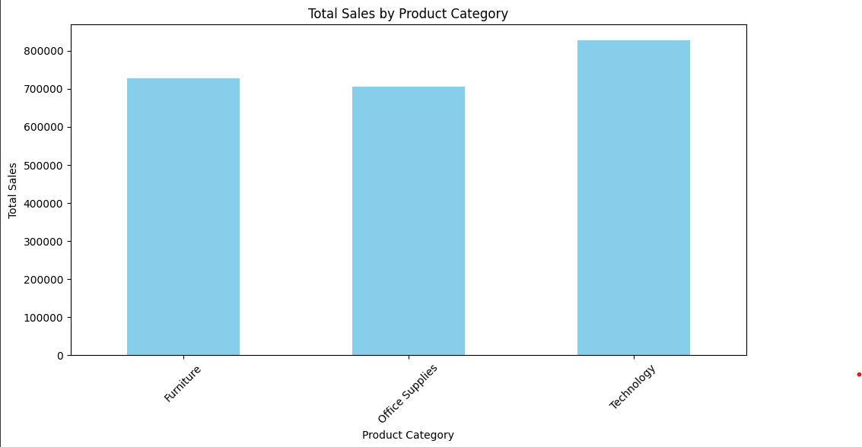
Total Sales by Product Category
We have made a bar plot of total sales by product category
It allows us to visualize the total sales across different product categories and technology has highest contribution of each category to overall sales.

Slide 19
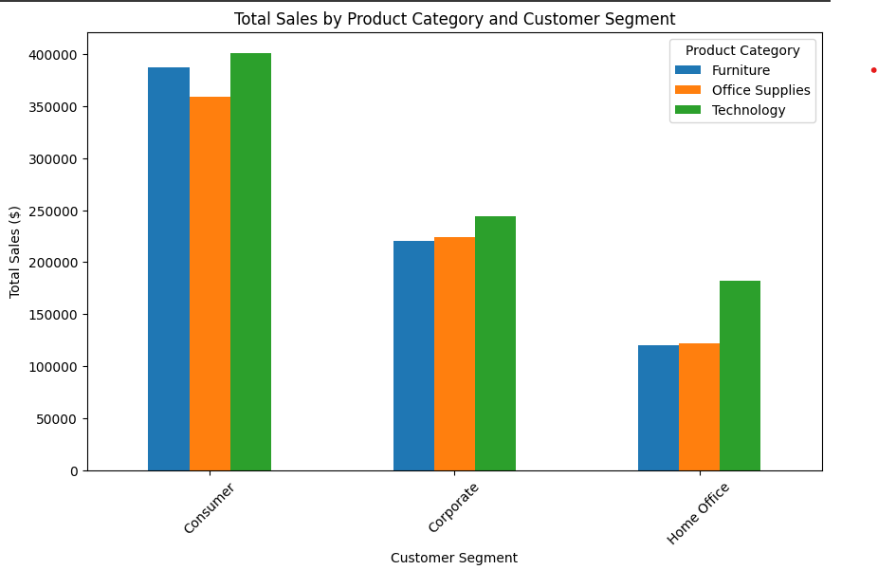
Total Sales by Product Category and Customer Segment
This graph effectively displays the total sales for each customer segment.
We observes that Technology contribute highest to sales in each consumer segment .

Slide 20
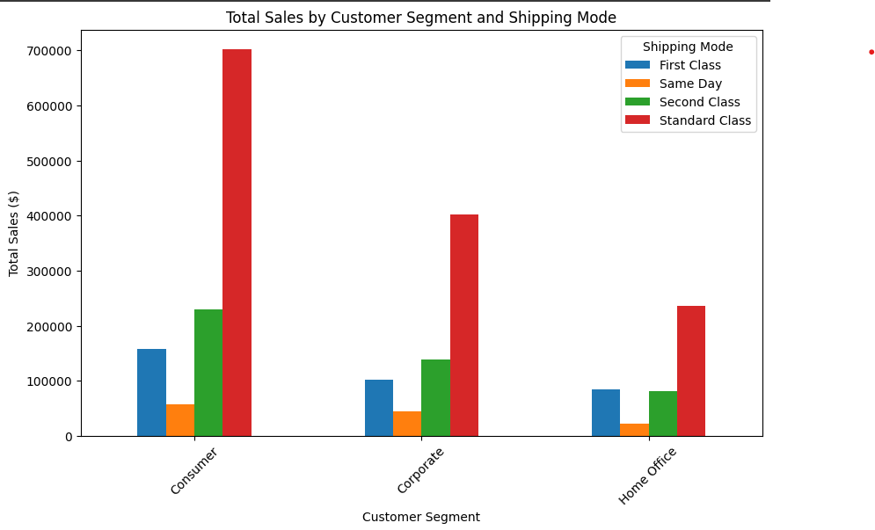
Total Sales by Customer Segment and Shipping Mode
This chart effectively displays the total sales for each customer segment and shipping mode.
We observed that in each customer segment standard class has contributed most to total sales

Slide 21
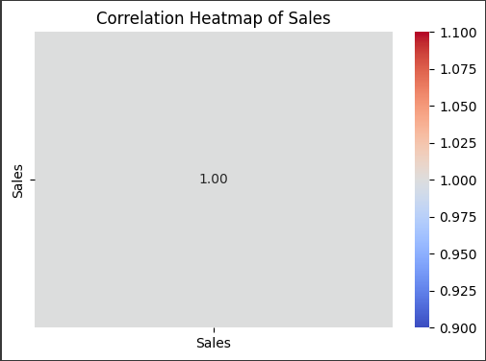
Correlation Heatmap of Sales
Creating a correlation heatmap between 'Sales' and itself.
Which will only display the correlation coefficient of 'Sales' with itself
Resulting in a single-cell heatmap with a correlation coefficient of 1.

Slide 22
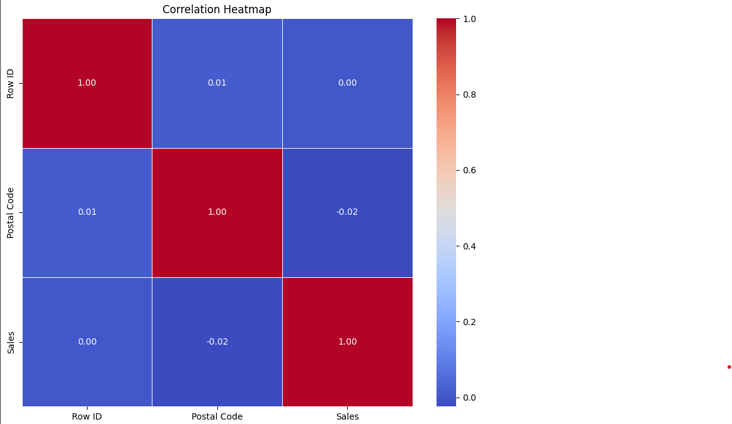
Correlation Heatmap
We have made a correlation Heat map of different numerical values like sales , row id and postal code
We observed that row id show positive correlation with itself and negative correlation with other numerical attributes.
Similarly all numerical attributes show positive correlation with itself and negative with others

Slide 23
Correlation Heat Map Colour Representation
Positive Correlation: If two variables have a positive correlation (i.e., they tend to increase or decrease together), the corresponding cell in the heatmap will be colored in shades of red. The darker the shade of red, the stronger the positive correlation.
Negative Correlation: If two variables have a negative correlation (i.e., as one variable increases, the other tends to decrease), the corresponding cell in the heatmap will be colored in shades of blue. The darker the shade of blue, the stronger the negative correlation.
No Correlation: If there's no significant correlation between two variables, the corresponding cell in the heatmap will be colored in a neutral color (often white or a very light shade of gray).

Slide 24
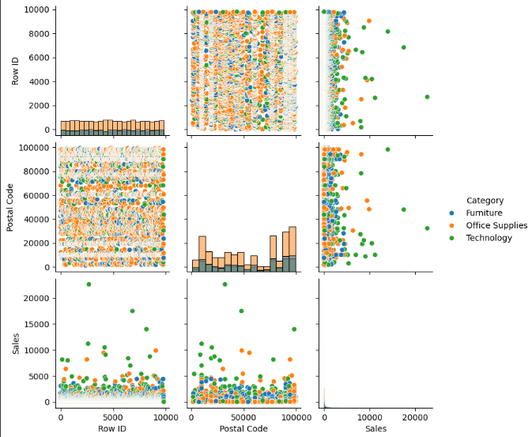
Pair Plot Sales, Postal Code & Row ID
From This pair plot we get to know sales are highly dependent on categorical variables ('Ship Mode', 'Segment', 'Region', 'Category') simultaneously.
We have only 3 numerical variables sale. We observed that in each customer segment standard class has contributed most to total sales

Slide 25

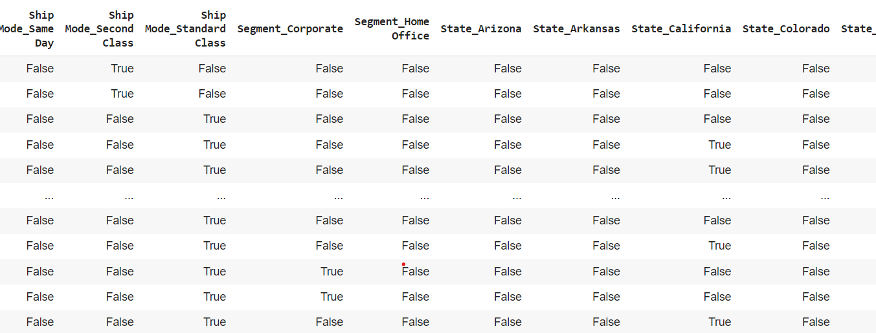
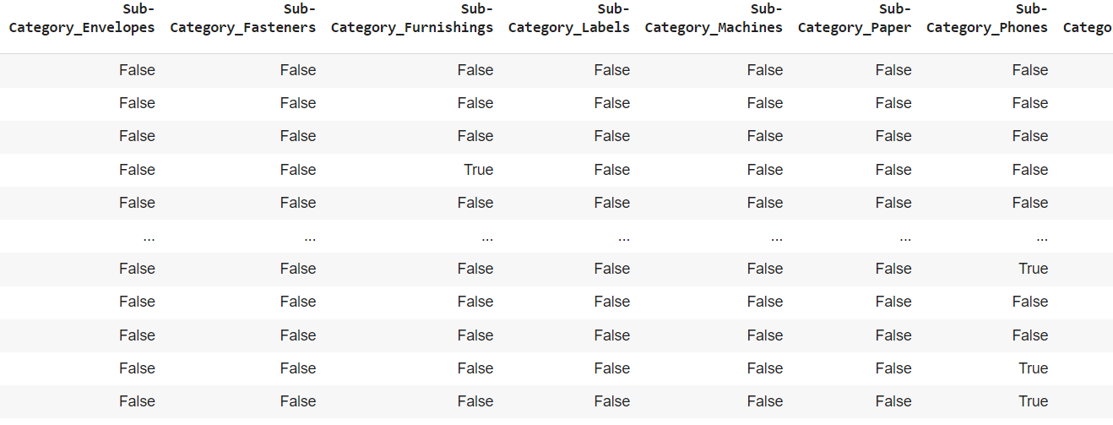
Feature Engineering & Data Pre-processing
1. Handling Missing Values
2. Categorical Encoding (One Hot)

Slide 26
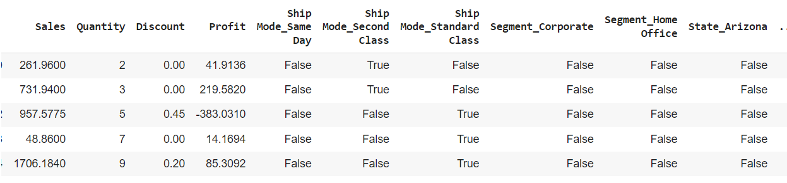
Feature Manipulation & Selection
1. Feature Manipulation

Slide 27
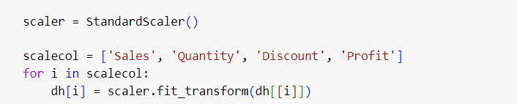
Data Scaling
StandardScaler from scikit-learn library is used to scale the data. The StandardScaler scales each feature by subtracting the mean and dividing by the standard deviation, which results in a distribution with a mean of 0 and a standard deviation of 1
It is less sensitive or more robust to outliers compared to other scaling methods like min-max scaling that's why we have used it here

Slide 28
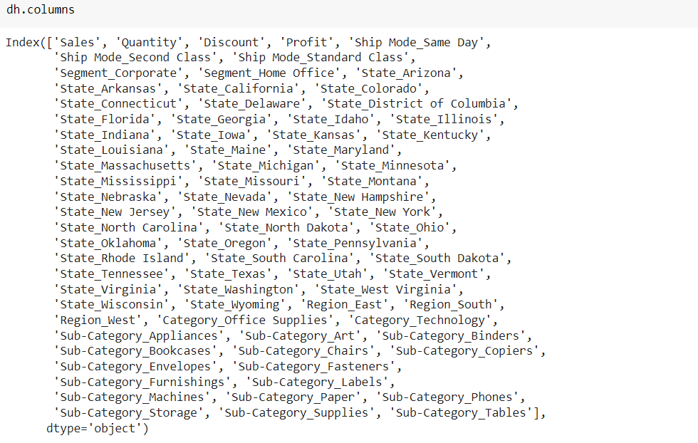
Columns

Slide 29
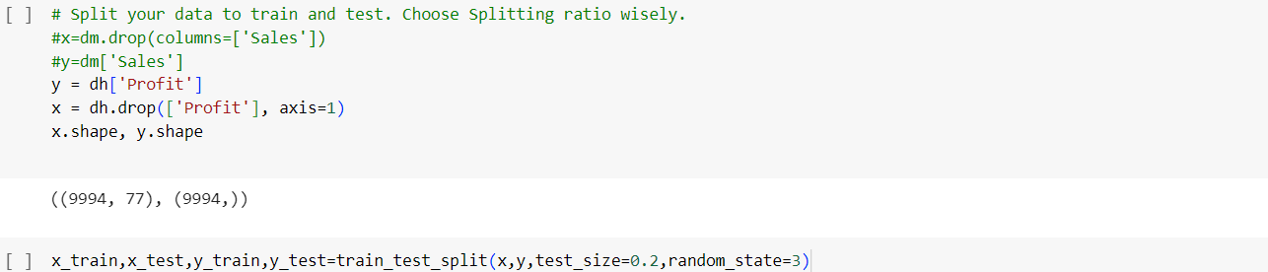
Data Splitting

Slide 30
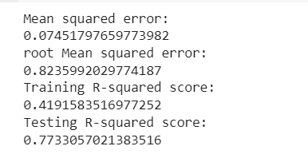
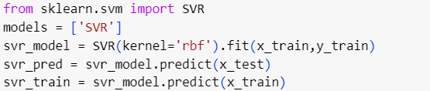
6. ML Model Implementation
ML Model - I
Support Vector Regressor (SVR):
Algorithm: SVR is a supervised learning algorithm used for regression tasks. It works by finding the hyperplane that best fits the data, with a margin that aims to minimize the error between the actual and predicted values while controlling for overfitting.

Slide 31
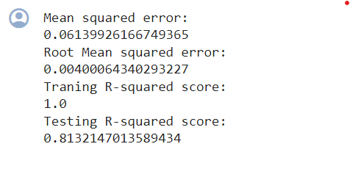
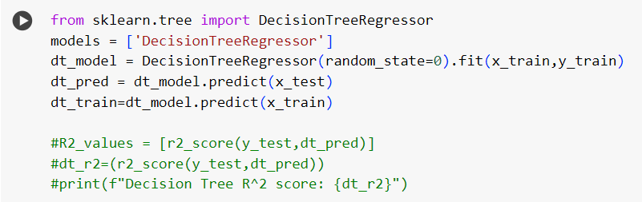
ML Model Implementation
ML Model - II
Decision Tree Regressor:
Algorithm: Decision trees partition the feature space into regions, with each region representing a simple decision rule. These rules are learned from the training data by recursively splitting the data based on the feature that best separates the target variable.

Slide 32
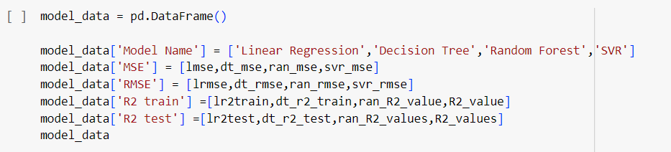
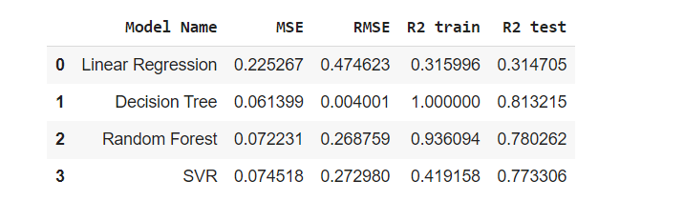
Conclusion

Slide 33
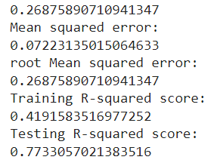
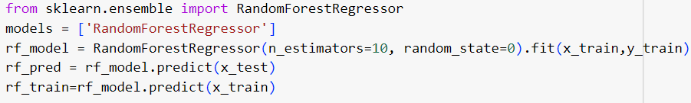
ML Model Implementation
ML Model - III
Random Forest Regressor:
Algorithm: Random Forest works by building multiple decision trees during training. Each tree is trained on a subset of the data and a random subset of features. This randomness helps to decorrelate the trees and reduces overfitting.

Slide 34
What CONCLUSION did we get?

Slide 35
Conclusion
Sales Trends and Seasonality:
The analysis reveals distinct seasonal patterns in sales, with peak periods coinciding with holidays and promotions. Understanding these trends can help optimize inventory management and marketing strategies to capitalize on peak demand periods.
Customer Segmentation Insights:
Through customer segmentation analysis, we identified distinct customer groups based on purchasing behavior and demographics. Tailoring marketing campaigns and product offerings to these segments can lead to more effective customer engagement and higher conversion rates.
Predictive Analytics for Demand Forecasting: By leveraging predictive analytics models, we can accurately forecast future sales demand, allowing the business to optimize inventory levels, reduce stockouts, and improve overall supply chain efficiency.
Sentiment Analysis of Customer Feedback: Sentiment analysis of customer feedback revealed valuable insights into customer satisfaction levels, common pain points, and areas for improvement. Addressing these issues proactively can enhance customer loyalty and retention rates.
Examining operational metrics such as shipping timing and order processing efficiency highlights areas where operational processes can be optimized to improve customer satisfaction and reduce costs.

Slide 36
What are the ‘RECOMMENDATIONS’?

Slide 37
Recommendation
Enhanced Data Exploration and Visualization:
Conduct more comprehensive data exploration and visualization to gain deeper insights into the relationships between different variables, such as sales trends over time, correlations between product categories, and customer purchasing behavior.
Predictive Analytics for Demand Forecasting:
Implement predictive analytics models to forecast future sales demand accurately, allowing the business to optimize inventory levels, manage supply chain operations more effectively, and minimize stockouts or overstock situations.
Customer Segmentation and Personalization:
Segment customers based on their purchasing behavior, demographics, and preferences to tailor marketing campaigns, promotions, and product recommendations for different customer segments.
Sentiment Analysis and Customer Feedback Mining:
Analyze customer feedback, reviews, and sentiment data to understand customer sentiment, identify areas for improvement, and address potential issues proactively to enhance customer satisfaction and loyalty.
Interactive Decision Support Systems:
Develop interactive decision support systems that enable business stakeholders to explore the data, visualize key insights, and simulate the impact of different strategies or scenarios to make informed decisions and drive business growth.

Slide 38
What Were the ‘CHALLENGES’?

Slide 39
Challenges
Data Quality and Completeness:
The dataset may contained missing values, inconsistent formatting, or errors that affected the accuracy of your models.
Feature Engineering:
Extracting relevant features from the dataset were complex, especially when we were dealing with categorical variables, timestamps, or text data.
Handling Imbalanced Data:
The dataset exhibited class imbalance, where certain classes or categories are underrepresented compared to others.
Interpreting and Communicating Results:
Translating the model predictions into actionable insights for business stakeholders will be difficult, especially when dealing with complex AI and ML models.

Slide 40
Questions?
How would we know the Value Count of Customers in Each State?
What are the calculated Value Counts?
How many categories does sales distribution have?
What is the Distribution of Sales across segments?
How did we described sales by row id?
What are the total selling sub-category within each product category?
What are the distribution of sale by region?
What are the Contribution In Total Sales By Each Customer Segment?
What are the average sales by region?
What are the average sales by ship mode?
What are the total sales by product category?
WHat are the total sales by product category and customer segment?
What are the total sales by customer segment and shipping mode?

Slide 41
Questions
Q. Which ML model did you choose from the above created models as your final prediction model and why?
Ans: I will choose Decision tree for future prediction as its r2 score is 1 for training set and for testing set it is 0.81 which is very high accuracy
Q. Explain the model which you have used and the feature importance using any model explainability tool?
Ans Decision Tree Algorithm:
Decision tree is a supervised learning algorithm used for both classification and regression tasks.
It works by recursively partitioning the feature space into subsets based on the values of features, creating a tree-like structure where each internal node represents a decision based on a feature, and each leaf node represents a predicted outcome.
The splitting process aims to maximize the homogeneity (purity) of the subsets with respect to the target variable.
Feature Importance Analysis:
Gini Importance or Mean Decrease in Impurity (MDI): One common method for determining feature importance in decision trees is to measure how much each feature contributes to decreasing impurity (Gini impurity or entropy) across all nodes where it is used for splitting.
Features that lead to the greatest reduction in impurity are considered more important.

