Slide 1



Org Trivia - Automated Weekly Quizzes
Jaypee University of Information Technology, Waknaghat - 173234 (India)
Major Project - II (18B19CI891) | AY 2024-25
Mid-Term Evaluation | March 17-22, 2025.
Group No.: 92C
Student Details
Name: Ujjwal Pathak (211105)
Designation: Product Dev Intern
Organization: Darwinbox
Location: Hyderabad, Telangana
Supervisor
Name: Sandip Pingle
Designation: Senior Engineering Architect
Organization: Darwinbox
Location: Hyderabad, Telangana

Slide 2
Outline
Introduction
Problem Statement
Objectives
Work Done (after Major Project - I)
Project Design
Implementation
Experimental Results and Evaluation
Key Learnings
Work Plan (till End-Term Evaluation)
Work Contribution and Other Details
References

Slide 3
Introduction
Employees focus primarily on their individual tasks and often miss out on company-wide updates, HR policies, and organizational achievements.
The project will develop an AI-driven automated weekly quiz system to enhance employee awareness and participation.
The system will employ Gemini AI to create quiz questions from company news, HR reports, and general aptitude.
Gamification features such as leaderboards, badges, streaks, and multipliers will be implemented to make learning interactive and engaging.

Slide 4
Problem Statement
Employees have limited awareness of organizational achievements, HR policies, and company-wide updates due to a focus on their own work.
Excessive amounts of HR teams' time are wasted creating quizzes or training material manually, thus failing to provide employees with information consistently.
Traditional training and learning processes are not interactive, resulting in low attendance and retention of critical information.
We need to reduce the Human Effort required by the HR to make these quizzes to increase adoption.

Slide 5
Objectives
Implement weekly quizzes with Gemini AI to produce appropriate questions.
Reduce HR involvement by retrieving content automatically and creating quizzes dynamically.
Improve employee engagement through gamification features like leaderboards, badges, and streaks.
Support ongoing learning of company news and HR policies in an engaging manner.

Slide 6
Work Done (after Major Project - I)
AWS Development
Passed an AWS Lambda function to manage question generation through Gemini.
Lambda uses HR Docs and company updates to dynamically create quiz questions.
Created a Node.js backend with MongoDB for quiz, user scores, and game data.
Frontend Development
Constructed a multi-screen and multiple-component React quiz platform.
Created an engaging UI to deliver a better experience for taking a quiz.
Automation & Integration
Automated Scheduling of the Quiz
The system programmatically creates the quizzes every week without human input.

Slide 7
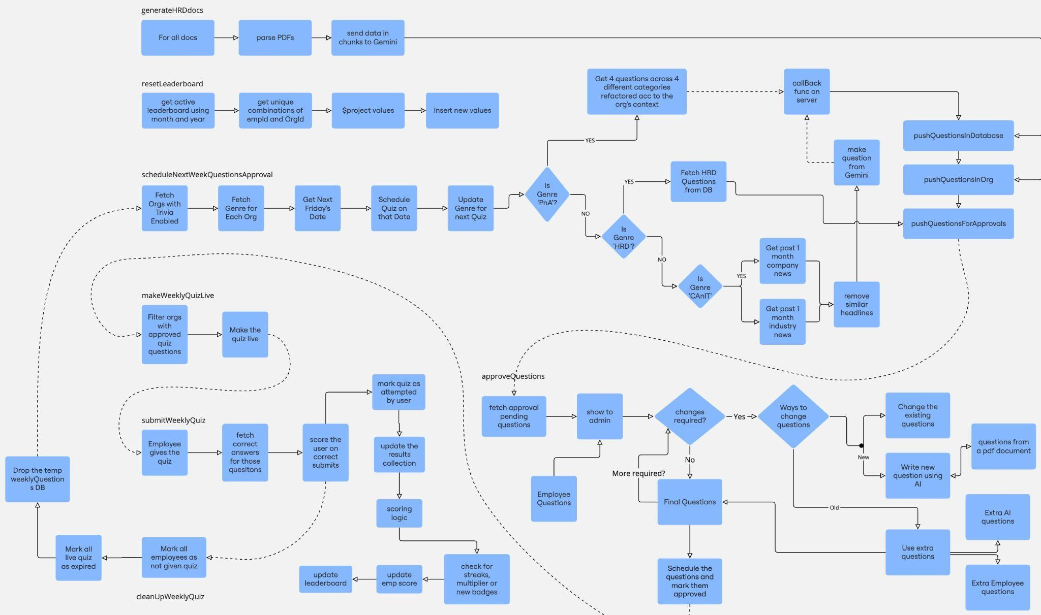
Project Design
Flow Chart for all Jobs

Slide 8
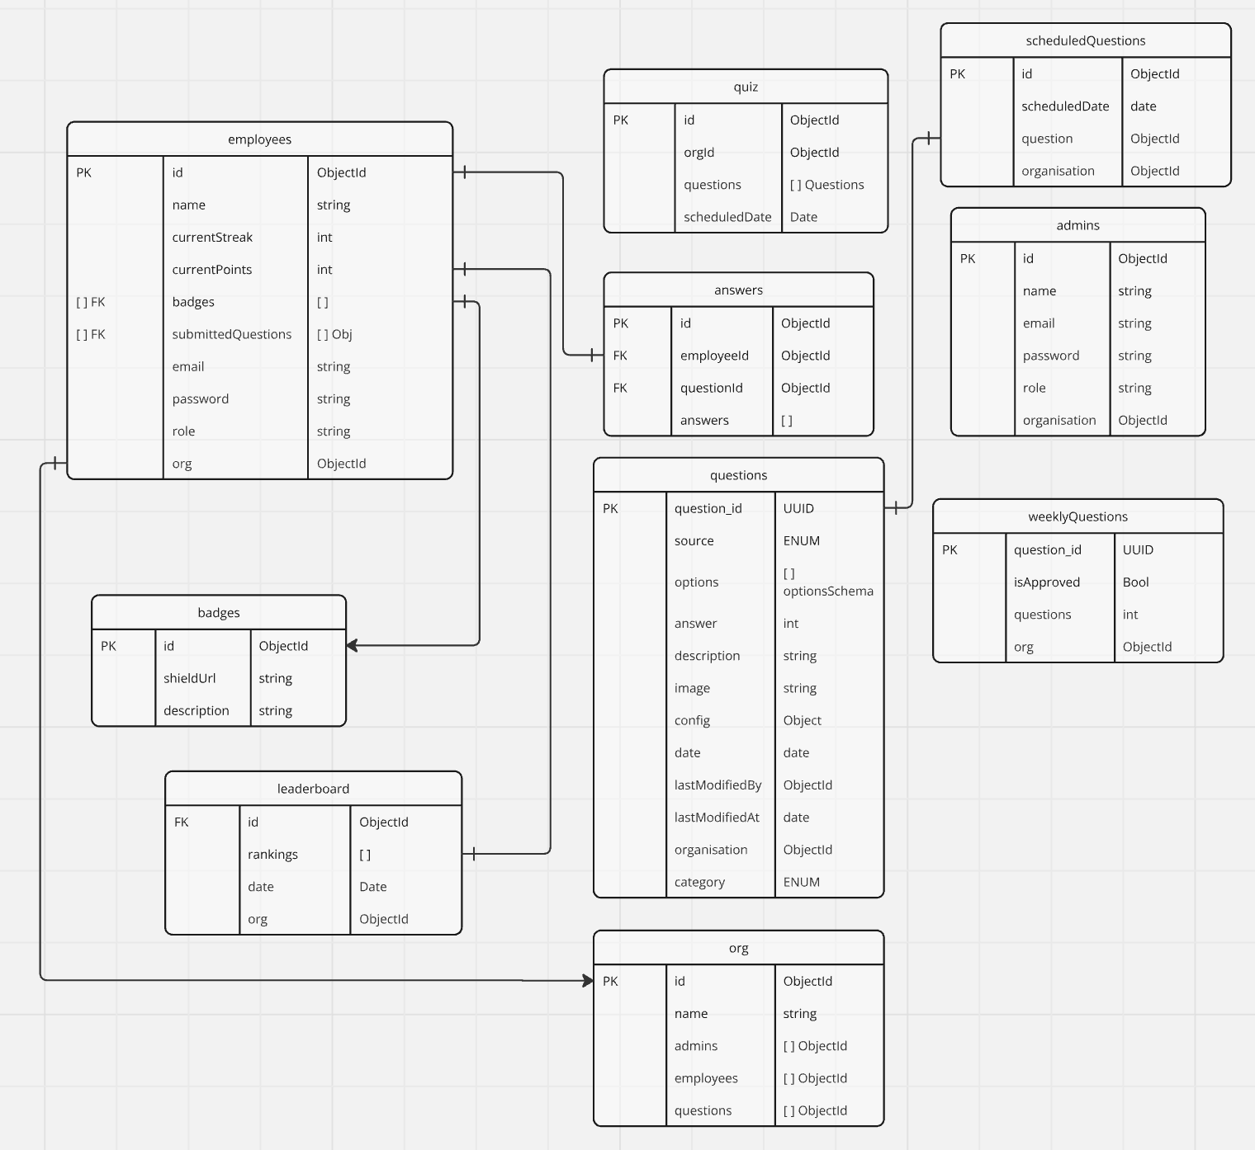
Project Design
ER Diagram

Slide 9
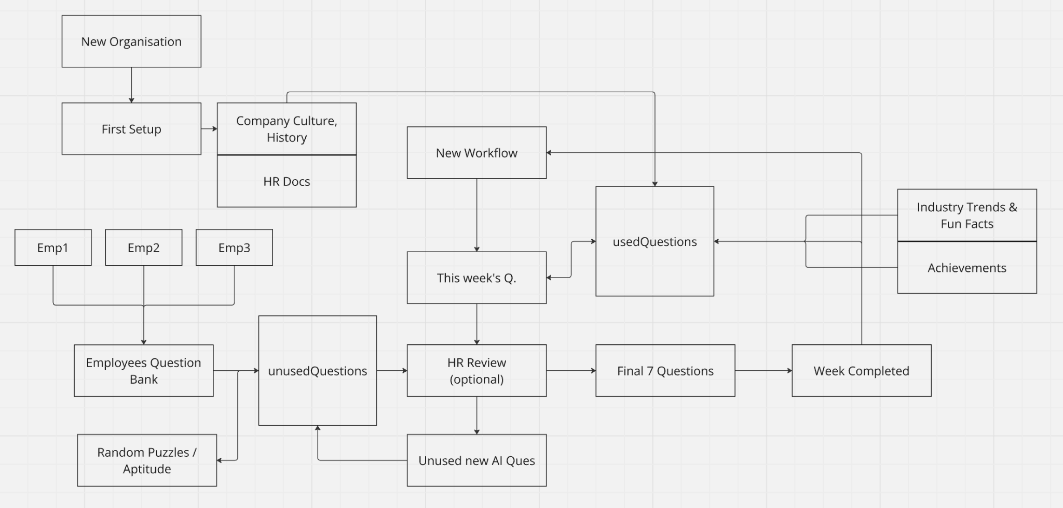
Project Design (cont…)
User Flow

Slide 10
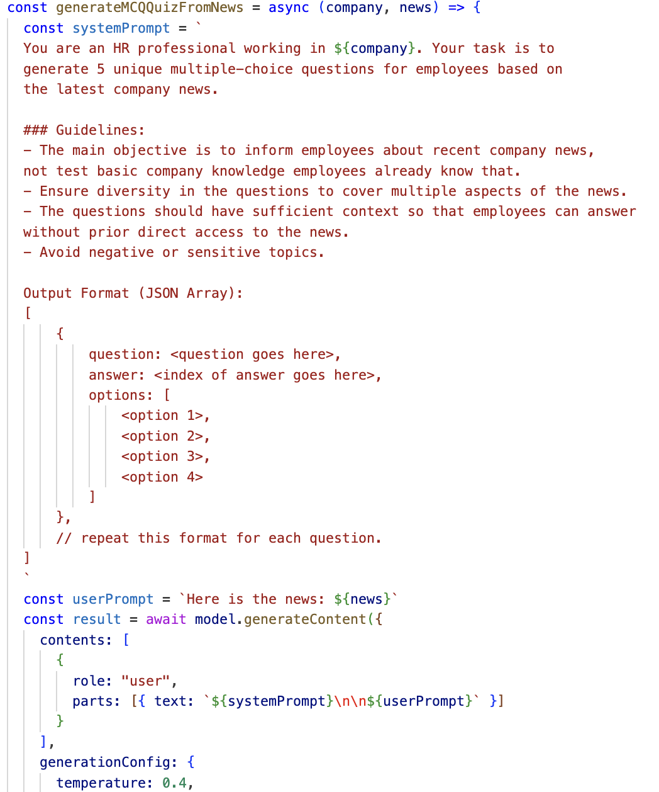
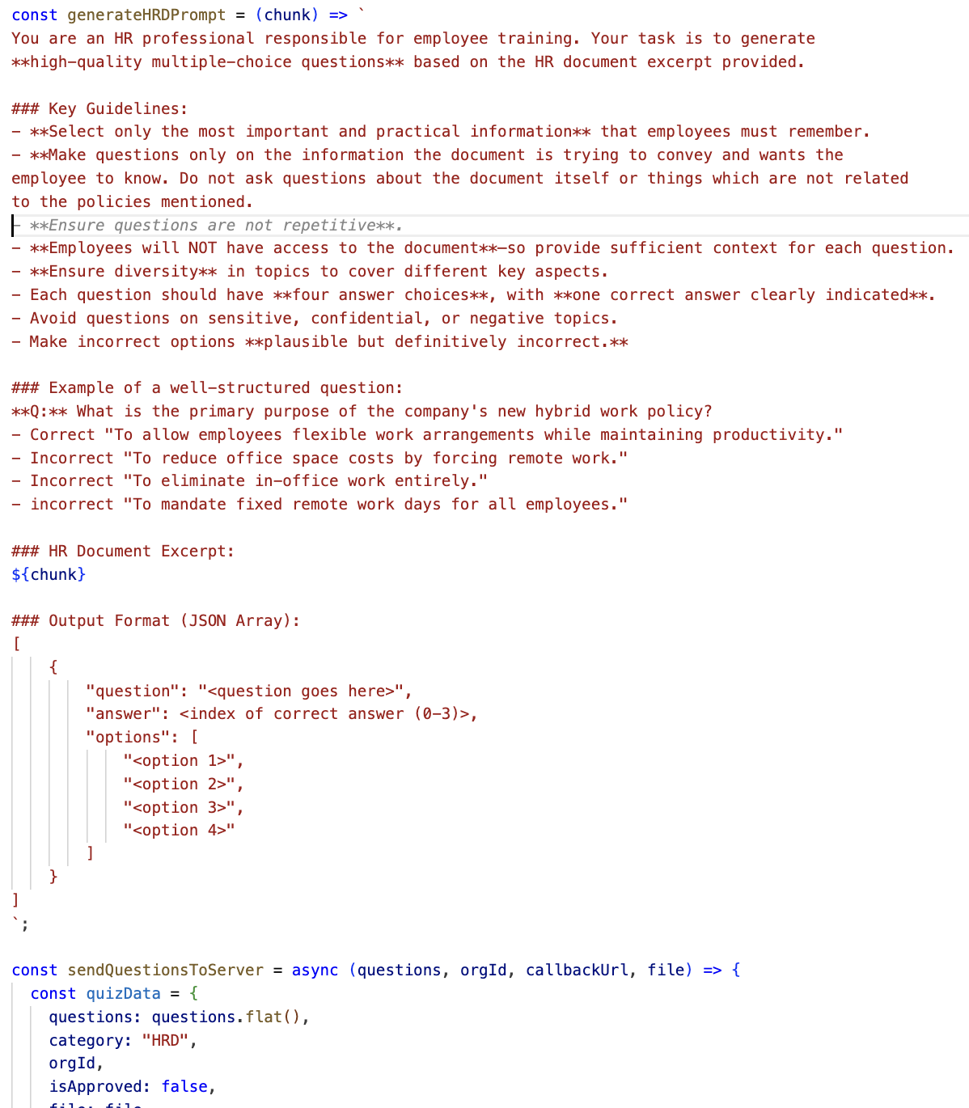
Implementation
Company and Industry Trends Genre
Human Resources Docs

Slide 11
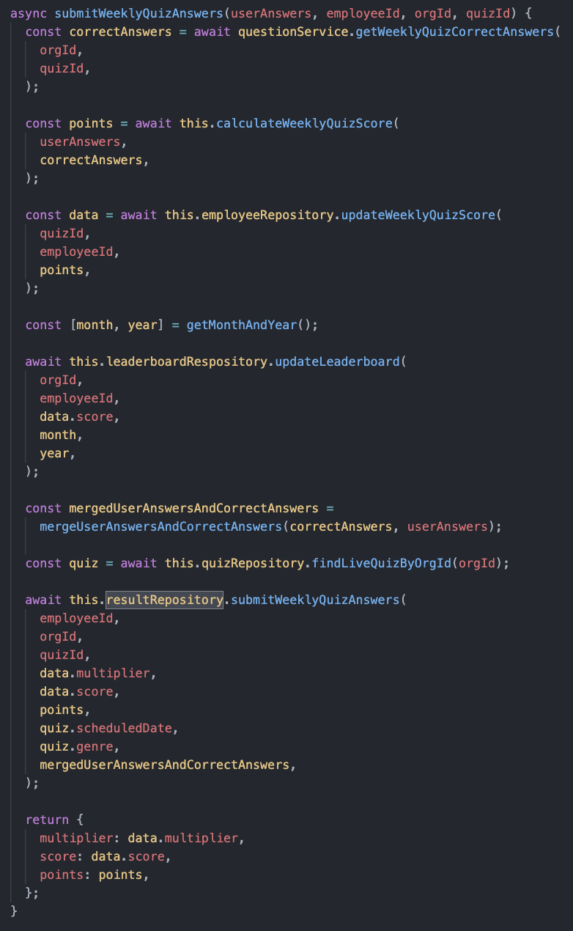
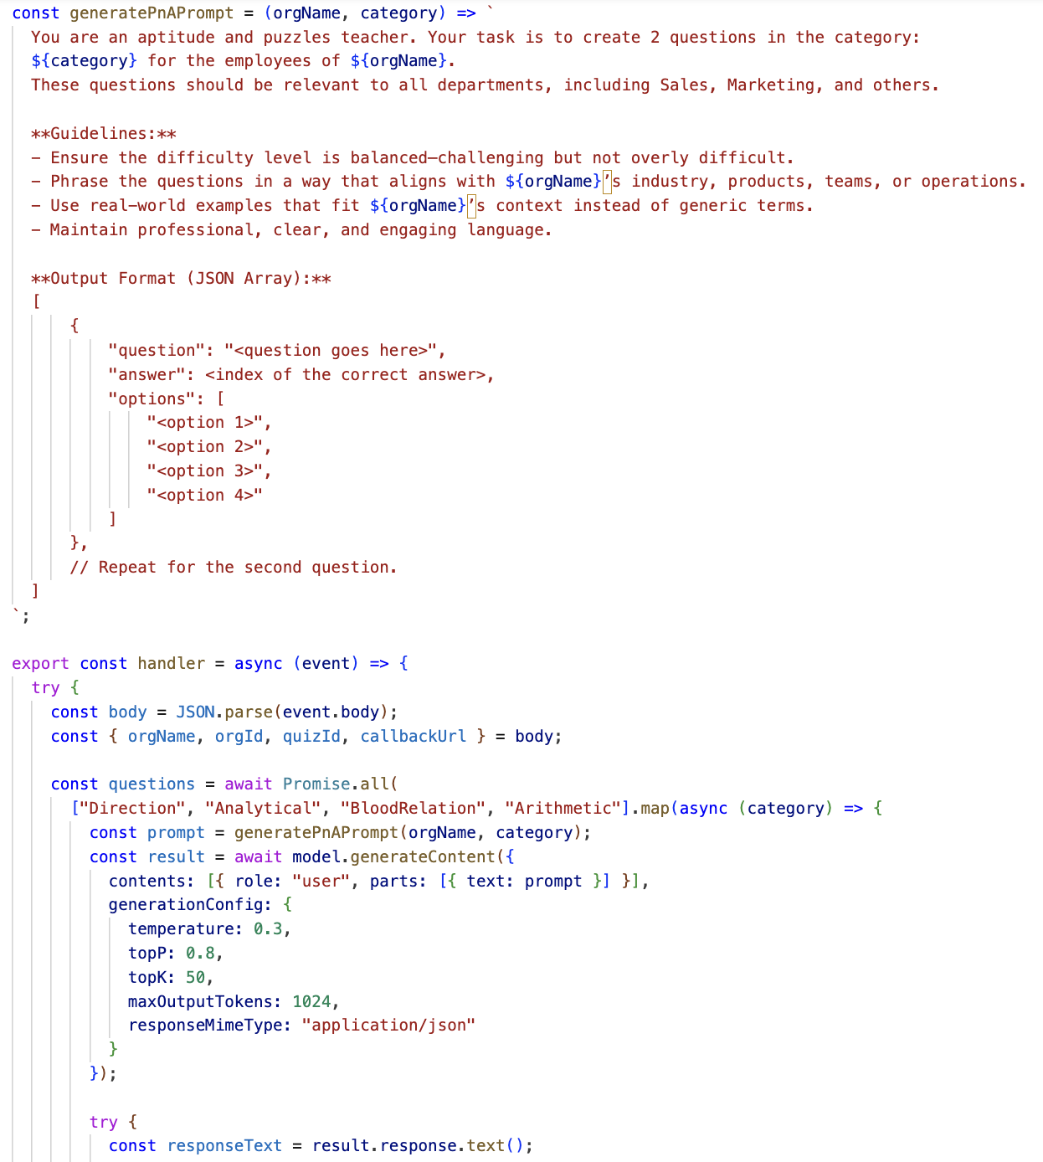
Implementation (cont…)
Final Score Calculating
Puzzles Genre Ques Generation

Slide 12
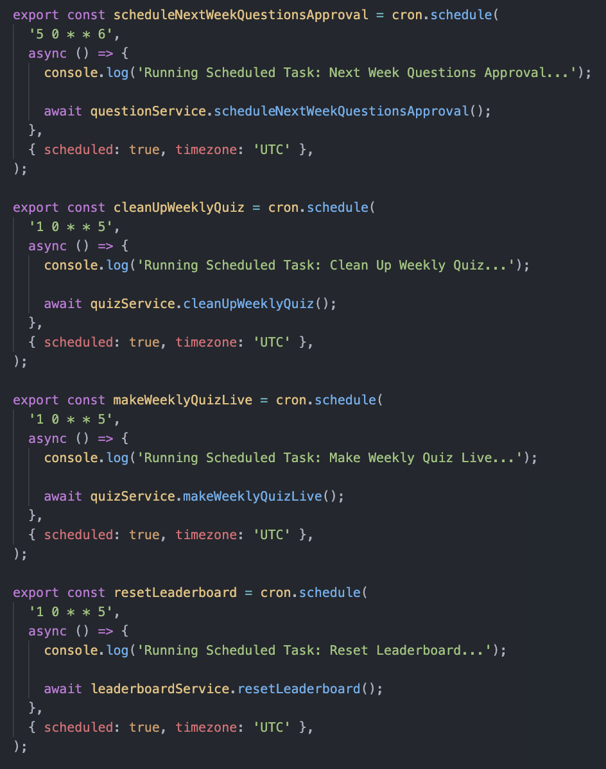
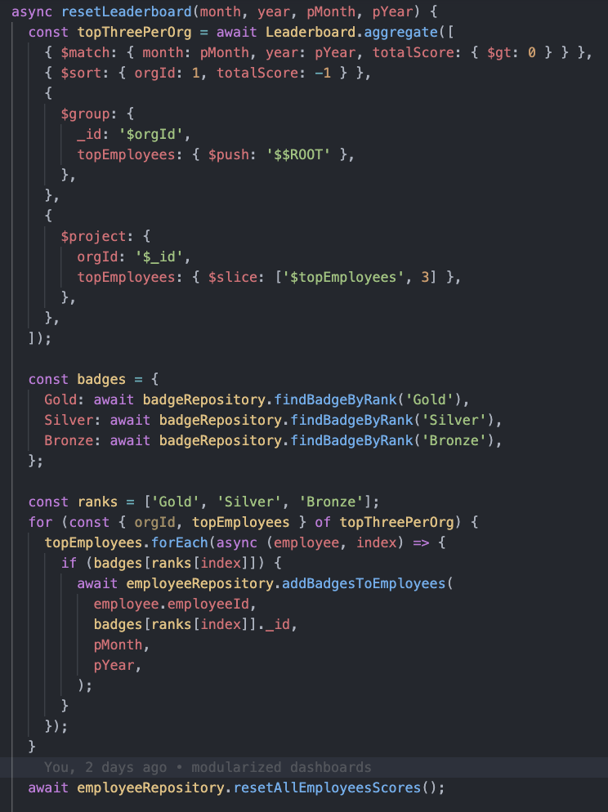
Implementation (cont…)
Cron Jobs to automate processes Resetting Leaderboard & Badges

Slide 13
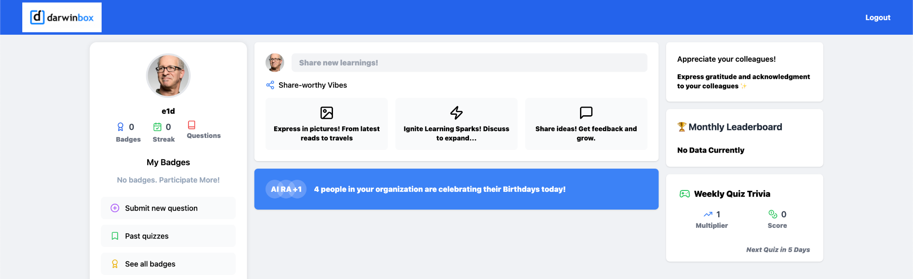
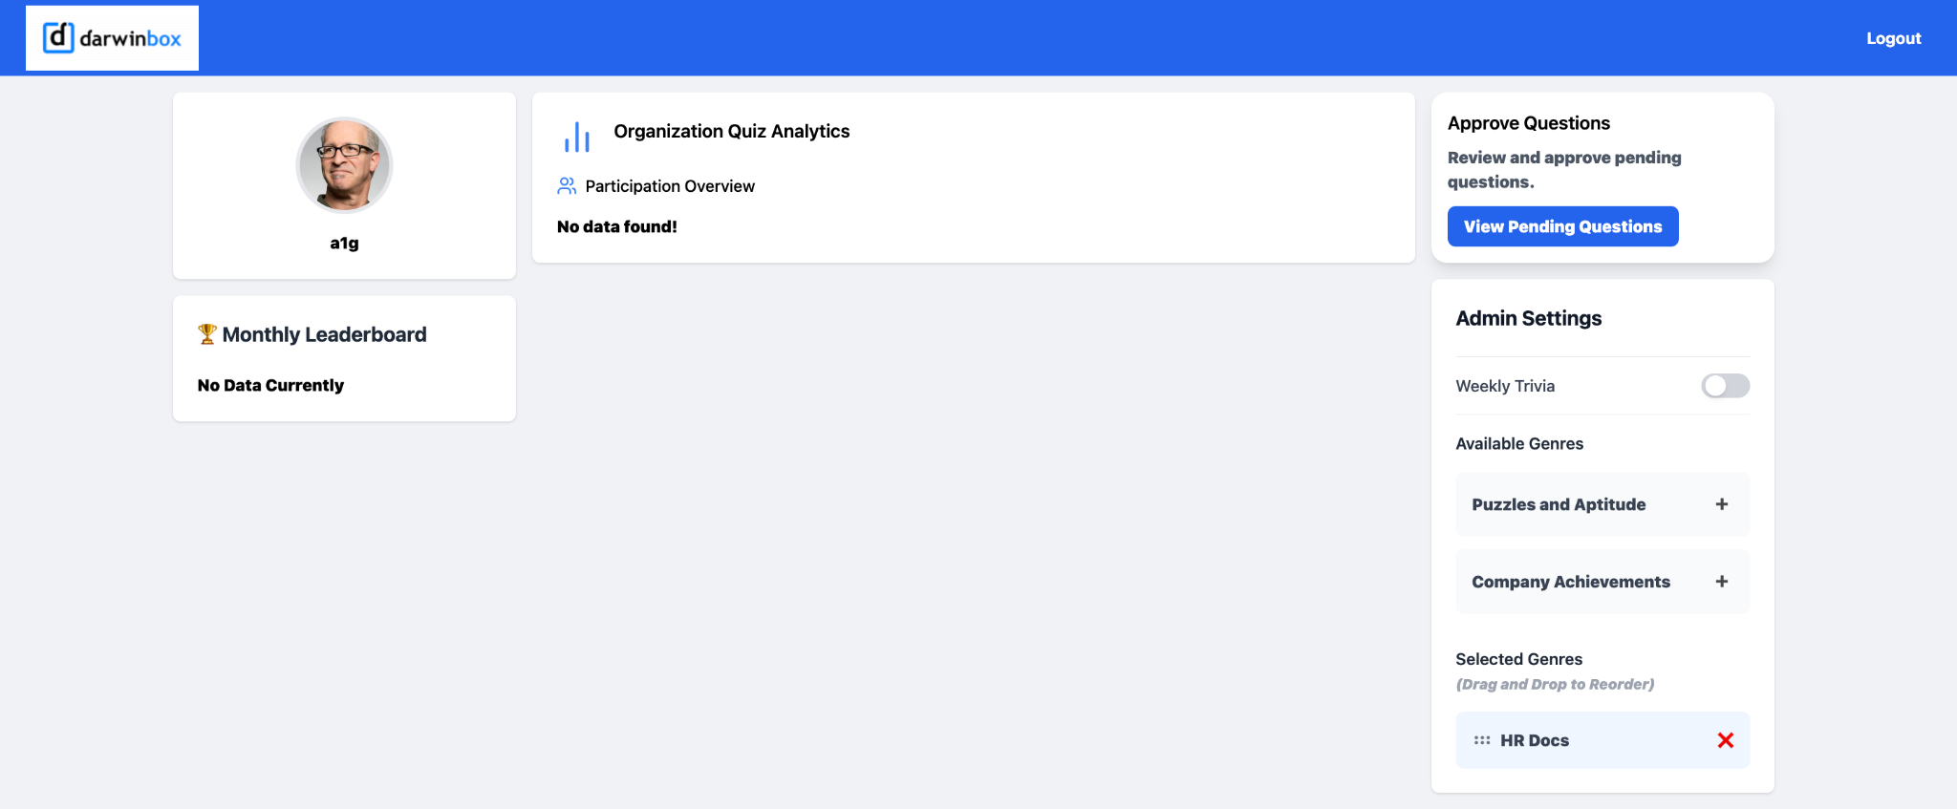
Experimental Results and Evaluation
Employee Dashboard
Admin Dashboard

Slide 14
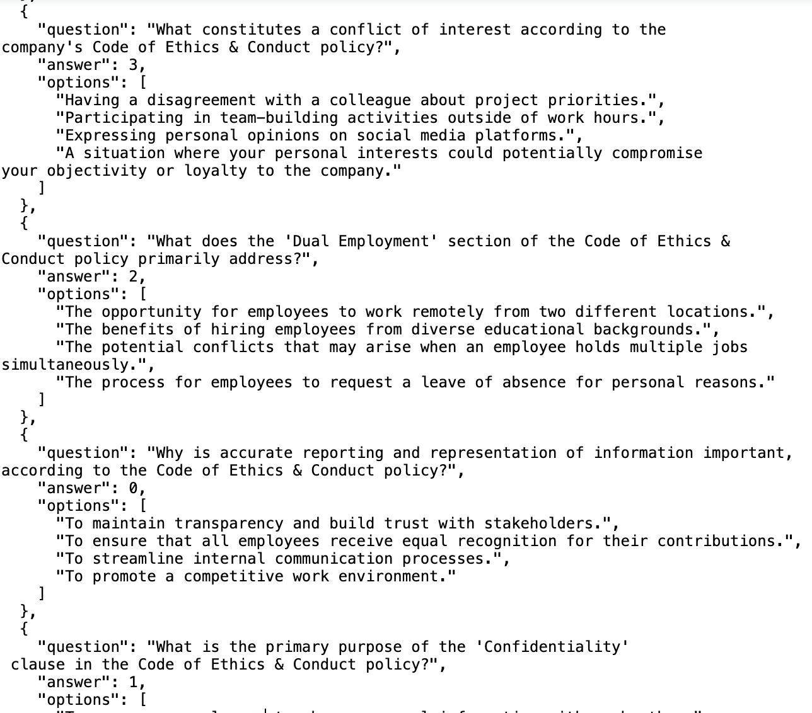
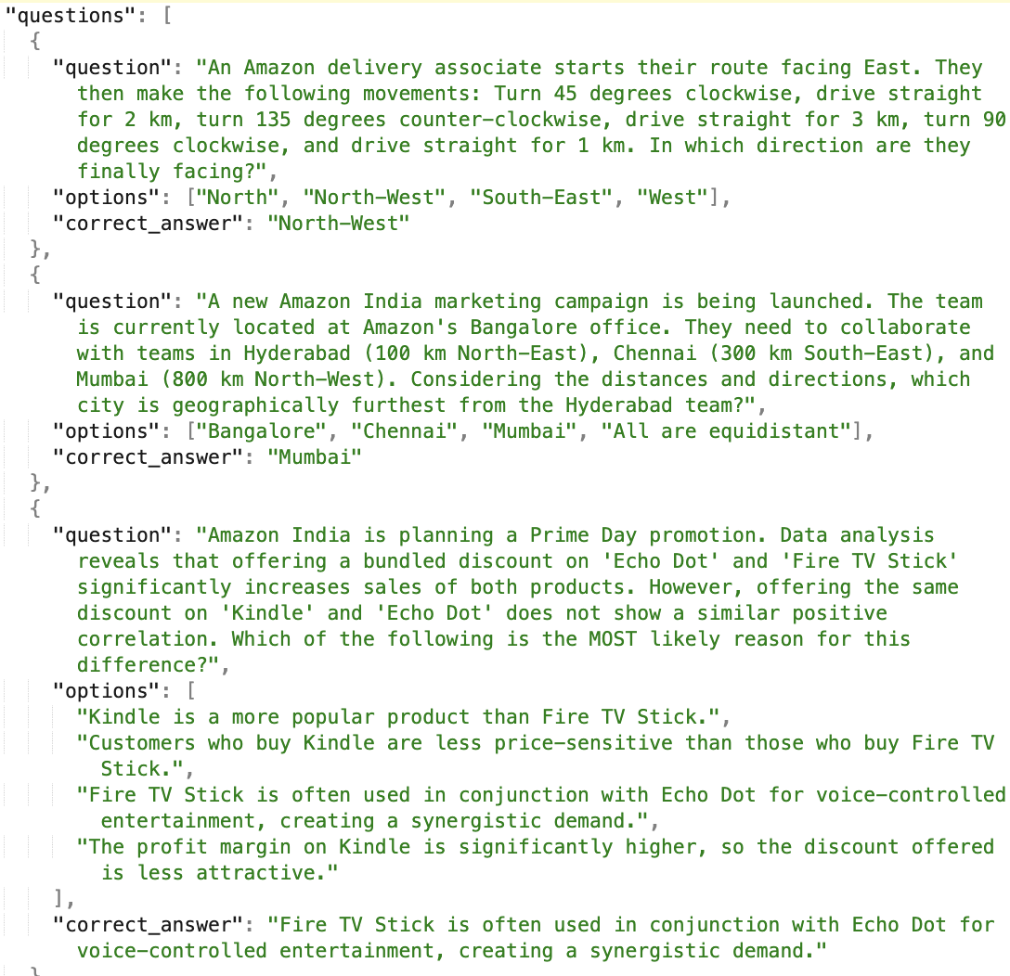
Experimental Results and Evaluation (cont…)
HRDocs Questions
Puzzle Questions

Slide 15
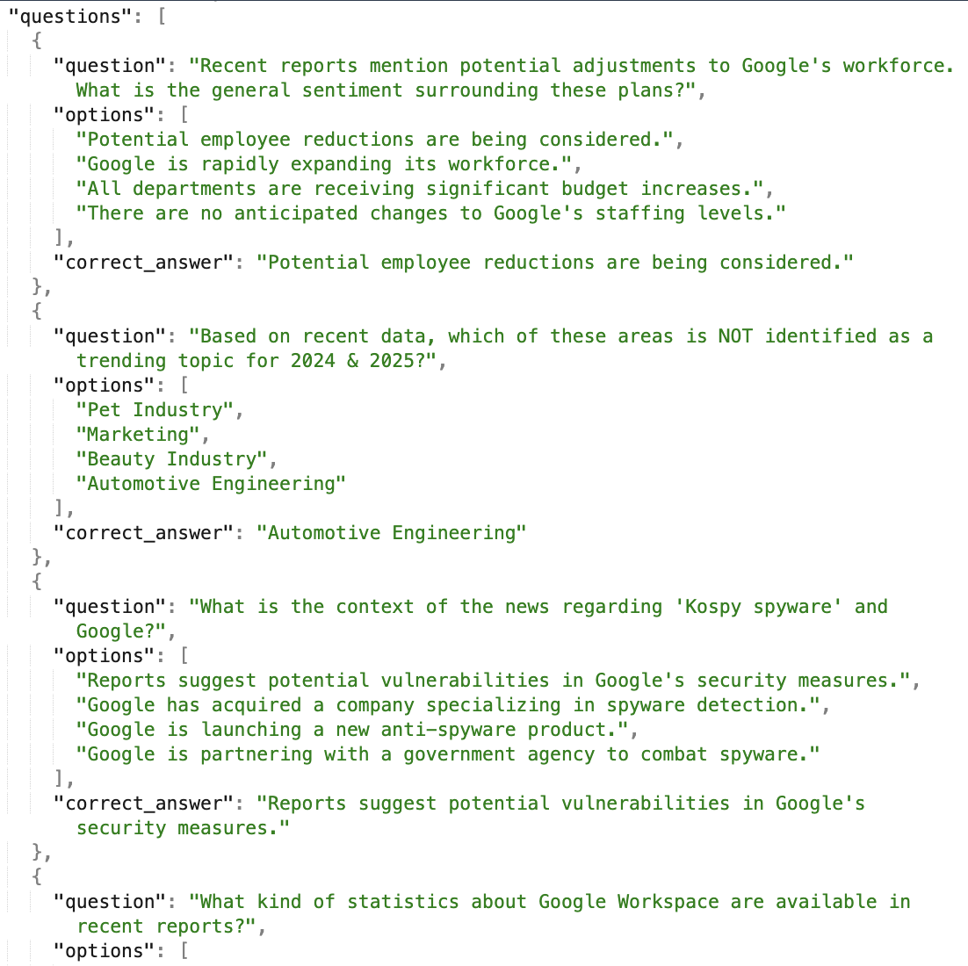
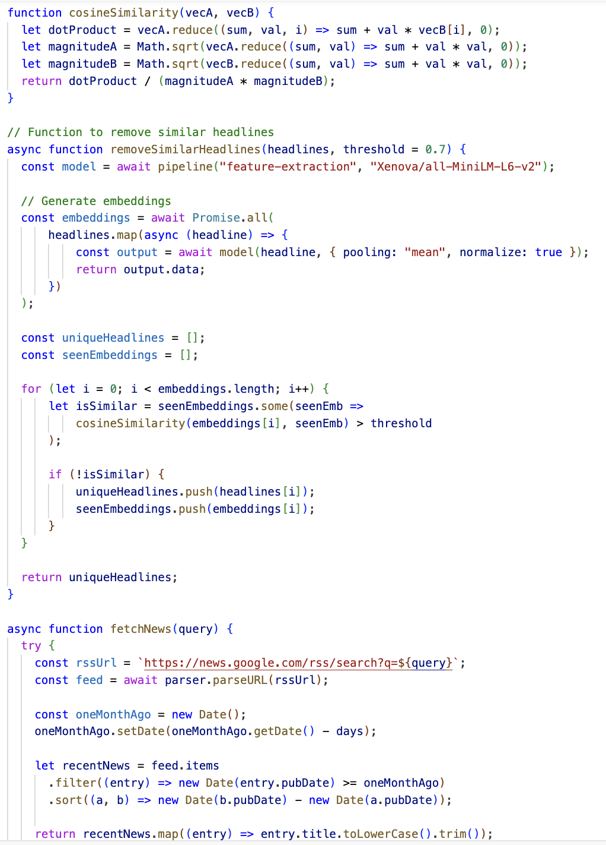
Experimental Results and Evaluation (cont…)
Company Trends Questions
Remove Duplicate Headings

Slide 16
Key Learnings
Employed Gemini AI to create quiz questions from business news and HR guidelines, automating quiz creation to minimize HR burden.
Developed a Node.js backend with MongoDB for quiz management, user scores, and automated scheduling.
Created an interactive React-based quiz website with gamification aspects such as leaderboards and badges.
Learned to write Complex MongoDB queries.

Slide 17
Work Plan (till End-Term Evaluation)
Improve Gemini AI’s question formulation by refining prompts and adding context from HR reports and company updates. Implement data preprocessing to filter out irrelevant content before feeding it to the AI.
Use Jest to add unit and integration tests for both backend and frontend. Implement fail-safe mechanisms for API failures.
Implement relapse methods: If the weekly quiz generation fails, retry with exponential backoff. Set up fallback storage to use the last successful quiz if regeneration fails.
Optimize MongoDB queries to handle large-scale user participation without slowdowns.

Slide 18
Work Contribution and Other Details
Roll No. |  | Start Date (dd/mm/2025) |  | Organization & Location | Work Mode (Online/Offline) | Work Nature (Tech./Non-Tech.) | Work Domain
211105 |  | 01/02/2025 |  | Darwinbox, Hyderabad | Offline | Tech | Full-Stack Development
GitHub Repository URL: https://github.com/ujjwalpathaak/org-trivia/tree/starting_scoring_and_leaderboard_features
Work Contribution
Week 1 | 27/01/2025 to 31/01/2025 |  | Meeting Leadership and Engineering Teams. Trainings about - POSH, Cyber Security & Code of Conduct. Meeting the CTO and Senior Engineering Managers.
Week 2 | 03/02/2025 to 07/02/2025 |  | Research about the requirements and changes in the project idea. Talking with PM to know about the requirements.
Week 3 | 10/02/2025 to 14/02/2025 |  | Making basic UI to see how the final product will be looking. Writing Backend APIs to setup the basic infra and the core code logic.
Week 4 | 17/02/2025 to 21/02/2025 |  | Connecting all jobs and starting the basic flow - simulating how the whole week will work. Added settings to the admin dashboard.

Slide 19
Work Contribution and Other Details (cont…)
Work Contribution
Week 5 | 24/02/2025 to 28/02/2025 | Refactoring UI to follow Darwinbox Design pattern. Added Analytics in the Admin Dashboard view.
Week 6 | 03/03/2025 to 07/03/2025 | Writing the Streak, Leaderboard & New Jobs to clean quizzes. Updating Models to optimize the queries and pipelines.
Week 7 | 10/03/2025 to 14/03/2025 | Finalizing the Streak, Leaderboard & Cleanup process. Refactoring code for readability.
Week 8 | 17/04/2025 to 21/04/2025 | Refactoring Code to follow the Controller, Service & Repository Architecture. Prepare for evaluation

Slide 20
References
[1] Artificial Intelligence Integration for Employee Engagement: A Review to Redefine Predictors, Atlantis Press, 2024.
[2] S. R. Na, “Application of Artificial Intelligence in Employee Training and Development,” Mathematical Modeling and Algorithm Application, vol. 1, no. 1, pp. 26-28, 2024.
[3] Gamifying Corporate Training With AI-Powered Quizzes, Training Industry, 2023.
[4] The Impact of Gamification on Training, Work Engagement, and Job Performance, International Journal of Training and Development, vol. 25, no. 2, pp. 99-121, 2023.
[5] The Future of Learning & Development: Adapting to an AI-Powered World, SHRM, 2023.
[6] When Generative AI Meets Workplace Learning: Creating A Realistic & Motivating Learning Experience With A Generative PCA, arXiv preprint arXiv:2405.15561, 2024.
[7] Game on: Can Gamification Enhance Productivity?, F1000Research, vol. 12, p. 818, 2023.
[8] Role of Artificial Intelligence in Corporate Training and Development, International Journal of Intelligent Systems and Applications in Engineering, vol. 11, no. 2, pp. 123-130, 2023.
[9] S. Chaurasiya and U. Kumar, “Use of Gamification in Employee Training and Development,” International Journal of Engineering Research and Technology, vol. 13, no. 5, pp. 1234-1240, May 2024.

Slide 21
References (cont…)
[10] O. Arnold and K. P. Jantke, “An Innovative Approach to Employee Training and Skill Development,” in Proceedings of the 15th International Conference on Applied Human Factors and Ergonomics (AHFE 2024), San Francisco, CA, USA, July 2024, pp. 567-578.

Slide 22
Thanks.

