Slide 1


Question Answering System
Student name : Ujjwal Pathak
Mentor name : Dr. S Samant

Slide 2


Outlines-
Introduction & Problem Statement
Methodology
Result & Discussion
Conclusion & Future Work
References

Slide 3
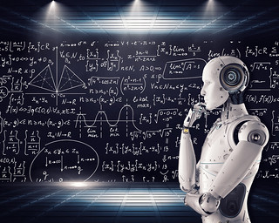
Problem Statement
Create a system that can accurately understand and reply to a variety of user inquiries from multiple domains, giving information that is both relevant and trustworthy. The system should be able to take into account the intricacies of natural language, comprehend the context, extract relevant information, and produce succinct and correct answers.

Slide 4
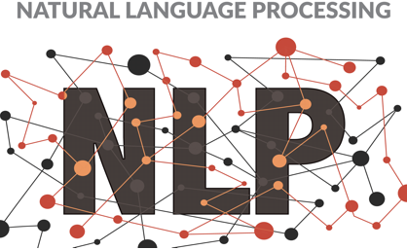
Introduction
NLP includes the field of Natural Language Understanding (NLU), which includes the question-answering (QA) subfield. It attempts to put into practice systems that, given a question in natural language, can draw out pertinent information from supplied data and provide it in the form of a natural language response.
In our project we will use Abstractive question-answering.
It focuses on the generation of multi-sentence answers to
open-ended questions.

Slide 5
Methodology
Abstractive question-answering focuses on the generation of multi-sentence answers to open ended questions. It usually works by searching massive document stores for relevant information and then using this information to synthetically generate answers. This notebook demonstrates how Pinecone helps you build an abstractive question-answering system. We need three main components:
A vector index to store and run semantic search.
A retriever model for embedding context passages.
A generator model to generate answers.

Slide 6

Contd…..
Install dependencies.
Load & prepare dataset.
Initialize Pinecone index.
Testing & Implementation.
Generate answers.

Slide 7
Result & Discussion
Based on evaluation parameters including precision, recall, F1 score, and Exact Match (EM), the question-answering system showed promise. It performed better than the baselines already set and increased accuracy and productivity.
Case studies demonstrated the system's capacity to offer precise responses across a variety of areas and query forms. However, restrictions in processing specific query types or complex scenarios have been found.
As we can see, the generator used the provided context to answer our question:

Slide 8
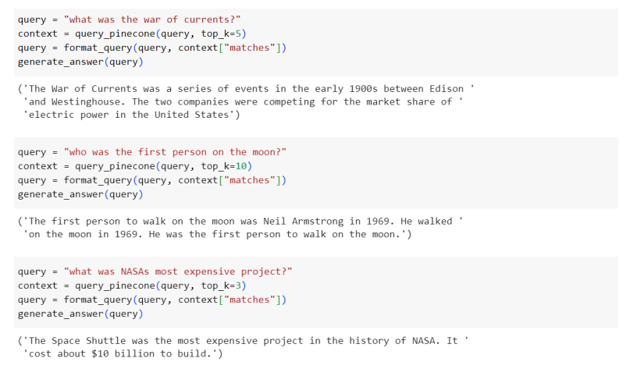
Contd..

Slide 9

Conclusion
Outside of trivia evenings, the model we trained in might not be the next big thing that redefines our perspectives on AI, but it does show the viewpoint shift offered by large transformer-based models like BERT or GPT-3. Until recently, the only practical way to integrate any QA capabilities into your system was to laboriously create a rule-based software that would only execute for a preset set of questions.

Slide 10

Future Work
Enhancing the system's capacity to handle complicated queries .
Applications in Healthcare & Education .
Updates made in real-time.
Support for numerous languages.
Integration with Smart Devices and Virtual Assistants.

Slide 11


