Slide 1

CS 207: Applied Database Practicum
Week 1
Varun Dutt
School of Computing and Electrical Engineering
School of Humanities and Social Sciences
Indian Institute of Technology Mandi, India
Scaling the Heights

Slide 2
Course Logistics
Weekly group activity and assignments. Two individual quizzes and a final exam.
Please don’t copy or plagiarize!
Being an AI researcher, I know how to catch it
If found, consequences will be catastrophic!
Please don’t copy or plagiarize!
- If you did copy, then please cite the sources as (author, date). E.g., (Dutt, 2012)

Slide 3
What is HTML?
HTML is a language for describing web pages.
HTML stands for Hyper Text Markup Language.
A markup language is a set of markup tags.
The purpose of the tags are to describe page content.

Slide 4
HTML Tags
Two types of tags:
Start and End Tags: Tags typically come in pairs. Eg <h1> abc </h1> , <p> abc </p>
Self-closing Tags: Only an opening Tag. Eg <hr> , <br> , <img src=”abc.png”>

Slide 5

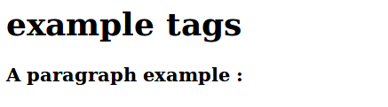
Tags contd..
<h1> biggest heading </h1>
<h6> smallest heading </h6>
Eg :
Output:

Slide 6
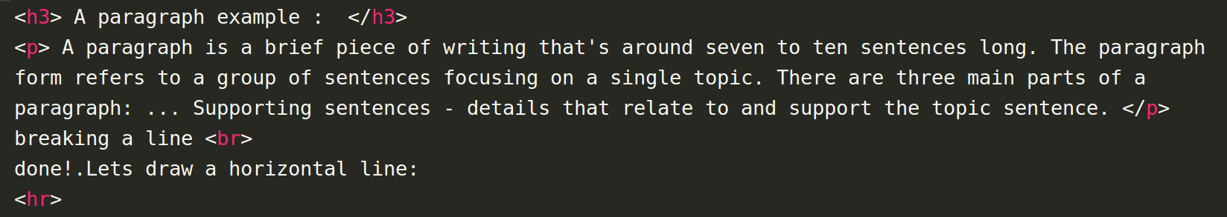
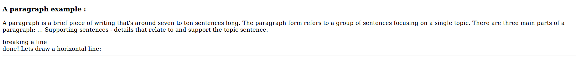
Tags contd..
<p> to define a paragraph </p>
<br> : to break line (go to next line)
<hr> : to draw a horizontal line
E.g.:
Output:

Slide 7
Images
Attributes:
src : to give source of image
width, height : to tell dimensions of image
alt : to give alternate text to image
E.g. :
<img src="http://gathergather.co.nz/grumpy-cat.png" Width="160" Height="131" alt="Grumpy Cat" >

Slide 8
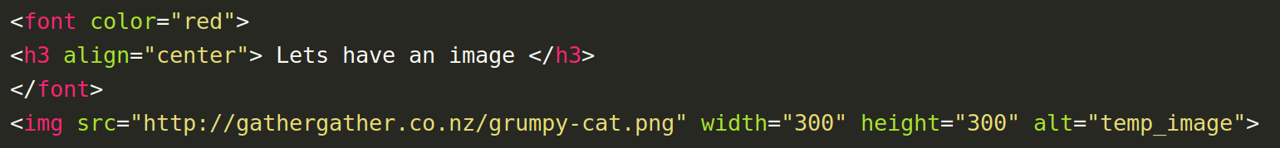

Images contd..
E.g.:
Output:

Slide 9
Anchors
The <a> anchor tag is used to tell the browser that we want to link to somewhere else on our site or on the web.
The a tag comes in pairs and the content between the opening and closing tags is what is displayed as the link text (typically underlined).
Attributes:
href : to tell destination of anchor
target : to specify where to open the link page
E.g. : <a href="http://codeavengers.com" target="_blank"> Code Avengers Home </a>
_blank loads the linked content in new window/tab.

Slide 10
Lists
Used to group related piece of information together.
Two types of lists:
Unordered List : group items in no particular order
Ordered List : group items in specific order
Eg: (of unordered List)
<ul>
<li>milk</li>
<li>butter</li>
</ul>
Ordered List use <ol> </ol> tags.
Where <li> </li> is used to represent a list item.

Slide 11
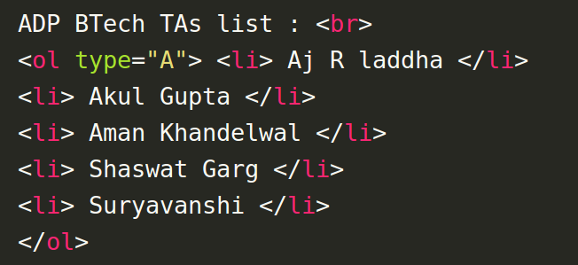
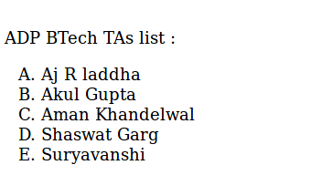
Lists Contd...
E.g.:
Output:

Slide 12
Meta Tags
<meta> tags provide information about the web page, which can be used by search engines to help categorize the page correctly.
They are put in the head section of the code after the title tag.
Attributes :
Name : attribute gives the type of information
Content : attribute contains the information
Eg : <meta name="description" content="This pages is about...">
Bonus : what does it means? <meta charset=”utf-8”>

Slide 13
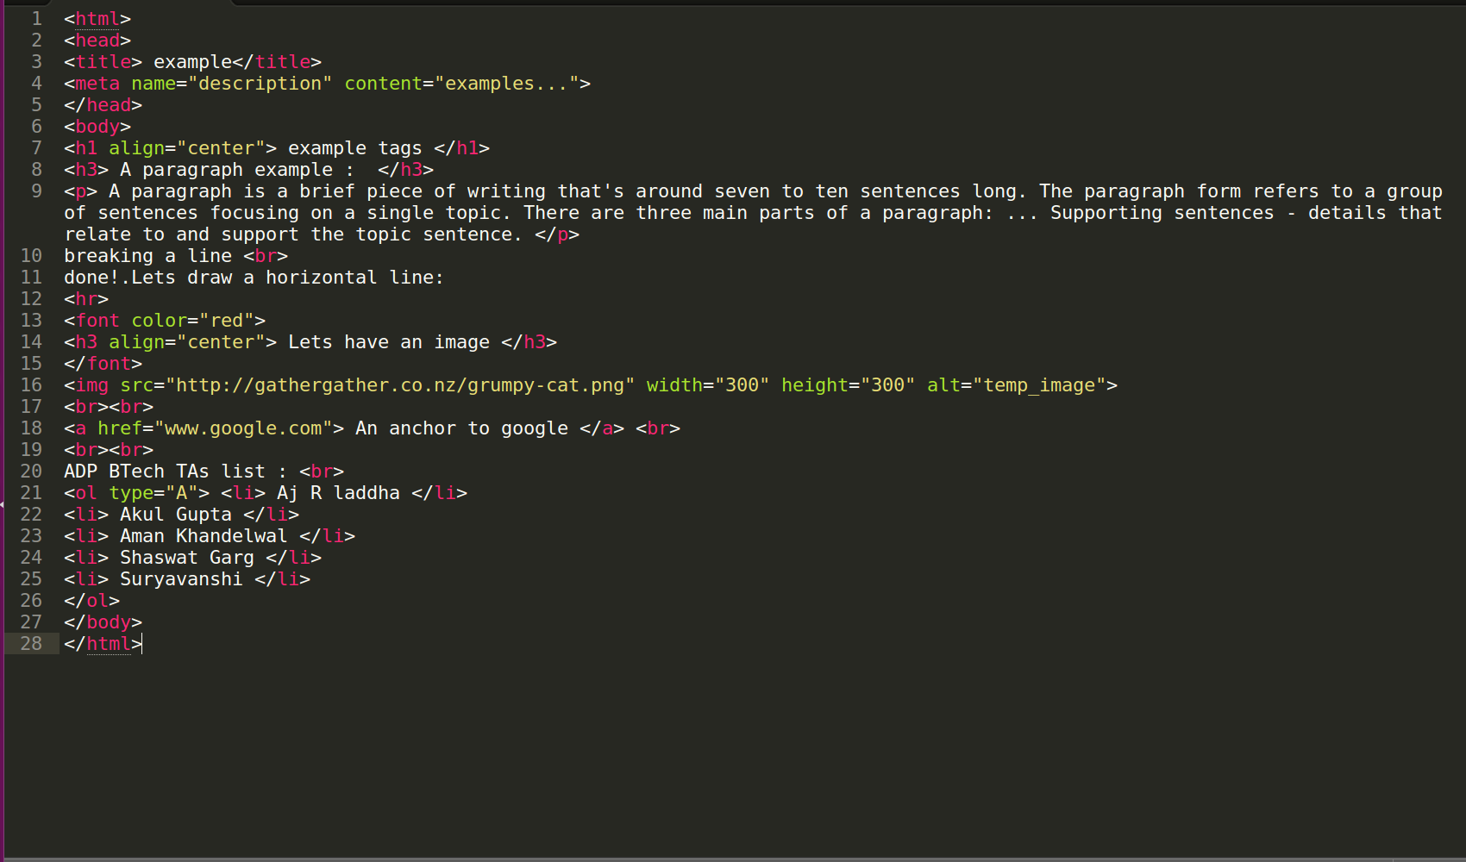
Example Code

Slide 14
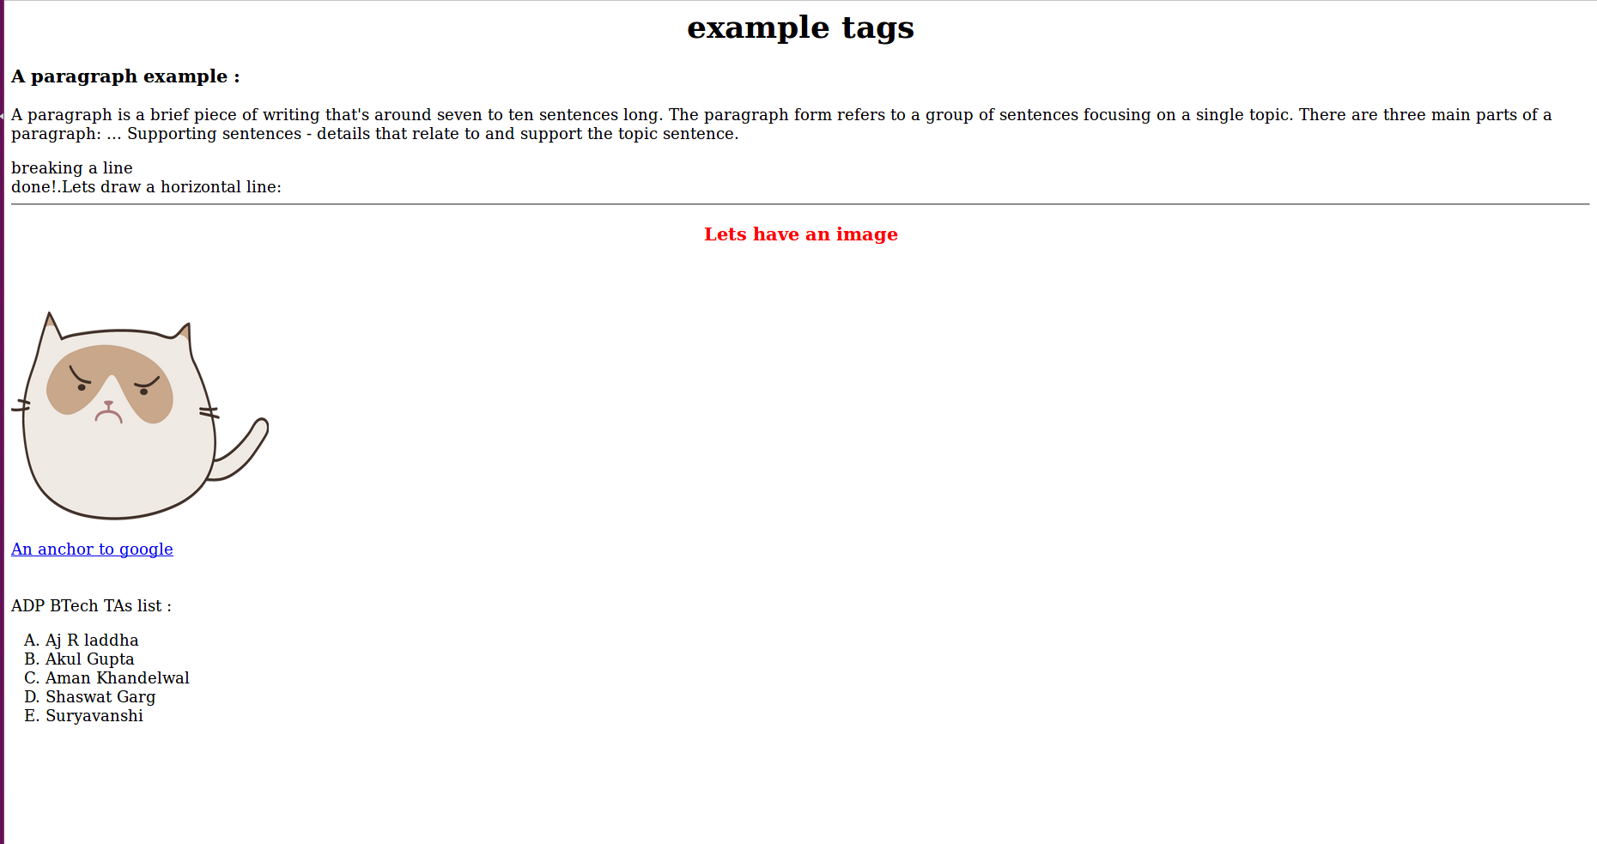
Example Output

Slide 15
What is HTML5?
HTML5 is the newest version of HTML, only recently gaining partial support by the makers of web browsers.
It incorporates all features from earlier versions of HTML, including the stricter XHTML.
It adds a diverse set of new tools for the web developer to use.
Some new elements in HTML5 :
<article> <audio> <canvas> <figure>
<footer> <header> <mark> <progress>
<section> <source> <time> <video>

Slide 16
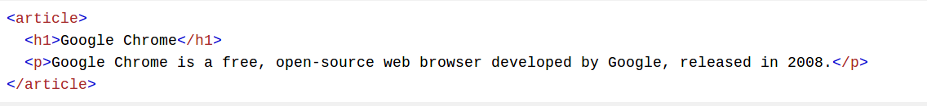
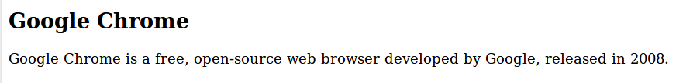
Using some new elements of HTML5
<article> : The <article> tag specifies independent, self-contained content.
E.g.:
Output:

Slide 17
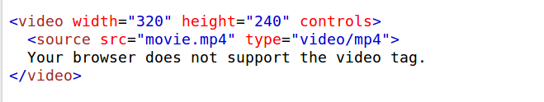
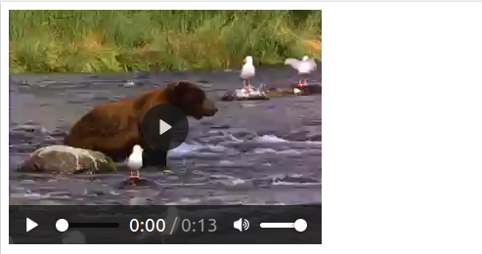
Using some new elements of HTML5
<video> : The <video> tag specifies video, such as a movie clip or other video streams.
E.g.:
Output:

Slide 18
Some New Features in HTML5
Built-in audio and video support (without plugins)
Enhanced form controls and attributes
The Canvas (a way to draw directly on a web page)
Drag and Drop functionality
Support for CSS3 (the newer and more powerful version of CSS)
More advanced features for web developers, such as data storage and offline applications.

Slide 19
What is CSS?
CSS stands for Cascading Style Sheets
CSS is a stylesheet language used to describe the presentation of a document written in HTML or XML.
Formatting the HTML pages will be a laborious process, as formatting elements need to be applied to each and every page.
CSS saves lots of work as we can change the appearance and layout of all the web pages by editing just one single CSS file.

Slide 20
CSS Selectors
CSS selectors allow you to select and manipulate HTML elements based on their id, class, type, attribute, and more.
Example:
Body is a selector that applies styles to the entire page, and all of its content. All elements in the page will inherit the styles you define.
body {
font-family: sans-serif;
}

Slide 21
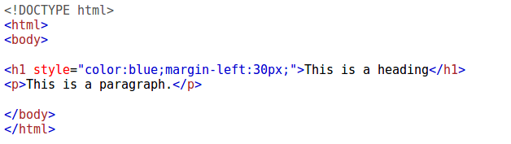
Three Ways to add CSS
Both are non ideal.
(Edit on same html file )
Inline Style
Internal Stylesheets
External Stylesheets
Ideal for styles.
(Make a separate CSS file)

Slide 22

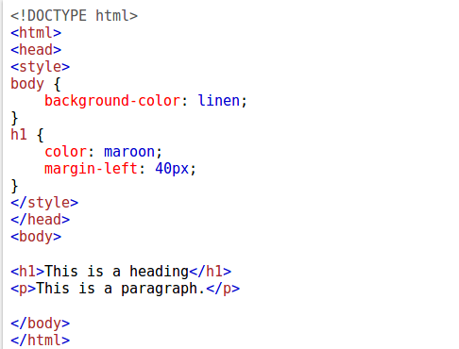
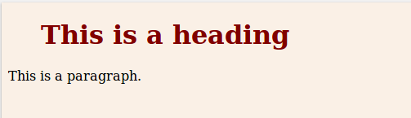
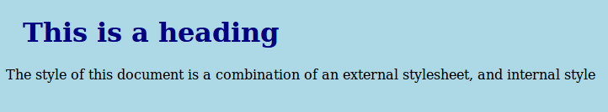
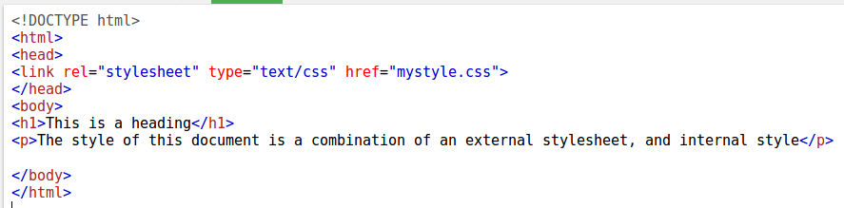
CSS Stylesheets
Inline Stylesheet
Internal Stylesheet
External Stylesheet

Slide 23
Formatting with CSS properties
Text Formatting.
Background Formatting.
Padding, Borders, Margins.
Links Formatting.
Lists Formatting.
Table Formatting.

Slide 24

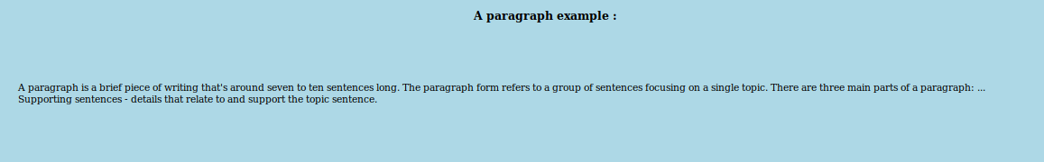
Applying Margins to
            Paragraph
Output:

Slide 25
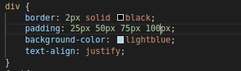
Padding to Div tag
Output:

Slide 26
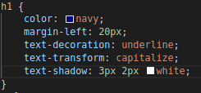

Highlighting the h1 heading
Output:

Slide 27
Introduction to CSS3
CSS3 is the newest version of CSS.
It incorporates all features from earlier versions of CSS.
It adds a diverse set of new tools for the web developer to use.
Some important CSS3 modules are-
1. 2D/3D Transformation.
2. Animations.
3. Multiple column layout.
4. Gradient effect.

Slide 28
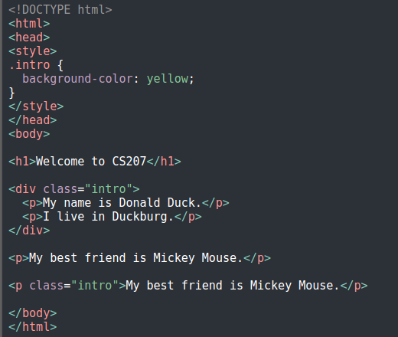
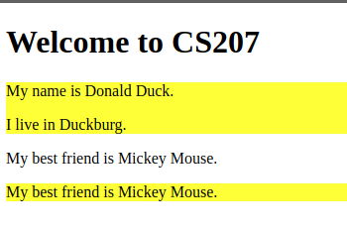

CSS Selector: .class

Slide 29
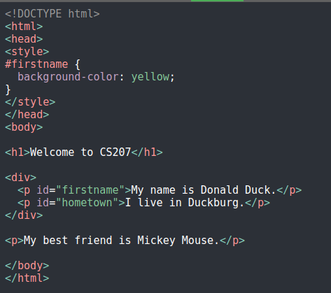
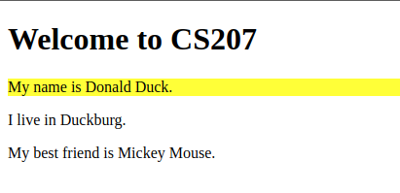

CSS Selector: #id

Slide 30
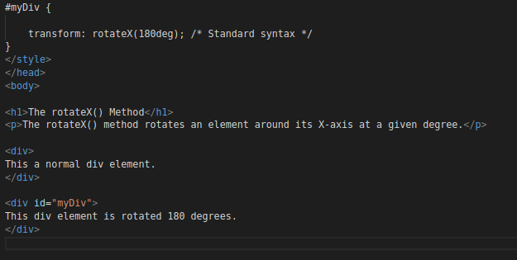
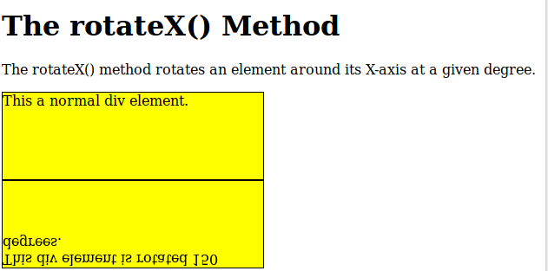
    Rotating using CSS 3
Output:

Slide 31
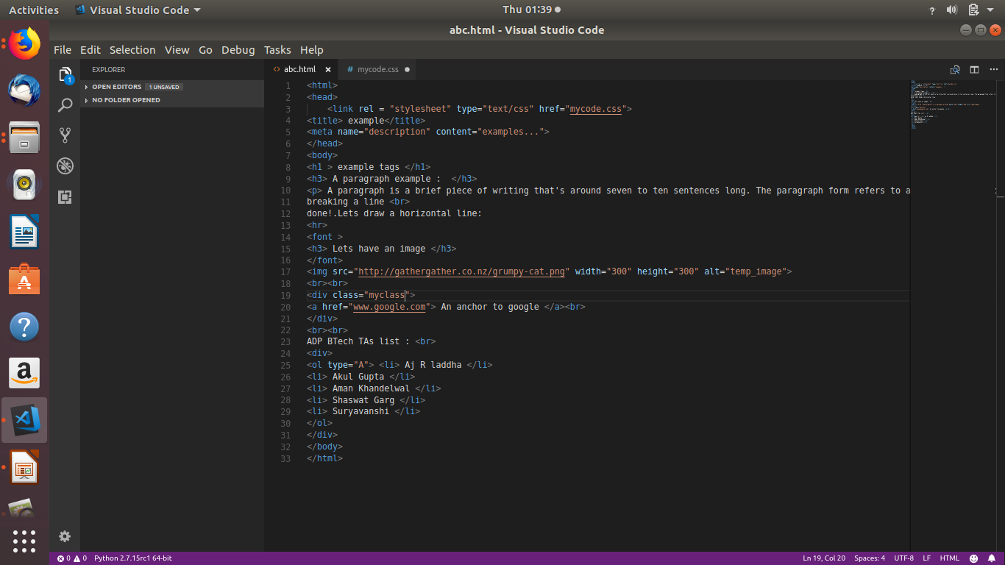
Example HTML Code

Slide 32
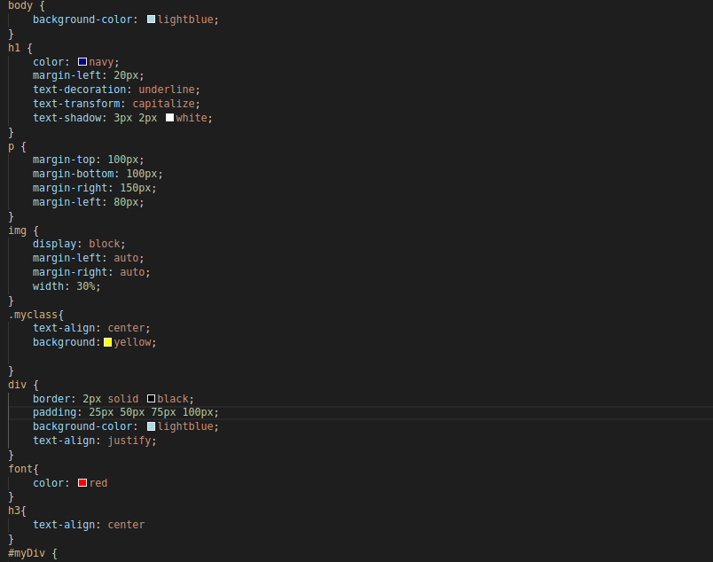
Example CSS Code

Slide 33
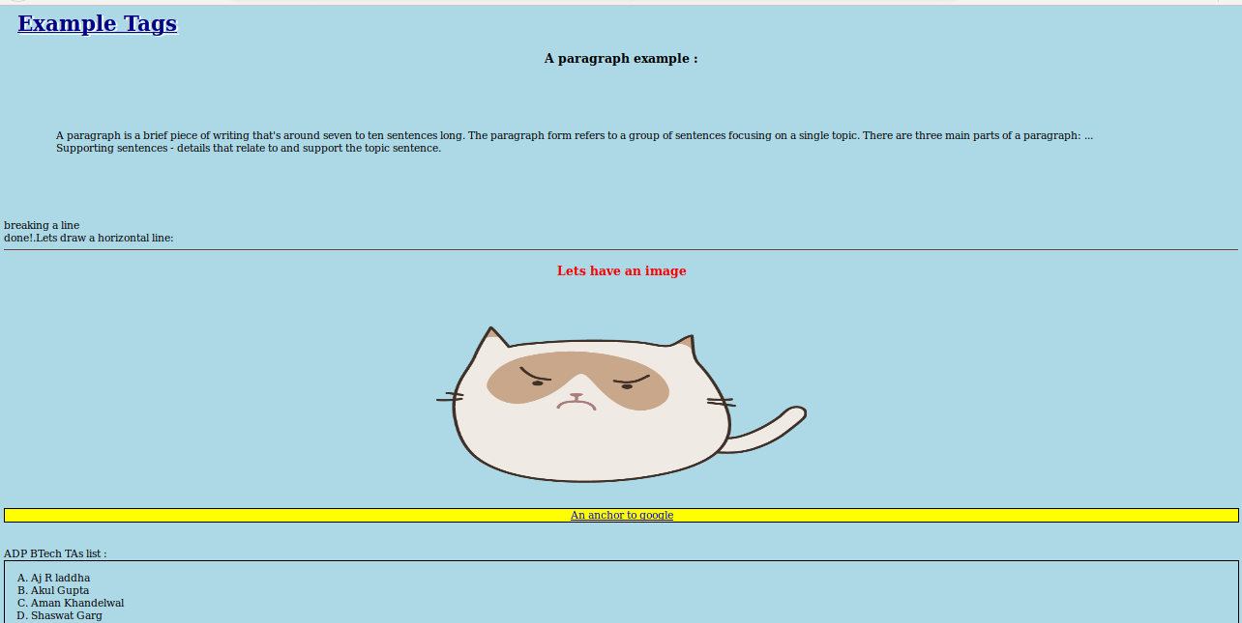
Example Output after CSS

Slide 34
References
https://www.codeavengers.com/teacher/web
https://goo.gl/2tfRS8
https://goo.gl/Tsot1E
www.w3schools.com

