Slide 1
B-Trees

Slide 2
Disk-Based Data Structure
Searching a large amount data
Binary search trees, AVL-Trees, Red-Black trees and 2-4 trees are limited to main memory
When amount data need to searched are huge and can’t be kept in main memory, it is required to build search tree which is secondary-storage enable
In such situation, even the data structure, i.e. search tree which acts as an index to the data in secondary-storage, is also huge
Now the data structure also won’t be fit in main memory
Issue with secondary-storage (disks)
  Disk access is slow, though it stores large amount of data

Slide 3
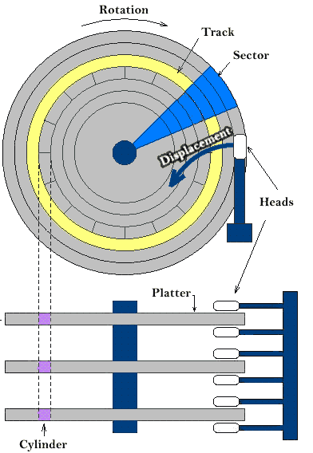
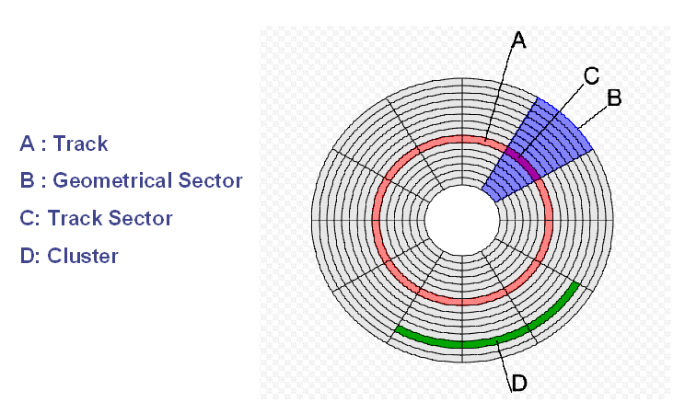
Information Storage in Disks

Slide 4
Issues When the Data in Disks
Significant amount of time is spent in rotation and in moving read/write head to identify the right track
Page is the unit of information transferred between the disk and main memory
  A page is a block of words that occupy contiguous locations in main memory
Word
Block
Page
CPU
Cache Memory
Main Memory
Secondary Memory
4-8 B
32-64 B
2-16 KB

Slide 5
Issues When the Data in Disks
Significant amount of time is spent in rotation and in moving read/write head to identify the right track
Page is the unit of information transferred between the disk and main memory
  A page is a block of words that occupy contiguous locations in main memory
Secondary Memory
Main Memory
Page 0
MM Block00
Cache Memory
Main Memory Page 0
MM Block01
Cache Block0
MM Block02
Page 1
Word
Block
Page
CPU
Cache Block1
MM Block10
Main Memory Page 1
Cache Block2
MM Block11
Cache Block3
MM Block12
Page 2
MM Block20
Main Memory Page 2
MM Block21
MM Block22
Page 3

Slide 6
Issues When the Data in Disks
Significant amount of time is spent in rotation and in moving read/write head to identify the right track
Page is the unit of information transferred between the disk and main memory
Identifying a page takes long time
This time is equal to seek time + rotational delay
Each page may be of several sectors
Typical size of a page is 2-16 KB
The entire page is moved to main memory during reading
During writing, entire page is written back to disk

Slide 7
Disk-Based Data Structure
The entire search tree is organized in such a manner that they sit suitably on the disk
The running time of disk based algorithms is measured in terms of
  CPU computing time
  Number of disk accesses
The entire data is organized in such a way that the time taken to access the disk should be small
For the algorithms seen so far, entire data sits in main memory
They work on one data element at a time

Slide 8
Disk-Based Search Tree
In disk-based search trees, the pointer refers to the object in the disk
Now a part of data structure is sitting on the disk
If the pointer is referring to an object in the main memory, the object is fetched from there
If it refers to disk, then disk read has to be done to read the object from disk to main memory
Typical work pattern look like
1. x = a pointer to some object
2. DISK-READ (x)
3. Operations that access and/or modify x
4. DISK-WRITE (x) // Omitted if nothing changes
5. Other operations

Slide 9
B-Tree
B-Tree is a multi-way search tree
B-Tree is a rooted tree having following properties:
  Every node x has following attributes:
    The number of keys, n, stored in node x
    Keys are in non-decreasing order
    A boolean attribute leaf that is TRUE if x is a leaf and FALSE if x is an internal node
  Each internal node x also contain n+1 pointers to its n+1 children
  All the leaves are at same level
  Any integer t≥2 called the minimum degree of the B-Tree
    Every node other than root must have at least t-1 keys
    Every node can contain at most 2t-1 keys
B⁺ Tree: Variant of B-Tree
  The data associated with are stored at leaves

Slide 10
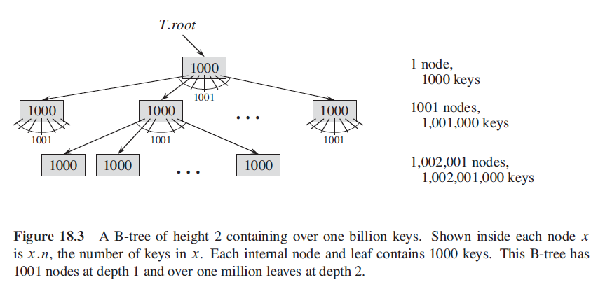
Illustration of B-Tree
Typically number of keys in a B-Tree node is determined by the page size
  One page is equal to one node
  Typically 500 to 2000 keys are used in a node

Slide 11
Operations in B-Tree
The B-Tree data structure is kept on the disk
Each node will be one page in the disk
The root node will be kept in main memory
Searching:
  First determine which path to choose at the root
  Go to the node at next level
  Access that node from disk to main memory
Disk accesses are involved for following purposes:
  To get the first node
  To get next node to determine which child node to select
  To get the data associated with the required key (record)

Slide 12
Operations in B-Tree
To reduce the number of disk accesses, reduce the height as low as possible
This is done by increasing the number of keys at each node
The number of keys in a node depends on the page size defined for a specific computer
Page size: 16 KBytes
A key + pointer: 8 Bytes
Number of keys/node: ~ 2000
Insertion and Deletion:
  Operation wise, they are similar to 2-4 tree
  Refer CORMEN Book – Chapter 18

