Slide 1
Graphs

Slide 2
Graphs as Data Structure
A graph G=(V, E) is an ordered pair of finite sets V and E.
  V: Set of vertices
  E: Set of edges connecting the vertices in V
An edge is e = (u, v) is a pair of vertices
  The e is edge between the vertices u and v
Example:
V = {a, b, c, d, e}
E = {(a, b), (a, c), (a, d), (b, e)
(c, d), (c, e), (d, e)}
Each edge is an unordered pair of vertices: Undirected Graph
a
b
c
d
e

Slide 3
Directed Graph (Digraph)
An edge is an ordered pair of vertices
  The e is edge between the vertices u and v
Example:
V = {a, b, c, d, e}
E = {(a, b), (a, c), (a, d), (b, e)
(c, e), (c, e), (d, b), (d, c)
(d, e), (e, d)}
a
b
c
d
e

Slide 4
Loop and Weighted Graph
Loop: Self edge in a graph
Weighted graph: Weights assigned to each of the edges
12
5
5
a
b
a
b
2
2
9
c
10
9
c
10
4
3
4
3
d
e
d
7
e
7
6

Slide 5
Adjacent Vertices: Undirected Graph
The vertices u and v are adjacent vertices iff (u, v) is an edge in the graph
The edge (u, v) is incident on the vertices u and v
Vertices a and b are adjacent
Vertices a and e are not adjacent
a
b
c
d
e

Slide 6
Adjacent Vertices: Directed Graph
Let (u, v) be the directed edge from u to v
The directed edge (u, v) is incident to vertex v and incident from vertex u
The vertex u adjacent to vertex v and vertex v adjacent from vertex u
Vertex a is adjacent to b Vertex b is not adjacent to a
a
b
c
d
e

Slide 7
Degree of a Vertex: Undirected Graph
Degree of a vertex:
  The number of adjacent vertices
  The degree of vertex v, deg(v) is the number of vertices incident on the vertex v
Example:
deg(a) = 3
deg(b) = 2
deg(c) = 3
deg(d) = 3
deg(e) = 3
a
b
c
d
e

Slide 8
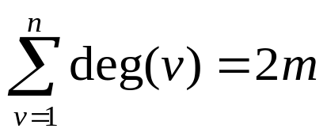
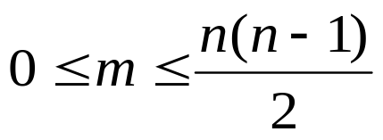
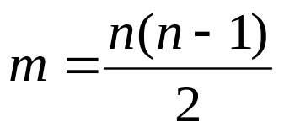
Properties of Undirected Graph
Let G=(V, E) be an undirected graph
Let |V|= n and |E|= m
Let deg(v) be the degree of vertex v
Sum of the degree of all the vertices:
The number of edges in an undirected graph:
Complete graph: A Graph in which there is an edge between every pair of vertices

Slide 9
Complete Graph: Example
a
a
b
a
b
c
b
c
c
d
d
e
n = 3
n = 4
n = 5
m = 3
m = 6
m = 10

Slide 10
Degree of a Vertex: Directed Graph
Indegree of vertex, v:
  The number of vertices adjacent to the vertex v
  Indegree of vertex v, deg_{in}(v) is the number of edges incident to v
  The number of edges coming into the vertex v
Outdegree of vertex, v:
  The number of vertices adjacent from the vertex v
  Indegree of vertex v, deg_{out}(v) is the number of edges incident from v
  The number of edges leaving from the vertex v
Example:
deg_{in}(a) = 0 deg_{out}(a) = 3
deg_{in}(b) = 2 deg_{out}(b) = 1
deg_{in}(c) = 2 deg_{out}(c) = 1
deg_{in}(d) = 2 deg_{out}(d) = 3
deg_{in}(e) = 3 deg_{out}(e) = 1
a
b
c
d
e

Slide 11
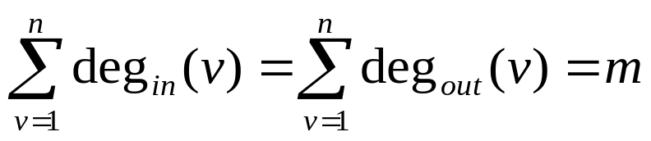


Properties of Directed Graph
Let G=(V, E) be a directed graph
Let |V|= n and |E|= m
Let deg_{in}(v) and deg_{out}(v) be the indegree and outdegree of vertex v
Sum of the degree of all the vertices:
The number of edges in an undirected graph:
Complete digraph: A digraph in which there is an edge between every pair of vertices

Slide 12
Complete Digraph: Example
a
a
a
b
b
c
n = 1
n = 2
n = 3
m = 0
m = 2
m = 6

Slide 13
Path in a Graph
Path: The sequence of vertices P=(v₁, v₂,…, v_{k}) is a path in a graph G=(V, E) iff the edge (v_{i}, v_{i+1}) is in E for every i, 1 ≤ i < k
This definition hold for both undirected and digraphs
Length of a path: Sum of length of each edges in a path (Number of edges in a path)
a
b
a
b
c
c
d
e
d
e
P₁ = (a, b, e, d, c, e)
P₁ = (a, c, e, d)
P₂ = (a, c, d)
P₂ = (a, d, c, e)

Slide 14
Path in a Graph
Simple path: Path in which no vertex is repeated
Cycle: A simple path, except that last vertex is same as first vertex
a
b
P₁ = (a, c, d)
c
P₂ = (a, d, c, e)
P₃ = (a, b, e, d, c, e)
Not a simple path
d
e
a
b
c
P₁ = (a, b, e, d, c, a)
d
e

Slide 15
Connected Graph
A graph is said to be connected, if there is a path between every pair of vertices in the graph
Subgraph: A graph H is a subgraph of G, iff the vertex and edge sets of H are subsets of that of G
a
b
a
b
Connected Graph
Not a Connected Graph
G
c
c
d
e
d
e
a
a
b
a
c
c
c
d
d
e
d
e

Slide 16
Tree
Tree is a connected graph that contain no cycles
Forest: Collection of trees
Spanning tree: The subgraph of G which contains all the vertices of G and is a tree
a
f
g
k
l
a
a
b
a
b
c
h
m
G
c
c
c
d
e
j
i
o
n
d
e
d
e
d
e
a
b
a
b
a
b
G
c
c
c
d
e
d
e
d
e

Slide 17
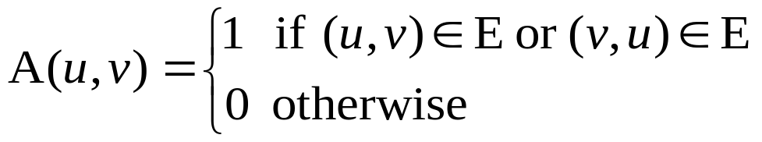
Representation of Graphs
Standard ways of representing graph:
  Adjacency Matrix
  Adjacency List
Adjacency Matrix:
  Given graph of n vertices, G=(V, E), an adjacency matrix A of G is an n x n matrix
  If G is undirected graph,

Slide 18
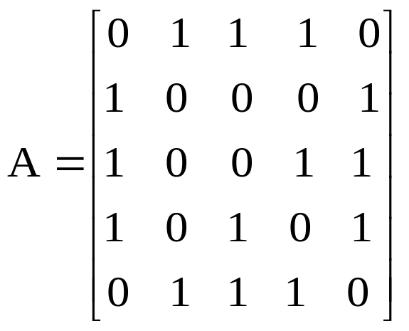
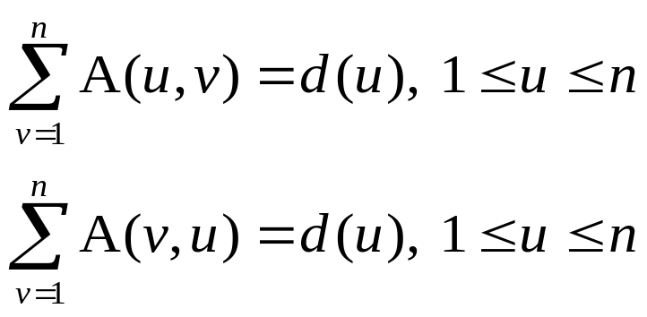
Adjacency Matrix: Undirected Graph
a b c d e
a
b
a
b
c
d
e
G
c
d
e
Observation:
  Adjacency matrix is symmetric matrix
  For n vertex
Space requirement: Θ(n²)

Slide 19
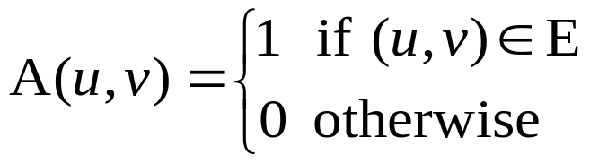
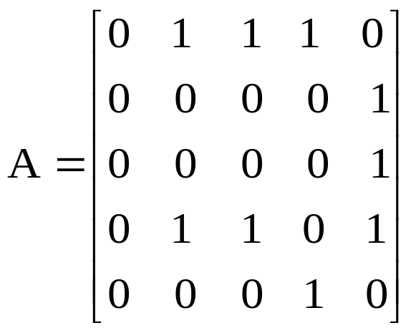
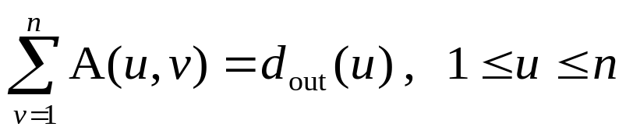
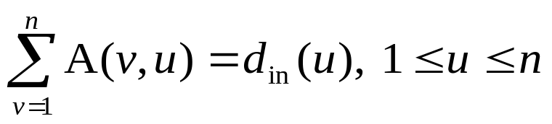
Adjacency Matrix: Digraph
If G is digraph,
Observation:
  Adjacency matrix need not be a symmetric matrix
  For n vertex
a b c d e
a
b
a
b
c
d
e
c
d
e

Slide 20
Adjacency List
It maintains an array A corresponding to vertices
Each cell of A maintains an linked list called adjacency list
Adjacency list of a vertex v : Sequence of vertices adjacent to v
Length of each adjacency list is equal to degree of that vertex
Space required: Θ(n+2m) = O(n+m)
A
a
b
c
d
/
a
b
b
a
e
/
G
c
c
a
d
e
/
d
a
c
e
/
d
e
e
b
c
d
/

Slide 21
Adjacency List
It maintains an array A corresponding to vertices
Each cell of A maintains an linked list called adjacency list
Adjacency list of a vertex v : Sequence of vertices adjacent to v
Length of each adjacency list is equal to out degree of that vertex
Space required: Θ(n+m)
A
a
b
c
d
/
a
b
b
e
/
c
c
e
/
d
b
c
e
/
d
e
e
d
/

Slide 22
Graph Searching Algorithms

Slide 23
Graph Searching Algorithms
Systematic search of every edge and vertices of the graph
Graph could be directed or undirected
We assume adjacency list representation for these algorithms
Two common graph searching algorithms:
  Breadth-first search
  Depth-first search

Slide 24
Breadth-First Search (BFS)

Slide 25
Breadth-First Search (BFS)
BFS is one of the simplest algorithms for searching a graph
It is basis for many important graph algorithms
Given a graph G=(V, E) and a source vertex s, BFS systematically explores the edges of G to discover every vertex that is reachable from s
It produces a breadth-first tree which is a spanning tree that contain all reachable vertex from s
The path in breadth-first tree from s to v is a shortest path from s to v in graph G
Why the name breadth-first search?
  It expands the frontier between discovered and undiscovered vertices uniformly
  It discovers all the vertices at distance k from s before discovering any vertices at distance k+1

Slide 26
BFS Algorithm
Start from the source vertex s
It is assigned with distance 0
In first round, all the vertices that are at distance 1 (i.e. one edge away) from s are visited (or discovered)
In second round, all the vertices that are at distance one more than from vertices visited in the first round are discovered
  These discovered vertices are at the distance 2 from s
This continues until every vertices in the graph are discovered
Each vertex is given a label
  The vertices visited at round 1 are labeled as 1
  The vertices visited at round 2 are labeled as 2 and so on
The label at any vertex v corresponds to the length of the path from s to v

Slide 27
Illustration of BFS
WHITE: Vertex is Undiscovered
GRAY: Vertex is discovered
BLACK: Adjacent vertices of that vertex are discovered
r
s
t
u
∞
∞
0
∞
∞
∞
∞
∞
∞
v
w
x
y
-
Q
s
0

Slide 28
Illustration of BFS
WHITE: Vertex is Undiscovered
GRAY: Vertex is discovered
BLACK: Adjacent vertices of that vertex are discovered
r
s
t
u
1
∞
0
0
∞
∞
∞
∞
1
∞
∞
v
w
x
y
-
Q
w
r
1
1

Slide 29
Illustration of BFS
r
s
t
u
1
0
∞
2
∞
∞
1
1
∞
2
∞
v
w
x
y
Q
r
t
x
1
2
2

Slide 30
Illustration of BFS
r
s
t
u
1
1
0
2
∞
∞
2
1
2
∞
v
w
x
y
Q
t
x
v
2
2
2

Slide 31
Illustration of BFS
r
s
t
u
1
0
2
2
3
∞
2
1
2
∞
v
w
x
y
Q
x
v
u
2
2
3

Slide 32
Illustration of BFS
r
s
t
u
1
0
2
3
2
1
2
2
∞
3
v
w
x
y
Q
v
u
y
2
3
3

Slide 33
Illustration of BFS
r
s
t
u
1
0
2
3
2
2
1
2
∞
3
v
w
x
y
Q
u
y
3
3

Slide 34
Illustration of BFS
r
s
t
u
1
0
2
3
3
2
1
2
∞
3
v
w
x
y
Q
y
3

Slide 35
Illustration of BFS
r
s
t
u
1
0
2
3
2
1
2
∞
3
3
v
w
x
y
Q
-

Slide 36
Breadth-First Tree
BFS constructs a spanning tree called breadth-first tree
Initially it contains only root, i.e., source vertex s
Whenever a white adjacency vertex v is discovered for the already discovered vertex u, the vertex v and edge (u, v) is added to the tree
The vertex u is the predecessor or parent of v in breadth-first tree
Hence breadth-first tree is a predecessor subgraph of the graph G

Slide 37
Representation of Graph for BFS
Let G=(V, E) be a graph with |V|= n and |E|= m
Graph is stored in adjacency list
Adjacency list representation:
pred
Pointer to predecessor vertex
Vertex v
in adjacency list
color
d
Distance from source s
A
r
s
t
u
s
r
w
/
∞
∞
∞
∞
r
s
v
/
t
u
w
x
/
u
t
x
y
/
∞
∞
∞
∞
v
r
/
v
w
x
y
w
s
t
x
/
x
t
u
w
y
/
y
u
x
/

Slide 38
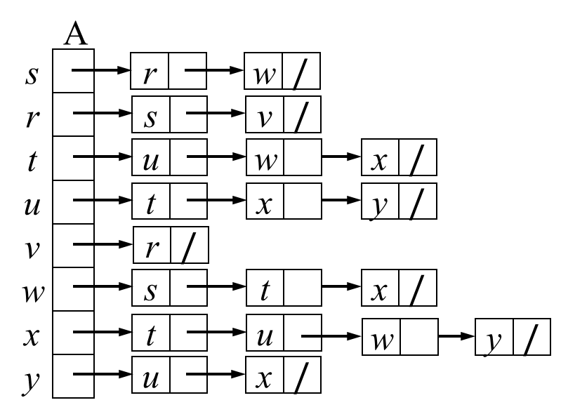
Pseudo-code for BFS Algorithm
BFS (G, s)
// G is a graph and s is a source vertex.
1. for each vertex u belong to V-{s}
2. u —› color = WHITE; u —› d = ∞;
u —› pred = NIL
3. end
4. s —› color = GRAY; s —› d = 0;
s —› pred = NIL
5. Q = EMPTY
6. ENQUEUE(Q, s)
7. while Q ≠ EMPTY
8. u = DEQUEUE(Q)
9. u —› color = BLACK
10. for each v belong to A[u]
11. if (v —› color = WHITE)
12. v —› color = GRAY; v —› d = (u —› d) + 1; v —› pred = u
13. ENQUEUE(Q, v)
14. end
15. end
16. end
O(n)
O(1)
O(n)
O(m)
O(n)
Total running time: O(m+n)

Slide 39
BFS Properties
Given the undirected graph G=(V, E), BFS discovers all vertices reachable from a source vertex s
BFS computes the shortest distance to all reachable vertices
For each vertex v at level i, the path of breadth-first tree between s and v has i edges and any other path of G between s and v has at least i edges
If (u, v) is an edge then the level numbers of u and v differ by at most one
r
s
t
u
1
0
2
3
2
1
2
∞
3
3
v
w
x
y

Slide 40
Depth-First Search (DFS)

Slide 41
Depth First Search (DFS)
Search deeper in the graph wherever possible
Edges are explored out of most recently discovered vertex, v
When all of v‘s edges have been explored, the search backtracks to explore edges leaving the vertex from which v was discovered
This process continues till all the vertices that are reachable from the original source vertex have been discovered
If any undiscovered vertices remain, then one of them is selected as a new source and search is repeated from that source
This entire process is repeated until all vertices are discovered

Slide 42
DFS: Illustration
s₁
s₂
Backtrack
Backtrack
a
b
c
d
Backtrack
Backtrack
Backtrack
e
f
g
h
Backtrack
Backtrack
Backtrack
i
j
k
l
Backtrack
Backtrack

Slide 43
DFS in Maze Problem
ENTRY
EXIT

Slide 44
DFS: Illustration
s₁
s₂
a
b
c
d
e
f
g
h
i
j
k
l

Slide 45
DFS
The predecessor subgraph formed by a DFS on a graph may composed of several trees
Thus the predecessor subgraph of a DFS forms a depth-first-forest composed of several depth-first-trees
DFS algorithm considers coloring scheme to colour the vertices during the search to indicate the state
  WHITE: Vertices are undiscovered
  GRAY: When the vertices are discovered in the search
  BLACK: When all the adjacent vertices of a vertex is explored completely
DFS also maintain timestamps at each vertex v
  Discovery time (v—›dt): Records when v is first discovered i.e. when colored GRAY
  Finishing time (v—›ft): Records when the search finishes examining v‘s adjacent vertices i.e. when colored BLACK

Slide 46
Pseudo-code for DFS Algorithm
DFS (G)
// G is a graph, G=(V, E).
1. for each vertex u belong to V
2. u —› color = WHITE
3. u —› pred = NIL
4. end
5. time=0;
6. for each vertex u belong to V
7. if (u —› color = WHITE)
8. DFS-VISIT(u)
9. end
10. end
DFS-VISIT (u)
1. u —› color = GRAY; time = time + 1
2. u —› dt = time
3. for each v belong to A[u] // A is a vector in adjacent list representation
4. if (v —› color = WHITE)
5. v —› pred = u
6. DFS-VISIT(v)
7. end
8. end
9. u —› color = BLACK; time = time + 1
10. u —› ft = time
A
1/
1/8
2/
2/7
9/
9/12
a
a
a
b
b
b
c
c
a
b
d
/
c
b
e
/
c
e
f
/
d
b
/
d
e
d
e
f
e
d
e
f
d
/
f
f
/
4/
3/
3/6
10/
4/5
10/11

Slide 47
Properties of DFS
Predecessor subgraph form a forest of depth-first trees
The discovery time and finishing time have parenthesis structure
Classification of edges:
  Tree edge: Edges in depth-first forest
  Back edge: Edges (u, v) connecting a vertex u to an ancestor v in a depth-first tree. It is not a part of the tree
    Self loop also considered as back edge
1/
1/8
2/
2/7
9/
9/12
a
a
a
b
b
b
c
c
c
Back edge
d
e
d
e
f
d
e
f
f
4/
3/
3/6
10/
4/5
10/11

Slide 48
Properties of DFS (Contd.)
Classification of edges:
  Forward edge: Edges (u, v) connecting a vertex u to its descendent v in a depth-first tree. It is not a part of the tree
  Cross edge: It is not a part of the tree
    The edges go between vertices in the same depth-first tree, as long as one vertex is not an ancestor of the other
    They are also the edges between vertices in different depth-first trees
1/
1/8
2/
2/7
9/
9/12
a
a
a
b
b
b
c
c
c
Cross edge
Forward edge
Back edge
d
e
d
e
f
d
e
f
f
4/
3/
3/6
10/
4/5
10/11

