Slide 1
Pattern Matching and Tries
Text Book:
M. T. Goodrich, R. Tamassia and M. H. Goldwasser, Data Structures and Algorithm in Java, Wiley, 6 ed, 2014.

Slide 2
Pattern Matching
Searching for patterns
Find all the occurrence of pattern P of length m inside the text T of length n
Exact matching
Approximate matching

Slide 3
Naïve Method for Pattern Matching
Given: A string (or word) as pattern P of length m and a text T of length n
Aim: To find all occurrences of pattern P in text T
1
2
3
4
5
6
7
8
9
10
11
12
13
14
15
16
17
18
19
20
21
22
23
24
25
26
T
W
h
a
t
i
s
a
n
a
l
g
o
r
i
t
h
m
?
W
h
y
P
a
l
a
g
l
a
o
g
l
a
r
o
g
l
a
i
r
o
g
l
a
t
i
r
o
g
l
a
h
t
i
r
o
g
l
a
m
h
t
i
r
o
g
l
a
m
h
t
i
r
o
g
l
a
m
h
t
i
r
o
g
l
a
m
h
t
i
r
o
g
l
a
m
h
t
i
r
o
g
l
a
m
h
t
i
r
o
g
l
a
m
h
t
i
r
o
g
l
a
m
h
t
i
r
o
g
l
a
m
h
t
i
r
o
g
l
a
m
h
t
i
r
o
g
l
a
m
h
t
i
r
o
g
l
m
h
t
i
r
o
g
m
h
t
i
r
o
m
h
t
i
r
m
h
t
i
m
h
t
m
h
m
27
28
29
30
31
32
33
34
35
36
37
38
39
40
41
42
43
44
45
46
47
48
49
50
51
52
i
s
t
h
e
s
t
u
d
y
o
f
a
l
g
o
r
i
t
h
m
53
54
55
56
57
58
59
60
61
62
63
64
65
66
67
68
69
70
71
72
73
74
75
76
77
78
79
w
o
r
t
h
w
i
l
e
?
W
h
a
t
i
s
t
h
e
r
o
l
e
80
81
82
83
84
85
86
87
88
89
90
91
92
93
O(mn)
o
f
a
l
g
o
r
i
t
h
m
?

Slide 4
Knutt-Moris-Prat (KMP) Algorithm
In KMP algorithm, pattern is pre-processed to speedup pattern matching
After pre-processing, time to matching will be proportional to the length of the text
Disadvantage: More time when the length of text is large
Can I pre-process the text so that search for a pattern in the time proportional to the length of pattern?
We require to pre-process the text and create a data structure tries
Standard tries
Compressed tries

Slide 5
Standard Tries
Trie is a data structure to maintain a set of strings
The standard trie for a set of strings S is an ordered tree such that
Each node except root is labelled with a character
The children of a node are alphabetically ordered
The paths from the root to external nodes yield the string of S
Trie is like a multiway search tree
The number of children of a node can be as large as the total number of alphabets
Leaf node is represented as square node
Leaf node correspond to the end of a word
Search time take order of length of the word/pattern

Slide 6
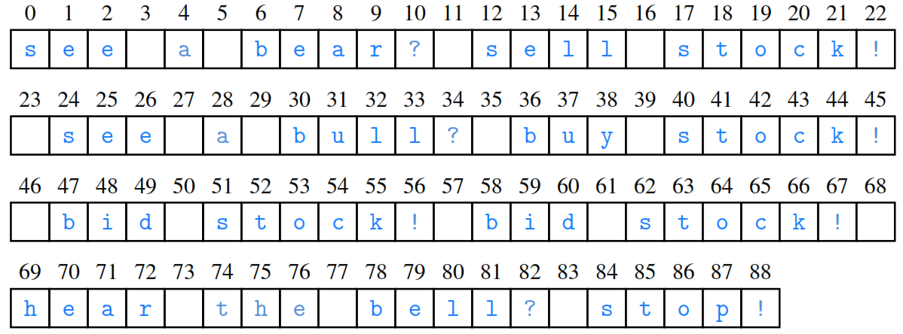
Illustration of Tries

Slide 7
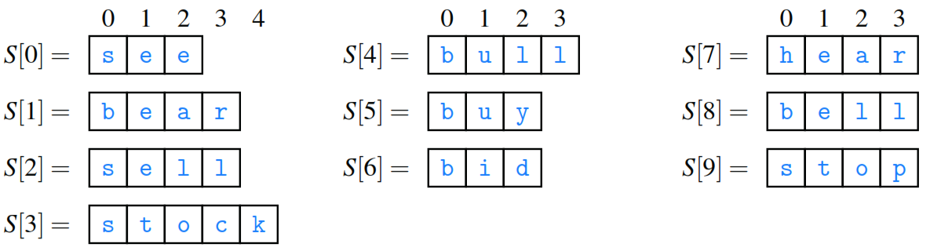
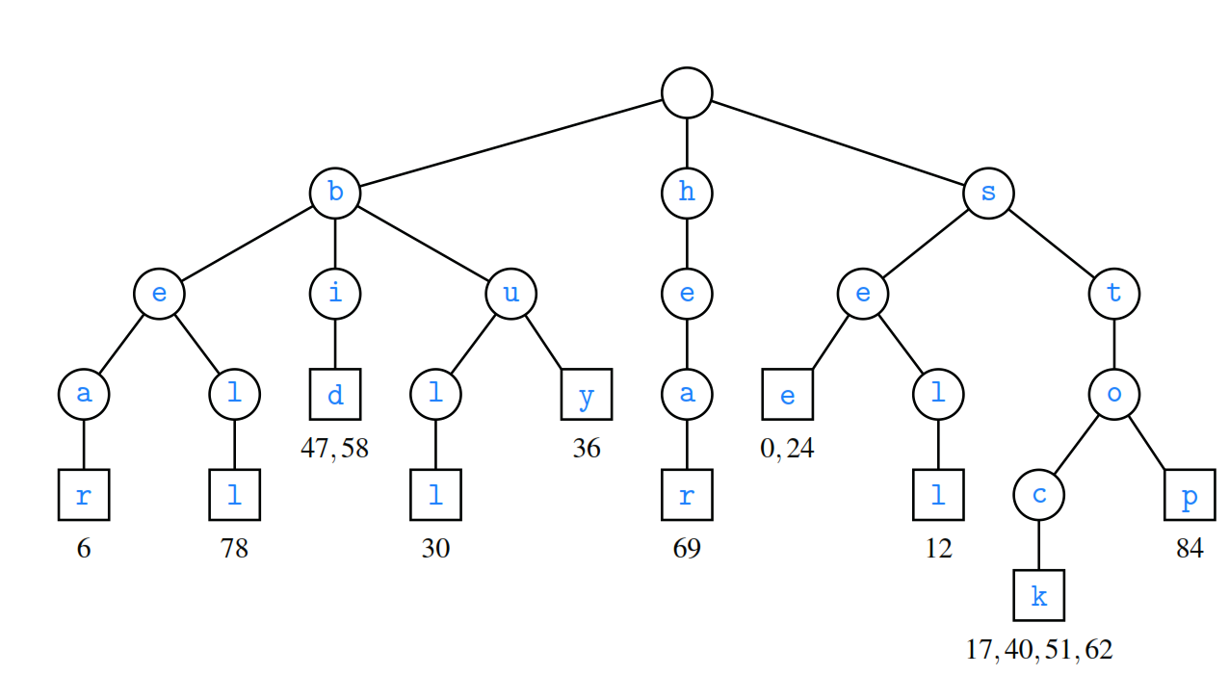
Illustration of Tries

Slide 8
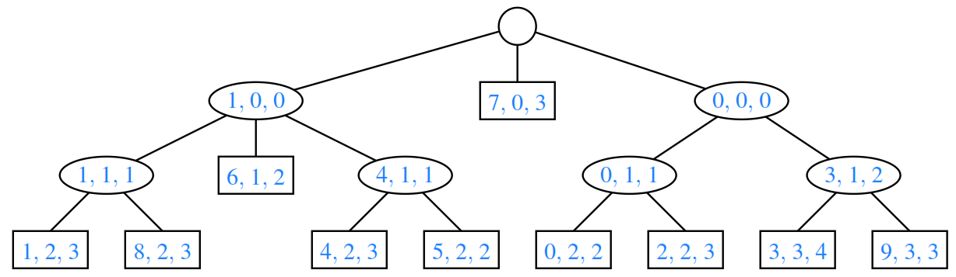
Illustration of Compression Tries

