Slide 1
RETAINX – CUSTOMER RETENTION & CHURN ANALYTICS
END-TO-END ANALYTICS PROJECT
PYTHON | SQL | POWER BI
UJJWAL VERMA | DATA ANALYST | SQL • PYTHON • POWER BI • EXCEL

Slide 2

BUSINESS CONTEXT & PROBLEM
Customer churn is one of the biggest revenue risks for Telecom, SaaS, OTT & FinTech companies
Acquiring new customers costs 5–7x more than retaining existing ones
Businesses struggle to:
1. Identify why customers churn
2. Detect who is at risk early
3. Quantify revenue impact of churn
Why This Problem Matters
Goal: Enable leadership to reduce churn and protect revenue using data-driven insights

Slide 3
PROJECT OBJECTIVES
What RetainX Solves
Analyze customer behavior and churn patterns
Segment customers by:
1. Usage
2. Tenure
3. Revenue
Identify high-value customers at risk
Quantify revenue at risk
Deliver executive-ready dashboards
This project simulates how analytics teams work in real companies.

Slide 4
DATA & TOOLS OVERVIEW
Data Source
Tech Stack
Database: PostgreSQL
Data Processing: SQL
EDA & Validation: Python (Pandas, NumPy, MatPlotlib, Seaborn)
Reporting: Excel
Visualization: Power BI
Version Control: Git & GitHub
1. Public Telecom Customer Dataset (Kaggle)
2. Customer-level behavioral & churn data

Slide 5
END-TO-END WORKFLOW
How the Project Was Executed
1. Business Understanding & KPI Definition
2. Data Ingestion (Raw Layer)
3. Feature Engineering (SQL)
4. Analytical Table Creation (Gold Layer)
5. Python EDA & Validation
6. Power BI Dashboarding
7. Business Insights & Recommendations

Slide 6
DATA ARCHITECTURE
LAYERED DATA MODEL
Raw Layer :
Original data ingested into PostgreSQL
Transformation Layer :
Revenue segmentation
Usage score
Usage category
Tenure calculation
Analytical (Gold) Layer :
Customer segmentation
Business-ready fact table
Optimized for Power BI

Slide 7
KEY KPIS DEFINED
Business Metrics Tracked :
1. Total Customers
2. Total Churned Customers
3. Churn Rate (%)
4 .Average Revenue
5. Revenue at Risk
6.High-Value Customers at Risk
Churn Analysis By :
1. Usage Category
2. Customer Segment
3. Tenure
4. Geography

Slide 8
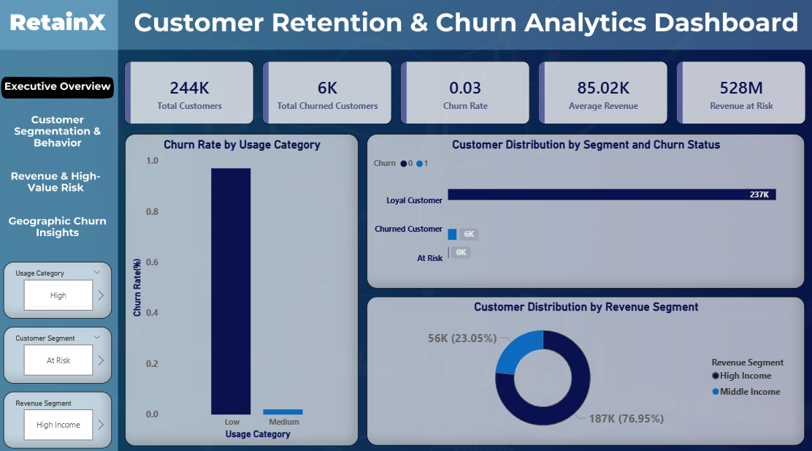
POWER BI DASHBOARD
Overall churn health of the business
Revenue exposure at a glance
Customer distribution by risk level

Slide 9
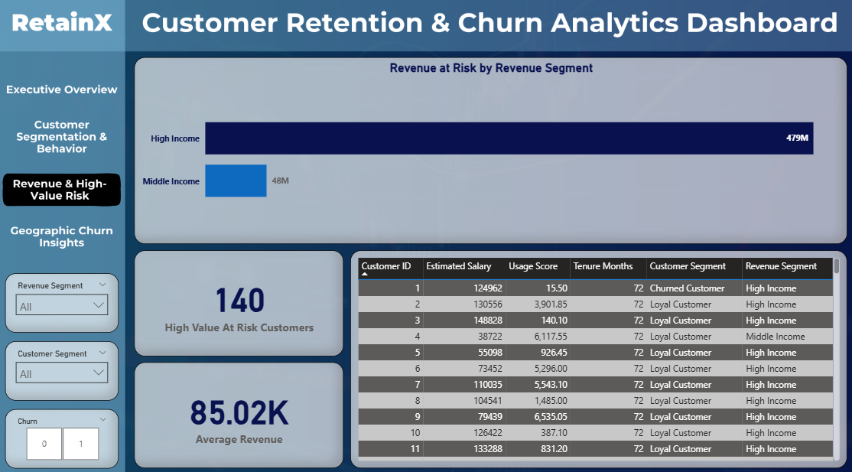
POWER BI DASHBOARD

Slide 10
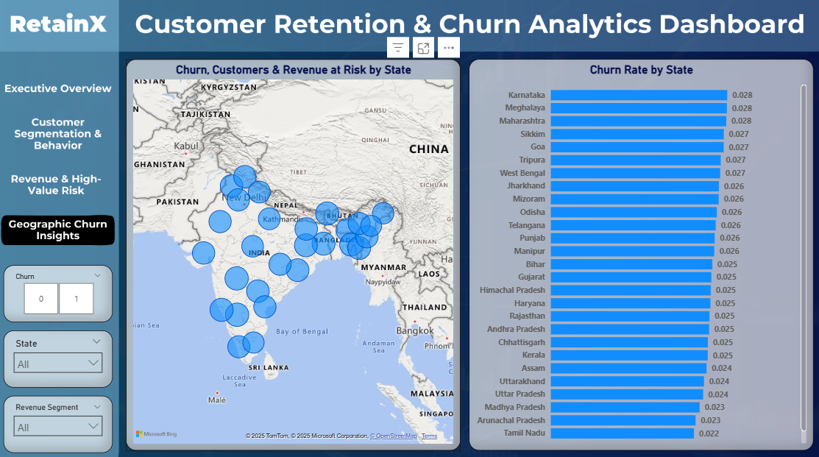
POWER BI DASHBOARD

Slide 11
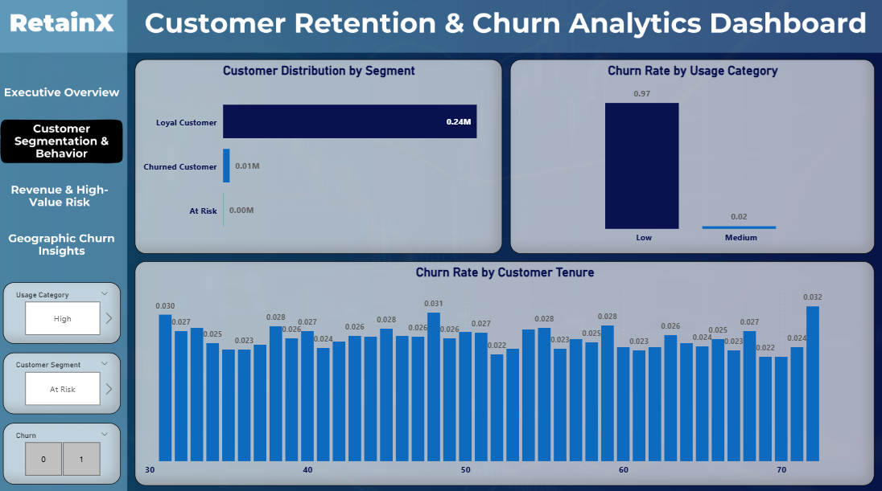
POWER BI DASHBOARD

Slide 12
KEY INSIGHTS SUMMARY
What We Learned
1. Low usage is the strongest churn indicator
2.Longer tenure → higher retention
3. High-income churn causes disproportionate revenue loss
4. Geographic churn patterns are non-uniform
5. Early identification can prevent significant losses

Slide 13
BUSINESS RECOMMENDATIONS
ACTIONABLE NEXT STEPS
Introduce usage-based retention offers
Proactively target high-income, low-usage customers
Launch region-specific churn campaigns
Build early-warning churn flags using usage trends

Slide 14
THANK YOU

