Slide 1

Go, change the world
RV College of
Engineering
Experiential Learning
Phase 1: Presentation
GRONK OS (x86 architecture)

Slide 2
TEAM INTRODUCTION
SUBJECT | OS
CLASS | CSE ‘D’ Section
Roll Number | Name | Submitted to
1RV22CS190 | SHREYANSH SINGH | Dr. Jothi shetty Associate Professor
1RVCSCS187 | SHREEJAY PANDEY
RVCE23BCS421 | UJJWAL SG
RVCE23BCS407 | VED REVANKAR

Slide 3

OUTLINE
INTRODUCTION
LITRATURE REVIEW
ARCHITECHTURE
SPECIFICATIONS
KEY FEATURES
BLOCK DIAGRAM
Working of product
SOFTWARE DESIGN
TOOLS & REQUIREMENTS

Slide 4
INTRODUCTION
GRONK OS, is an exciting venture into crafting a custom operating system designed specifically for the x86 architecture. Within the realm of operating system development, GRONK OS stands as a student-driven initiative to explore and implement core concepts in a real-world application.
Importance of Developing a Custom x86 Operating System: Creating a custom x86 operating system serves as a valuable learning experience for students. GRONK OS dives into the intricacies of the x86 architecture, providing hands-on insight into system-level programming. This personalized approach allows us to gain a deeper understanding of hardware-software interactions, a fundamental aspect of computer science education.

Slide 5
LITRATURE REVIEW
Title | Authors | Inference
Create Your Own Kernel In C | Paritham zoop | Create Your Own Kernel In C - CodeProject
Building an OS os-tutorial | nanobytes cfenollosa | https://youtu.be/9t-SPC7Tczc?list=PLFjM7v6KGMpiH2G-kT781ByCNC_0pKpPN os-tutorial/01-bootsector-barebones at master · cfenollosa/os-tutorial · GitHub
Patent | Source | Methodology | Incorporating Changes
Innovative Bootloader Techniques for x86 Platforms | U.S. Patent and Trademark Office | Explored novel approaches to bootloader design. Investigated methods for efficient disk access and initialization. | Integrating innovative bootloader techniques. Enhancing disk access and initialization strategies.

Slide 6
x86 Architecture
The x86 architecture, also known as IA-32 (Intel Architecture 32-bit), is a family of instruction set architectures (ISAs) primarily developed by Intel and later adopted by AMD and other CPU manufacturers.
Instruction Set: x86 processors execute instructions from the x86 instruction set, which includes a wide range of operations for arithmetic, logic, control flow, and system-level tasks.
Registers: x86 processors have a set of general-purpose registers (such as EAX, EBX, ECX, EDX) used for data manipulation, addressing, and control.
Memory Addressing: x86 architecture supports various memory addressing modes, including direct addressing, indirect addressing, base/index addressing.
Operating Modes: x86 processors typically operate in different modes, including real mode, protected mode, and long mode (64-bit mode in modern x86-64 processors).

Slide 7
SPECIFICATIONS
1.x86 Architecture Support
Implementation: Tailored for seamless interaction with x86-based processors.
Significance : Ensures compatibility with a wide range of x86 hardware, optimizing performance and functionality.
2. Minimum System Requirements
Implementation : Designed to run on standard x86-based computers.
Significance : Facilitates accessibility, making GRONK OS usable on common hardware configurations.

Slide 8
TOOLS & REQUIREMENTS
Development Tools:
Text editor – VS Code
Assembler – NASM
Emulator – Qemu
Build Automation tool – Make
Debugger - Bochs
Components :
x86-based computer for development and testing.
Storage media (e.g., floppy disk or disk image).

Slide 9
OBJECTIVES
Custom Kernel for x86 Architecture: handles tasks like scheduling and system calls . Ensures seamless interaction with x86 hardware, optimizing performance.
Reading from the disk using BIOS INT 0x13
Bootloader Implementation: Initializes the system, loads the kernel, and facilitates smooth OS transition.
Efficient File System: Utilizes FAT12 file system for streamlined data storage and retrieval.
Basic string output function for accessibility.

Slide 10
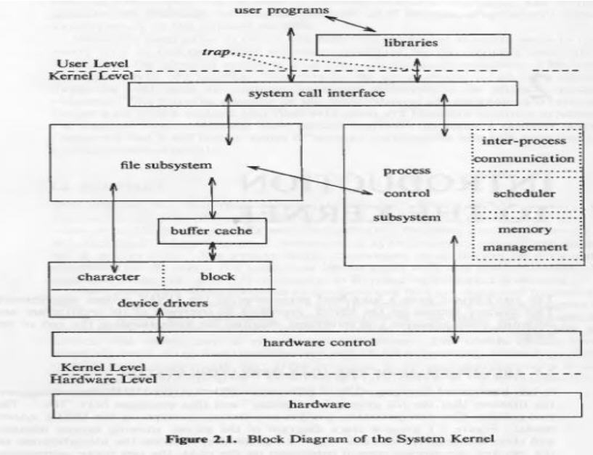
BLOCK DIAGRAM

Slide 11
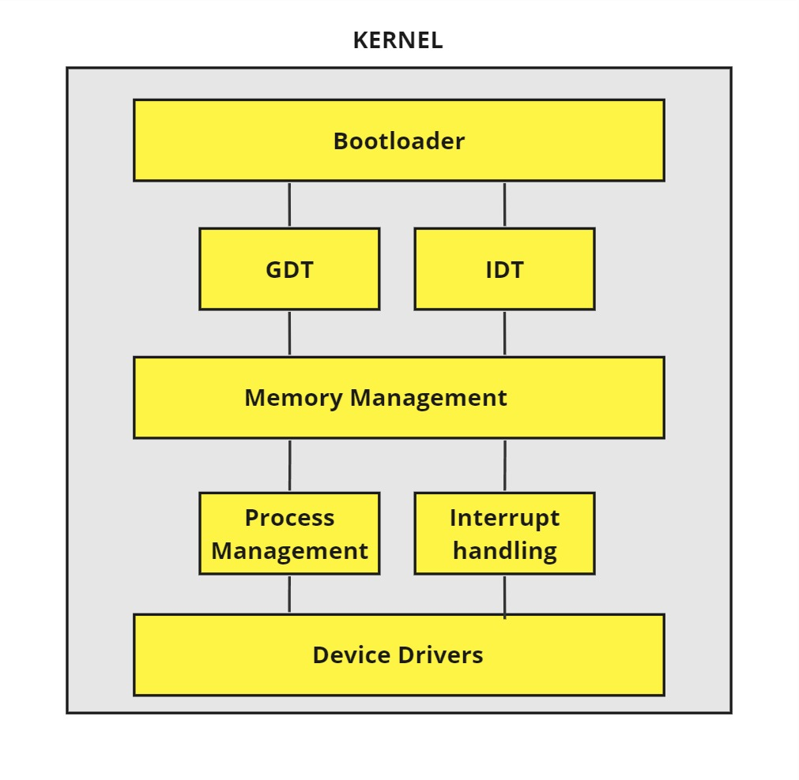
SOFTWARE DESIGN

Slide 12
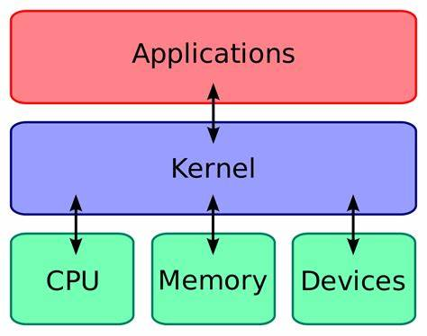
WORKING OF KERNEL
Kernel acts as an intermediate between hardware and software
Kernel responds to system calls
These are called by different parts of the OS to get the actual physical memory to do things

Slide 13
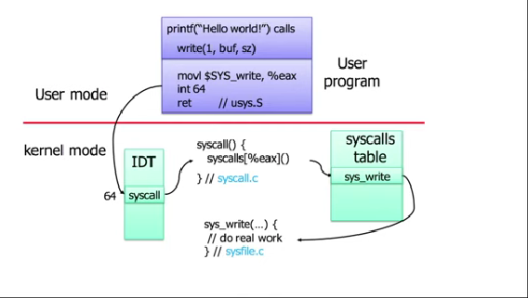
WORKING OF KERNEL
For example when ever we compile and run c code , c library uses system calls

Slide 14
HOW A COMPUTER STARTS
BIOS is copied from a ROM chip into RAM
BIOS starts executing code
Runs some tests(POST)
BIOS searches for an OS
BIOS loads and starts
OS runs
BIOS finds an OS by method legacy booting
BIOS loads first sector of each bootable device into memory (at location 0x7C00)
BIOS checks for 0xAA55 signature
If found ,it starts executing code

Slide 15
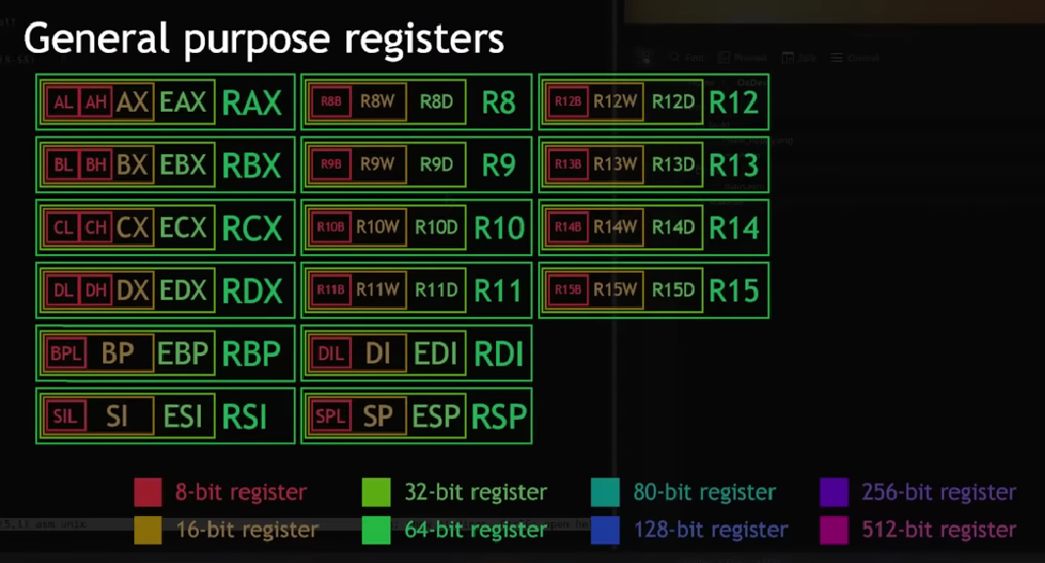
X86 REGISTERS

Slide 16
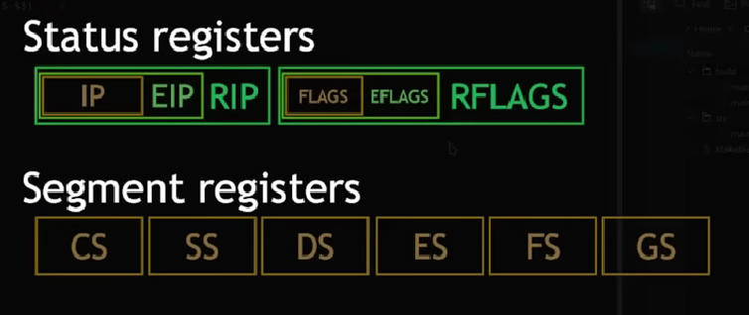
X86 Registers

Slide 17
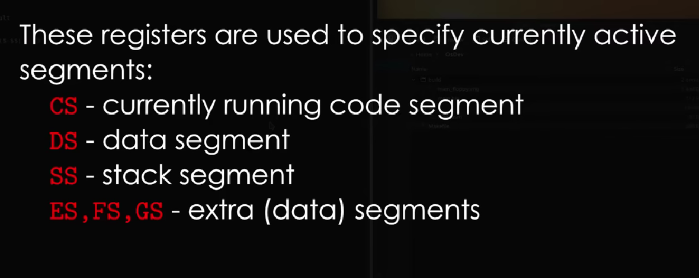
MEMORY SEGMENTATION

Slide 18
Working of product (customer perspective)
Enhanced Productivity:
Boosts work efficiency and accelerates task completion.
Robust Security:
Ensures data protection and shields against cyber threats.
Scalable Performance:
Adapts to varying workloads while maintaining top-notch performance.
Reliable Connectivity:
Provides seamless and stable connectivity for uninterrupted operations.

