Slide 1



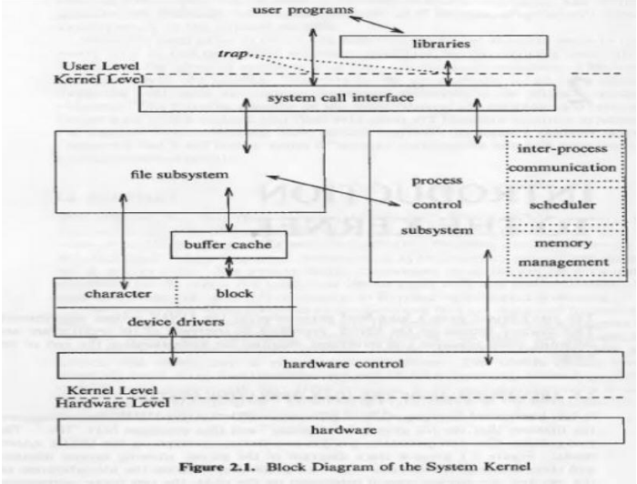


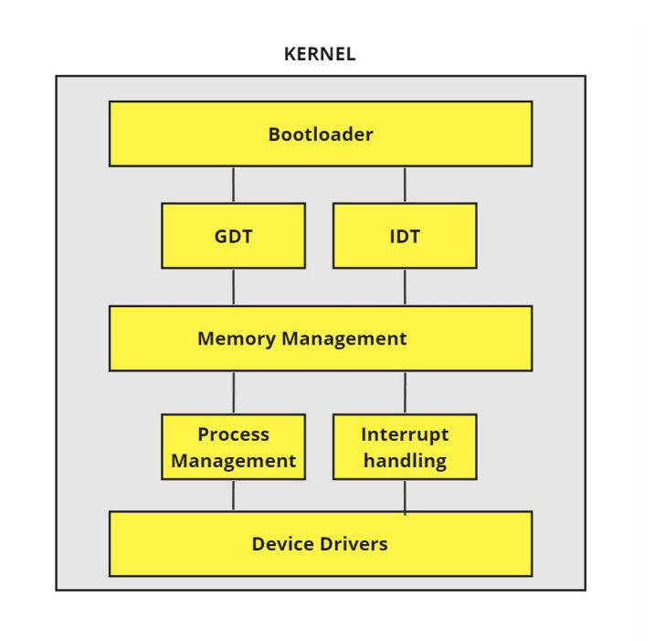



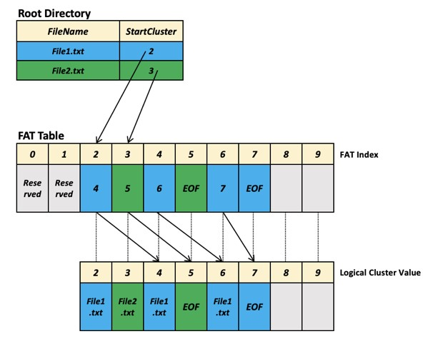

1) Introduction
3) KEY FEATURES
4) BLOCK DIAGRAMS
Our college EL project—a custom operating system designed for x86 architecture. It’s an initiative exploring core OS concepts in real-world application.
Developing a custom x86 OS is crucial for learning. It offers hands-on insight into system-level programming and deepens understanding of hardware-software interactions.
This project is fueled by our eagerness to apply theoretical knowledge practically. It hones programming skills and showcases our commitment to hands-on learning.
1.Custom Kernel for x86 Architecture: handles tasks like scheduling and system calls.
Ensures seamless interaction with x86 hardware, optimizing performance.
2.Bootloader Implementation: Initializes the system, loads the kernel, and facilitates smooth OS transition.
3.Efficient File System: Utilizes FAT12 file system for streamlined data storage and retrieval.
4. Basic string output function for accessibility.
5. Advanced Memory Management: Rudimentary techniques for dynamic memory allocation. It improves stability and performance through optimized memory usage.
6. Comprehensive Device Drivers : Initial steps toward supporting hardware peripherals.
7.Robust Security Measures : Basic interrupt disabling for foundational security.
.
2) TOOLS AND COMPONENTS USED
Development Tools:
NASM (Netwide Assembler) for assembly code.
Emulator or Virtual Machine for testing (e.g., QEMU).
Text Editor or Integrated Development Environment (IDE).
We used NVIM – neovim
Components :
x86-based computer for development and testing.
Storage media (e.g., floppy disk or disk image).
TEAM MEMBERS BIOGRAPHY
SHREYANSH SINGH [1RV22CS190]
SHREEJAY PANDEY [1RVCS187]
UJJWAL
[RVCE23BCS421]
4.VED REVANKAR
[RVCE23BCS407]

