Slide 1
Multimedia for Education
LMK : Learning Math easily with Kim
2018313285 Ujin Kim

Slide 2
CONTENTS
01 02 03 04
Why Math?
Design
Contents
User Convenience

Slide 3
CONTENTS
01
Why Math?

Slide 4
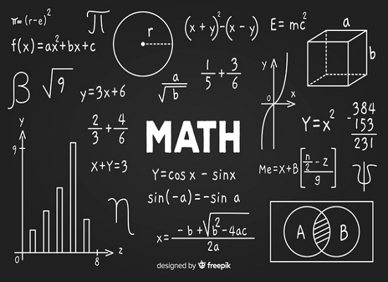
Why Math?
Multimedia for Education
01
Why Math?
소제목

Slide 5
CONTENTS
01 02 03 04
Design

Slide 6
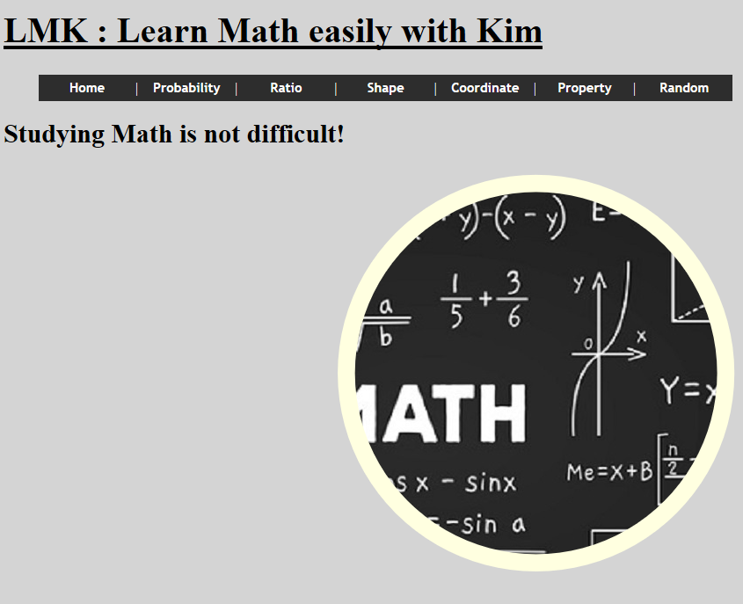
Design
Multimedia for Education
02
Simple is best!

Slide 7
CONTENTS
01 02 03 04
Contents

Slide 8
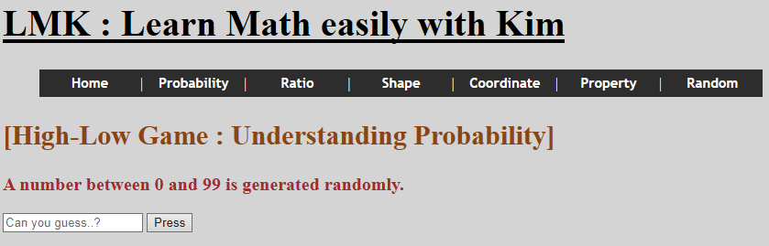
Contents
Multimedia for Education
03
1) Probability

Slide 9
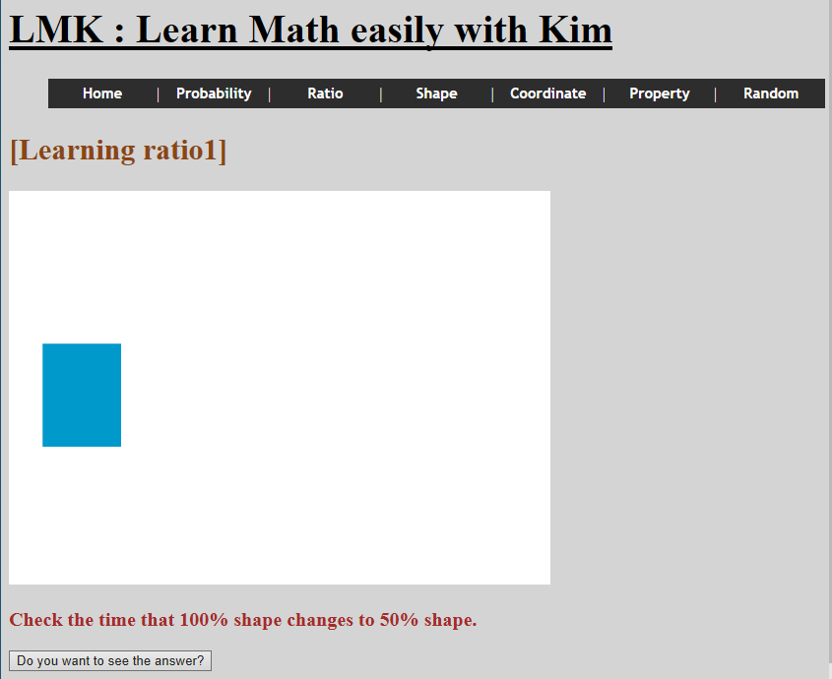
Contents
Multimedia for Education
03
2) Ratio

Slide 10
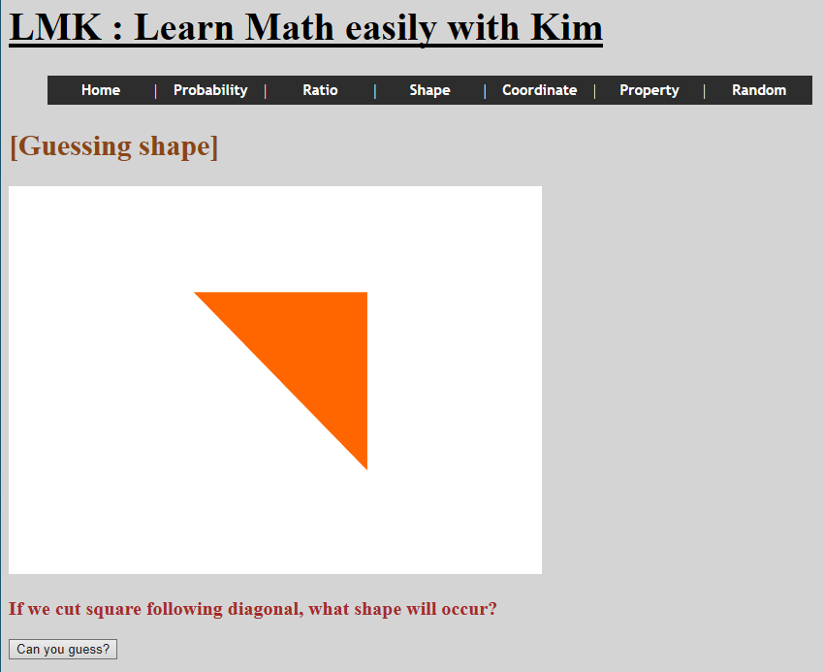
Contents
Multimedia for Education
03
3) Shape

Slide 11
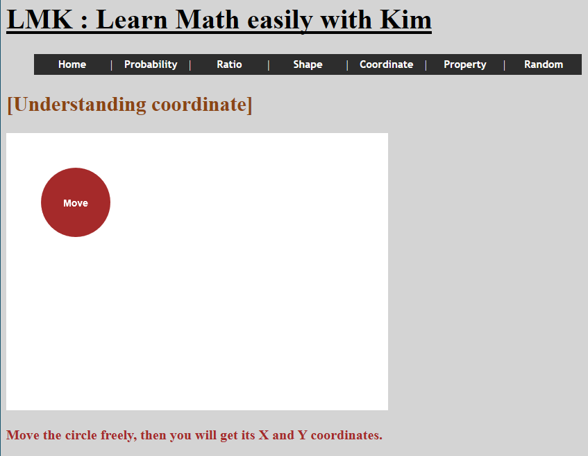
Contents
Multimedia for Education
03
4) Coordinate

Slide 12
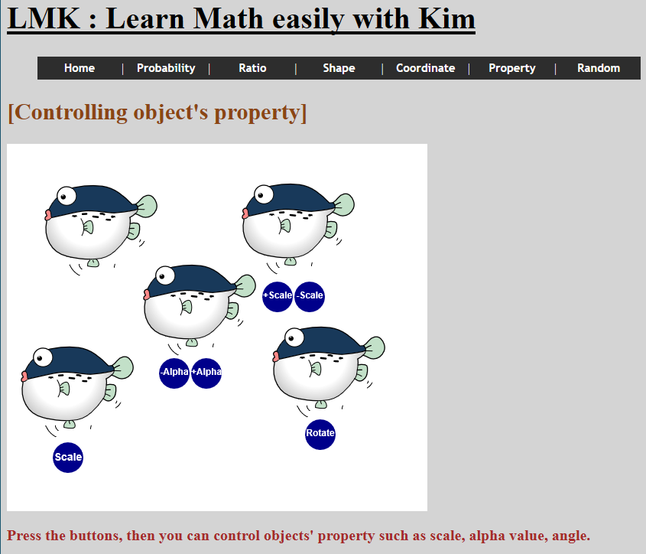
Contents
Multimedia for Education
03
5) Property

Slide 13
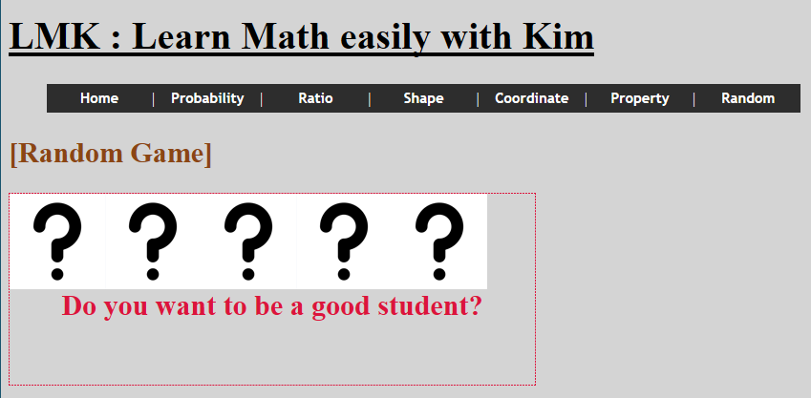
Contents
Multimedia for Education
03
6) Random

Slide 14
CONTENTS
01 02 03 04
User Convenience

Slide 15
User Convenience
Multimedia for Education
04
1) Menu bar and mask effect

Slide 16
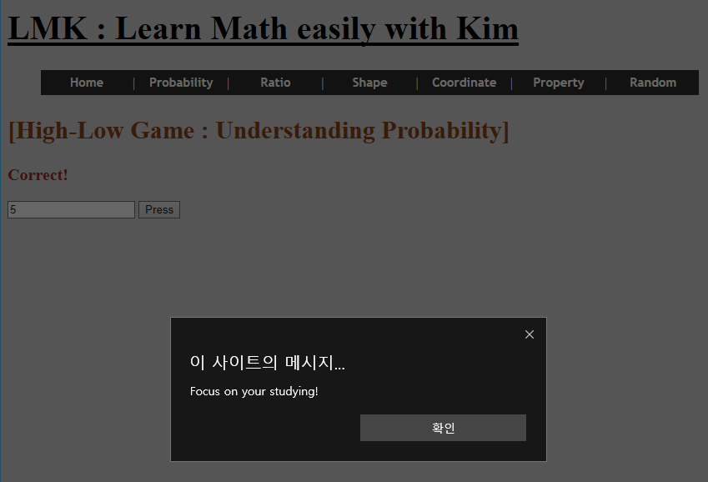
User Convenience
Multimedia for Education
04
2) ‘Focus!’ Alarm

Slide 17
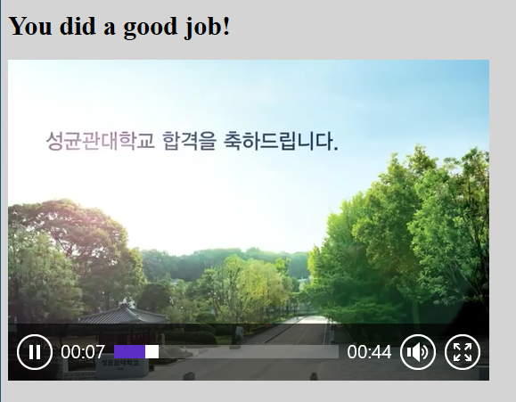
User Convenience
Multimedia for Education
04
3) Complimenting and Encouraging

Slide 18
Multimedia for Education
THANK
YOU
2018313285 Ujin Kim

