Slide 1
Homework #3
Rick Lee

Slide 2
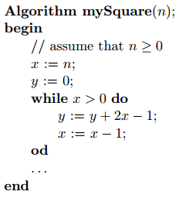

Problem 1
Consider the following algorithm for computing the square of a given non-negative integer.
Let $Inv(n, x, y)$denote the assertion: $x≥0∧y≥0∧y=n^{2}−x^{2}$. Claim: $Inv(n, x, y)$is a loop invariant of the while loop, assuming that $n≥0$. Prove the claim by induction. What does the loop invariant implicate when the while loop terminates?

Slide 3
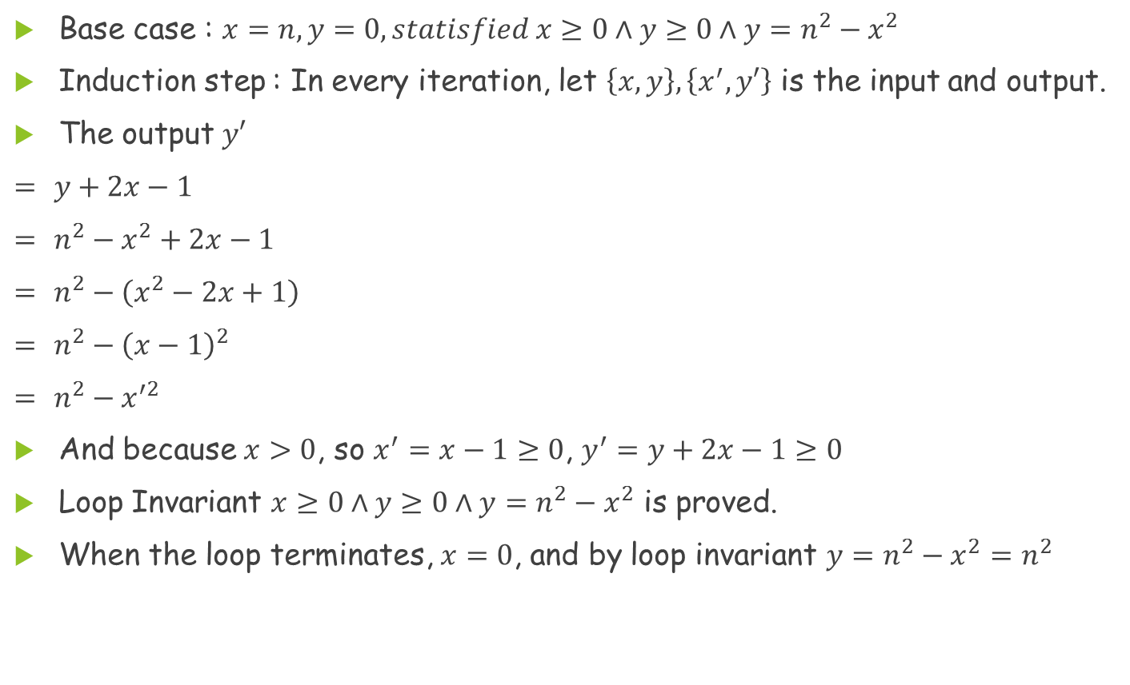
Problem 1(Cont.)
Base case : $x=n, y=0, statisfied x≥0∧y≥0∧y=n^{2}−x^{2}$
Induction step : In every iteration, let $\left\{x,y\right\},\left\{x^{′},y′\right\}$ is the input and output.
The output $y′$
$=$ $y+2x−1$
$=$ $n^{2}−x^{2}+2x−1$
$=$ $n^{2}−\left(x^{2}−2x+1\right)$
$=$ $n^{2}−{\left(x−1\right)}^{2}$
$=$ $n^{2}−x^{′2}$
And because $x>0$, so $x^{′}=x−1≥0$, $y^{′}=y+2x−1≥0$
Loop Invariant $x≥0∧y≥0∧y=n^{2}−x^{2}$ is proved.
When the loop terminates, $x=0$, and by loop invariant $y=n^{2}−x^{2}=n^{2}$

Slide 4
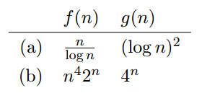

Problem 2
For each of the following pairs of functions, say whether $f\left(n\right)=O(g(n))$and/or $f(n)=Ω(g(n))$. Justify your answers.

Slide 5
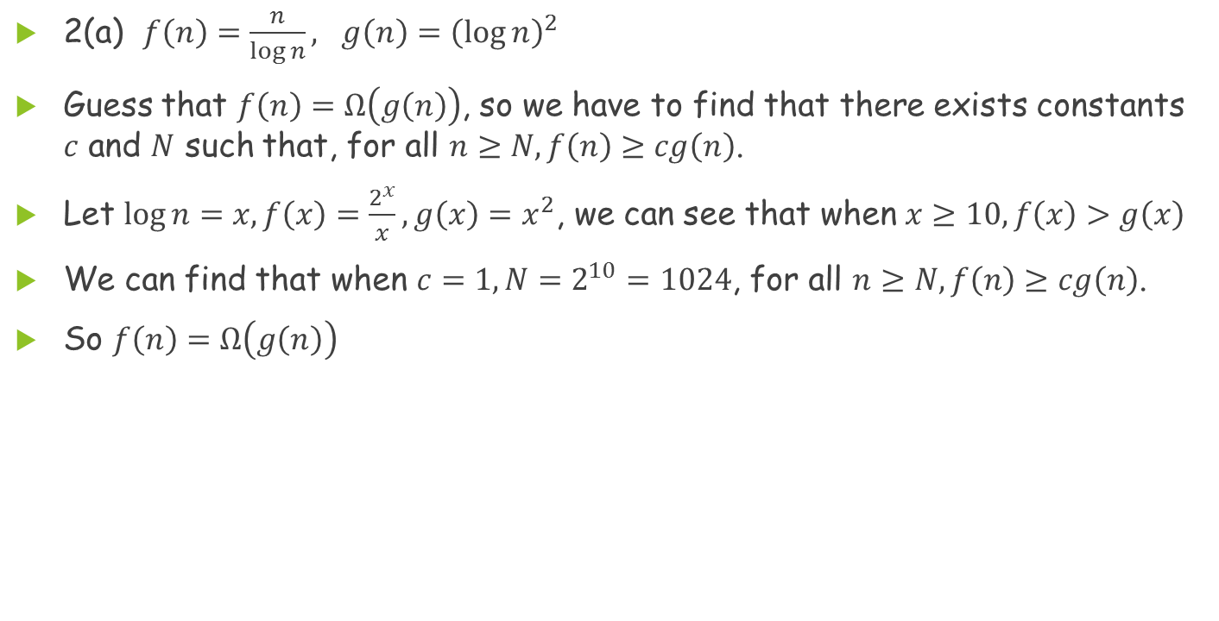
Problem 2(Cont.)
2(a) $f\left(n\right)=\frac{n}{\log{n}}, g\left(n\right){=\left(\log{n}\right)}^{2}$
Guess that $f\left(n\right)=Ω\left(g\left(n\right)\right)$, so we have to find that there exists constants $c$ and $N$ such that, for all $n≥N, f\left(n\right)≥cg\left(n\right)$.
Let $\log{n}=x, f\left(x\right)=\frac{2^{x}}{x}, g\left(x\right)=x^{2}$, we can see that when $x≥10, f\left(x\right)>g\left(x\right)$
We can find that when $c=1, N=2^{10}=1024$, for all $n≥N, f\left(n\right)≥cg\left(n\right)$.
So $f\left(n\right)=Ω\left(g\left(n\right)\right)$

Slide 6
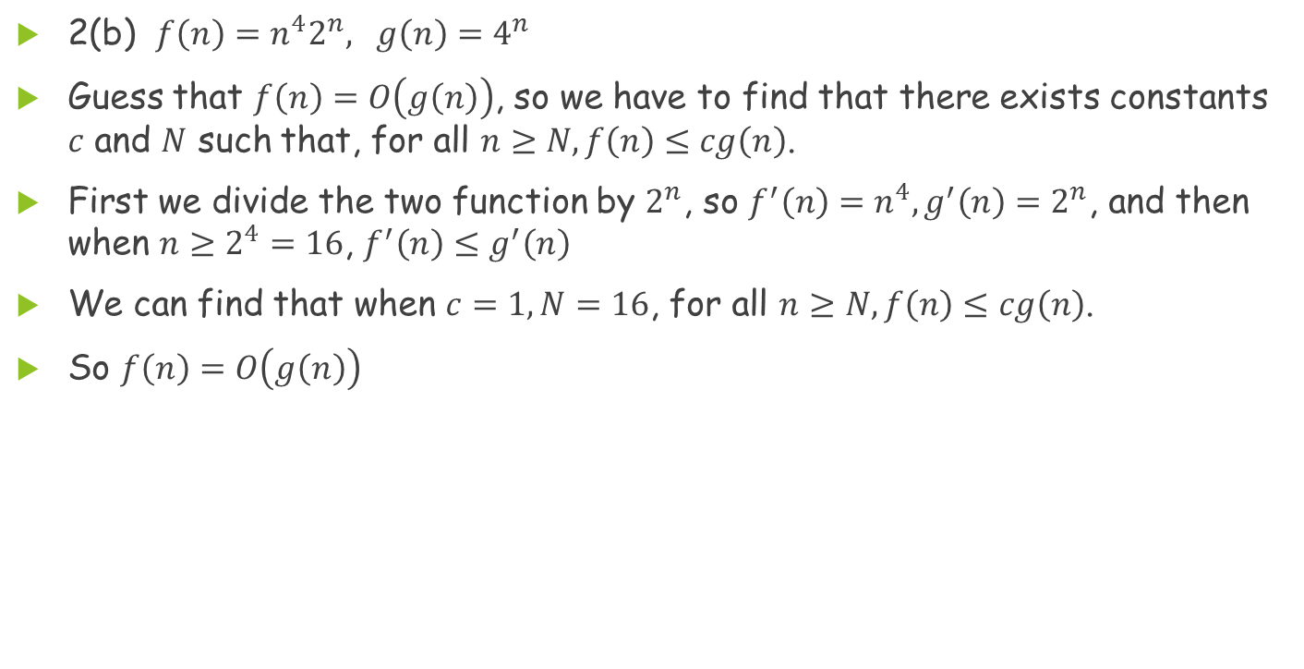
Problem 2(Cont.)
2(b) $f\left(n\right)=n^{4}2^{n}, g\left(n\right)=4^{n}$
Guess that $f\left(n\right)=O\left(g\left(n\right)\right)$, so we have to find that there exists constants $c$ and $N$ such that, for all $n≥N, f\left(n\right)≤cg\left(n\right)$.
First we divide the two function by $2^{n}$, so $f^{′}\left(n\right)=n^{4},g^{′}\left(n\right)=2^{n}$, and then when $n≥2^{4}=16$, $f^{′}\left(n\right)≤g^{′}\left(n\right)$
We can find that when $c=1, N=16$, for all $n≥N, f\left(n\right)≤cg\left(n\right)$.
So $f\left(n\right)=O\left(g\left(n\right)\right)$

Slide 7

Problem 3
Solve the following recurrence relation using generating functions. This is a very simple recurrence relation, but for the purpose of practicing you must use generating functions in your solution.
$$\left\{\begin{aligned}\begin{aligned}T\left(1\right)=1 \\ T\left(2\right)=3 \end{aligned} \\ T\left(n\right)=2T\left(n−1\right)−T\left(n−2\right), n≥3\end{aligned}\right.$$

Slide 8
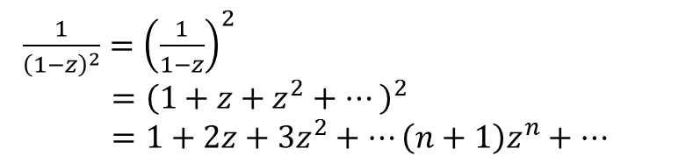
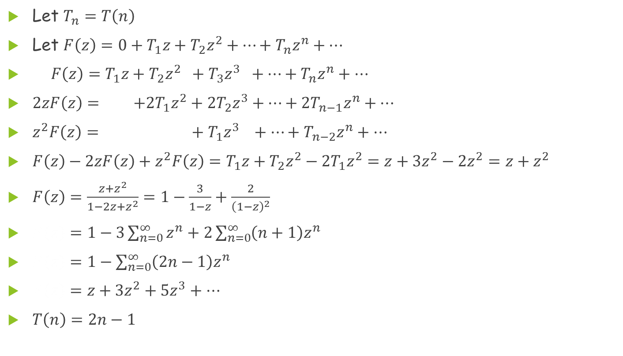
Problem 3(Cont.)
Let $T_{n}=T\left(n\right)$
Let $F\left(z\right)=0+T_{1}z+T_{2}z^{2}+…+T_{n}z^{n}+…$
$F\left(z\right)=T_{1}z+T_{2}z^{2} +T_{3}z^{3} +…+T_{n}z^{n}+…$
$2zF\left(z\right)= +2T_{1}z^{2}+2T_{2}z^{3}+…+2T_{n−1}z^{n}+…$
$z^{2}F\left(z\right)= +{ T}_{1}z^{3} +…+T_{n−2}z^{n}+…$
$F\left(z\right)−2zF\left(z\right)+z^{2}F\left(z\right)=T_{1}z+T_{2}z^{2}−2T_{1}z^{2}=z+3z^{2}−2z^{2}=z+z^{2}$
$F\left(z\right)=\frac{z+z^{2}}{1−2z+z^{2}}=1−\frac{3}{1−z}+\frac{2}{{\left(1−z\right)}^{2}}$
$F\left(z\right)=1−3\sum_{n=0}^{∞}{z^{n}}+2\sum_{n=0}^{∞}{\left(n+1\right)z^{n}}$
$F\left(z\right)=1−\sum_{n=0}^{∞}{\left(2n−1\right)z^{n}}$
$F\left(z\right)=z+3z^{2}+5z^{3}+…$
$T\left(n\right)=2n−1$
$\frac{1}{{\left(1−z\right)}^{2}}={\left(\frac{1}{1−z}\right)}^{2}$
$={\left(1+z+z^{2}+…\right)}^{2}$
$=1+2z+3z^{2}+…\left(n+1\right)z^{n}+…$

Slide 9

Problem 4
Find the asymptotic behavior of the function $T(n)$ defined by the recurrence relation $T(n)=T(\frac{n}{2})+\sqrt{n}, T(1)=1$. You can consider only values of n that are powers of 2.

Slide 10
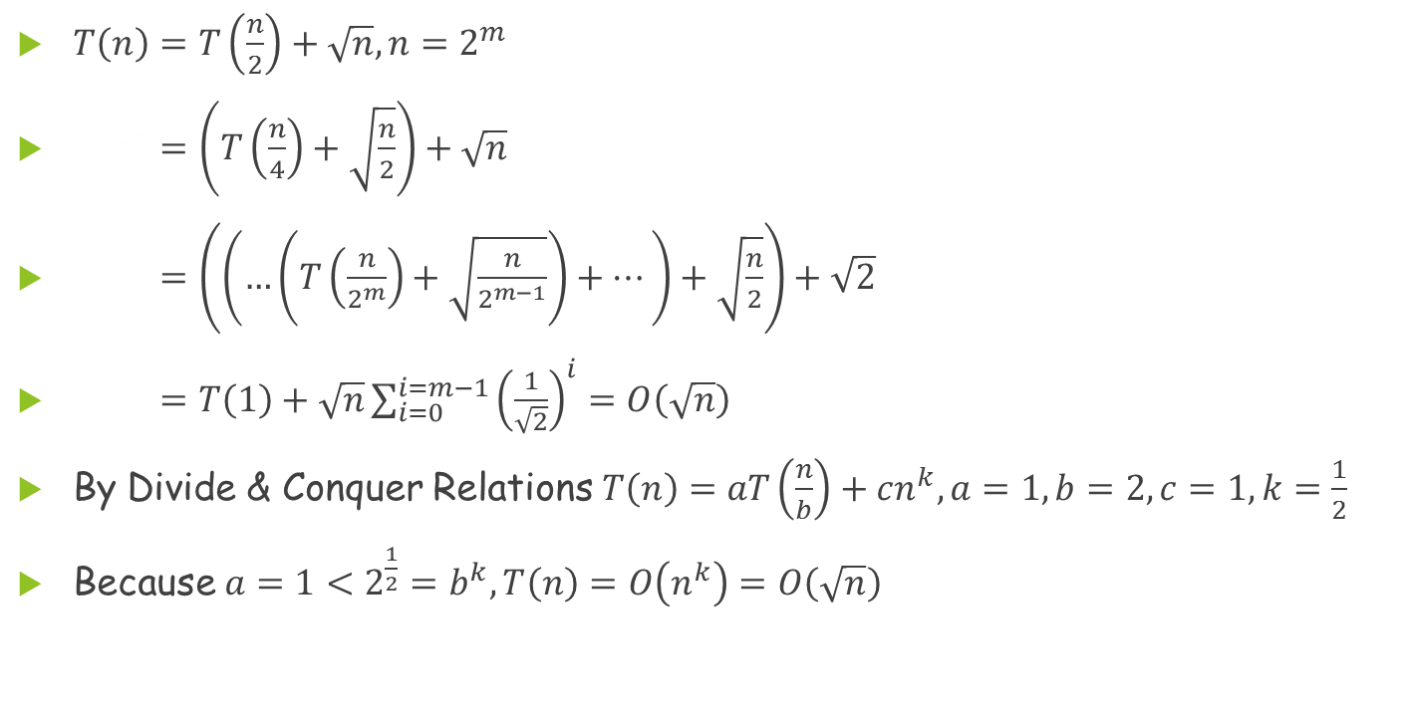
Problem 4(Cont.)
$T\left(n\right)=T\left(\frac{n}{2}\right)+\sqrt{n}, n=2^{m}$
$T\left(n\right)=\left(T\left(\frac{n}{4}\right)+\sqrt{\frac{n}{2}}\right)+\sqrt{n}$
$T\left(n\right)=\left(\left(…\left(T\left(\frac{n}{2^{m}}\right)+\sqrt{\frac{n}{2^{m−1}}}\right)+…\right)+\sqrt{\frac{n}{2}}\right)+\sqrt{2}$
$T\left(n\right)=T\left(1\right)+\sqrt{n}\sum_{i=0}^{i=m−1}{{\left(\frac{1}{\sqrt{2}}\right)}^{i}}=O\left(\sqrt{n}\right)$
By Divide & Conquer Relations $T\left(n\right)=aT\left(\frac{n}{b}\right)+cn^{k},a=1,b=2,c=1,k=\frac{1}{2}$
Because $a=1<2^{\frac{1}{2}}=b^{k}, T\left(n\right)=O\left(n^{k}\right)=O\left(\sqrt{n}\right)$

Slide 11
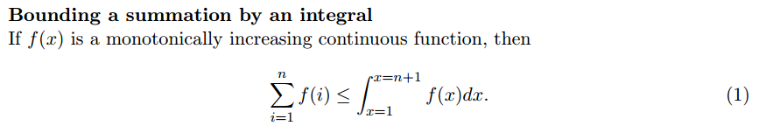
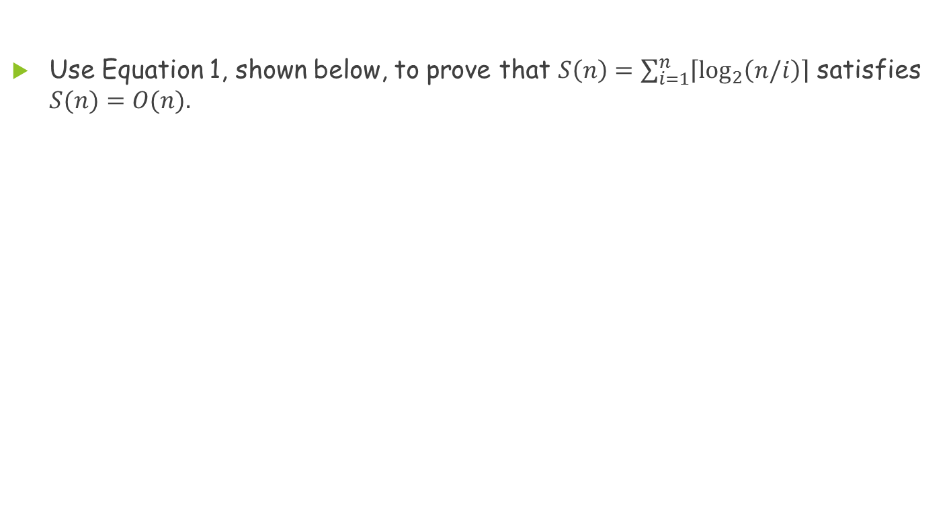
Problem 5
Use Equation 1, shown below, to prove that $S\left(n\right)=\sum_{i=1}^{n}{\left\lceil \log_{2}\left(n/i\right)\right\rceil }$ satisfies $S(n)=O(n).$

Slide 12
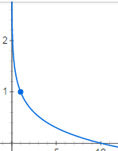
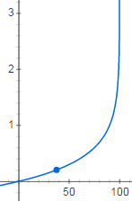
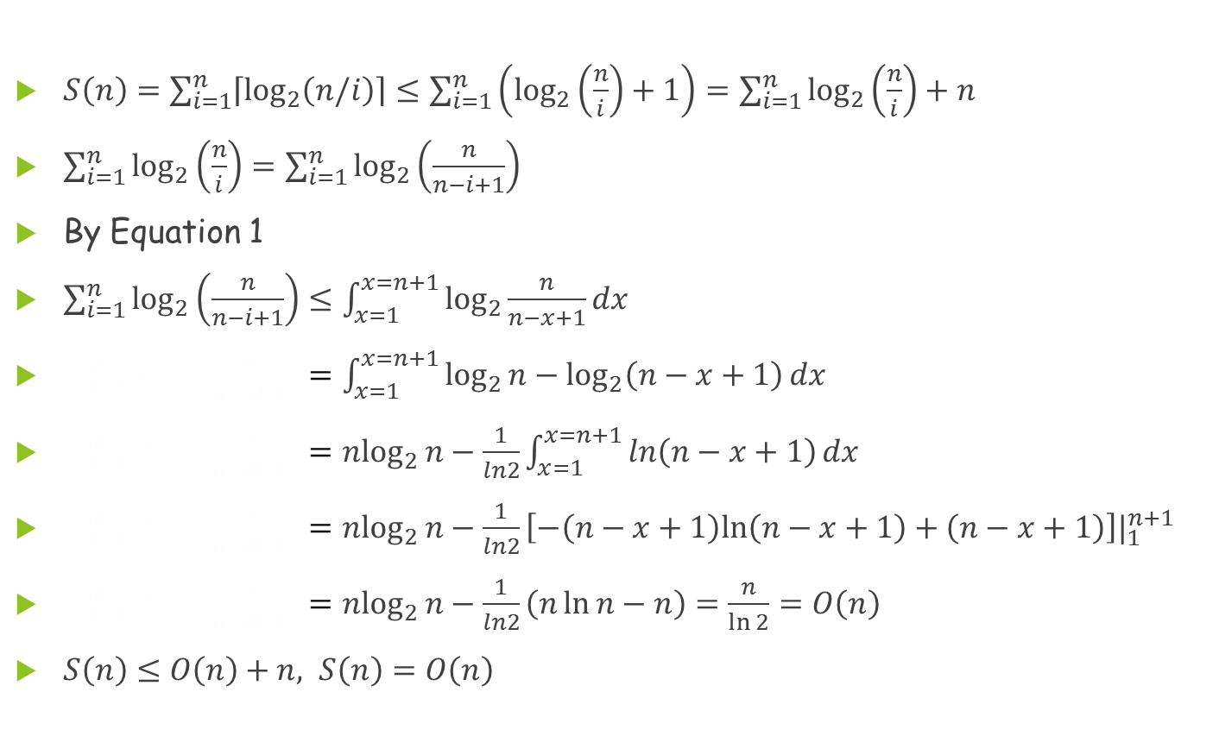
Problem 5(Cont.)
$S\left(n\right)=\sum_{i=1}^{n}{\left\lceil \log_{2}\left(n/i\right)\right\rceil }≤\sum_{i=1}^{n}{\left(\log_{2}\left(\frac{n}{i}\right)+1\right)}=\sum_{i=1}^{n}{\log_{2}\left(\frac{n}{i}\right)+n}$
$\sum_{i=1}^{n}{\log_{2}\left(\frac{n}{i}\right)}=\sum_{i=1}^{n}{\log_{2}\left(\frac{n}{n−i+1}\right)}$
By Equation 1
$\sum_{i=1}^{n}{\log_{2}\left(\frac{n}{n−i+1}\right)}≤\int_{x=1}^{x=n+1}{\log_{2}{\frac{n}{n−x+1}}dx}$
$\sum_{i=1}^{n}{\log_{2}\left(\frac{n}{n−i+1}\right)}=\int_{x=1}^{x=n+1}{\log_{2}{n}−\log_{2}\left(n−x+1\right)dx}$
$\sum_{i=1}^{n}{\log_{2}\left(\frac{n}{n−i+1}\right)}=n\log_{2}{n}−\frac{1}{ln2}\int_{x=1}^{x=n+1}{\ln\left(n−x+1\right)dx}$
$\sum_{i=1}^{n}{\log_{2}\left(\frac{n}{n−i+1}\right)}=n\log_{2}{n}−\frac{1}{ln2}\left[−\left(n−x+1\right)ln\left(n−x+1\right)+\left(n−x+1\right)\right]|_{1}^{n+1}$
$\sum_{i=1}^{n}{\log_{2}\left(\frac{n}{n−i+1}\right)}=n\log_{2}{n}−\frac{1}{ln2}\left(n\ln{n}−n\right)=\frac{n}{\ln{2}}=O\left(n\right)$
$S\left(n\right)≤O\left(n\right)+n, S\left(n\right)=O\left(n\right)$

