Slide 1
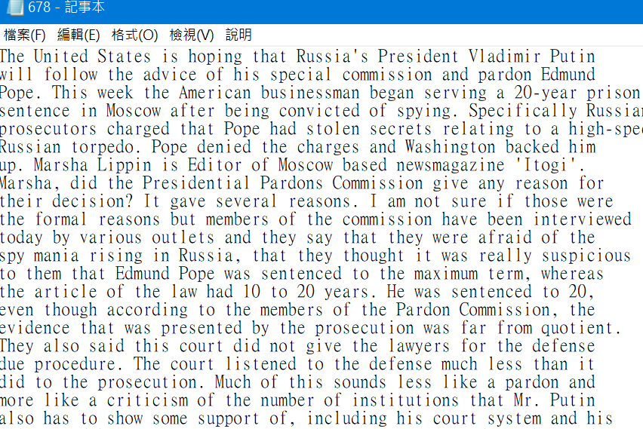
Programming Assignment 1
1. Write a program to convert a set of documents into TF-IDF vectors
Text collection: 1095 news documents
https://cool.ntu.edu.tw/files/1125546/download?download_frd=1
1.txt ~ 1095.txt
Use TfidfVectorizer
Lowercase everything
Filter out English stopwords

Slide 2
Programming Assignment 1
2. Save each document’s TF-IDF vector as a plain text file
1.vec, 2.vec, … 1095.vec
3. Load the TF-IDF vectors of documents 1 and 2, and calculate their cosine similarity.
Please zip the vector files of documents 1 and 3, your code, and a report to TA.
You have 2 weeks to do the work, deadline is 2021/10/22.

