Slide 1
Joint decision-making of product family configuration and order allocation by coordinating suppliers under disruption risks
Key words :capacity-constraint (coordination strategy) , disruption risk (protection strategy), product family configuration
2022.10.04
Journal of Engineering Design (2021)
Deng Zhuo Liu & Zhong Kai Li
School of Mechatronic Engineering, China University of Mining and Technology
Notes:
제품군에 관심이 있다.
그런데 요즘, 코로나 / 러시아 우크라이나 문제 등을 보면서, 유통 (SCM) 관점에서 문제가 많다는 기사르 봤다.
그러던 중, 이 두가지를 모두 고민한 논문이 있어서 흥미롭다고 생각되어서 읽어보게 됐다.

Slide 2
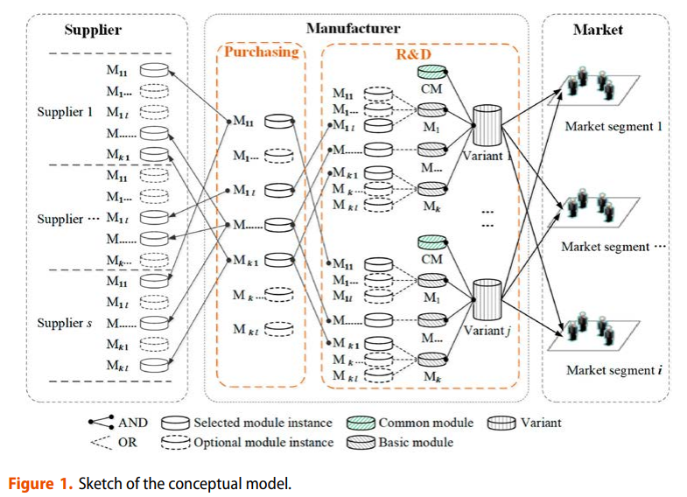
backgrounds of solving PCOA (Product family Configuration & Order Allocation )
R&D department
Max utility value of variants
Product family configuration
multi market segment
Purchasing Department
Min supply chain cost
Multi OEM (sourcing)
Capacity Constraint
Disruption risk , defect ratio
Wholesale cost
➔ cost min & risk management
EX ) variant : computer , Module : GPU, Module instance : RTX 3080

Slide 3
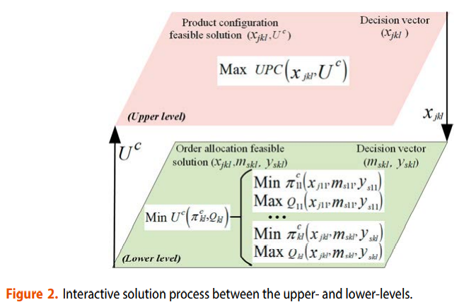
backgrounds of solving product platform design (End – End optimization problem)
Bi-level optimization (Game-theory)
Leader-Follow decision-making process
Upper level
- R&D) Product configuration decision
Lower level
- Purchasing department) Order allocation
Robustness (defect ratio, disruption risk)
OEM 마다 defect ratio, disruption risk, wholesale price 등이 상이함
Notes:
Frictional resistance & wave_making resistance

Slide 4
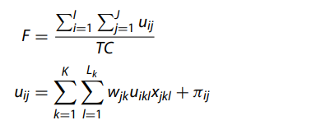

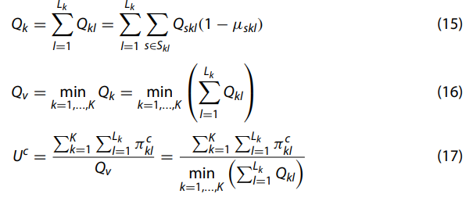
Upper level (Phase 1) : Max Utility per cost
Equation
(Origin)
Parameters
Decision variable
- x_{jkl} : j : product variant, k : module, l : module instance That is, whether module instance l of module k is used in variant j ex) j 번째 컴퓨터에, 그래픽카드 ( =k) 에 RTX 2080 (l) 이 사용되었는지
Given
- U^{C}: Unit supply chain cost (제품 하나당 평균 공급망 비용)
Notes:
Multi OEM
capacity constraint
disruption risk
defect ratio
wholesale cost

Slide 5
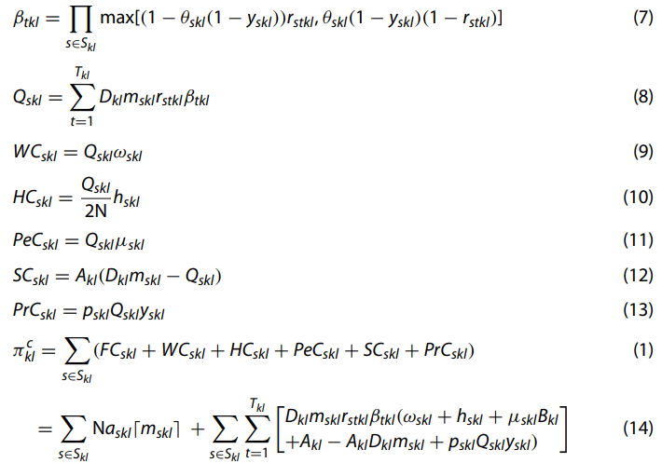
Lower level (Phase 2) : Min unit supply chain cost
(Expected quantity of module instance l )
(Wholesale Cost)
(Holding Cost)
(Penalty Cost)
(Shortage cost)
(Protection cost)
Decision variable
m_{skl} : supplier s 에게, module instance l 을 얼마나 분배할 것인가.
ex) l 을 생산하는 회사 3곳에 대해, (25%, 30%, 45%) 를 맡김
y_{skl} : protection decision (일종의 보험)
Given
- x_{jkl} : j : product variant, k : module, l : module instance That is, whether module instance l of module k is used in variant j
Notes:
Beta : 성공적으로 disruption을 고려하여, 성공적으로 만들어질 확률

Slide 6
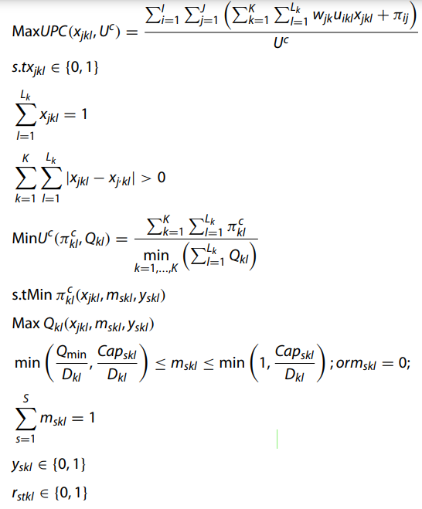
Summary of solving mechanism
- m_{skl} : orders ratio
- y_{skl} : protection decision
Notes:
Frictional resistance & wave_making resistance

