Slide 1
Technical change management for the maintenance of product platforms 외 관련 논문
Key words :Release management , Technical (Engineering) change management, product platform, clustering
2022.11.22
International Academy For Production Engineering, CIRP (2017)
Gunther Schuh& Michael Riesener, Christian Tonnes
Laboratory for Machine Tools and production engineering, RWTH Aachen University

Slide 2
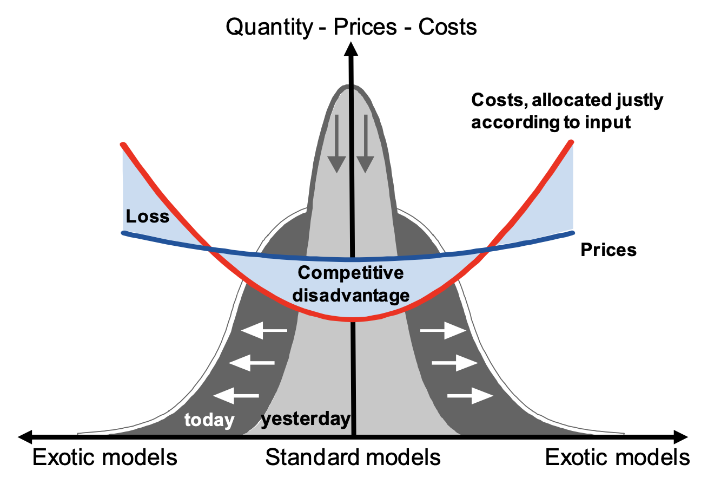
Release management and relation with product platform
기존 연구에 대한 고찰
A) 단일 제품에서, 구조가 복잡 해질수록 그에 대한 cost & duration에 악영향
B -1) 플랫폼은 new variants를 만들면서, 구조가 복잡해짐.
B-2) platform design (configuration)에 대한 연구 But management관점에서의 연구 부족.
product platform management 관점에서 연구가 필요. Structured release management for the systematic introduction of technical changes
Release Management : Clustering technical changes into bundles + set periodical cycles.
- From information Technology
- 단일 제품이 아닌, 플랫폼 관점에서의 용어
Synonym) Technical change management, Engineering change management
Identification of optimum bundle of technical changes
Flexibility of modules
Scenarios of implementation
Most companies do not have a structured release management for the systematic introduction of technical changes and modified modules of physical products.
Notes:
Information technology as the collection of one or more new or changed configuration items deployed into the live environment.
즉, 실제 기존에 틀을 갖고 있는 product platform에서의 새로운 추가 조합을 collection 하여 배포하고자 하는 과정.

Slide 3
Overall flow of release management
Step 1
Step 2
Step 3
Customer Requirements set
Calculate Effort and Benefit values of each feasible changes
Adjust Efforts and benefits through TCCF
Identifying flexibility of modules
Identification of optimum bundle of technical changes
Set Release cycle
* Step 2 (optimum bundle of technical changes) 부분이 가장 상세하게 적힌 핵심 부분
Notes:
Information technology as the collection of one or more new or changed configuration items deployed into the live environment.
즉, 실제 기존에 틀을 갖고 있는 product platform에서의 새로운 추가 조합을 collection 하여 배포하고자 하는 과정.

Slide 4
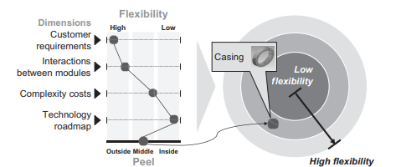
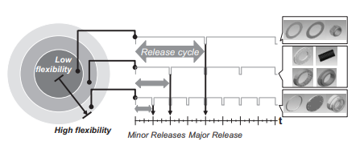
i) Identifying flexibility of modules
Onion peel model
1) Customer’s requirements
2) Interactions between modules
3) Complexity costs ➔Effort due to a technical change within a model
4) Technology roadmap
Set each release cycle
Notes:
Flexibility 를 판단할 수 있는 방법을 크게 4가지.
1) Kano model
2)CI-R,S → passive and active path 를 통해 flexibility
3)
4) Technology roadmap 을 통해 미리 어느정도 파악을 가능. (forthcoming and urgent technology replacement

Slide 5
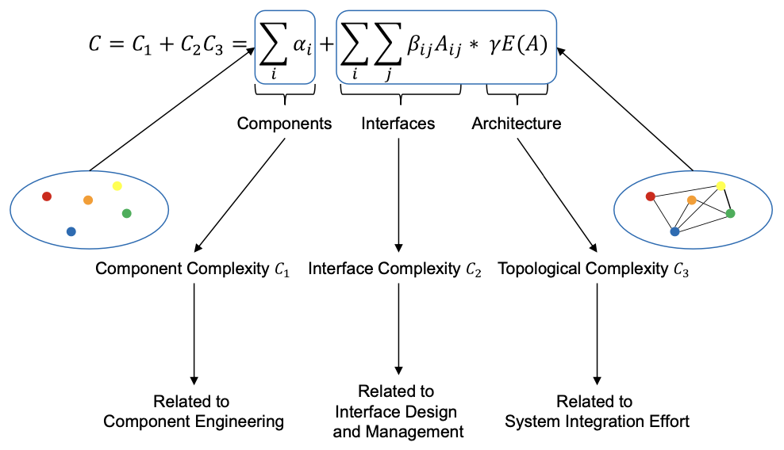
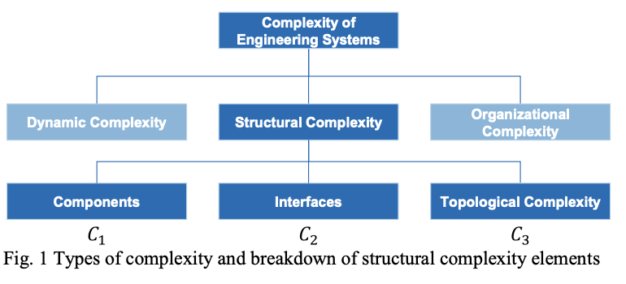
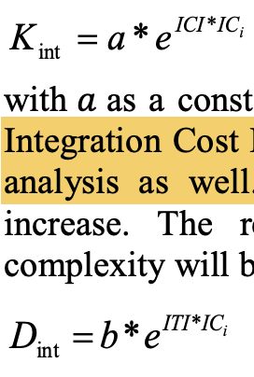
i – 1) Complexity costs
Cost and duration
Inducing that the higher complexity in product ➔ duration and cost get worse.
Notes:
Flexibility 를 판단할 수 있는 방법을 크게 4가지.
1) Kano model
2)CI-R,S → passive and active path 를 통해 flexibility
3)
4) Technology roadmap 을 통해 미리 어느정도 파악을 가능. (forthcoming and urgent technology replacement

Slide 6
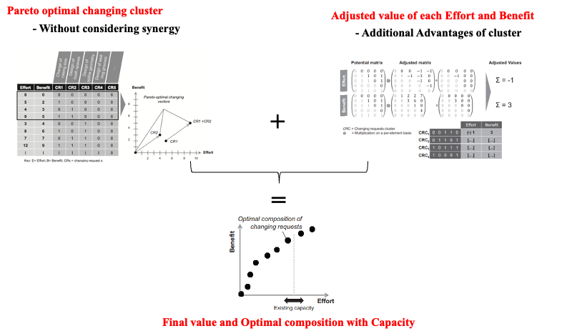
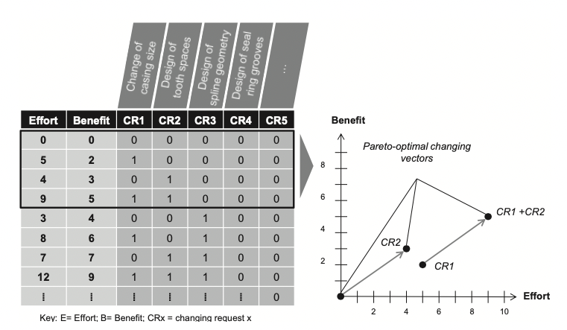
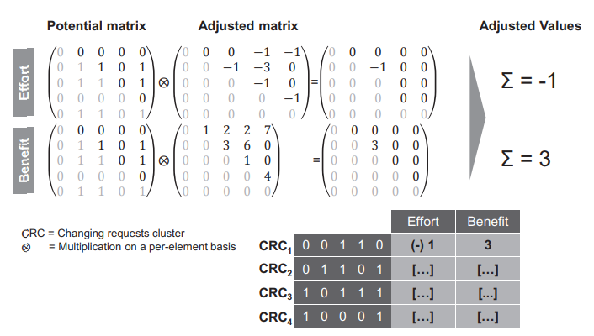
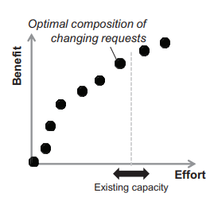
ii) Identification of optimum bundle of technical changes
Pareto optimal changing cluster
Adjusted value of each Effort and Benefit
- Without considering synergy
- Additional Advantages of cluster
+
Then, how to induce with mathematics formulation?
=
Final value and Optimal composition with Capacity
- As Knapsack problem

Slide 7
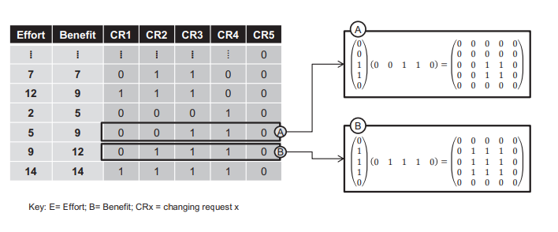
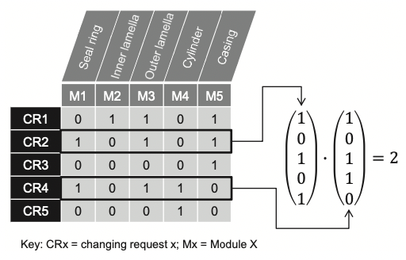
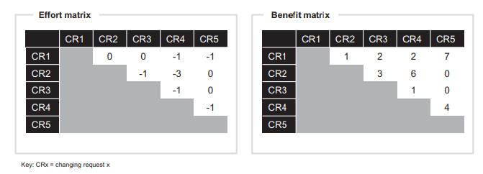
ii-1) how to induce the Adjusted value of Effort and Benefit
Potential matrix
Technical Change Coupling Factor
( = TCCF)
Adjusted matrix
(Effort, Benefit)
* Technical coupling 이 존재하면 Synergy로, 좋은 점만 보이는게 맞나? (WTM, CP)
7
Notes:
TCCF : Technical change coupling factor

Slide 8
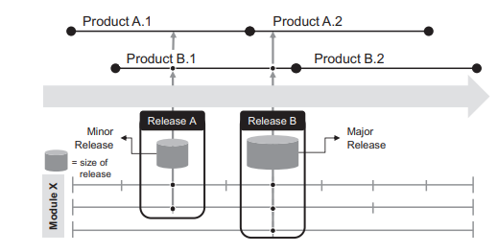
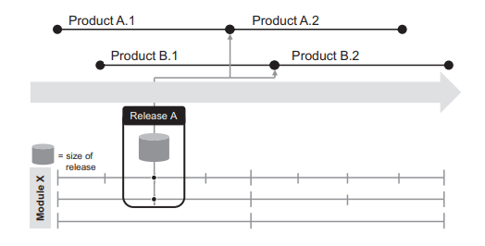
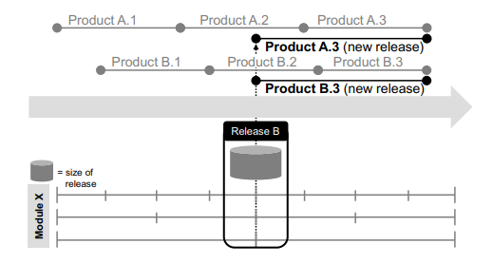
iii) Scenarios of implementation (release strategy of timing)
Synchronizing Technical Changes with different strategies
Ad-hoc Implementation
Gradual Implementation
Change of product release
Contribution and Limitations
Software에서의 용어 및 시도들을 제품 도메인에 연결하고자 하는 부분이 신선
Design 측면 뿐만 아닌, 그것을 활용(management)하는 측면에 대한 연구 시도
앞단의 문제 상황 자체는 흥미로웠으나, 각 단계에서의 논리성이 부족
Product platform을 주 포인트로 잡았으나, 그것에 대한 연관성 부분 부족

