Slide 1
연구실 세미나 목차
발표자
제목
연구/논문
유재상
Product platform management strategy for pre-planned life cycle
연구 및 논문

Slide 2
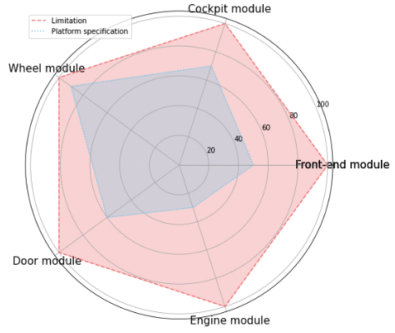
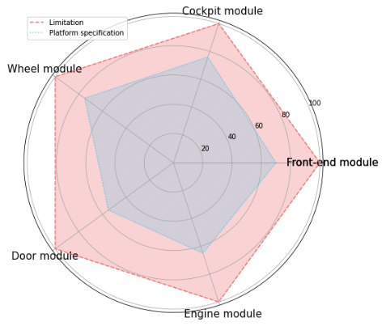
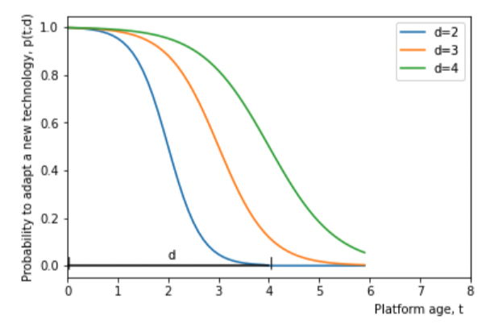
Research Objective
d = max(MS₁ ,MS₂ ,MS₃ ,MS₄ ,MS₅ …)
Before
After
Is product platform properly used within pre-planned duration?
If pre-planned duration = 5
Reasons :
Relative obsolescence
Dynamic exogeneous factors
Internal complexity
The gap between design and application stage
Existing way :
→ Make flexible product platform design (config)
Need (release) management strategy
component combination from various candidates that deal with customer requirement - Need microscopic view of adaptability - Change management with unchangeable (= product platform) component
<Product platform replacement: impact of performance objectives, innovation speed, and competition >
< Chang Muk Kang , Yoo S. Hong & Woonghee Tim Huh (2012) Platform replacement planning for management of product family obsolescence, IIE Transactions, 44:12, >
Notes:
a long-lasting platform is prone to obsolescence and, thus, to becoming unsuitable for the adoption of state-of-the-art technologies.
1) 외부 효과가 너무나 dynamic 해서 design 단계에서 cover가 불가능
2) Product platform design 단계와 실제 그것을 사용하는 단계 사이의 격차로 인해, 모든 것을 다 담기가 불가능

Slide 3
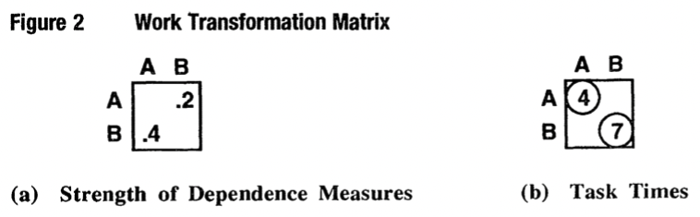
Methodology (naive)
Variant Com
Variant Com
Platform Com
Variant Com
(1)
(2)
Variant Com
Ex) FR : 회전축 속도 증가 + PC가 발열을 잡지 못함
Variant component 자체적으로 change를 흡수 → 더 높은 cost & duration 필요
PC와 인접한 다른 component에서 변화를 흡수
Platform과 인접한 variant component들의 더 많은 cost & duration (effort)을 요구 ➔ module selection에 따른 모듈별로의 adaptability 비교

Slide 4
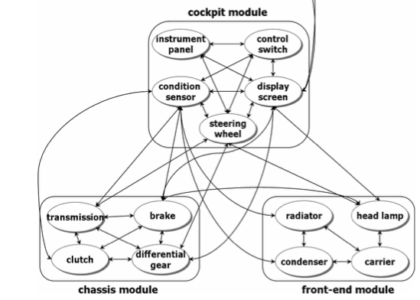
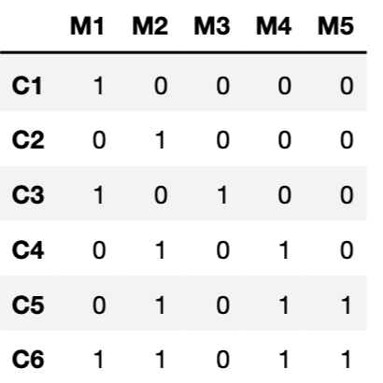

Methodology (naive)
Ex) FR : 회전축 속도 증가 + PC가 발열을 잡지 못함
Calculate penalty and additional process effort
FR occurs
Multiple candidate for FR₁
Increase the speed of rotating power
*Option) Consider degree
Processing to prevent further propagation to PC
*Option) Decision whether platform replacement or develop NPD
Choose one that doesn’t cause a lot of obsolescence effect on PC
Notes:
회전 축 자체를 변경하거나,
회전축을 감싸고 있는 부분에 대한 재설계를 통해 속도를 올리는 방법 자체를 바꾸는 등
기존 그것과 인전한 모듈의 무게를 줄이거나
여기서의 패널티란, 플랫폼에 영향을 주는 정도 / 둘 사이의 interaction 정도?
가령 power 가 100까지 handle. 초기엔 20 -> 30 정도로 늘었다고 해서, 플랫폼 자체에 대한 엄청난 노후화 같은 것이 현상화 되지 않음.

Slide 5
현재 진행중인 사항 및 향후 계획
제 주장에 대한 구체적인 근거 찾기!
Product platform
Wang (2010), Kang (2012) Broeke(2021)
Adaptability (obsolescence)
Release management
&
Microscopic
Change Propagation
& Un-changeable
Wolfgang (2015)
Notes:
1] Disturbance Factors Analysis of Product Platform : If the stability of product platform is broken, company need to conduct series of actions of product platform innovation and upgrading.
2]
3] These parts must kept stable during the whole platform life cycle as changes affect all variants and are very costly and time-consuming. On the other hand, the product platform must enable differentiation for the satisfaction of various customer needs and to react to occurring changes by an incorporated flexibility [1, 15]. Therefore, it is necessary to anticipate the influences in the environment of the platform-based product and their dynamics over the platform life cycle.

