Slide 1
Distribution Agreement – Important Points

Slide 2
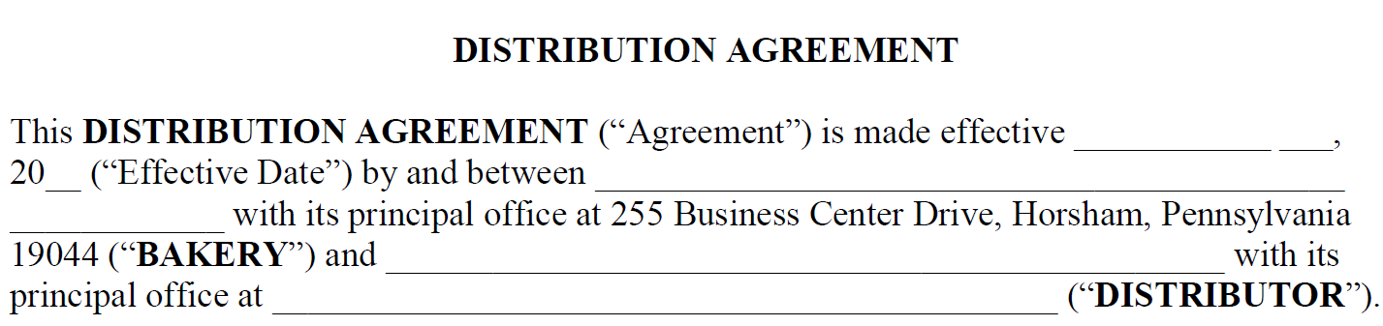
Agreement is effective between BFBD (Bakery) and your business (Distributor).
Agreement is the exclusive right to sell Products to Outlet in the Sales Area by Direct Store Delivery.
Effective date is usually the first day of the week (Sunday) after the closing.

Slide 3
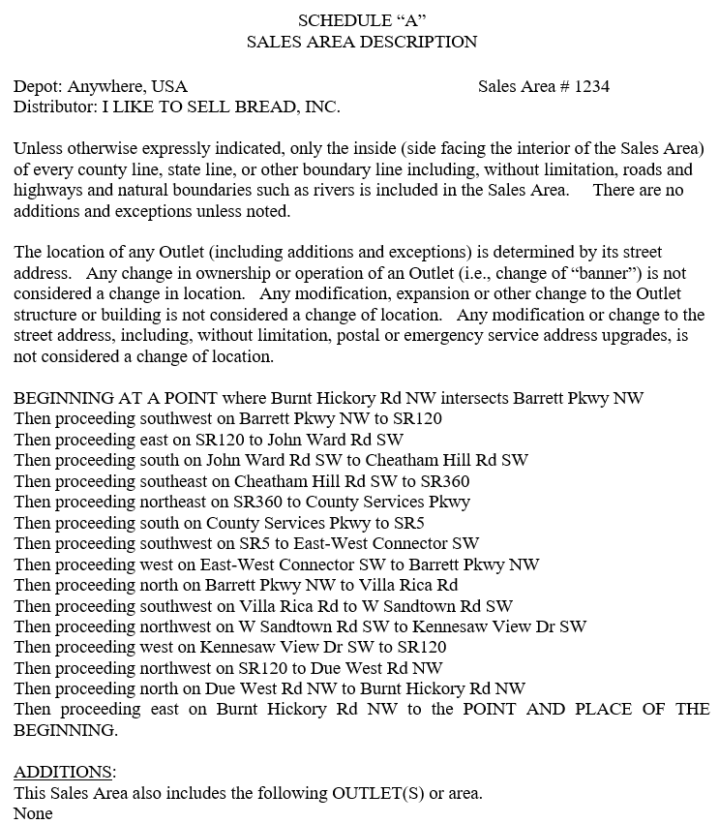
Schedule A
Schedule A is the geographic boundaries of your Sales Area.
The Sales Area is the inside of every boundary line.
There are no additions or exceptions to the Sales Area unless noted on the document.
Location of Outlets is determined by its street address.

Slide 4
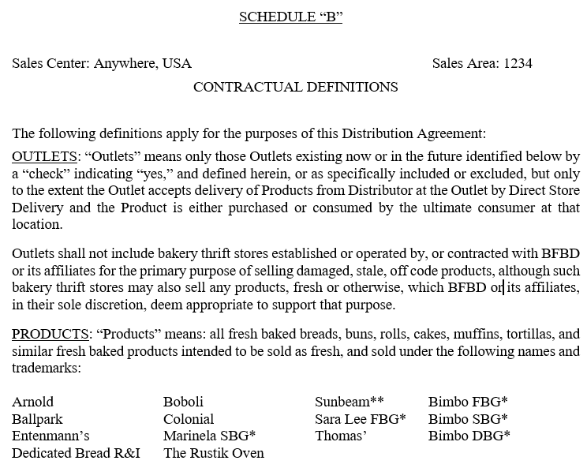
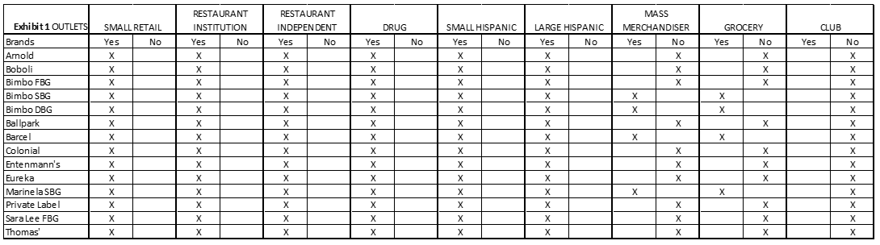
Schedule B
Schedule B is the contractual definitions in the Sales Area.
Lists the Products your company has rights to distribute.
Lists the Channels (type of accounts) your company has rights to distribute to.
The matrix lists which channels your company has rights to.

Slide 5
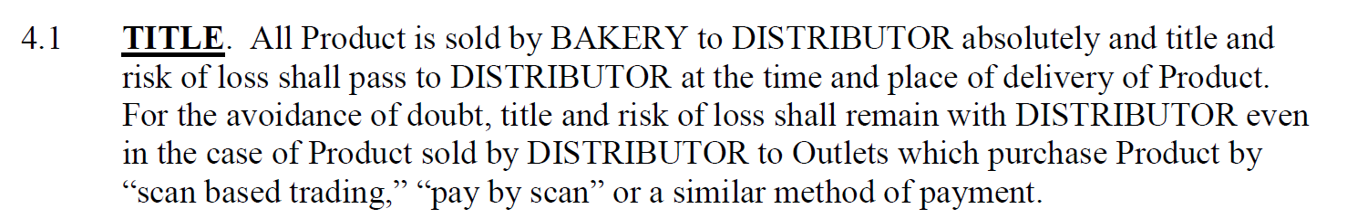
Article 4 – Sale of Product by Bakery to Distributor
Once product is purchased by your company from Bakery, the product is the property of your company.
Your company will bear all risk of the product henceforth.

Slide 6
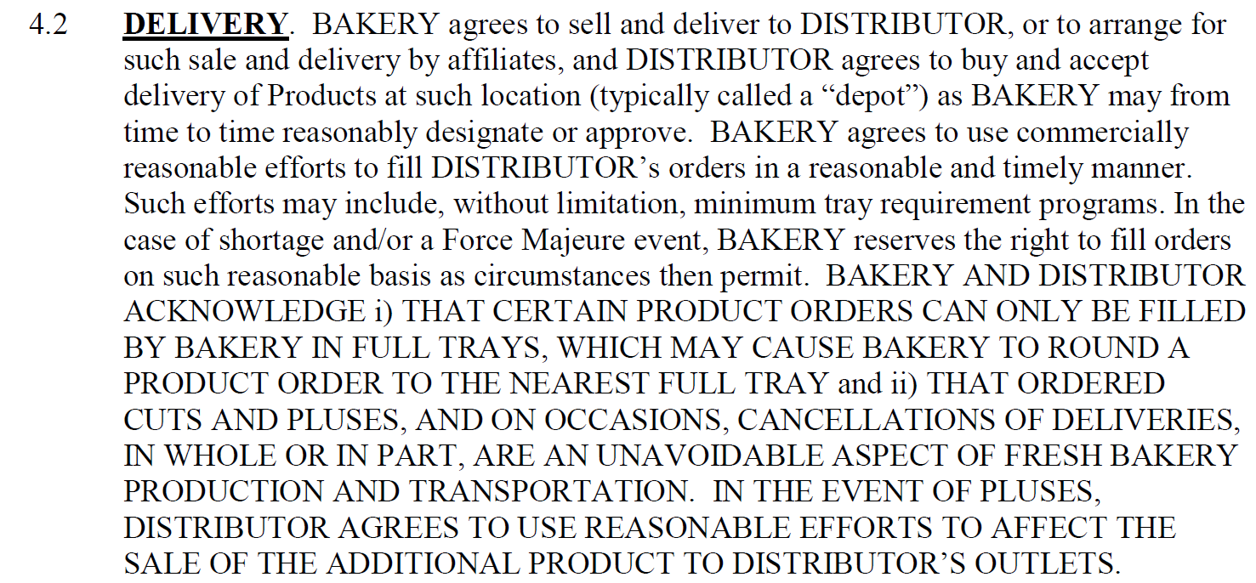
Article 4 – Sale of Product by Bakery to Distributor
BBU will round orders from time to time to ensure the ability to bake all product
Cuts and Pluses of product are a normal part of the business

Slide 7
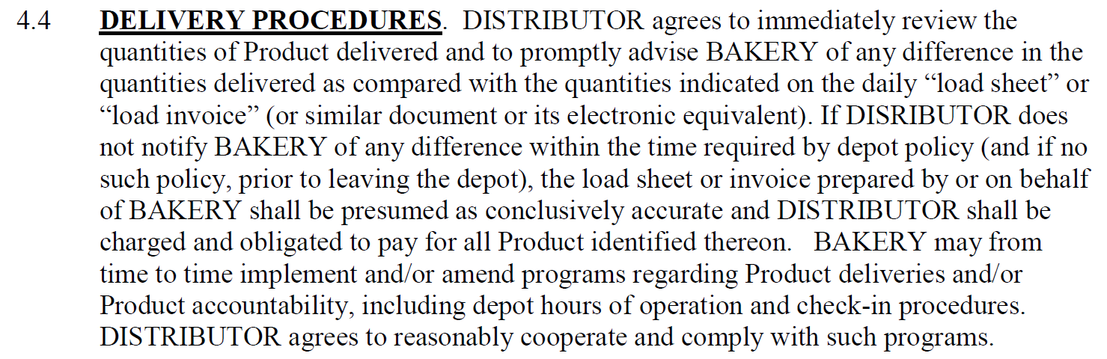
Article 4 – Sale of Product by Bakery to Distributor
It is your company’s responsibility to notify BBU of any discrepancies between product quantity delivered and product quantity on the daily load invoice.
If BBU is not notified the daily load invoice will be presumed accurate and BBU will charge your company for all products purchased as listed.

Slide 8
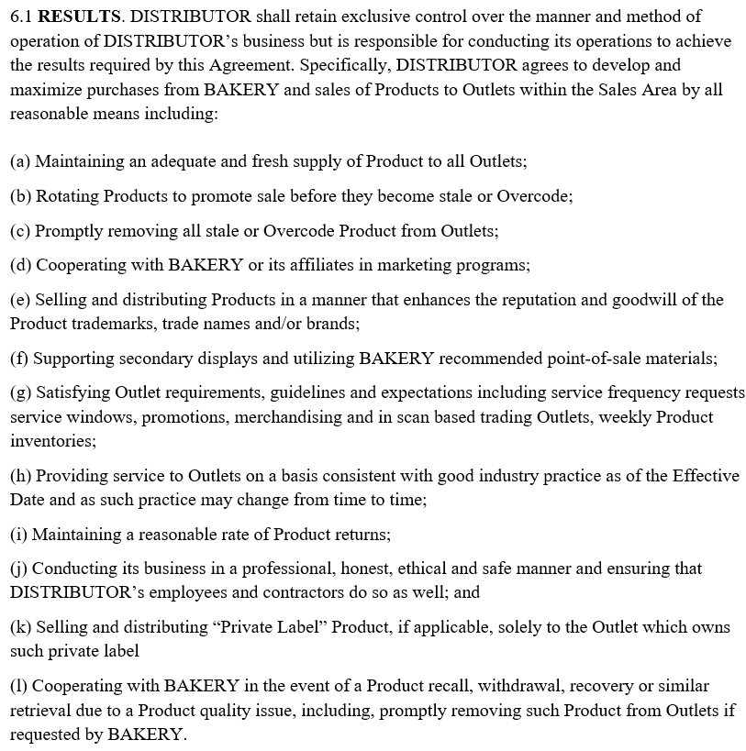
Article 6 – Distributor’s Obligations
Bakery retains the right to review your company’s performance under the Agreement.
Out of Stock, low stock, and Overcode conditions, excessive returns, and/or Outlet complaints of improper or unsatisfactory service shall constitute a material breach of the Agreement.

Slide 9
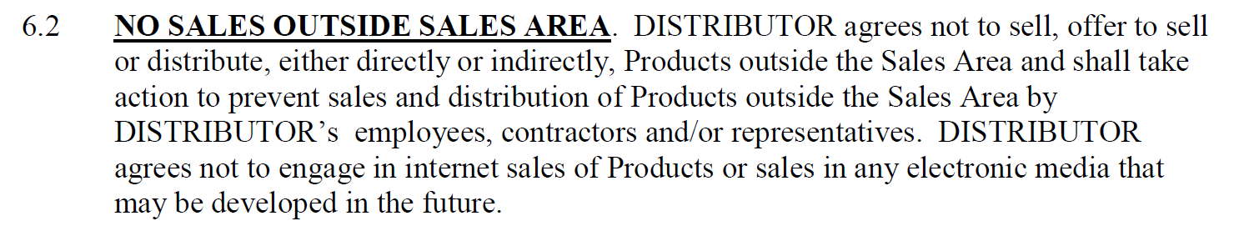
Article 6 – Distributor’s Obligations
Your company only has the right to distribute product to outlets inside your Sales Area geography as outlined by your Schedule A.
Your company only has the right to distribute products to certain channels as outlined by your Schedule B.

Slide 10
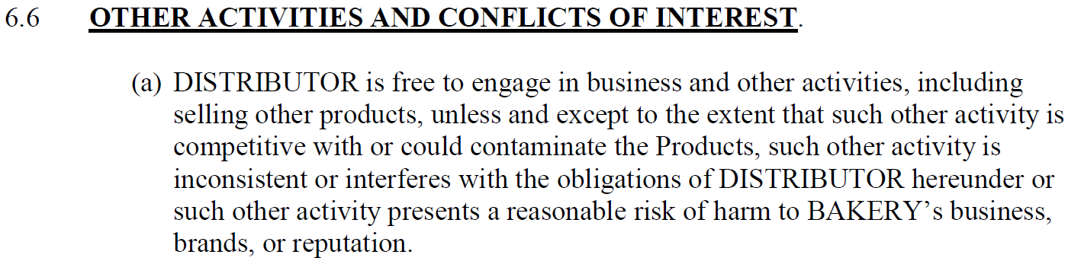
Article 6 – Distributor’s Obligations
Your company cannot distribute any competitive products or products that could contaminate product purchased from BBU.
Reach out to your OSL if you have any questions about competitive products.

Slide 11
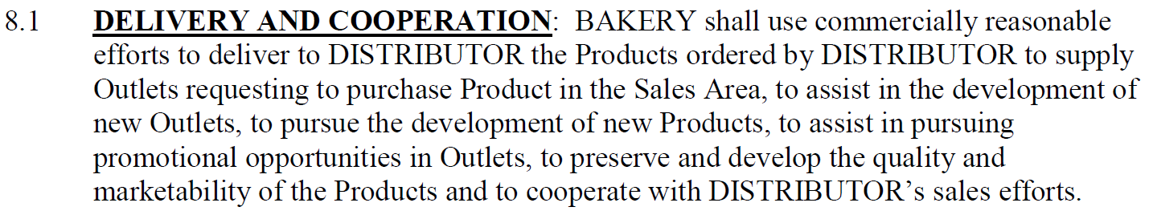
Article 8 – Bakery Obligations
Bakery will make every reasonable effort to deliver to your company the Products you order on the correct sales date.
Bakery will work with your company to develop the Sales Area, create new products, and pursue promotional opportunities in your Outlets.

Slide 12
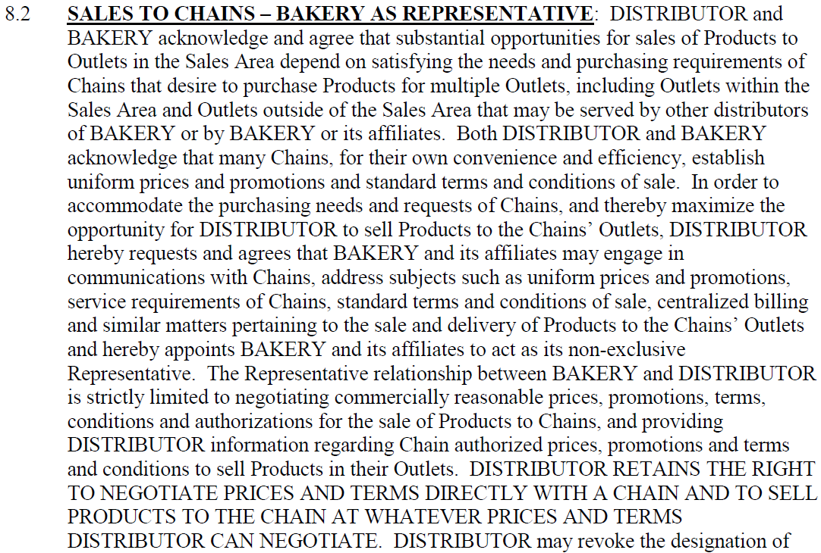
Article 8 – Bakery Obligations
Bakery acts as your company’s representative to negotiate chain customer promotions, prices, product authorizations, etc. on your company’s behalf.

