Slide 1


Intelligent Ordering
Network
**Please be aware that this will be recorded for training purposes**

Slide 2
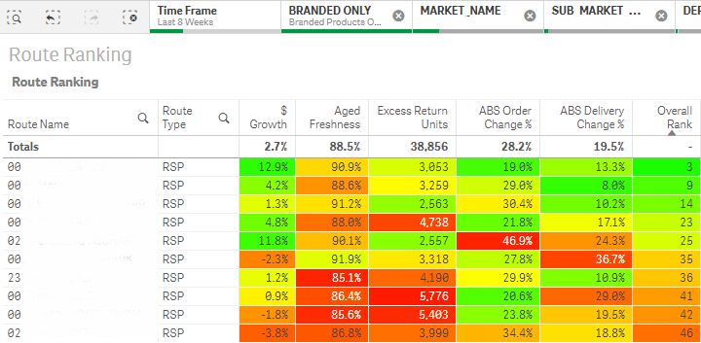
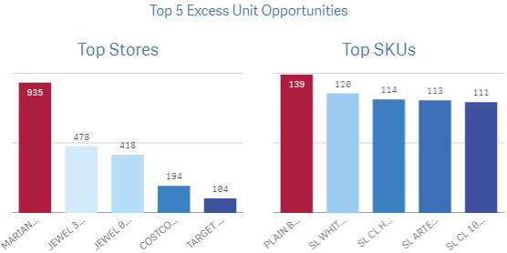
Recognizing Behaviors
Before going into the market, you can use Qlik to help identify opportunities.
After locking in the area of responsibility, utilize the Route Ranking page to quickly find both positives to share with the frontline and opportunities to grow the business.

Slide 3
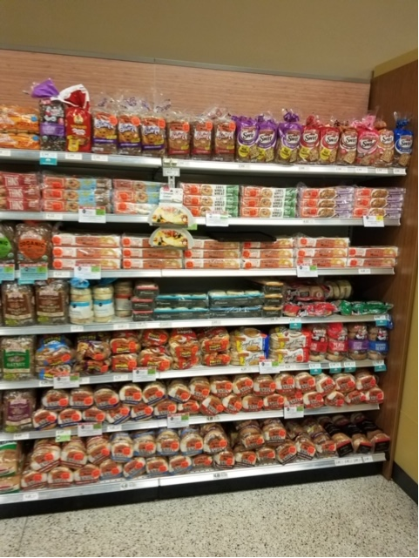
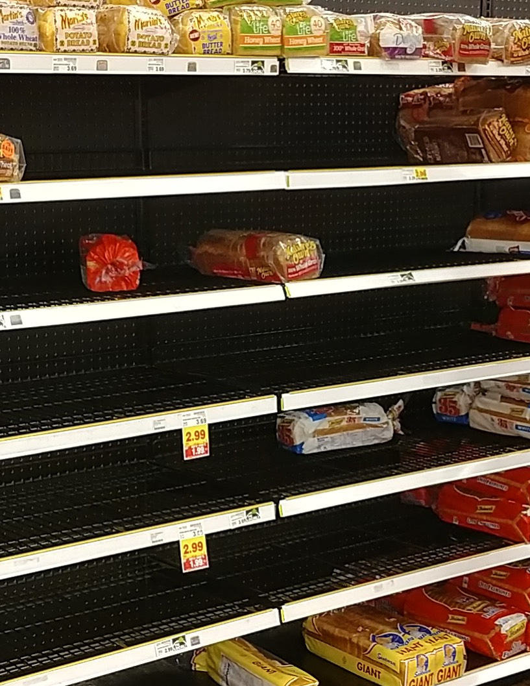
Recognizing Behaviors
While in the market, ION lets you recognize behaviors at the shelf. Adequate stock and shelf conditions can be identified with good ordering behavior.
ION can also be used to identify missed opportunities based on frontline behaviors.
So, how do we recognize these behaviors?

Slide 4
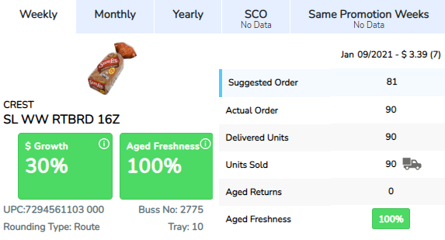
Recognizing Behaviors - Order Management
When in ION, you can find these behaviors while in a specific store and with a specific item.
The frontline should adjust orders accordingly after recognizing a high
Aged Freshness number of 98% or more.
**Notice the addition is small (from 81 to 90) and not excessive between the suggestion and actual order.
Notes:
Local market examples replace the screen shots

Slide 5
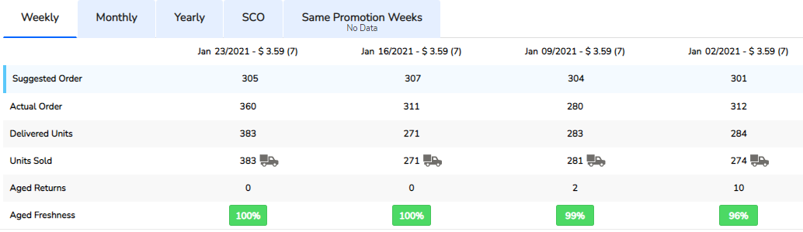

Recognizing Behaviors - Following The Plan
Another behavior that can be coached is when the Frontline’s own plan is not followed.
Below, you can see the actual order and the delivered units have a large difference. This indicates the plan is not being followed and creates excess work ordering and distributing the plan.
Notes:
Local market examples replace the screen shots

Slide 6
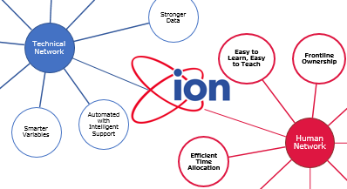
Recognizing Behaviors - Following Your Plan
This is a great example of how the human and technical sides of ION work together.
When an IBP/RSP follows the plan, they will see positive results.
Notes:
Local market examples replace the screen shots

Slide 7
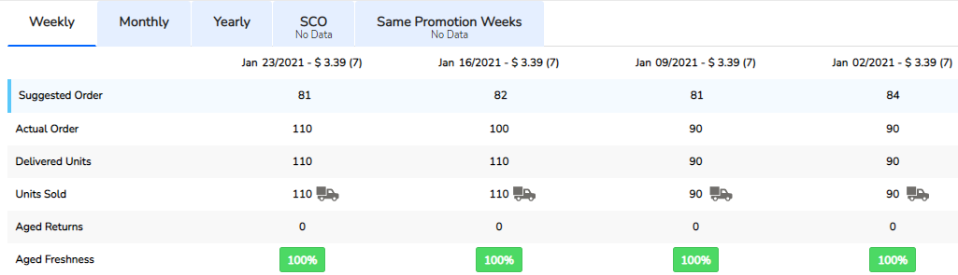

Recognizing Behaviors - Growth Opportunity
The frontline does not increase orders when achieving 99% Aged Freshness. ION will not increase orders at 100% Aged Freshness. This is a perfect example on how to coach the frontline when ordering.*
*Running 100% Aged Freshness does not mean the store is out of product, but it could be an opportunity.
Notes:
Local market examples replace the screen shots

Slide 8
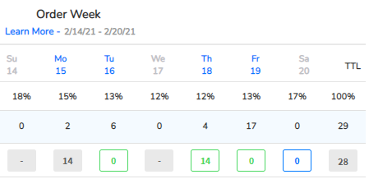
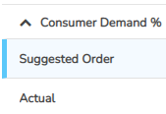
Recognizing Behaviors - Consumer Demand Delivery
The final example of a behavior that can be coached is when the frontline is not delivering during scheduled days of service.
Below was a suggested order of 6 and 17 on Tuesday and Friday and the frontline ordered 0. This also indicates the consumer demand is not being followed and creates excess work ordering and distributing the plan.
Notes:
Local market examples replace the screen shots

Slide 9
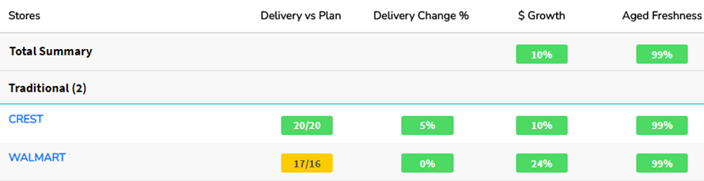
Recognizing Behaviors - Consumer Demand Delivery
There are also insights on the front page that can help identify opportunities in delivering the frontline’s plan.
Below you can see where Crest has been delivered to all 20 of the scheduled deliveries in the last 4 weeks.
You can also see where Walmart has more deliveries than were scheduled and ordered for.
Notes:
Local market examples replace the screen shots

Slide 10
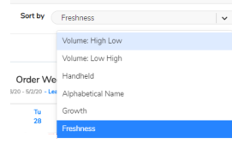

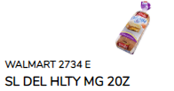
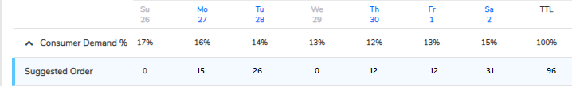
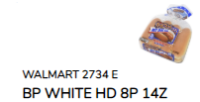
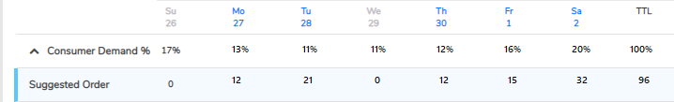
Tips for Successful Frontline Ordering
Focus on promos/display
Sort by Freshness
Submit / Arrow Forward
Adjust things that are out of the norm
Consumer Demand %
Order it the way your consumers purchase it
Deliver it the way your consumers purchase it
This Walmart is using the scan data from that store for this item to determine when product is being purchased by day—notice the differences?

Slide 11
Using ION in the Market Effectively
Before going into the market, use QLIK to identify both positive behaviors and opportunities to coach
In the market, open ION and look at the item’s performance in the account
Were excessive returns due to one week’s returns?
Overly aggressive on a promotion
Didn’t secure extra display
Is the frontline making out a plan and following it?
Is the frontline moving product from account to account?
Is the frontline delivering every day the item is available?
Is the frontline utilizing Safe Carry Over to leverage in-week adjustments?
Is the frontline out-of-stock on an item?
Is freshness high? Growth high?
Has the order been increased to determine a ceiling?

Slide 12






Useful talking points for frontline conversations: ION is going to be very beneficial
overall_0_131769252873397940 columns_1_131769252873397940
RSL
5_89 14_84 18_84 19_84 20_84 21_84
A tool and network to grow your business, not just your order
Advanced dashboard with freshness and growth metrics on an intuitive and easy to use interface
Fewer extra touches on orders from Leadership
Smarter machine with fewer errors
Reduce time spent ordering and pulling stales by ~2 hours/week
Designed for you, by you!
Notes:
Speaker Role: RSL
We want to make sure we continuously emphasize the following reasons why ION is beneficial for our frontline

Slide 13
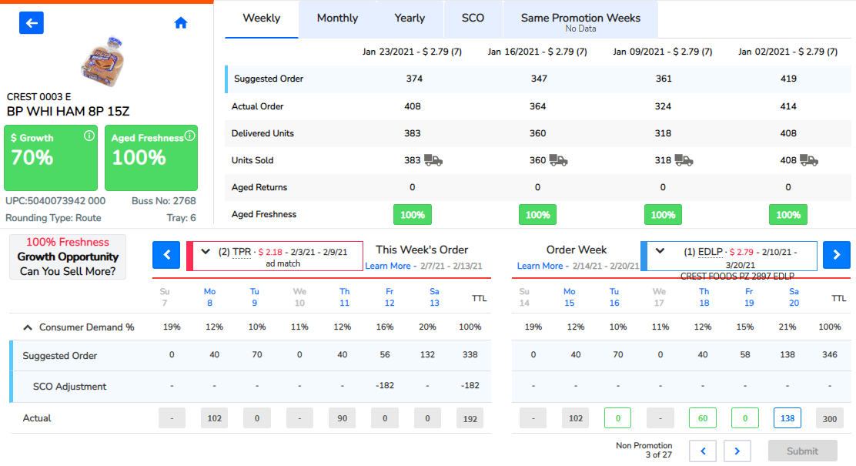
Coaching the Frontline with THEIR Tool
17_84
overall_0_131769380195392323 columns_1_131769380195392323
CAPABILITIES & MOTIVATION
FORECAST
ROLES & PROCESS
USER
INTERFACE

