Slide 1
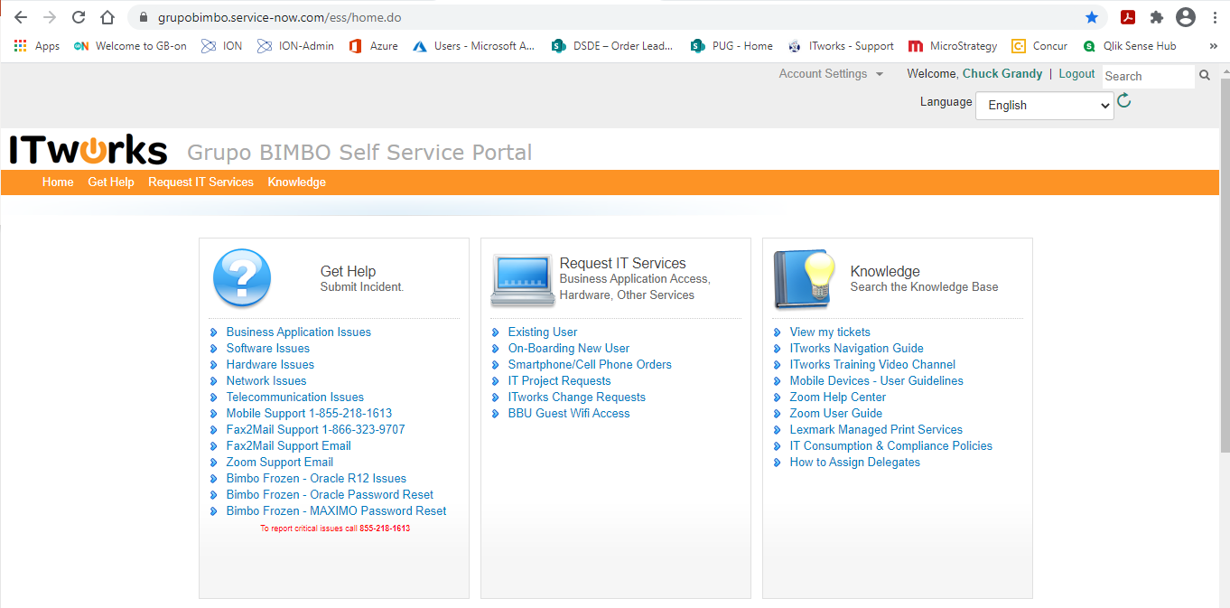
ION Request in ITWorks
Start by select Existing User under Requesting IT Services even if it is for a new user.

Slide 2
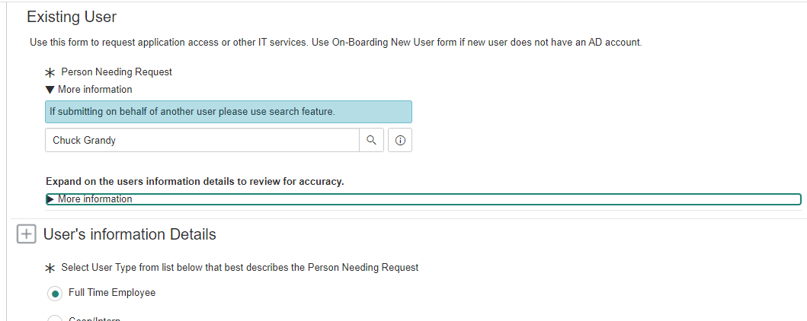
ION Request in ITWorks
When you start the request, it should have your information populated as the person needing the request. Clicking on More information under “Expand on the user’s information to review for accuracy” will contain your email and phone numbers that are listed in the Active Directory.
Under “User’s information Details” Select Full Time Employee for RSP or Sales Leader, or Independent Operator for IBP.

Slide 3
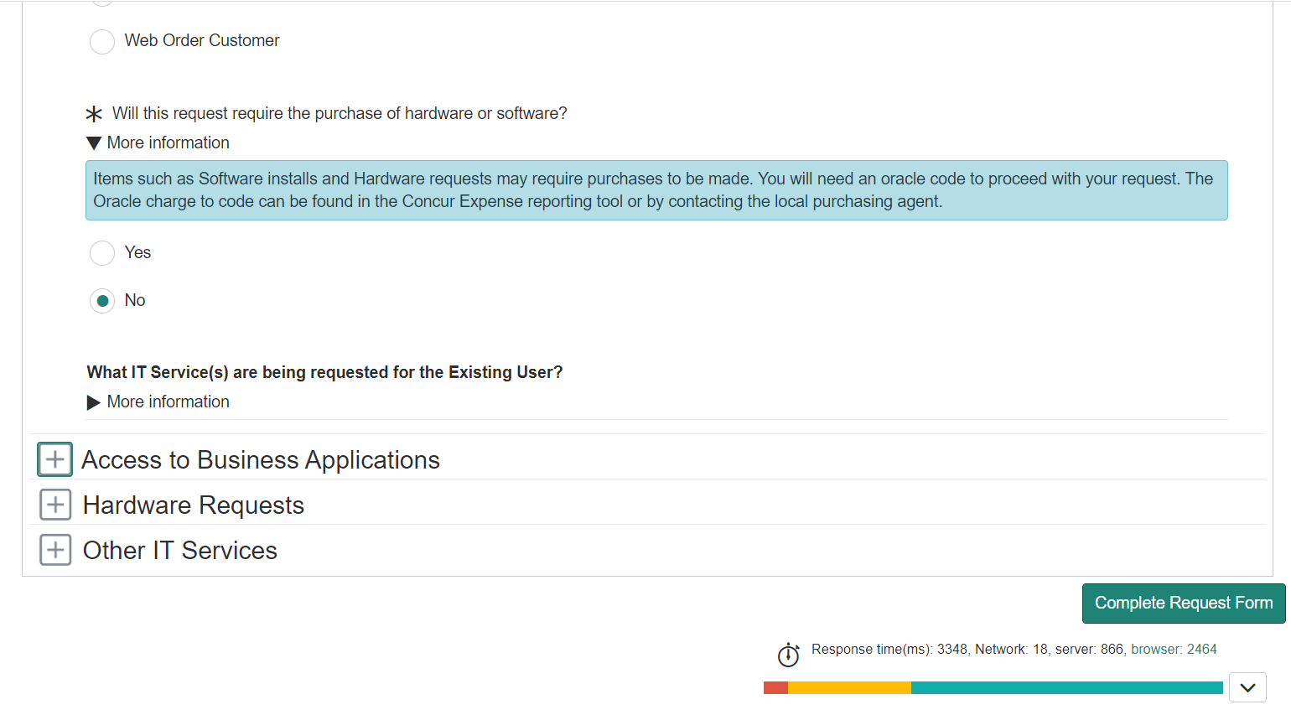
ION Request in ITWorks
When selecting Full Time Employee, answer No to hardware or software purchase.
Next click on the + next to Access to Business Applications.

Slide 4
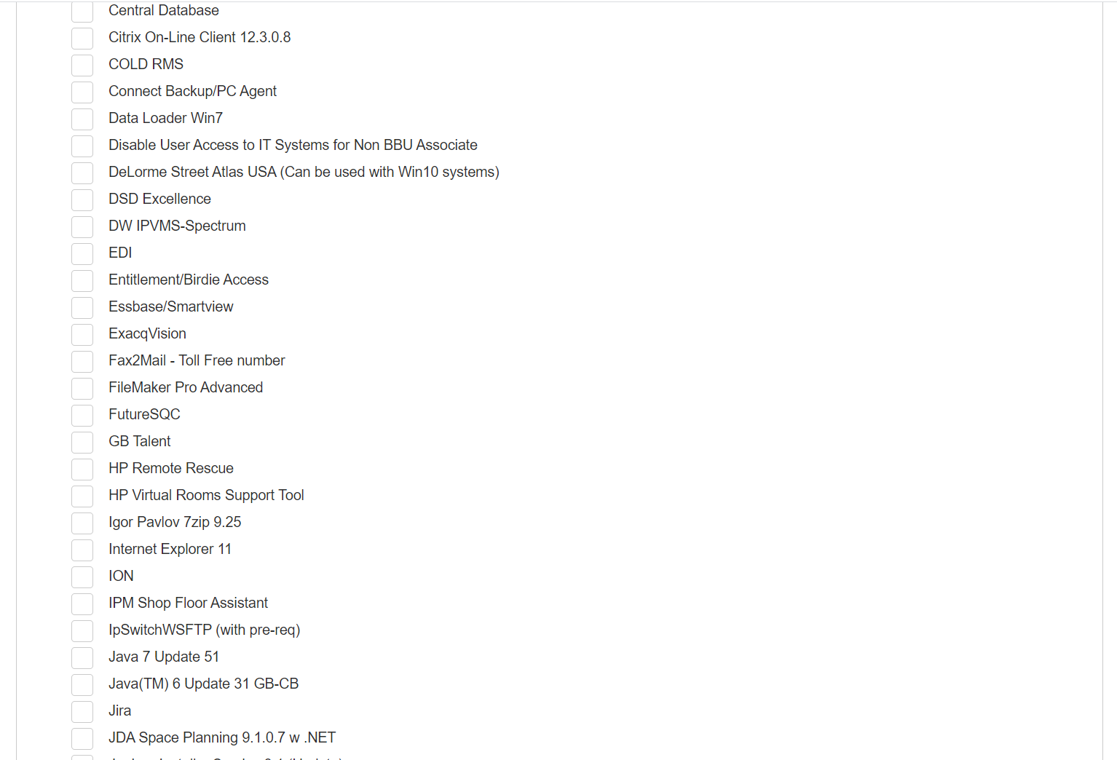


ION Request in ITWorks
Look for ION in the list and check the box.
Scroll either to the top or bottom and select “Complete Request Form” button.

Slide 5
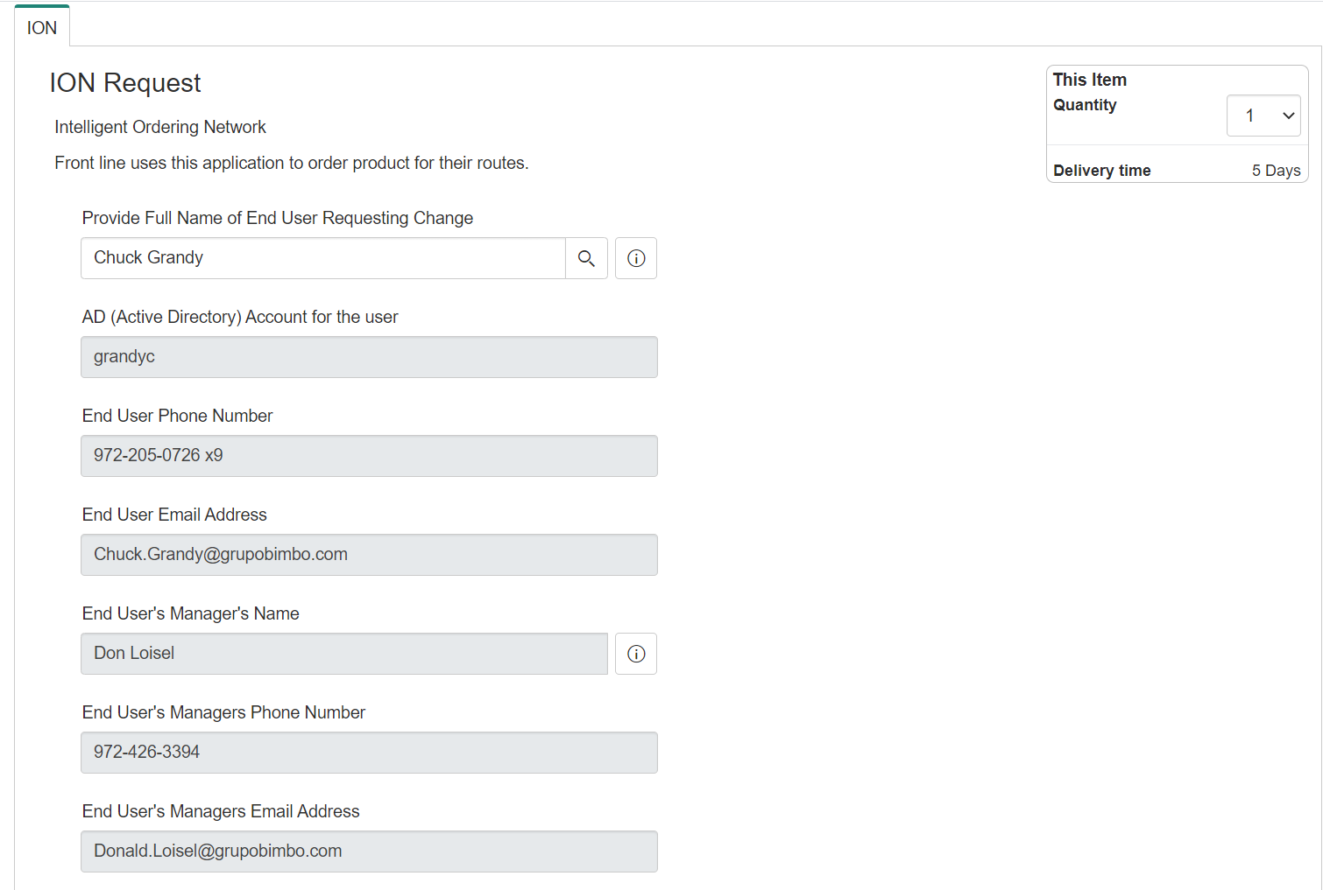
ION Request in ITWorks
The next screen will appear. Begin by validating the information for requestor.

Slide 6
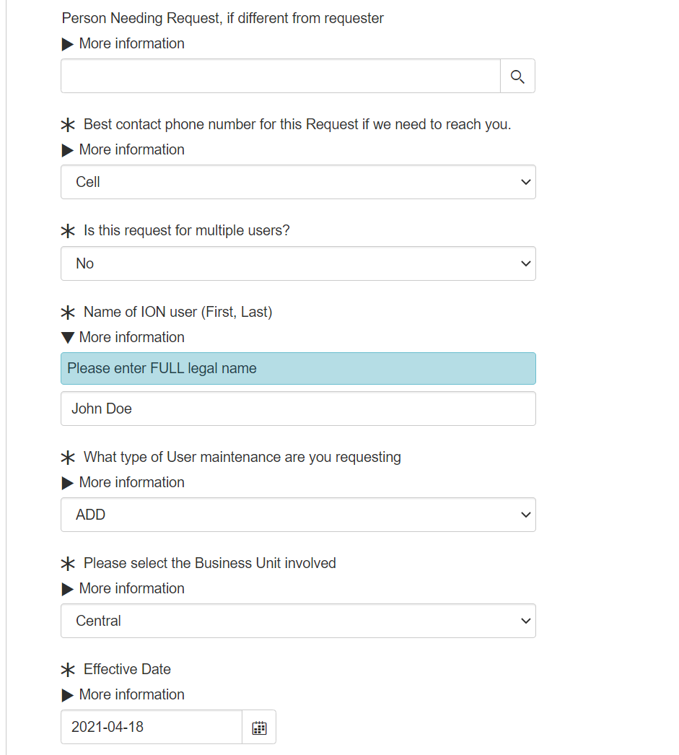
ION Request in ITWorks
A different person can be designated to receive the request here. That person must already have an @grupobimbo.com Active Directory set up.
Next provide how to be contacted.
A request for one or multiple user can be selected. Starting with “no” for a single request the following questions will appear.
FULL legal name (First and Last) of the user. This is not asking for an IBPs business name.
Is this an “ADD, CHANGE, or DELETE”? Starting with the “ADD”.
Which Business Unit (East, Central, West)
Effective date, please select a Sunday date.

Slide 7
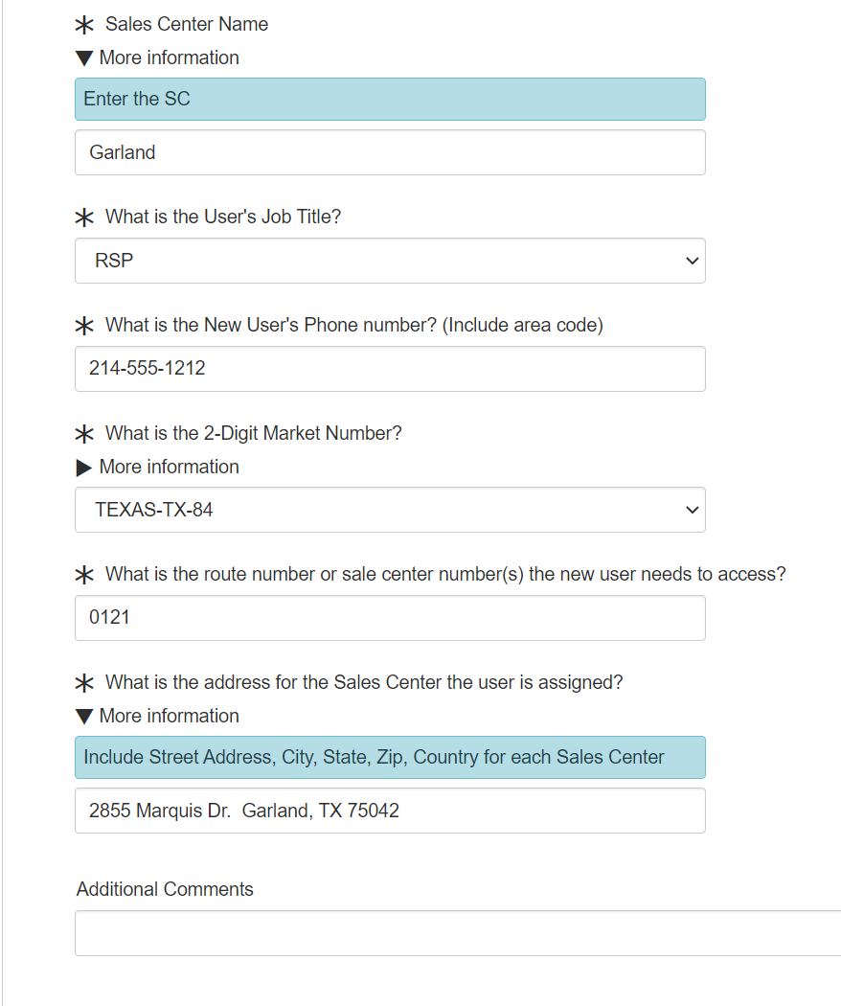
ION Request in ITWorks
Sales Center name
Job Title “RSP, IBP, Sales Leader, Admin, Route Alternate, Planner”
User’s phone number For non-IBP this can be the SC number or MSL/OSL’s number
Select the BUSS environment from the list
Enter the route number(s) needed for access. If the user is an RSS or extra person list all SC numbers that they will need access to all routes within.
Enter the SC address. For RSS “Route Alternate” use the SC address that is their primary SC.
Comments are available if special requirements are needed.

Slide 8
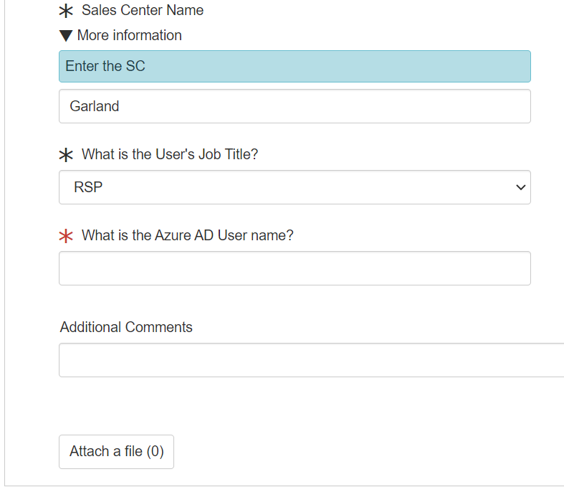
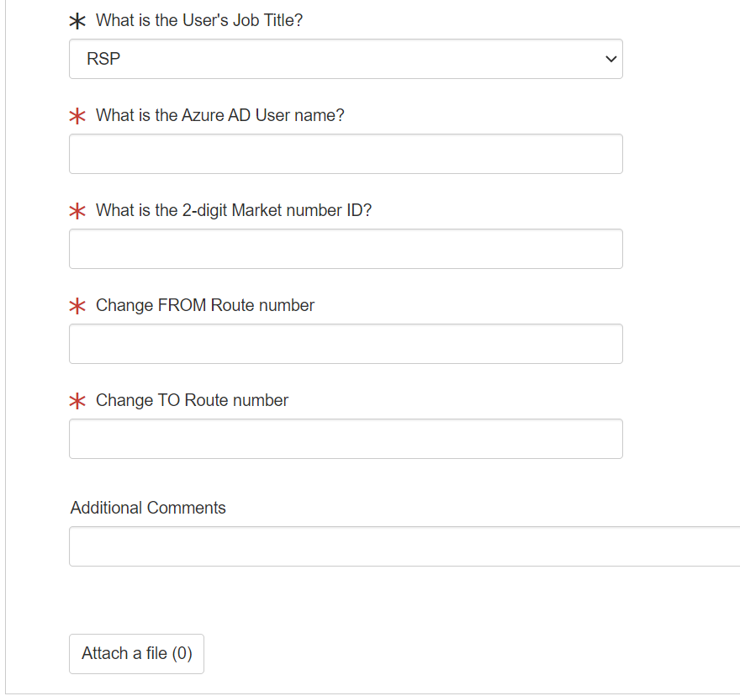
ION Request in ITWorks
Questions asked if Change is selected. Questions asked if Delete is selected.
Both Change and Delete require the user’s Login name (IE john.doe@om.bbuconnect.com)
Whether it is an add, change, or delete the “Checkout” button is selected to submit.

Slide 9
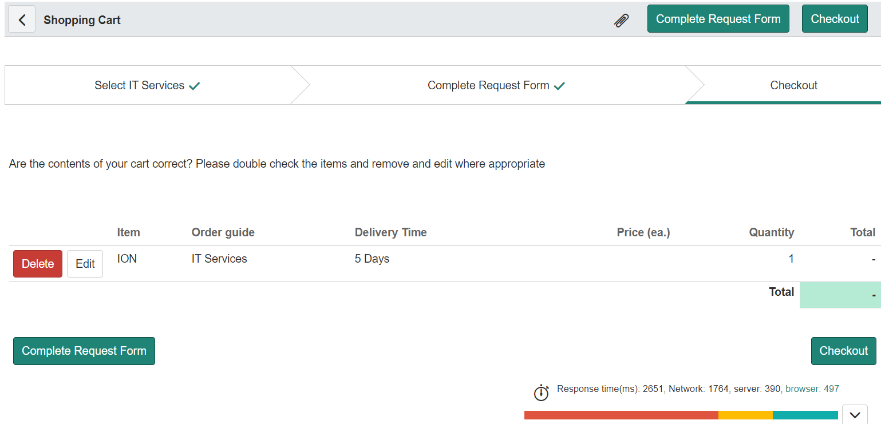
ION Request in ITWorks
Once “Checkout” is selected this screen appears. From here the request can be deleted or edited before final submission. Select “Checkout” again if the request is correct.

Slide 10
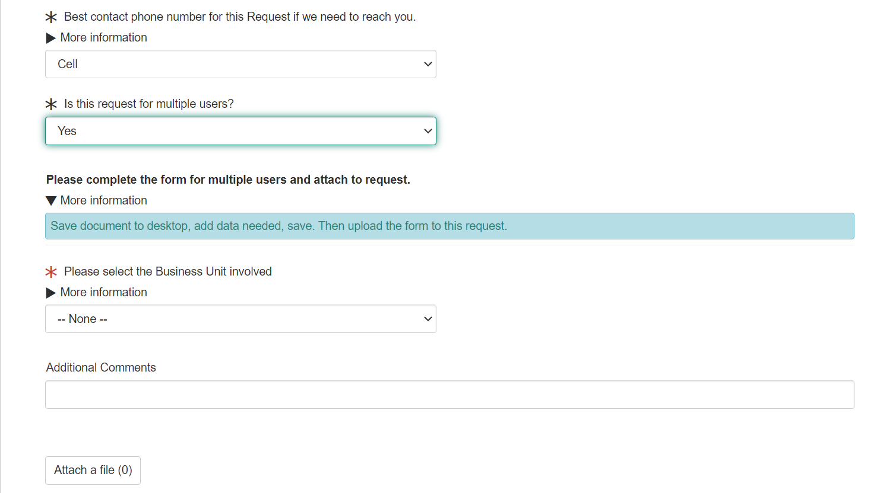
ION Request in ITWorks
If the request is for multiple user a form is utilized to complete the request.
Click on “Save document to desktop, add data needed, save.” to access the form.

Slide 11
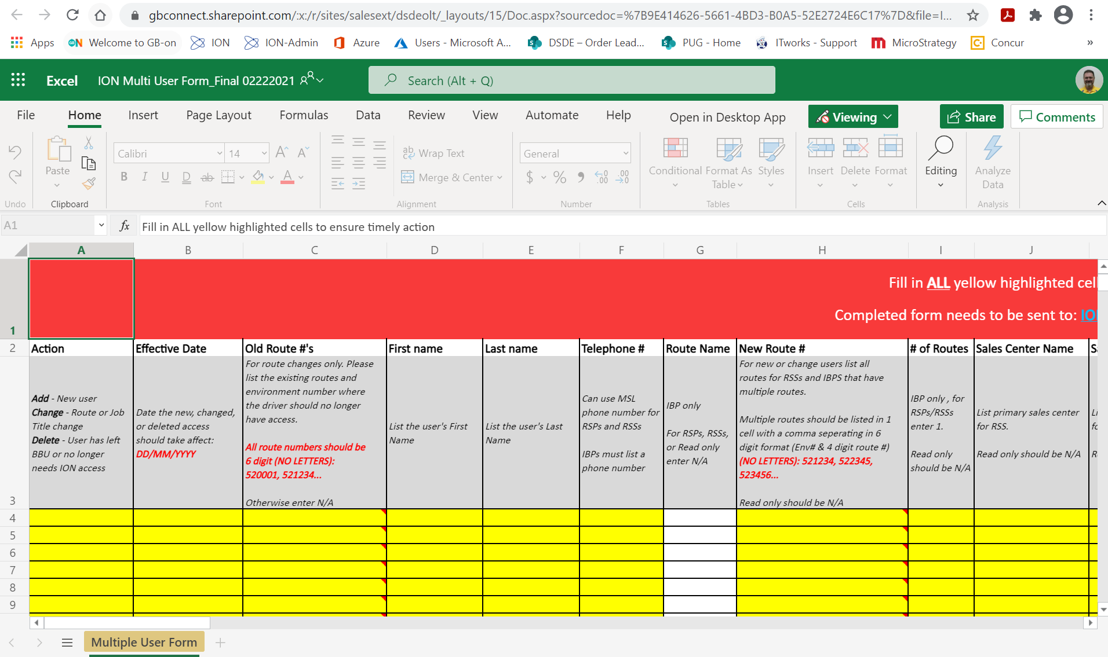
ION Request in ITWorks
The form will open in a browser, select “Open in Desktop App”.

Slide 12
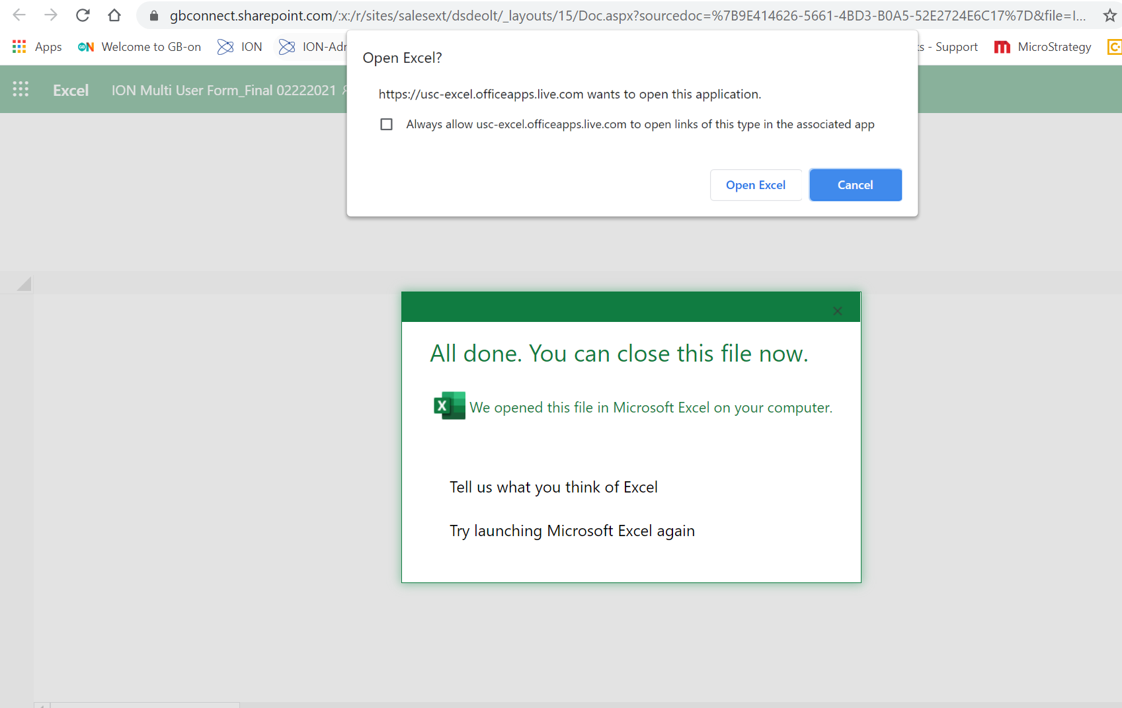
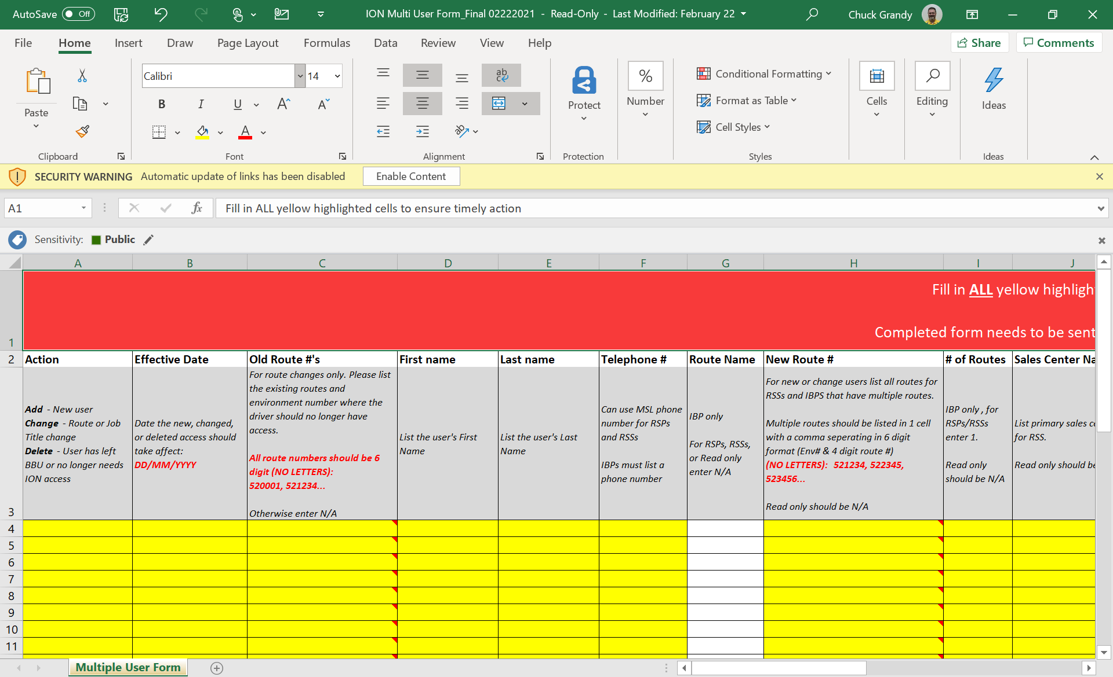
ION Request in ITWorks
Select “Open Excel”.
Save a copy to your computer or tablet.
Select “Enable Content” to begin entering data.
Fill out the form completely following the instructions in the header of each column. Columns A through R must have complete data.
Save the copy with the entered data.

Slide 13
ION Request in ITWorks
Select the Business Unit (East, Central, West)
Add comments if needed.
Select “Attach a File”.

Slide 14
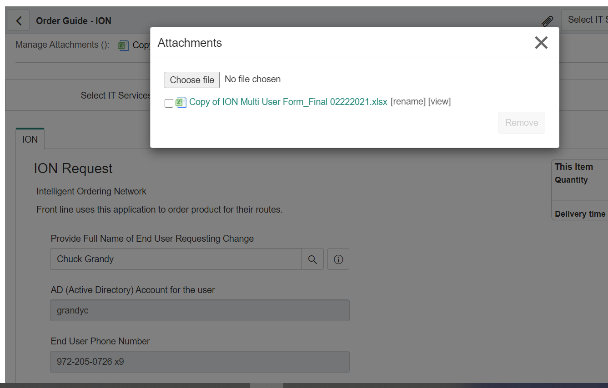
ION Request in ITWorks
Scroll to the top and find the Attachments box.
Select “Choose file”, select the file saved on your computer or tablet, and attach. Once attached it will be listed as seen in the screen shot.
Click on the X in the upper right and proceed to “Checkout” as described before.

