Slide 1
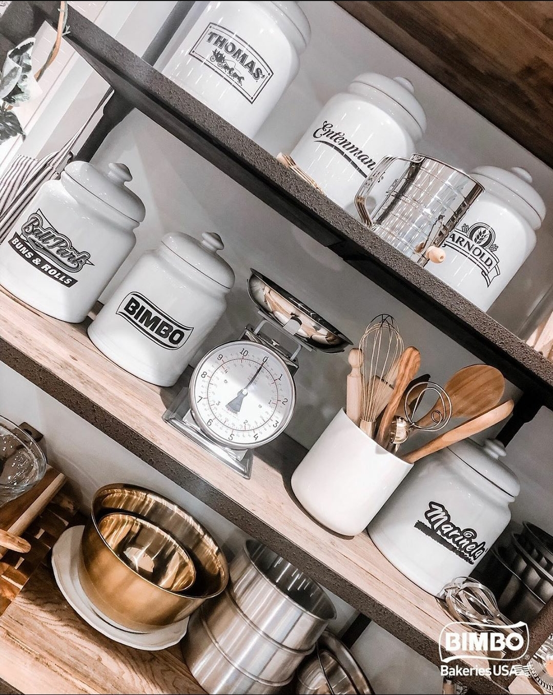
IBP SETTLEMENT STATEMENT
Understanding the Settlement Statement

Slide 2
Agenda
1
The Settlement Dept
Settlement Reports
3
True Up Calculation
2
Contact Information
Introduction
Miscellaneous Fees
Quarter-To-Date Accruals Summary
Weekly Shrink
6 Week Shrink Trend
Scan Pay Reconciliation
Quarterly Scan Adjustment
Reconciliation
Change in Inventory and Promo Adj
Shrink Share
Inventory Balance

Slide 3

Grupo Bimbo
“I believe in on-going challenges. We should never be satisfied and keep our eyes wide open to discover new opportunities.”
Daniel Servitje – Grupo Bimbo CEO

Slide 4
IBP SETTLEMENT TEAM
Contact information and introduction

Slide 5

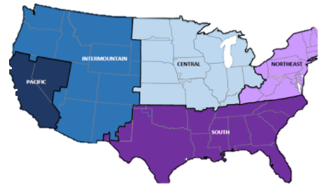
Settlement Department Contact Information
Email Contact
Ibpsettlement_East@grupobimbo.com
For AL, GR, MI, NL, VA, TH
Ibpsettlement_west@grupobimbo.com
For DA, DE, NP, SE, SP, TX
Mainline Phone number
866-492-2242 Ext 5081 or
519-620-5081
Voice messages only: Call your Settlement Analyst for a faster response or to speak directly

Slide 6
Distributors Partners
Scan Based Trading Introduction
IBP Settlement
SBT Customer
Reporting SBT in the Settlement Statement
Provide support and explanations
Auditing IBP SBT information
Requests for store to operate as SBT
Sells products delivered by IBP to final consumer
Responsible for sending accurate scan information
Sales Team
SBT Departments
Account Executive responsible for the Store SBT Set up
Maintenance for SBT products
Support IBP or SBT departments
Responsible for validating the scan information
Auditing SBT stores and routes

Slide 7
Settlement Reports
Miscellaneous Fees
Quarter-To-Date Accruals Summary
Weekly Shrink
6 Week Shrink Trend
Scan Pay Reconciliation
Quarterly Scan Adjustment

Slide 8
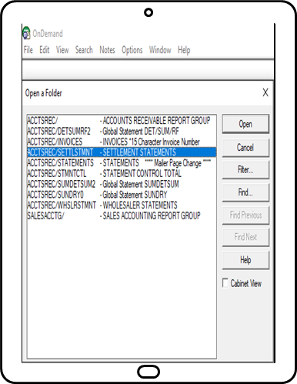
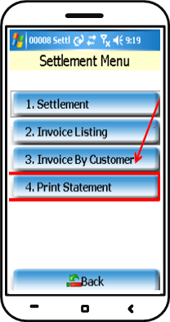
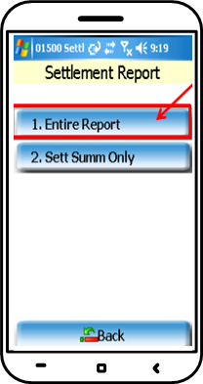
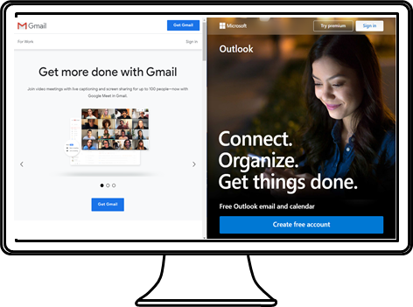
Settlement Statement
IBP Settlement sends a weekly settlement statement report
Statements can be:
Received via email
Printed out from the Handheld
Viewed OnDemand (For sales managers)

Slide 9

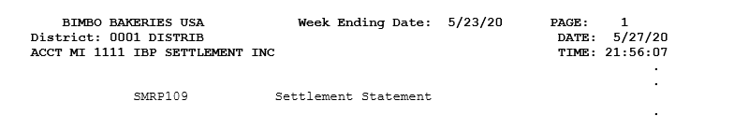
Reading your Settlement Statement
Every break page will have the district number for the route’s location followed by the Settlement Account Number and the business name or last name
Week Ending Date is always displayed in the top middle of the page
Every settlement statement is sent on Tuesday or Wednesday after the week ending date, and it covers Sunday to Saturday activities
The Settlement Statement can be a very large document most Settlement Statements are between 25 to 50 pages, sometimes even longer
The Settlement Statement is a document that consists of multiple reports grouped together. Every report will start with SMRPXXX to show when a new report is showing.
Notes:
This presentation will follow the Settlement Statements reports in order

Slide 10

Personal Information
Route Number
Settlement Account Number
Business Name
Business address
Keeping personal information up to date is very important
Important documents are sent from time to time to the address on file
Filling a form is required for any changes or updates
*I/O stands for Independent Operator – Independent Business Partner

Slide 11
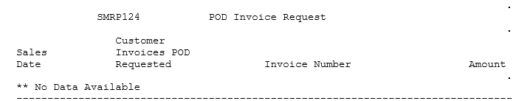
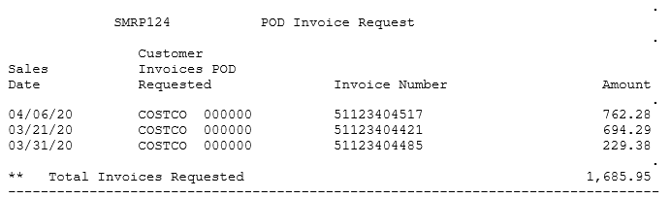
POD – Proof of Delivery
No requests:
Unpaid or short paid invoices might prompt a POD request
No Scan Based Trading or Cash customers
Requests go to the Handheld first as a message then show in the Settlement Statement as a reminder
Invoices are requested within a year
These are not charges; however, proper POD needs to be submitted to the Settlement Team to avoid future charges
Any charges will be posted in the Miscellaneous Fees report
Invoices requested:

Slide 12
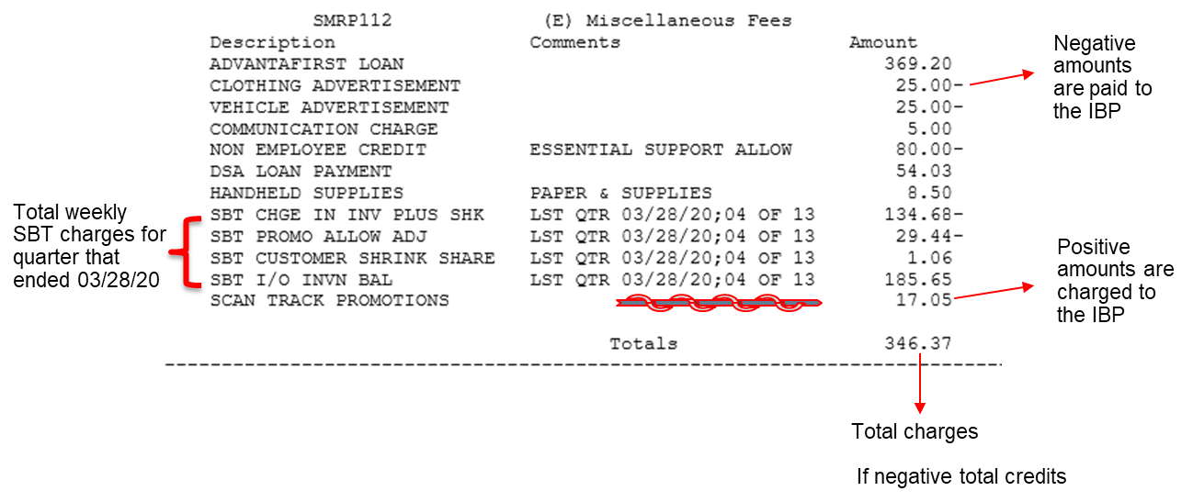
(E) Miscellaneous Fees
Miscellaneous Fees contain details on charges or credits to the IBP’s account

Slide 13
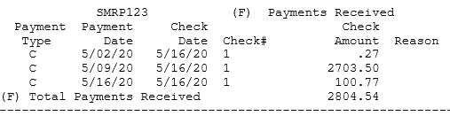
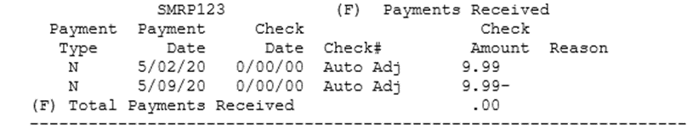
(F) Payments Received
If there is no payments – this section does not print in the statement
Payment applied - Samples
This section shows the total dollar value of all payments received and applied towards the IBP’s account
Methods of payment:
Mail special envelope (5-10 Business days)
ATM card (1 Business day)
Mobile Deposits (1 Business day)
NSF fees applicable
Payments are applied to the oldest balance unless paying an exact balance amount
If previous or partial balance owed is covered with the weekly Settlement profits the amount paid towards that balance will be noted as “Auto Adj” the entry is not a payment.

Slide 14
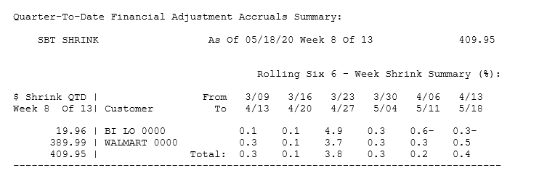
Quarter-To-Date Financial Adjustment Accruals Summary
Shrink refers to unaccounted product or found product based on activity from store scans, carryover counts, and invoices.
Accumulated dollar value of Shrink for SBT stores for the current quarter
As of last carryover count in the quarter
Percentage of units that are shrink in a 6-week period time
Negative values are found Shrink
Positive values are lost Shrink

Slide 15
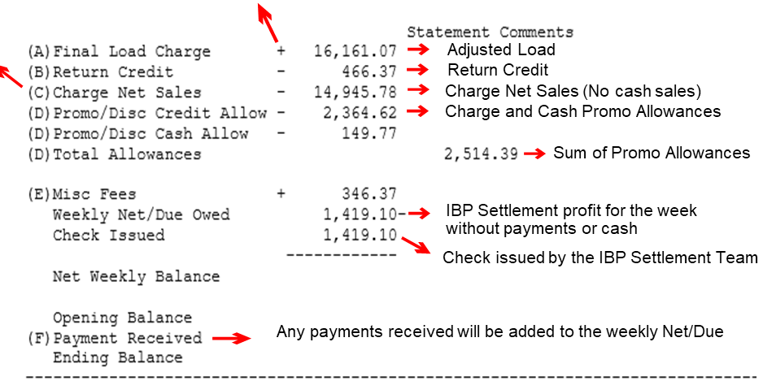
Statement Comments
Items with a letter next to them have linking reports
Numbers should be compared to your Handheld EOD Settlement Reports
+ Charge to IBP
- Credit to IBP
Settlement report

Slide 16
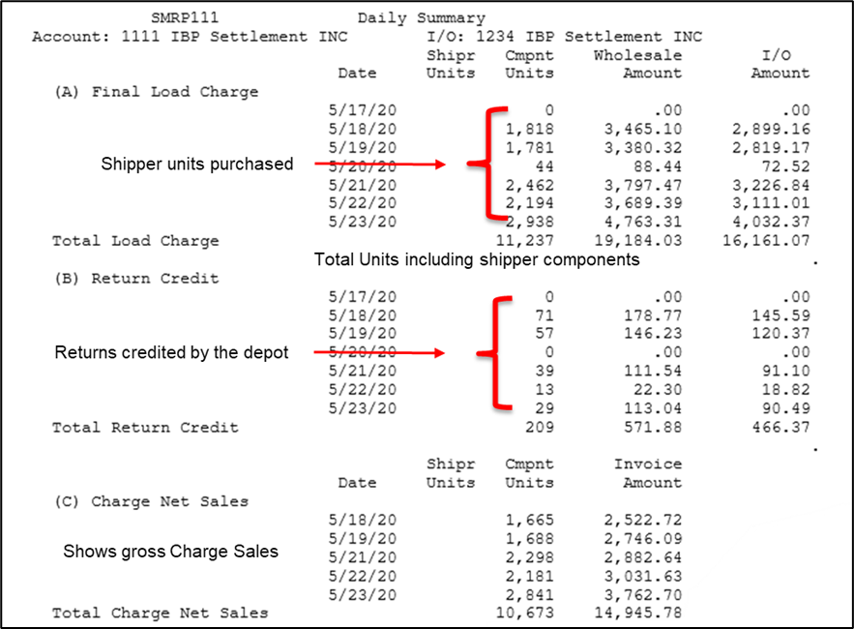
Daily Summary
Cash sales do not show in this section!

Slide 17
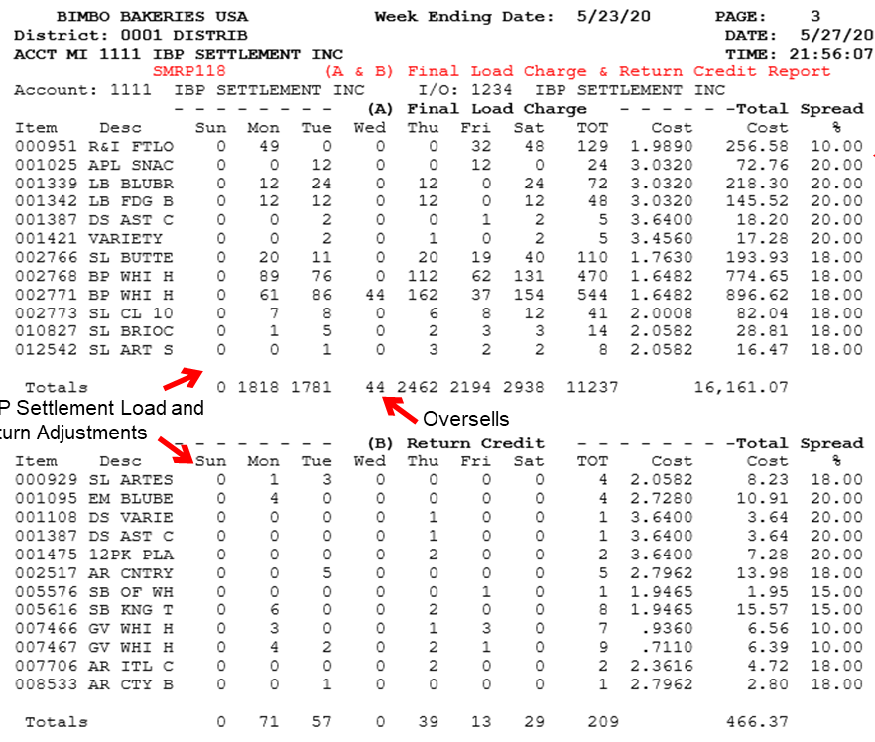
Product Purchased, Product Returns
Load Margin - might not be the final margin paid
IBP Settlement Load and return Adjustments

Slide 18
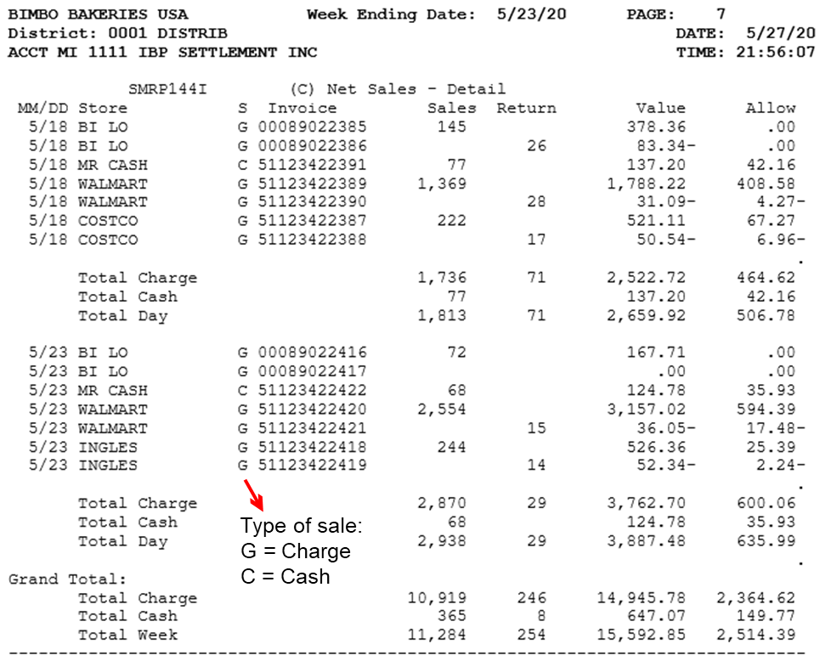
Net Sales – Detail Invoices
only section that shows cash sales
Promotion and Discount Allowances
Details on the next report

Slide 19
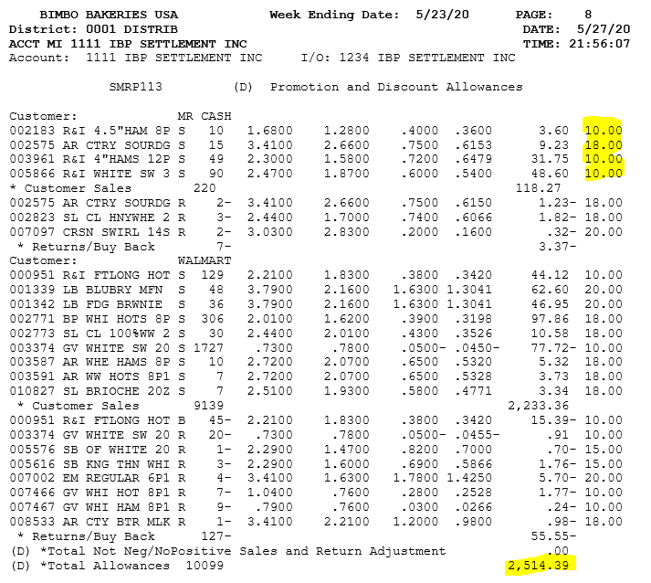
Promotion and Discount Allowances
The final margin paid to the IBP
Margin % paid to IBP
Positive dollar value is a credit for IBP

Slide 20
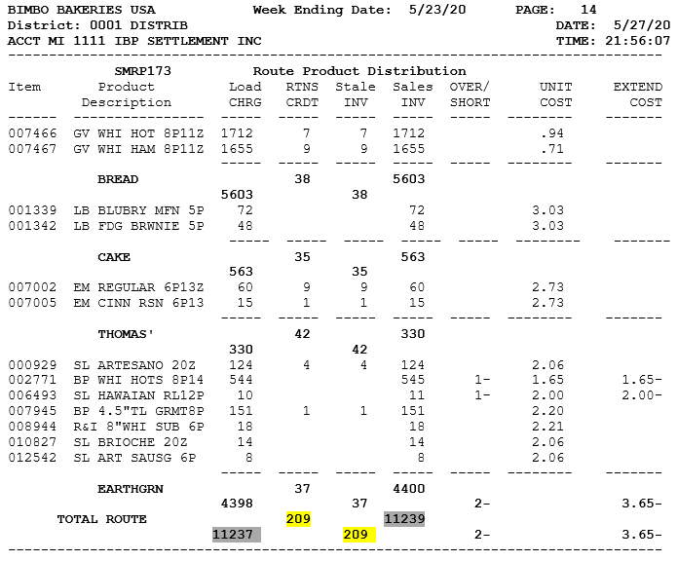
Route Product Distribution
Purchase, return and sale information sorted by brands and product number for the week
Positive numbers are loss of profit
Negative numbers are gain of profit
Extended cost will allow the IBP to identify the value of the inventory on hand or missing depot returns
Adjusted Load charges including Oversells
Depot Return Credit / Stales Invoiced
Sales Invoiced

