Slide 1
Overview: What is Safe Carry Over?
Safe Carry Over "SCO" is a simple process of automating adjustments based on current inventory levels. After establishing the carry over value, when an IBP enters inventory quantity the system will compare the two numbers. If the inventory is less than the carry over value, product is ordered. Conversely, if the inventory is greater than the carry over value, the system looks to reduce a future order.
There is a not a definitive formula for calculating the desired inventory; however, a general rule of thumb is 1.5 days of inventory. Items on the extreme ends of the spectrum will fall further from this figure.

Slide 2
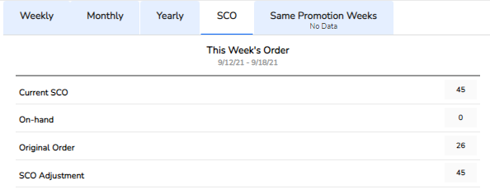
How to View SCO Information in ION
This Week’s Order: Based off the current weeks market conditions, this is a summary of the impact SCO value will have to the upcoming weekend order.
Current SCO: The amount you would like to see within the store when you take inventory at the beginning of the week.
Inventory: This is the total amount that you counted on each product within a store.
Original Order: This was the planned amount that you were expected to deliver for the next open delivery day (depending on bakery close schedules).
SCO Adjustment: The process of adding or subtracting based off the current SCO, what was counted (inventory), and what was planned to be delivered for the next open day.
1
2
Inventory
3
4
5
Example: As a user, I have set my SCO value to 45 for my Ball Park Hamburger Buns within Walmart. On Monday (beginning of the week), I counted 0 of this item within the store. At the end of the week (Friday), I have planned to deliver 26 units. But because I counted 0 for the week, my SCO adjustment will add 45 units, totaling Friday’s order 71 units.

Slide 3
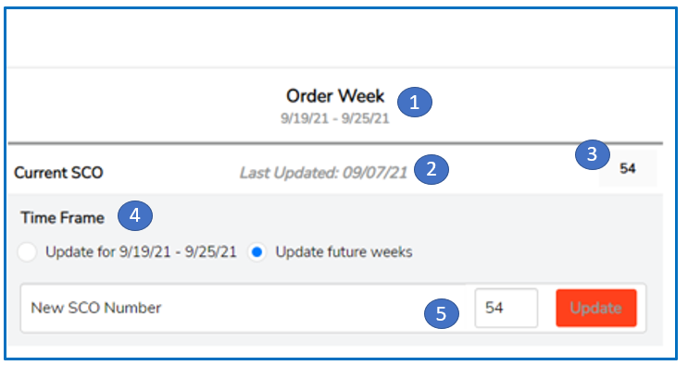
How to Modify SCO Value in ION
Order Week: The earliest week that a user can make an SCO adjust. Please note the date range before proceeding.
Last Updated: This will let the user know the last time the SCO value for the item was updated within a specific customer.
Current SCO: What the current SCO value is set to.
Time Frame: This will allow the user to either temporarily change the SCO value or change it for the foreseeable future. Note: If a user chooses to temporarily change the SCO value, he/she can only change for the upcoming order week. The value will then revert to the original SCO value once the week has passed.
New SCO Number: This is where the user can modify a new SCO value. Type in the value that you would like to implement and click ‘Update’.

Slide 4
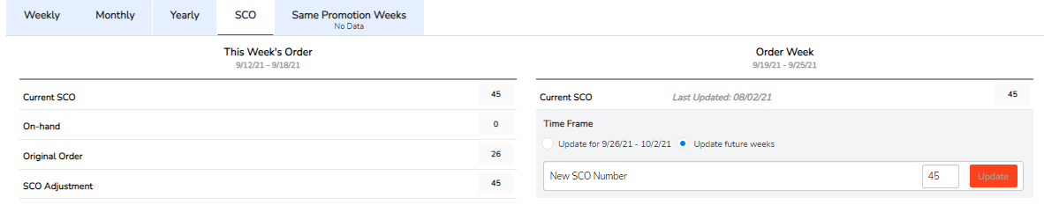
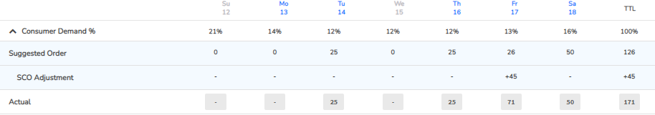
Modifying SCO Value in ION – A Full Look

