Slide 1
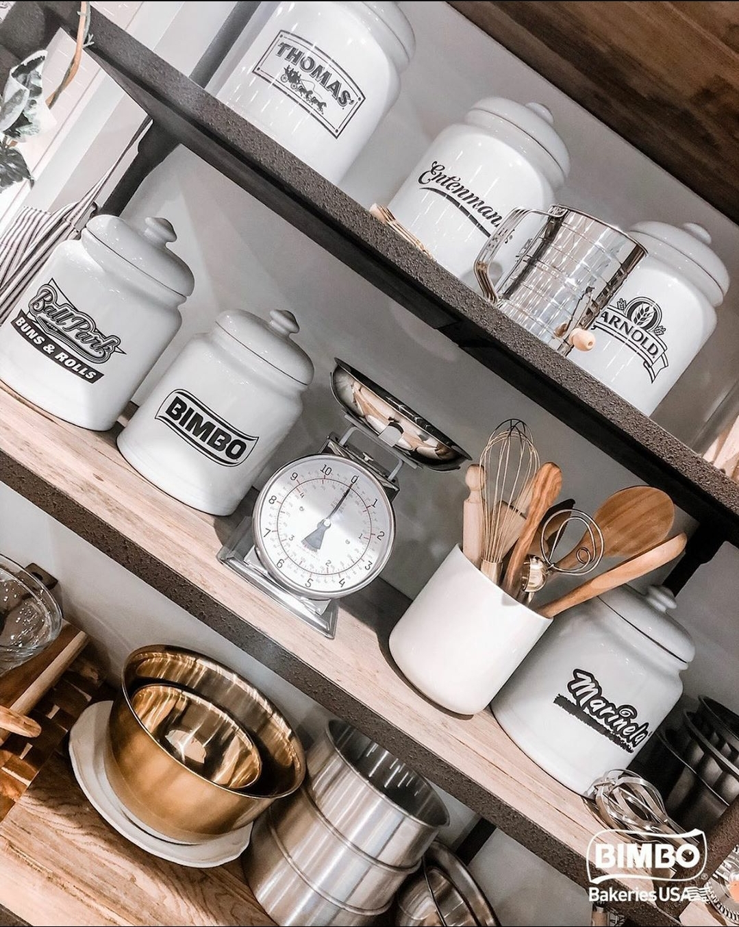
IBP SCAN BASED TRADING (SBT)

Slide 2
Agenda
1
The Settlement Dept
2
3
Reasons Contributing to High SBT Charges
SBT Introduction
Contact Information
Introduction
SBT Overview
Promotions, Shrink, and Errors

Slide 3
IBP SETTLEMENT TEAM
Contact information and introduction

Slide 4

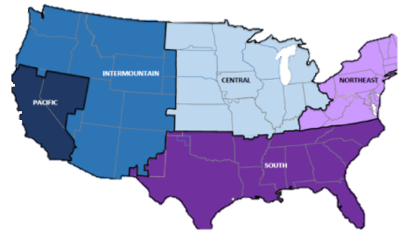
Settlement Department Contact Information
Email Contact
Ibpsettlement_East@grupobimbo.com
For AL, GR, MI, NL, VA, TH
Ibpsettlement_west@grupobimbo.com
For DA, DE, NP, SE, SP, TX
Mainline Phone number
866-492-2242 Ext 5081 or
519-620-5081
Voice messages only: Call your Settlement Analyst for a faster response or to speak directly

Slide 5
Distributors Partners
Scan Based Trading Introduction
IBP Settlement
SBT Customer
Reporting SBT in the Settlement Statement
Provide support and explanations
Auditing IBP SBT information
Requests for store to operate as SBT
Sells products delivered by IBP to final consumer
Responsible for sending accurate scan information
Sales Team
SBT Departments
Account Executive responsible for the Store SBT Set up
Maintenance for SBT products
Support IBP or SBT departments
Responsible for validating the scan information
Auditing SBT stores and routes

Slide 6
Scan Based Trading (SBT) Introduction

Slide 7
Independent Business Partner SBT Role
Accurate invoices – deliveries and returns
Accurate Carryover counts
Review SBT reports
Work with IBP Settlement for corrections
Establish and maintain good relationships with the customers
Ask for support from the Sales Team if needed

Slide 8
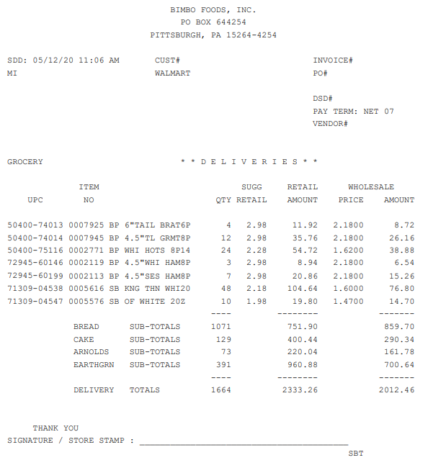

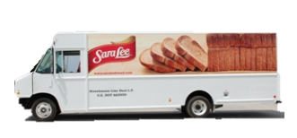
Scan Based Trading – IBP Overview
IBP delivers to SBT customer where there is no receiver
The unit and dollar value difference between what the IBP receives at delivery and what BBU is paid
As product scans through the register, BBU is paid for the product at ‘Price of the Day’
IBP delivery
Product Scans
Change in Inventory
Shrink
IBP Invoice
Reconciliation
Any product not accounted for is considered Shrink
IBP Purchases
IBP receives credit for the ‘full value’ of the invoice in their A/R. SBT invoices are finalized at ‘Price of the Day’
A weekly reconciliation of what the IBP receives for the invoices created AND the value BBU is paid by the customer – ‘True Up’
IBP Purchases product at IBP cost from the depot
Notes:
This presentation will follow the Settlement Statements reports in order

Slide 9
SBT Weeks
An SBT week runs Monday to Sunday
The weekly reconciliation is based on Net Deliveries and Scan information
Weekly reconciliations are posted in the settlement statement but not charged until the following quarter
Net Deliveries
Deliveries: Monday to Sunday
Scans: Monday to Sunday
Returns: Tuesday to Monday
M | T | W | TH | F | SA | S | M
94 | 49 | 0 | 46 | 54 | 24 | 0 | 111
12 | 28 | 0 | 6 | 2 | 1 | 0 | 8
NET UNITS
DELIVERIES
RETURNS
Total Deliveries – 267
Total Returns/Buybacks – 45
Net Deliveries - 222

Slide 10
SBT Quarters
SBT is broken down yearly into 4 – 13-week quarters
Weekly reconciliations are posted but only charged at the end of each quarter
At the end of each quarter calculations for Shrink Share and the Inventory Balance are summed
All SBT charges and credits are subject to audits that may result in delays/adjustments
IBP can end a quarter in a charge or credit balance
Credits are paid two weeks after the end of the quarter in full
Charges are billed five weeks after the end of the quarter in 13 weekly installments
January
February
March
13 weeks

Slide 11
SBT True Up Calculation
Change in Inventory and Promo Adjustment
Shrink Share
Inventory Balance

Slide 12
Change in Inventory and Promo Adjustments
Change in Inventory is also called SCN1
SCN1 represents the value and quantity change between invoices created by the IBP and scan information paid by the customer
Promo adjustment is also called SCN2
SCN2 represents the promotional dollar adjustment between promo paid in the invoices created and the promo of the scan information in relation to the price of the product scanned through the store register

Slide 13
Change in Inventory or SCN1
Change in Quantity
IBP delivers a net total of 100 units on invoice(s) and receives A/R credit
75 units scan through the store register
25 net units are charged through SCN1
Change in Price
IBP delivers a product at the full price of $3.79 on Saturday
The product scans through the store register on Sunday when price is on promotion for $2.04
If the IBP would have delivered the product on Sunday the invoice price would be $2.04
The change in price is a $1.75 charge

Slide 14
Promo Adjustment or SCN2
Change in Quantity
IBP delivers 10 items and receives promo allowance of $0.56 each for a total of $5.60 promo allowance
8 items scan through the store register
SCN2 charges $1.12 for the promo allowance of the 2 units that have not scanned
Change in Price
IBP delivers a product at the full price of $3.79 on Saturday and receives no promo allowance
The product scans through the store register on Sunday when price is on promotion for $2.04
If the IBP would have delivered the product on Sunday the invoice price would be $2.04; at this price promo allowance is paid for $1.40
The $1.40 is credited to the IBP

Slide 15

 |  | Change in Inventory | Scan Promo Adjustment | Net $ to IO
 |  | (Scan 1) | (Scan 2)
 | Sold in at Regular Price | $3.79 | $0.00
 | Scans out at Regular Price | ($3.79) | $0.00
 | Net Adjustment | $0.00 | $0.00 | $0.00
 | Sold in at Regular Price | $3.79 | $0.00
 | Scans out at Promo Price | ($2.04) | ($1.40)
 | Net Adjustment | $1.75 | ($1.40) | $0.35
 | Sold in at Promo Price | $2.04 | $1.40
 | Scans out at Regular Price | ($3.79) | $0.00
 | Net Adjustment | ($1.75) | $1.40 | ($0.35)
 | Sold in at Promo Price | $2.04 | $1.40
 | Scans out at Promo Price | ($2.04) | ($1.40)
 | Net Adjustment | $0.00 | $0.00 | $0.00
Using 20% margin example

Slide 16
Shrink Share and Inventory balance
Shrink Share and Inventory Balance adjustment are shown in the Quarterly Scan Adjustment report
Shrink Share – Scan 3
Shrink Share is calculated once at the very end of the quarter
Calculations depend on each customers particular SBT agreement with BBU
Shrink Share can be a credit or a charge to the IBP
Inventory Balance – Scan 4
Inventory Balance is a temporary credit and chargeback
Credits are calculated at the end of each quarter
Values are calculated based on the price of the day for the carryover count at the end of each quarter
Chargebacks will automatically post in the following quarter at the same value as the temporary credit given
The net amount can be a credit or a charge to the IBP

Slide 17
Reasons Contributing to High SBT Charges
Mistakes
Shrink
Promotions

Slide 18
High SBT Charges
Mistakes
Shrink
Promotions
Creating invoices:
Any errors on a delivery invoice or a return invoice including not invoicing items
Delivering unauthorized products
Carryover counts:
Not doing carryover counts, incomplete or overstated counts
Damaged product
Any product thrown away by the store without the IBP’s knowledge
Missing Scans
Customer Appreciation Day, grand openings, deli displays or improper scans at the register,
incorrect scan data
Theft
Delivery timing
Reconciliations of prices paid on invoices and prices at the time of the final sale
Higher deliveries prior to promotion

