Slide 1
CAUSA
pricing.cau · dependency fragment
price
savings
subtotal
A Compiler for Explainable and Counterfactual Programming
discount
total
Compiler Design Project · Final Review
$ ./pricing
total = 88.375
[Student name] · [Registration number]
[School / University]
Guide: [Faculty guide name]
Notes:
Opening (about 20 seconds). CAUSA is a custom programming language and a compiler written from scratch, in which the dependencies between computed values are a language feature. A CAUSA program can explain how a value was derived, list what depends on an input, and evaluate hypothetical inputs without disturbing the real results. The motif on the right is a real fragment of the pricing example used throughout the talk.
Placeholders: replace the name, registration number, school and guide on this slide; they are deliberately not filled in because they cannot be verified from the repository.
Likely question: 'Is this a library?' No. It is its own language with a lexer, parser, semantic analysis, intermediate representation, optimizer and C backend.

Slide 2
A result appears. Its reasoning does not
program
?
total
88.375
1
2
3
Why did this result occur?
What depends on this input?
What changes if this value changes?
CAUSA Problem and idea
Notes:
The problem in under 20 seconds. A program computes a number such as a total price. To understand it, you normally read the code and trace values by hand. Three questions come up all the time: why did this result occur, what depends on this input, and what changes if this value changes. In most workflows each answer means manual tracing, print statements, or editing and rerunning.
Transition: so what would it look like if the language itself answered these questions?
Likely question: 'Debuggers already do this.' Debuggers show execution state; CAUSA answers these questions about the program's dependency structure as language operations, and it can run the hypothetical without touching the real result.

Slide 3
Objectives: dependencies as a language feature
Motivation Understanding a computed value usually means tracing code by hand.
1
2
3
4
5
Source-level dependency awareness
Explainable calculations
Impact analysis
Isolated what-ifs
Native executables
Each binding records the names its expression uses.
explain prints a derivation tree with values and source expressions.
impact lists direct and all dependents, known statically.
whatif recomputes in a separate environment; real values stay.
A Python compiler emits C99; a system C compiler builds the program.
✓ Implemented
✓ Implemented
✓ Implemented
✓ Implemented
✓ Implemented
semantic.py · ir.py
runtime: causa_explain
runtime: causa_impact
runtime: causa_whatif
codegen.py · runtime
CAUSA Problem and idea
Notes:
Motivation versus delivery. The motivation is that understanding a computed value usually costs manual tracing. The five objectives follow from that, and every one is implemented in version 1; the tag at the bottom of each card names where it lives in the repository. 'Implemented' here means built and covered by automated tests, not planned.
Transition: before the design, a quick comparison with how this is done today.
Likely question: 'What is out of scope?' Conditionals, loops, functions, recursion, mutation, strings and collections are deferred (language specification section 13); version 1 is deliberately small so the dependency semantics can be precise.

Slide 4
Manual tracing vs built-in operations
Conventional workflow
CAUSA
Understand a derivation
Read the code; add prints or step through a debugger
explain total
a derivation tree with values and source expressions
Find downstream effects
Search for uses by hand or with editor tooling
impact price
direct and all dependent bindings
Try a changed input
Edit the value, rerun, compare outputs
whatif price = 160
before → after; original values untouched
Keep dependencies through optimization
Depends on the tool; not a language guarantee
verified optimizer
binding-level graph re-checked after optimization
Conventional tools can do all of this. CAUSA makes it explicit and built into the language and runtime.
CAUSA Problem and idea
Notes:
A fair comparison. Conventional languages and tools can answer all of these questions: with a debugger, with print statements, with IDE navigation, or by editing and rerunning. The difference is that in CAUSA each question is a statement in the language, answered by the runtime from compile-time dependency information. The last row matters for a compiler project: the optimizer is required to leave the binding-level dependency graph unchanged, and a verification pass re-derives the graph after optimization and fails the compile if it differs.
Likely question: 'Is CAUSA better than a debugger?' It is not a replacement. It makes these specific questions cheap and repeatable, and it is a small language, not a general-purpose one.

Slide 5
CAUSA: a language and a compiler
show
print a binding's value
example.cau
input price = 100
input discount = 0.25
let savings = price * discount
let total = price - savings
show total # total = 75.0
explain total
whatif price = 160 show total
impact price
explain
derivation tree for a binding
impact
direct and all dependents
whatif
recompute under hypothetical inputs
assert
check a condition at run time
A custom language and compiler (Python → C99 → native executable): not a Python library, not a graph viewer.
CAUSA Problem and idea
Notes:
What the language looks like. A CAUSA program is a list of inputs and immutable let bindings, each defined from earlier ones, so the dependency structure is a DAG known at compile time. Five statements work on it: show prints a value, explain prints a derivation, impact lists dependents, whatif evaluates hypothetical inputs, and assert checks a condition. Files use the .cau extension. The sample is from the project README: total is 75.0, and the whatif repeats the computation with price = 160.
Important framing: CAUSA tracks computational dependencies, meaning how values are computed from other values. It does not model real-world causation.
Likely question: 'What types exist?' int, float and bool, with static type checking and declaration-before-use.

Slide 6
Related work and foundations
Dependency analysis
Provenance
Explanations and counterfactuals
Compilers and testing
[1] Weiser 1984
program slicing
Foundational
[2] Ferrante et al. 1987
program dependence graph
Foundational
[3] Cheney et al. 2009
why, how, where provenance
Directly related
[4] Cheney et al. 2011
provenance as dependency analysis
Directly related
[5] Ko & Myers 2004
Whyline: “why” questions
Directly related
[6] Karimi et al. 2022
counterfactual explanations survey
Recent · related
[7] Lattner & Adve 2004
LLVM IR
[8] Lattner et al. 2021
MLIR
[9] Chen et al. 2020
compiler testing survey
[10] Ma 2023 (preprint)
compiler fuzzing survey
Which statements affect a value
Dependencies explain results
Asking why, and what if
IR design and validation
CAUSA builds on established ideas; its contribution is integrating them into one language, compiler and runtime workflow.
CAUSA Problem and idea
Notes:
A concise literature survey; the full verified bibliography is on the last slide. Four themes. Dependency analysis: Weiser's program slicing and the program dependence graph of Ferrante, Ottenstein and Warren are the classic foundations for asking which statements affect a value. Provenance: the Cheney, Chiticariu and Tan survey, and the Cheney, Ahmed and Acar paper on provenance as dependency analysis, connect dependencies to explanations of results. Explanations and counterfactuals: the Whyline lets programmers ask why-questions about program behavior, and the Karimi et al. 2022 survey covers contrastive and counterfactual explanations. Compilers and testing: LLVM and MLIR are reference intermediate-representation designs, and the compiler-testing survey by Chen et al. and the fuzzing survey preprint by Ma frame how compilers are validated.
Claim discipline: CAUSA uses established ideas. Its contribution is integrating dependency tracking, explanation and counterfactual evaluation into one small language, compiler and runtime workflow. I am not claiming it is the first system of its kind.
Recent sources: Karimi et al. is 2022; the Ma survey is a 2023 arXiv preprint, not peer reviewed.

Slide 7
System architecture
Front end · Python
Causal IR and optimizer · Python
Back end · C
CAUSA Source
Lexer
Parser
Abstract Syntax Tree
Semantic Analysis
Causal IR
Optimizer
C Code Generator
Generated C + Runtime
System C Compiler
Native Executable
Runtime library
explain
impact
whatif
assert
checked math
--set check
causa_runtime.h / .c
Dependencies are computed at compile time and embedded as metadata; the executable records values.
CAUSA Architecture
Notes:
The most important slide. Source code in a .cau file flows through the front end: the lexer produces tokens on demand, the hand-written recursive-descent parser builds the AST, and semantic analysis resolves names and checks types. The middle is the Causal IR, a typed single-assignment graph with stable node IDs and explicit dependency edges, plus a frozen binding-level provenance graph, and the optimizer, which may only make rewrites that leave that graph unchanged. The back end is the C code generator, which emits deterministic C99 together with metadata tables; this is compiled together with the CAUSA runtime by a system C compiler into a native executable.
The Python compiler performs every step up to and including C generation; it never runs the C compiler itself. The runtime library provides the language's execution operations: explain, impact, whatif and assert, plus checked arithmetic and launch-time --set validation in the runtime header.
Likely question: 'Why does the compiler not call gcc?' It is a documented design decision for the first version; a single build command is listed as a next step.

Slide 8
Language example: a pricing model
pricing.cau (excerpt)
price
100
input price = 100
input discount = 0.25
input tax = 0.125
input fee = 4
let savings = price * discount
let subtotal = price - savings
let total = subtotal * (1 + tax) + fee
show total
input
savings
25.0
price * discount
subtotal
75.0
price - savings
total
88.375
subtotal * (1 + tax) + fee
100 → 25.0 savings → 75.0 subtotal → 88.375 total
CAUSA Demonstration
Notes:
The running example, examples/pricing.cau in the repository. Inputs are price, discount, tax, fee and units; lets compute savings, subtotal and total, plus expensive, per_unit and bulk (not shown on this slide to keep it readable). With the source values: savings is 100 times 0.25, which is 25.0; subtotal is 100 minus 25.0, which is 75.0; total is 75.0 times (1 plus 0.125) plus 4, which is 88.375. per_unit is 88.375 divided by 4, which is 22.09375, and expensive and bulk are both true. These values are the program's real output, checked against the documentation.
Transition: the same program as a dependency graph.
Likely question: 'Why does 100 print as 100 but 25.0 as 25.0?' Types are inferred from literals; price is an int and savings is a float, and the runtime prints floats like Python's repr.

Slide 9
The dependency graph: 11 bindings, 11 edges
price
input · int
subtotal
let · float
discount
savings
input · float
let · float
expensive
let · bool
tax
total
input · float
let · float
fee
per_unit
bulk
input · int
let · float
let · bool
units
input · int
input
let (computed)
Arrow: a value flows from a binding to the bindings that use it. The compiler stores the reverse (binding → names it uses).
Dependencies are derived from source expressions, not from whether the current numerical output changes.
CAUSA Demonstration
Notes:
The same program as a graph. Green nodes are inputs; blue nodes are let bindings. Each column is a step deeper in the DAG. Arrows here point from a binding to the bindings that use it, which matches how CAUSA Studio draws it. Be careful with direction: the compiler stores the canonical edges the other way round, each binding pointing to the names it uses, and derives the reverse direction for impact. The edges are: price and discount into savings; price and savings into subtotal; subtotal, tax and fee into total; total into expensive; total and units into per_unit; per_unit into bulk. That is 11 edges, matching the count Studio reports.
Key point in the note on the slide: dependencies come from the source expressions, not from the current numbers. So x * 0 still depends on x.
Likely question: 'Are there cycles?' No. Each binding can only use earlier ones, so the graph is acyclic by construction.

Slide 10
explain: why did this value occur?
$ ./build/pricing (output of explain total)
depends on
explain total
total = 88.375 [let: subtotal * (1 + tax) + fee]
subtotal = 75.0 [let: price - savings]
price = 100 [input]
savings = 25.0 [let: price * discount]
price = 100 [input, see above]
discount = 0.25 [input]
tax = 0.125 [input]
fee = 4 [input]
direct dependencies: tax, fee, subtotal
transitive dependencies: price, discount, tax,
fee, savings, subtotal
inputs: price, discount, tax, fee
intermediates: savings, subtotal
total
subtotal
tax
fee
price
savings
price
discount
Each arrow: “uses”. price is reached twice; the runtime prints it once and marks it “see above”.
CAUSA Demonstration
Notes:
explain answers 'how was this derived?'. The statement is explain total, run in the compiled pricing program; the output on the left is real runtime output, identical to the documented expected output. It is a pre-order tree: each binding with its value and its source expression, children in order of first appearance, and a shared input such as price is expanded once and marked 'see above' the second time. Below the tree are four summary lists: direct dependencies, transitive dependencies, inputs, and intermediates.
The tree is built from source-level metadata and the recorded base values. It never reads the optimized node graph, which is why optimization cannot change an explanation.
Likely question: 'Does explain re-run the program?' No. It reads the compile-time dependency tables and the values recorded during execution.

Slide 11
impact: what else changes?
output of impact discount
Two answers
impact discount
direct dependents: savings
all dependents: savings, subtotal, total,
expensive, per_unit, bulk
direct: bindings whose expression mentions discount
all: those plus everything downstream of them
all affected: savings, subtotal, total, expensive, per_unit, bulk
direct dependent
expensive
discount
savings
subtotal
total
per_unit
bulk
Static: read from compile-time dependency tables. No values are recomputed.
CAUSA Demonstration
Notes:
impact answers 'what depends on this?'. For impact discount, the direct dependent is just savings, because only savings mentions discount. The full affected set is six bindings, because savings feeds subtotal, which feeds total, which feeds expensive and per_unit, which feeds bulk. The text on the left is the real runtime output. The labels the runtime prints are 'direct dependents' and 'all dependents'; Studio shows the same lists as 'direct' and 'all affected'.
Impact is static. It reads only the compile-time dependency tables and never reads values, so it is instant and cannot fail. Compare with whatif, which actually recomputes.
Likely question: 'Is impact the reverse of explain?' Yes, in direction: explain walks backward from a binding to what it uses; impact walks forward to what uses it.

Slide 12
whatif: counterfactual execution
binding
baseline
whatif price = 150
Isolated
price
100
150
A separate environment is recomputed; the real execution is never written. After five whatif statements, show total still prints 88.375.
savings
25.0
37.5
subtotal
75.0
112.5
total
88.375
130.5625
launch-time inputs
expensive
true
true
$ ./build/pricing \
--set price=150 \
--set discount=0.3
total = 122.125
per_unit
22.09375
32.640625
bulk
true
false
Source: values from the real runtime, shown in CAUSA Studio's What-if panel; launch output from docs/demonstration.md.
changed input → affected calculations recomputed → resulting output
CAUSA Demonstration
Notes:
whatif answers 'what if this input were different?'. Left is the baseline with price 100; right is the counterfactual with price 150, from CAUSA Studio's What-if panel, which runs the real runtime. savings becomes 37.5, subtotal 112.5, total 130.5625, and per_unit 32.640625; expensive stays true, and bulk flips from true to false. The table marks the override, changed values, and unchanged values.
How it works: the runtime copies the base values into a separate counterfactual environment, writes the overrides there, and re-evaluates only the dependency cone of the overridden inputs. The original execution state is never written; in the pricing demo, the final 'show total' after five whatif statements still prints 88.375.
Launch-time inputs are different: ./pricing --set price=150 --set discount=0.3 changes the real inputs before anything runs (total becomes 122.125) and every statement, including each whatif's before values, sees them. Invalid arguments are rejected before any output.
Likely question: 'What if a hypothetical fails?' A failure such as division by zero is reported as an error outcome, dependents are marked unavailable, and the program continues.

Slide 13
Causal IR: optimization without losing dependencies
Causal IR (price * (1 - discount))
Optimizer
Design invariant
n0 = input int price
n1 = input float discount
n2 = const int 1
n3 = itof n2
n4 = sub n3, n1
n5 = itof n0
n6 = mul n5, n4
n7 = bind n6 total
total → price, discount
Allowed
fold constants that cannot fail
merge duplicates in one binding
remove dead constants
Never
drop an input or binding
remove a reference to a binding
fold 1 / 0 or an overflow
let y = x * 0
let z = x - x
A numeric simplifier would turn both into 0 and erase the edge to x.
CAUSA keeps it:
y: let → x
z: let → x
optimizer: no changes
Illustrates the invariant; checked by running the compiler.
pricing.cau: 30 → 28 nodes
After optimizing, the binding-level graph is re-derived and must equal the original.
CAUSA Internals and Studio
Notes:
Technical depth. The Causal IR is a typed, single-assignment graph: input, const, op and bind nodes with stable IDs, explicit operand edges, and source locations. A bind node anchors each let so explain, whatif and impact can refer to source-level bindings even if the operations under them are merged. On the left is the real IR for a one-line program: note the explicit itof nodes where an int is promoted to float.
The optimizer may do three things: constant folding when it cannot raise a runtime error, common-subexpression elimination within one binding, and removal of dead constants. It must never remove an input or a bind, never rewrite away a reference to a binding, and never reorder anything that can fail. After optimizing, a verification pass re-derives the binding-level graph and requires it to equal the original; a mismatch is an internal compiler error.
The x * 0 example illustrates the invariant, and it is also real behaviour: I ran the optimizer on a program with let y = x * 0 and let z = x - x; it reported no changes and both y and z still depend on x. On pricing.cau the optimizer folds two integer-to-float conversions and removes two constants, taking the IR from 30 to 28 nodes.
Likely question: 'Why not simplify x * 0 to 0?' Because the value 0 hides that y depends on x, and explain and impact would be wrong.

Slide 14
Code generation and the runtime
CAUSA
C source
C runtime + system compiler
native executable
generated C (excerpt of pricing.c)
Checked arithmetic
case 6: /* n6 op mul @10:21 owner savings */
return causa_check(
causa_mul_f64(env[5].f, env[1].f, &env[6].f),
10, 21, err);
case 7: /* n7 bind savings: price * discount */
env[7] = env[6];
return CAUSA_OK;
causa_configure(argc, argv); /* --set NAME=VALUE */
causa_explain(env, CAUSA_BINDING_total);
overflow detected before computing; R101–R103 report the operator’s line and column
Exact floats
literals emitted as hex floating constants; no decimal rounding in the C compiler
Small runtime
explain, impact, whatif, assert from metadata tables; standard C library only
Build: gcc -std=c99 -I causa/runtime pricing.c causa/runtime/causa_runtime.c -o pricing -lm
CAUSA Internals and Studio
Notes:
From IR to a program. The generator emits one deterministic C99 file: one case per IR node in a switch, metadata tables describing nodes, bindings and dependencies, and a main that runs the program's steps in order. Integers map to int64_t with overflow checked before computing, so there is no signed-overflow undefined behaviour; floats map to double, and float literals are emitted as exact hexadecimal constants so the C compiler does no decimal rounding. Division by zero and non-finite results become runtime errors R101 to R103 reported at the operator's source location.
The runtime library, causa_runtime.c, uses only the C standard library. It formats values the way Python's repr does, and implements explain, impact, whatif and assert from the metadata tables. The system C compiler then builds generated C plus runtime into the native executable.
Why C? It gives a real native executable with little machinery, a stable target, and lets the runtime be small and testable. Likely question: 'Why is gcc -O2 so slow in the benchmark?' The generated file has one switch case per IR node, which -O2 optimizes slowly; see the evaluation slide.

Slide 15
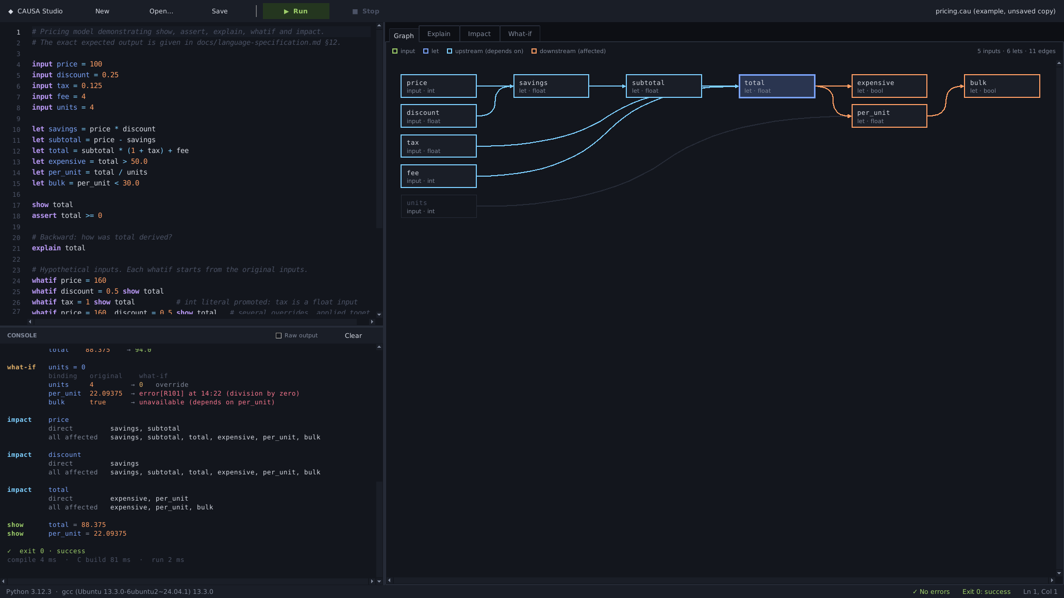
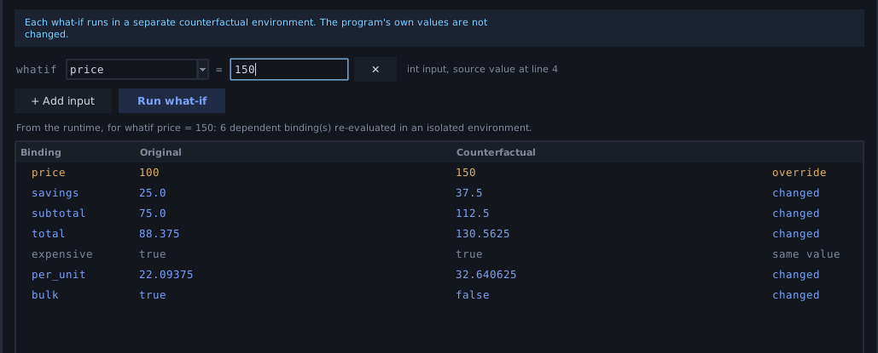
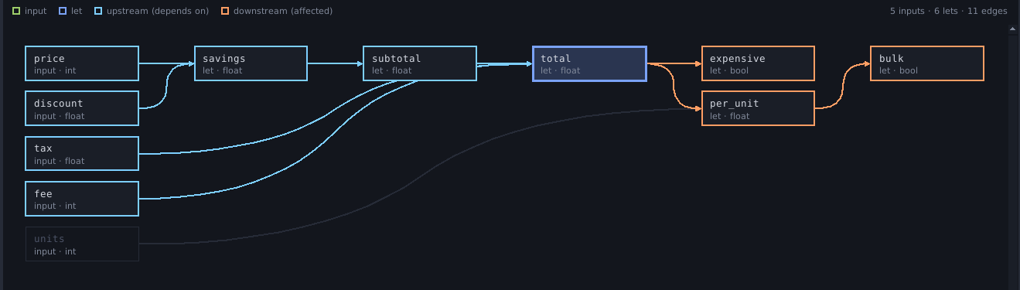
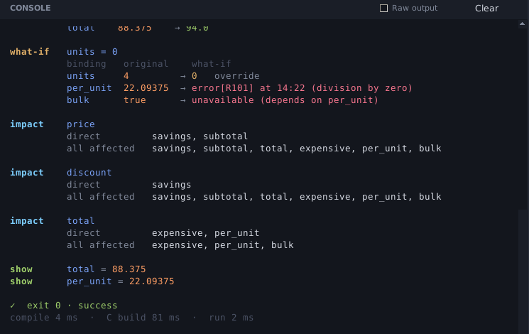
CAUSA Studio: the desktop application
4
3
1
2
5
1
Source editor
2
Integrated console
3
Dependency graph
4
Analysis tabs
5
Build / runtime status
Real application screenshots, captured by presentation/capture_studio.py (Linux, Xvfb, Python 3.12). Pricing example: 5 inputs · 6 lets · 11 edges.
CAUSA Internals and Studio
Notes:
CAUSA Studio is a desktop application, written in Tkinter with only the standard library, that drives the real compiler and runtime: a source editor with highlighting and live diagnostics, an integrated console, the dependency graph, and Explain, Impact and What-if tabs. Studio has no CAUSA semantics of its own; for Explain, Impact and What-if it builds a small query program, compiles it with the real compiler and runs it with the real runtime.
The screenshots are genuine captures of the running application, taken by a script (presentation/capture_studio.py) that drives the real window. They were captured on Linux under a virtual display with Python 3.12, Tk and GCC 13.3 because that is what was available when building the deck; the project's documented validated environment is Windows 11. Replace them with Windows captures if you prefer. The pricing example shows 5 inputs, 6 lets and 11 edges, as the caption in the Graph tab states.
Callouts: 1 source editor, 2 integrated console, 3 dependency graph, 4 analysis tabs, 5 build and runtime status.
Likely question: 'Can Studio change values at launch?' Not yet; the What-if panel covers hypothetical inputs and launch values are a command-line feature.

Slide 16
Testing and validation
205
Strict C99
Byte-for-byte
Generated C compiles warning-free with -Wall -Wextra -Wpedantic -Werror (-O0 and -O2 on selected examples, fresh clone)
Runtime spec cases and every command in docs/demonstration.md compared exactly: stdout, stderr, exit status
automated tests passed
0 skipped · recorded full run
35,000 floats
≈12,000 strings
Windows 11 · Python 3.11.9 · MSYS2 UCRT64 GCC 16.1.0
Float formatting checked against Python’s repr on every test run
C literal parser for --set compared with the Python lexer
Current main has 257 tests: these 205 plus 52 Studio tests.
Validated environment: Windows 11, MSYS2 UCRT64 GCC 16.1. Linux/WSL: compiler-side tests passed; generated-C execution was not validated there. No cross-platform claim.
CAUSA Evaluation
Notes:
Headline: 205 automated tests passed, with none skipped, in the recorded full run on Windows 11 with Python 3.11.9 and MSYS2 UCRT64 GCC 16.1.0. The test suite in the repository today has 257 tests: those 205 compiler, runtime and demo tests plus 52 CAUSA Studio tests (service, formatting and window tests). I counted both from the repository; the 205 pass figure is the recorded Windows result, and I did not re-run Windows here.
What the tests check, from the README: every specification runtime case is built and its stdout, stderr and exit status compared byte for byte; every shell command in docs/demonstration.md is executed and its output compared; float formatting is compared with Python's repr on 35,000 values on every run; the C literal parser for launch arguments is compared with the Python lexer on about 12,000 strings; and generated C compiles warning-free with -std=c99 -Wall -Wextra -Wpedantic -Werror. A fresh-clone check also compiled selected examples at -O0 and -O2 under those strict flags.
Qualification to state out loud: generated-C execution is validated on Windows with MSYS2 UCRT64 GCC. On Linux/WSL the compiler-side tests passed but generated C was not run there. I make no claim of comprehensive cross-platform validation.
Likely question: 'Why not a pass percentage?' Because there is one recorded configuration and no failing runs to report against; a percentage would add nothing.

Slide 17
Performance and evaluation
workload | front end | gcc -O0 | gcc -O2 | run
pricing | 1.2 | 366 | 451 | 23.9
chain-100 | 7.4 | 438 | 846 | 24.8
chain-1000 | 102 | 1,651 | 5,769 | 27.8
fan-1000 | 177 | 2,667 | 10,561 | 28.8
milliseconds, median of 5 runs. Three different quantities: CAUSA front end, native C compile, program run.
Compilation dominates
Runs ≈ process start-up
gcc at -O2 took 5.8–10.6 s for 1,000 lets; the CAUSA front end took 0.1–0.2 s.
Executables finish in about 24–29 ms in every workload.
Recorded on one Windows 11 machine (8 logical CPUs, Python 3.11.9, GCC 16.1.0); environment-dependent engineering measurements, not a speed claim.
CAUSA Evaluation
Notes:
These are previously recorded results from benchmarks/benchmark.py and docs/evaluation.md, measured on one Windows 11 machine (AMD, 8 logical CPUs) with Python 3.11.9 and GCC 16.1.0, median of five runs, on 2026-10-25. I did not re-run the benchmark here: a Linux re-run would be a different environment and would not be comparable.
The chart shows only front-end time, which is the CAUSA compiler up to Causal IR: lexing, parsing, semantic analysis and IR construction. It is in milliseconds and grows with program size: 1.2 ms for the 6-let pricing program up to 177 ms for 1,000 lets. The table keeps native compilation (gcc at -O0 and -O2) and run time as separate columns on purpose, because they are different quantities on different scales: gcc takes seconds, the front end takes milliseconds. Compilation dominates these timings; the generated C has one switch case per IR node, which -O2 optimizes slowly. Executables finish in roughly 24 to 29 ms, which is close to process start-up cost on this machine, so these runs cannot distinguish workloads.
Caveats to state: one machine, one OS, one C compiler, one session; workloads other than pricing are synthetic; wall-clock noise of up to about 30 percent between runs was observed. This is an engineering evaluation, not a speed comparison with any other language and not a claim of superiority.
Likely question: 'Does the optimizer speed things up?' Not measurably here: it cut fan-1000 from 8,002 to 5,001 IR nodes but changed neither run time nor gcc time noticeably, and it never changed program output.

Slide 18
Limitations and future work
Completed
Limitations today
Not built yet
Language v1: inputs, lets, show, explain, whatif, impact, assert
Causal IR with verified, dependency-preserving optimizer
C99 backend and C runtime
Launch-time --set inputs
CAUSA Studio desktop app
Generated C validated on Windows + MSYS2 UCRT64 GCC only
No conditionals, loops, functions, strings, collections
Front end grows faster than linear on long chains
C compiler dominates build time
Studio: one file at a time, no launch values
Test Linux, macOS, Clang, MSVC
One command to build and run
Deferred language features
Studio usability and visualization
Broader performance evaluation
CAUSA Closing
Notes:
Honest scope. Completed: everything in language version 1 and the Studio application, listed in the left column. Limitations are things that are true today. First, portability: generated-C execution is validated on Windows with MSYS2 UCRT64 GCC; Linux, macOS, Clang and MSVC are untested, and float formatting depends on a correctly rounded printf and strtod in the C library. Second, scope: no conditionals, loops, functions, recursion, mutation, strings or collections; conditionals are deferred because static and dynamic dependency semantics give different explain and impact answers. Third, performance: the front end grows faster than linearly on very long dependency chains because each binding stores its full transitive dependency set, and the C compiler dominates build time. Studio runs one file at a time and cannot set launch values.
Future work is proposed, not implemented: a single build and run command that invokes the C compiler, testing other compilers and C libraries, the deferred language features, Studio usability improvements, and a more systematic performance evaluation on larger and more realistic programs.
Likely question: 'What would you do first?' Cross-platform validation and a one-command build, because they remove the most friction for new users.

Slide 19
CAUSA connects compilation with explainability and counterfactual reasoning.
explain
impact
whatif
Understand
Trace
Explore
why a value was produced
the impact of a binding
alternative inputs without changing the original execution
Questions?
savings
price
total
Notes:
Close. CAUSA connects compilation with explainability and counterfactual reasoning: a small language and compiler in which dependencies are first-class, so a program can say why a value was produced, what depends on a binding, and what would happen under different inputs, all without disturbing the original execution. Three takeaways on the slide. The implementation is verified by an automated test suite and demonstrated by CAUSA Studio. The limitations are real and listed. Thank you; I am happy to take questions.
Suggested backup answers: dependency direction (binding to names it uses, reverse derived); why C (native output, small testable runtime); why constant folding is safe (never folds anything that could raise a runtime error, and the dependency graph is re-verified); what is not claimed (no cross-platform validation, no performance superiority, no claim of being the first system of its kind).

Slide 20
Appendix: references
[1] M. Weiser, “Program Slicing,” IEEE Transactions on Software Engineering, vol. 10, no. 4, pp. 352–357, 1984.
[2] J. Ferrante, K. J. Ottenstein, J. D. Warren, “The Program Dependence Graph and Its Use in Optimization,” ACM TOPLAS, vol. 9, no. 3, pp. 319–349, 1987. doi:10.1145/24039.24041
[3] J. Cheney, L. Chiticariu, W.-C. Tan, “Provenance in Databases: Why, How, and Where,” Foundations and Trends in Databases, vol. 1, no. 4, pp. 379–474, 2009. doi:10.1561/1900000006
[4] J. Cheney, A. Ahmed, U. A. Acar, “Provenance as dependency analysis,” Mathematical Structures in Computer Science, vol. 21, no. 6, pp. 1301–1337, 2011. doi:10.1017/S0960129511000211
[5] A. J. Ko, B. A. Myers, “Designing the Whyline: A Debugging Interface for Asking Questions About Program Behavior,” CHI 2004, Vienna, pp. 151–158.
[6] A.-H. Karimi, G. Barthe, B. Schölkopf, I. Valera, “A Survey of Algorithmic Recourse: Contrastive Explanations and Consequential Recommendations,” ACM Computing Surveys, vol. 55, no. 5, 2022. doi:10.1145/3527848
[7] C. Lattner, V. Adve, “LLVM: A Compilation Framework for Lifelong Program Analysis & Transformation,” CGO 2004, Palo Alto. https://llvm.org/pubs/2004-01-30-CGO-LLVM.html
[8] C. Lattner, M. Amini, U. Bondhugula, A. Cohen, A. Davis, J. Pienaar, R. Riddle, T. Shpeisman, N. Vasilache, O. Zinenko, “MLIR: Scaling Compiler Infrastructure for Domain Specific Computation,” CGO 2021. https://research.google/pubs/mlir-scaling-compiler-infrastructure-for-domain-specific-computation/
[9] J. Chen, J. Patra, M. Pradel, Y. Xiong, H. Zhang, D. Hao, L. Zhang, “A Survey of Compiler Testing,” ACM Computing Surveys, vol. 53, no. 1, pp. 1–36, 2020. doi:10.1145/3363562
[10] H. Ma, “A Survey of Modern Compiler Fuzzing,” arXiv preprint, 2023 (not peer reviewed). doi:10.48550/arXiv.2306.06884
CAUSA Closing
Notes:
Verification: each entry's title, authors, year and venue were checked against a publisher, library or official project page while building this deck. DOIs are given only where a page showed one. Items [1] and [5] show venue, volume and pages but no DOI, because none was confirmed. [7] has a stable official page but no DOI listed there. [8] is the CGO 2021 paper listed on Google Research's publication page; no DOI was confirmed. [10] is an arXiv preprint (not peer reviewed). A Halpern and Pearl structural-model causality paper was considered for the counterfactual theme and dropped because its journal venue could not be verified. Recent sources (2022 to 2024) are [6] (2022) and [10] (2023).

