Slide 1
FMCG Sales Analysis — Business Insights & Recommendations
- Varshini U J

Slide 2
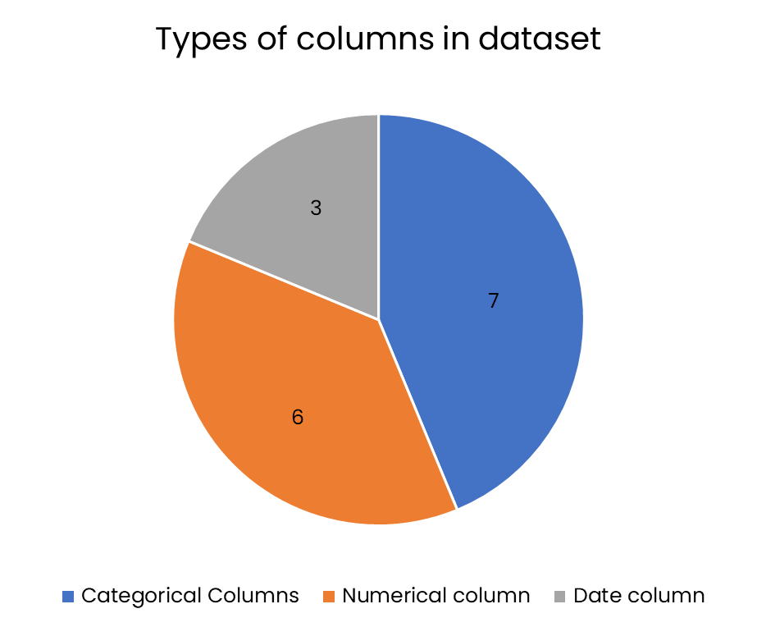
Dataset Overview
1,000 synthetic transactions includes sales, customer, product, and promotions.
Key fields
Total Sales
Units Sold
Customer Satisfaction
Promotions
Returns
Coverage: Full calendar year 2023.
Data cleaning: No major missing values in sales fields. Promotion types filled logically. Customer satisfaction filled with mean.
Identify trends across sales, customers, products, and promotions
Understand revenue drivers and customer satisfaction
Generate actionable business recommendation aligned with growth goals
Objective

Slide 3
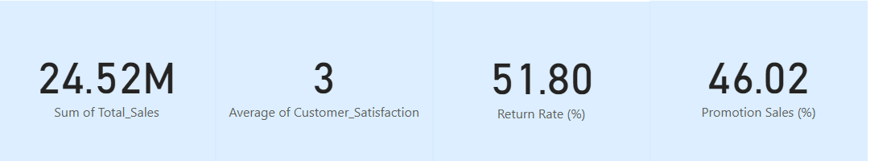
Key KPI- Total sales (Revenue)
Total Sales is the primary business performance indicator
Customer Satisfaction and Return Rates are key supporting KPIs
Promotion effectiveness directly influences Total Sales volume

Slide 4
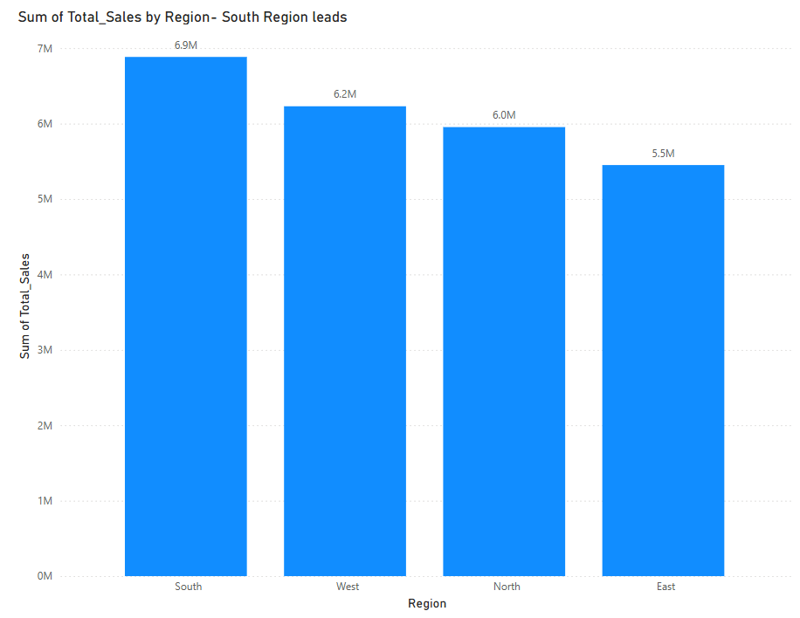
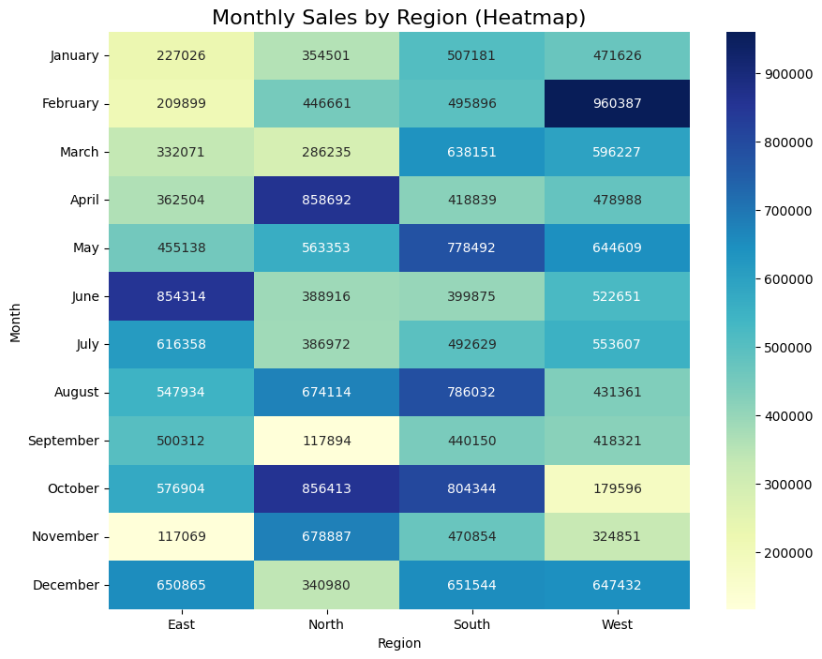
South Region Leads FMCG Sales — Revenue Opportunity
South dominates in total sales- strong brand affinity and retail presence.
West follows closely with maximum sales in February- opportunity to scale up distribution efforts.
East shows potential for improvement via focused strategies during seasons.

Slide 5
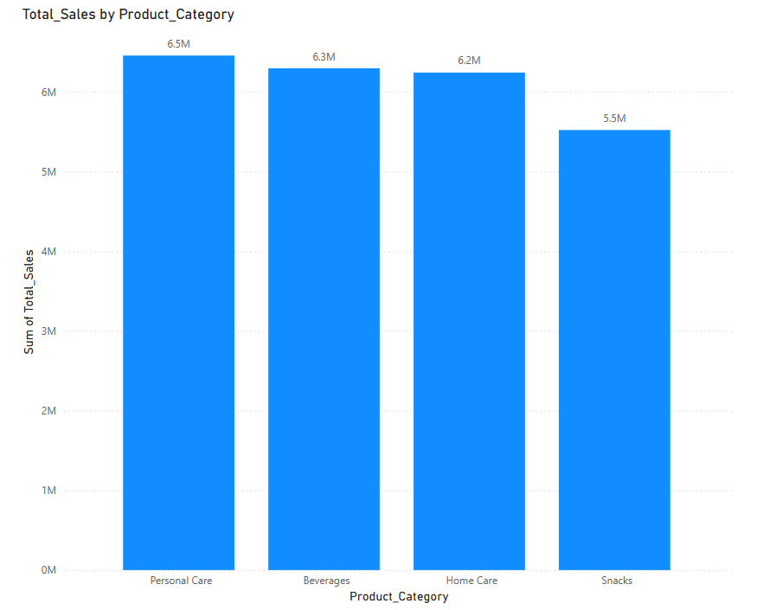
Sales by product category- Personal Care Category Leads Revenue Contribution
Personal Care products generate the highest revenue share, leading category contribution.
Beverages and Home Care show near-equal strength- strong secondary focus areas.
Snacks category underperforms relative to other categories- innovation or rebranding could uplift.

Slide 6
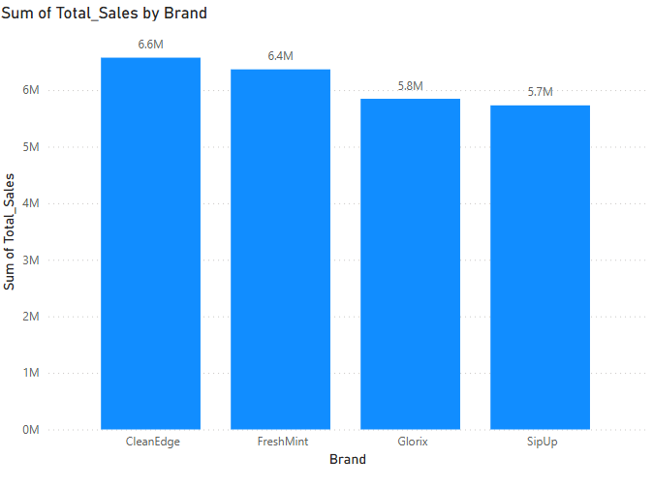
Sales by Brand
Brand | Top Category | Strongest Region | Promotions (%) | Peak season
CleanEdge | Personal Care | South | 51.78 | February, Aug, December
FreshMint | Home Care | South | 48.48 | April–May, October
Glorix | Home Care | East | 48.52 | October
SipUp | Beverages | West | 44.28 | May, August, December
Brands maintain balanced promotion usage (~45–52%), using promotions smartly to enhance seasonal or regional sales.
FreshMint and Glorix tactically boost Home Care sales through moderate promotions during cleaning seasons, while SipUp drives beverage sales with minimal promotion reliance.
Regional strengths are amplified through promotions for Homecare, with FreshMint leading in South, Glorix in East, and SipUp capitalizing on West’s seasonal beverage demand.

Slide 7
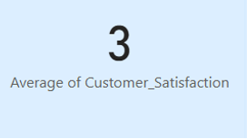
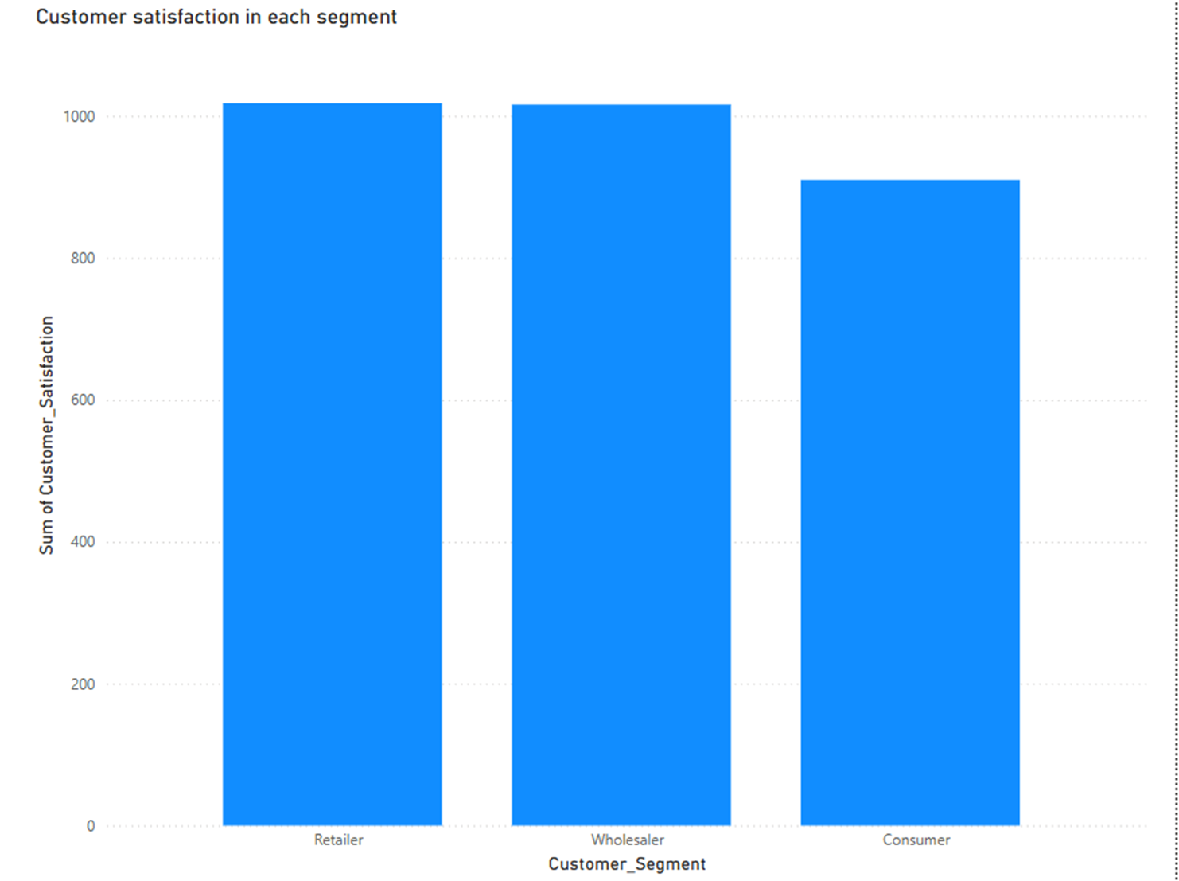
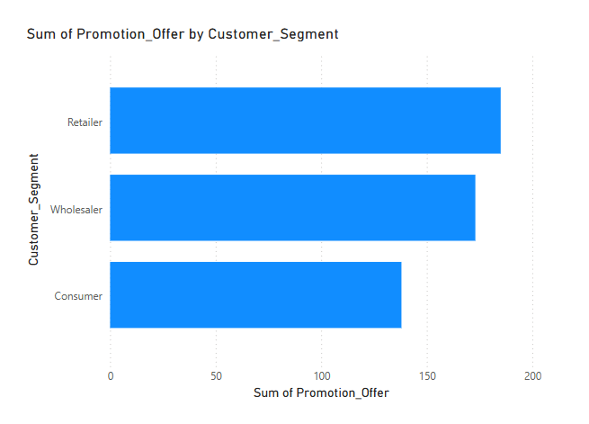
Customer satisfaction
There is promising Wholesalers and Retailers cumulative satisfaction, confirming strong B2B relationships
Consumers have low satisfaction and received very less promotions compared to other segments

Slide 8
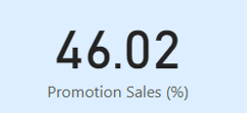
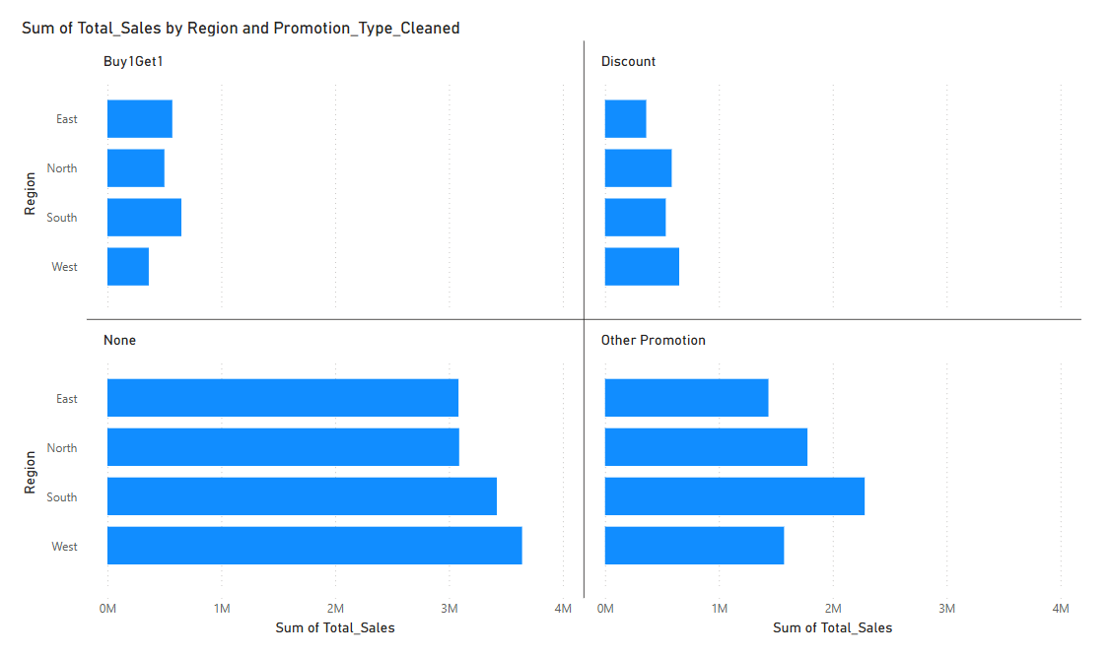
Promotion Effectiveness Analysis
Organic sales (No promotion) dominate across all regions, affirming brand loyalty.
Buy1Get1 and Discount promotions contribute less significantly.
Discount-based offers are relatively more effective than Buy1Get1 across regions.

Slide 9
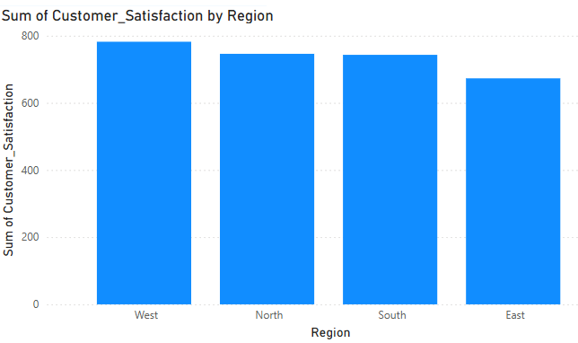
Root Cause Analysis: Lower Customer Satisfaction in East Region
Customer segment | Highest % Consumers (37.66%)
Product Category Mix | Higher Beverages/Snacks, Lower Personal Care
Promotions | Slightly less than South
Sales in East is low since average customer satisfaction in East is Lowest (2.89). Needs focus on improving customer experience.
Recommendations
Expand Personal Care product offerings to strengthen high-satisfaction categories.
Launch some programs to enhance the consumer engagement.

Slide 10
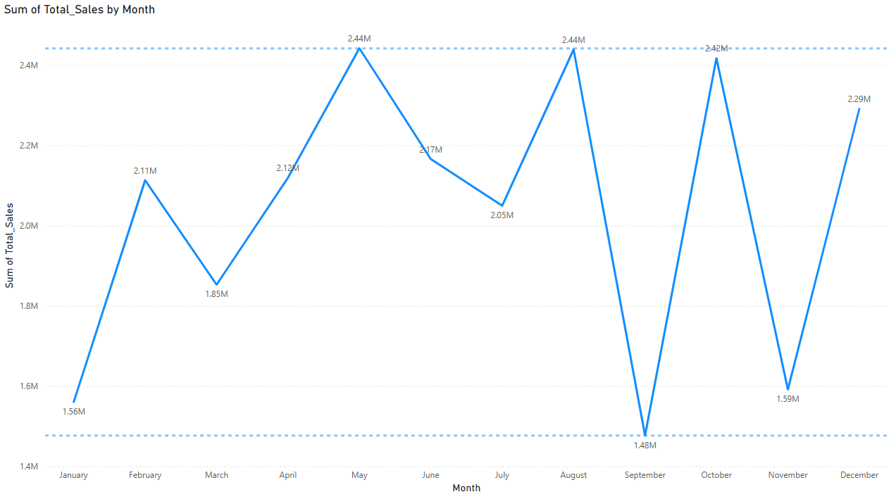
Monthly Sales Trend
Sales show strong seasonality with clear peaks in May, August, and October.
Significant sales dips in September and November
December exhibits recovery momentum- important for year-end sales strategy.

Slide 11
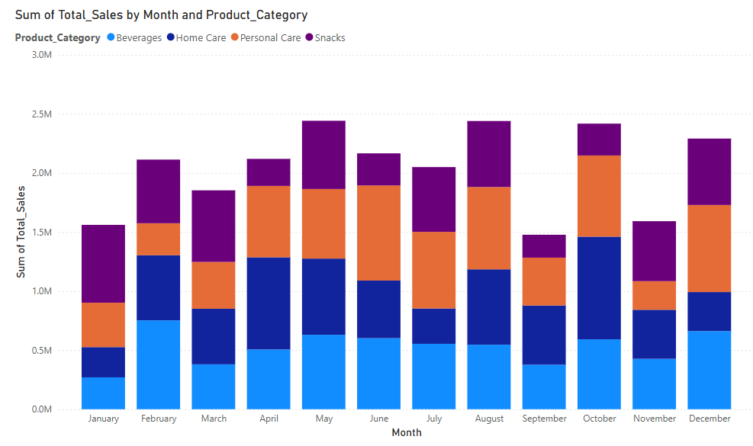
Root Cause and Strategic Actions — Low Sales in January, September, November
Month | Avg Units sold | Top Category sold
January | 89 units | High Snacks (30%)
September | 91.8 units | High Home Care (34%)
November | 89.9 units | High Beverages (29%) and Snacks (28%)
Recommendations:
Boost promotions
Focus on personal and home care products
January and November have more Snacks and Beverages, Average units sold is less than other months

Slide 12
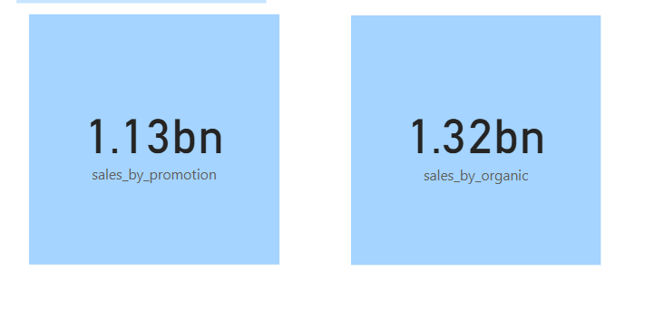


Key Business Insights Derived from Analysis
Strong 53.98% organic sales demonstrates brand strength and customer loyalty.
Over 46% of sales influenced by promotions — showing importance of tactical campaigns.
The South region leads sales performance, driven mainly by FreshMint and CleanEdge — offering opportunities for focused regional campaigns.
Personal Care (CleanEdge) and Home Care (FreshMint, Glorix) dominate sales; however, Home Care relies slightly more on promotions to drive peak sales.
May, August, and October witnessed peak sales

Slide 13
Recommendations
Region-Specific Marketing Double down on marketing spend in the South region while developing tailored strategies for relatively underperforming East markets.
Improve Promotion Tracking Systems Invest in more robust data capture processes for promotions to ensure better measurement of ROI and campaign effectiveness.
Strategic Promotion Deployment Optimize use of Buy1Get1 and targeted Discounts during peak demand months such as May, August, October and December; minimize unnecessary promotions during high organic sales periods.
Enhance Consumer Satisfaction Focus on improving direct-to-consumer experience and post-purchase engagement to uplift Consumer segment satisfaction scores.

Slide 14
THANK YOU

