Slide 1
SRM INSTITUTE OF SCIENCE AND TECHNOLOGY
Bengaluru AI Property &
Urban Intelligence Platform
Machine Learning Based Property Price Prediction
PROJECT REVIEW – 1
B.Tech — Computer Science and Engineering
Artificial Intelligence and Machine Learning
Submitted by
UJWAL M
Register Number: [Register Number]
Faculty Guide
[Faculty Name]
Department of Computing Technologies
Notes:
Project Review 1. The application has not been developed yet; this review covers problem definition, the dataset, statistical analysis, EDA and the proposed ML methodology.

Slide 2
OVERVIEW
Introduction
The proposed project applies machine learning to estimate residential property prices in Bengaluru using property characteristics together with location-related features. Property price is treated as a continuous target, making this a supervised regression problem.
Scope of Review 1
Covered in this review
Problem definition and objectives
Dataset description
Statistical analysis
Exploratory data analysis
Proposed ML methodology
To be carried out next
Model training and comparison
Evaluation and tuning
Explainability analysis
Application interface
Property price is influenced simultaneously by several groups of factors:
1
Physical attributes
Built-up area, configuration (BHK), bathrooms, balconies
2
Location
Locality, and the market conditions specific to that locality
3
Accessibility
Proximity to transport, healthcare, education and road network
The broader intent is to combine the resulting model with location intelligence and GIS-derived information in a later stage of the project.
Project Review 1 · B.Tech CSE (AI & ML) · SRMIST
2
Notes:
Regression problem. Review 1 stops at methodology; model results come in Review 2.

Slide 3
MOTIVATION
Understanding the Problem
A prospective buyer typically knows the asking price, the built-up area, the configuration and the locality. Judging whether that asking price is reasonable requires comparing the property against a large number of historical records across several variables at once.
Property Data
Location Data
Infrastructure Data
Why an ML problem?
Area, BHK, bathrooms,
balcony, property type
Locality and
geographic position
Transport, healthcare,
education, road access
The target is continuous
Many predictors act together
Relationships are not purely linear
Historical labelled records are available
Patterns can be learned rather than hand-coded
Machine Learning — Supervised Regression
Estimated Property Price
Project Review 1 · B.Tech CSE (AI & ML) · SRMIST
3

Slide 4
DEFINITION
Problem Statement
“To develop a machine learning based system that can estimate residential property prices using property characteristics and location-related features, while identifying the factors that influence the prediction.”
1
Multiple influencing variables
Price depends on area, configuration, locality and accessibility acting together rather than in isolation.
2
Non-linear relationships
The effect of one variable may change depending on the value of another, which limits simple linear estimation.
3
Difficulty of manual estimation
Comparing a property against thousands of historical records by hand is impractical for an individual buyer.
4
Learning from historical data
A regression model can learn these patterns from labelled records and generalise to unseen properties.
5
Interpretability requirement
The system should indicate which features influenced a prediction, not only produce a number.
Project Review 1 · B.Tech CSE (AI & ML) · SRMIST
4

Slide 5
AIM AND SCOPE
Objectives
Primary objective: to develop and evaluate a machine learning model for residential property price prediction.
1
Understand and preprocess the selected dataset.
6
Compare model performance under a common evaluation protocol.
2
Perform statistical analysis and exploratory data analysis.
7
Evaluate predictions using MAE, RMSE and R².
3
Identify the features that influence property price.
8
Analyse feature importance for the selected model.
4
Engineer property-level and location-level features.
9
Explore explainable AI methods for interpreting predictions.
5
Train several regression models on the prepared data.
10
Use the resulting model as the basis for a future application.
Project Review 1 · B.Tech CSE (AI & ML) · SRMIST
5

Slide 6
DATA
Dataset Description
Parameter | Details
Dataset | Bengaluru House Price dataset (public, tabular)
Source | Publicly mirrored CSV (GitHub); licence unconfirmed
Records (raw) | 13,320 rows
Attributes (raw) | 9 columns
Records after cleaning | 12,038 rows
Distinct localities | 1,203
Target variable | Price per sq.ft (derived from price and area)
Task type | Supervised regression
Domain | Residential real estate
Raw attributes
area_type · availability · location · size · society · total_sqft · bath · balcony · price
Note on data provenance
The dataset contains listed asking prices rather than registered transaction values. Registered transaction prices are not published publicly in Karnataka. This distinction is stated explicitly and will be carried into the interpretation of results.
Project Review 1 · B.Tech CSE (AI & ML) · SRMIST
6
Notes:
Asking price, not transaction price. Karnataka does not publish transaction prices. This is a stated limitation, not an oversight.

Slide 7
FEATURE GROUPS
Dataset Features
Attributes are grouped by the aspect of the property they describe. Accessibility features are to be derived in the feature-engineering stage.
Property Features
Location Features
Accessibility Features
Configuration (BHK)
Built-up area
Bathrooms
Balcony
Area type
Availability status
Locality name
Latitude — to be derived
Longitude — to be derived
Distance to metro
Distance to railway station
Distance to bus stop
Distance to hospital
Distance to school
Distance to major road
Available in the dataset
Partly to be derived
To be computed
Target variable: Price per sq.ft (INR) — chosen over total price so that properties of different sizes remain comparable.
Project Review 1 · B.Tech CSE (AI & ML) · SRMIST
7

Slide 8
DESCRIPTIVE STATISTICS
Statistical Analysis of the Dataset
Descriptive statistics computed on the cleaned dataset (n = 12,038).
Variable | Count | Mean | Median | Std. Dev. | Min | Q1 | Q3 | Max
Area (sq.ft) | 12,038 | 1,551 | 1,298 | 972 | 300 | 1,112 | 1,685 | 30,400
Price (INR) | 12,038 | 1,02,90,047 | 68,00,000 | 1,26,46,494 | 9,00,000 | 48,50,000 | 1,10,00,000 | 29,12,00,000
BHK / Rooms | 12,038 | 2.6 | 3.0 | 1.0 | 1.0 | 2.0 | 3.0 | 16.0
Bathrooms | 11,981 | 2.5 | 2.0 | 1.0 | 1.0 | 2.0 | 3.0 | 16.0
Balcony | 11,578 | 1.6 | 2.0 | 0.8 | 0.0 | 1.0 | 2.0 | 3.0
Price per sq.ft (INR) | 12,038 | 6,015 | 5,226 | 3,170 | 1,579 | 4,198 | 6,705 | 37,500
Observations
1
Price per sq.ft is positively skewed (skewness = 3.086).
The mean (6,015) exceeds the median (5,226), indicating a minority of high-priced properties pulling the average upward.
2
Built-up area is strongly right-skewed (skewness = 8.429).
Values range from 300 to 30,400 sq.ft, so the median is the more representative measure of central tendency.
3
Configuration is concentrated in a narrow band.
Mean BHK is 2.6 with a standard deviation of 1.0, indicating that 2 and 3 BHK properties dominate the dataset.
Project Review 1 · B.Tech CSE (AI & ML) · SRMIST
8

Slide 9
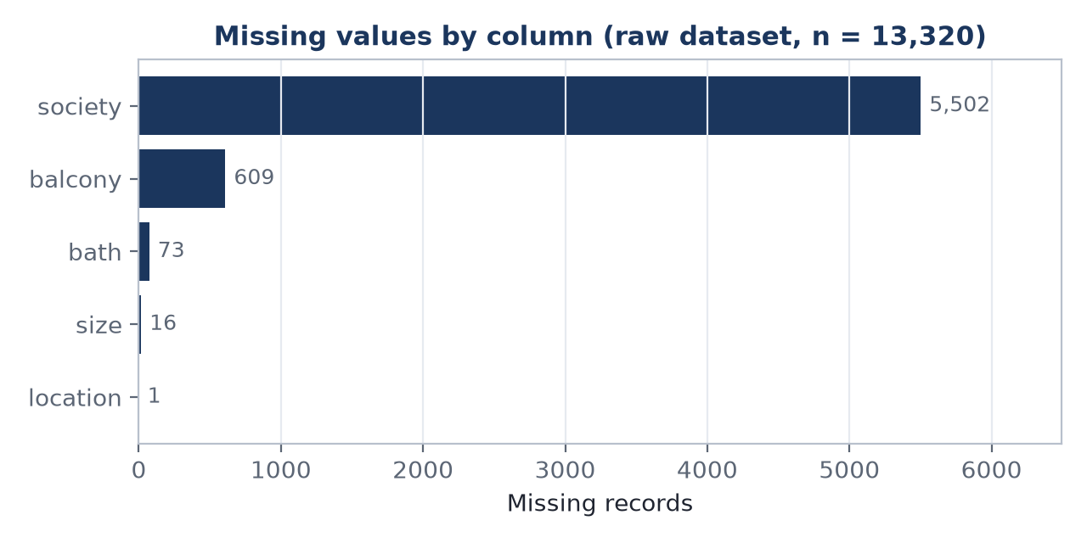
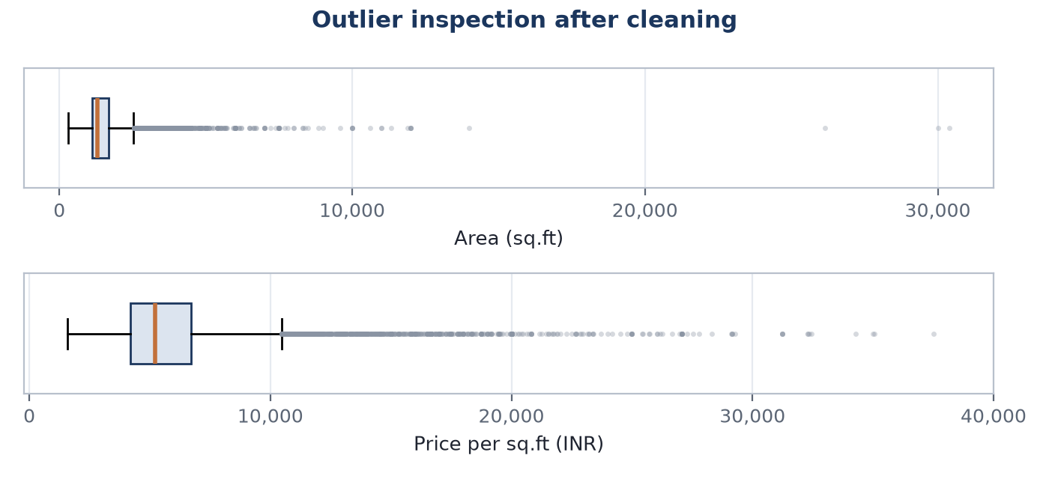
PREPROCESSING
Data Quality Analysis
Quality check | Observation
Duplicate records | 529 exact duplicate rows in the raw data
Missing — society | 5,502 (41.3%) — column excluded
Missing — balcony | 609 (4.6%) — to be imputed
Missing — bath | 73 — to be imputed
Missing — size | 16 — records removed
Outliers — area | 1,026 beyond 1.5 × IQR
Outliers — price/sq.ft | 855 beyond 1.5 × IQR
Data type handling
total_sqft is stored as text and contains ranges (e.g. “1195 - 1440”) and alternative units, requiring parsing to a numeric value.
size is text (e.g. “2 BHK”, “4 Bedroom”) and must be converted to an integer room count.
area_type, availability and location are categorical and require encoding before model training.
Data quality is addressed before training because unparsed and inconsistent values would otherwise propagate directly into the model.
Project Review 1 · B.Tech CSE (AI & ML) · SRMIST
9

Slide 10
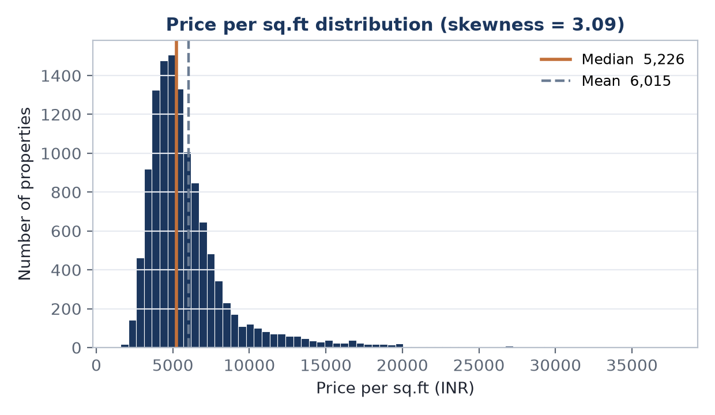
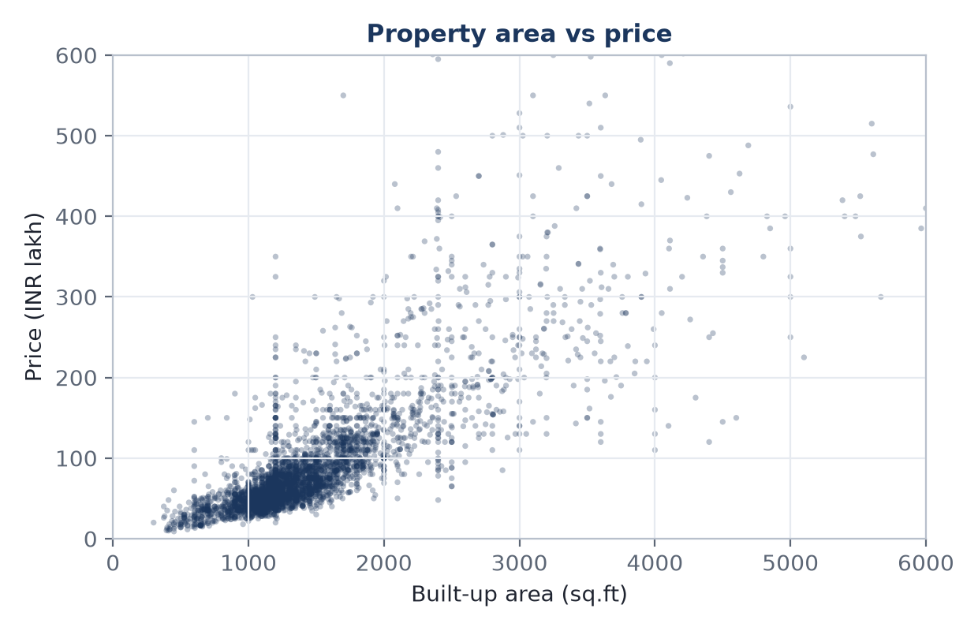
DISTRIBUTION AND AREA
Exploratory Data Analysis
Price per sq.ft distribution
Area versus price
The distribution is positively skewed (skewness = 3.086), with the majority of properties concentrated below the mean of ₹6,015 and a long right tail. This supports the use of the median as the representative measure.
Price increases with built-up area, but the relationship shows widening dispersion at larger areas, indicating that area alone does not determine price. The Pearson correlation between area and price per sq.ft is 0.311.
Project Review 1 · B.Tech CSE (AI & ML) · SRMIST
10

Slide 11
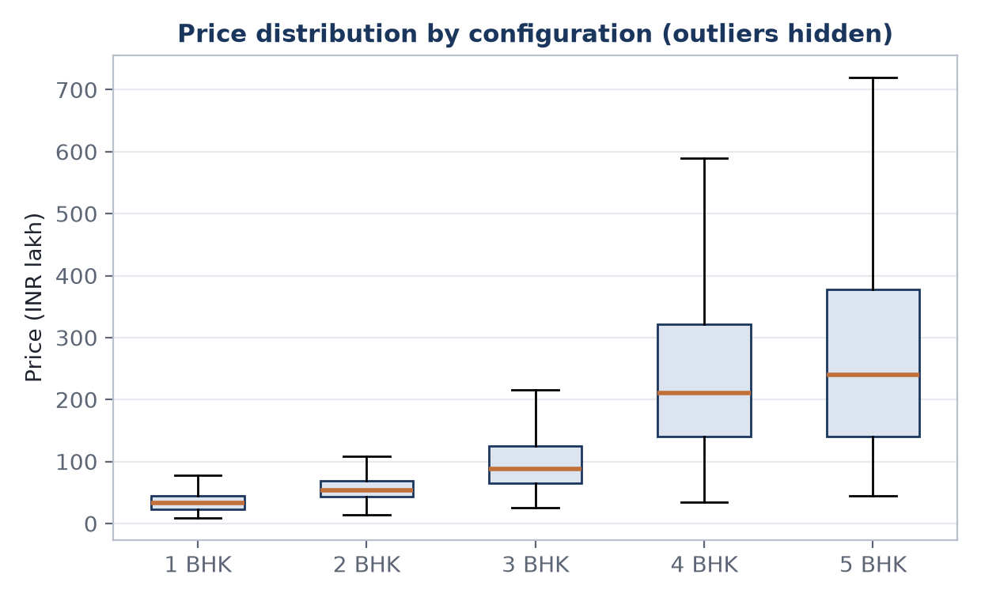
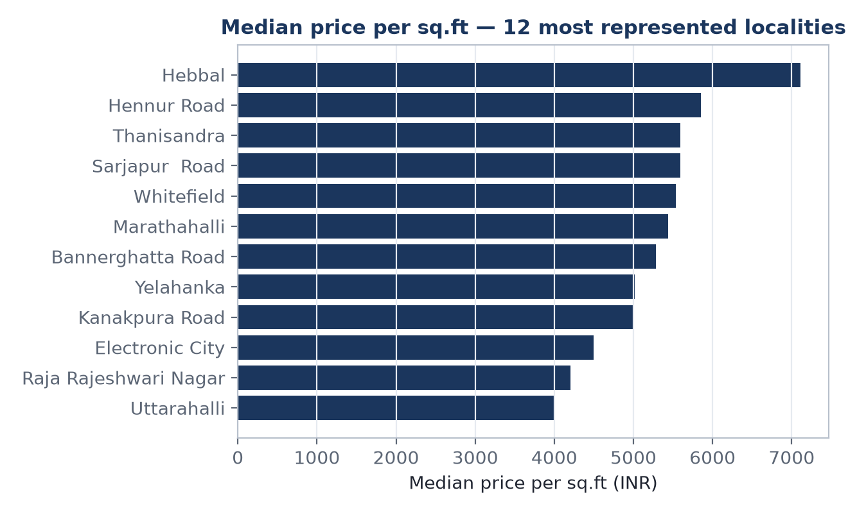
EXPLORATORY DATA ANALYSIS
Configuration and Location Analysis
Configuration
Location
Median price rises consistently with configuration:
1 BHK — ₹33.0 L · 2 BHK — ₹53.5 L · 3 BHK — ₹88.0 L · 4 BHK — ₹211.0 L · 5 BHK — ₹240.0 L.
The spread within each group is wide, so configuration alone does not determine price.
Median price per sq.ft differs substantially across the most represented localities, indicating that locality captures variation not explained by the physical attributes alone. Location may reflect differences in accessibility, infrastructure and local market conditions; this is an association and does not establish causation.
Project Review 1 · B.Tech CSE (AI & ML) · SRMIST
11

Slide 12
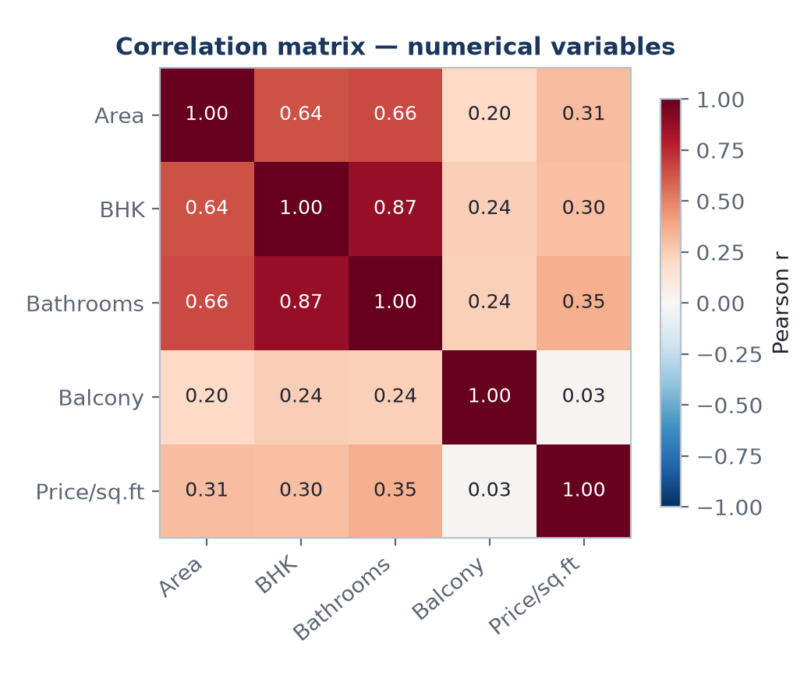
FEATURE RELATIONSHIPS
Correlation Analysis
Variable | Pearson r with price per sq.ft
Bathrooms | 0.353
Built-up area | 0.311
Configuration (BHK) | 0.3
Balcony | 0.03
Interpretation
No single numerical variable is strongly correlated with the target; the highest is bathrooms at r = 0.353.
This indicates that price per sq.ft is not explained by any one attribute in isolation, which supports the use of multivariate models over simple linear estimation.
Area, configuration and bathrooms are themselves inter-related, so multicollinearity is expected among the input variables and will be considered during feature selection.
Correlation measures linear association only. It does not capture non-linear relationships, and it does not establish causation.
Project Review 1 · B.Tech CSE (AI & ML) · SRMIST
12
Notes:
Weak individual correlations are themselves a finding: they justify multivariate, non-linear models.

Slide 13
PROPOSED FEATURES
Feature Engineering
Raw Data
Feature Engineering
ML-Ready Features
Derived property features
Derived location features
Derived accessibility features
Price per sq.ft — target normalisation
Area per room
Bathrooms per room
Property age (where date data exists)
Locality-level median price
Locality-level record count
Administrative ward and zone
Distance to nearest metro station
Distance to nearest railway station
Distance to nearest bus stop
Distance to nearest hospital and school
Count of amenities within a fixed radius
The final feature set will depend on data availability and on the results of preprocessing. Features derived from the target variable will be excluded to avoid target leakage.
Project Review 1 · B.Tech CSE (AI & ML) · SRMIST
13

Slide 14
WORKFLOW
Proposed Machine Learning Methodology
1. Dataset
6. Train / Validation / Test Split
11. Best Performing Model
2. Data Cleaning
7. Model Training
12. Prediction
3. Exploratory Data Analysis
8. Cross Validation
13. Explainability
4. Feature Engineering
9. Hyperparameter Tuning
Evaluation protocol
All candidate models will be trained and evaluated under an identical preprocessing pipeline and data split, so that the comparison reflects the algorithm rather than differences in preparation.
5. Feature Selection
10. Model Evaluation
Project Review 1 · B.Tech CSE (AI & ML) · SRMIST
14

Slide 15
REGRESSION MODELS
Candidate Machine Learning Algorithms
Four regression algorithms are proposed. The intention is to compare them under a common protocol rather than to assume in advance which will perform best.
1
Linear Regression
2
Random Forest Regressor
Baseline model
Bagging ensemble
Fits a linear relationship between the input features and the target. Included as a reference point against which the more complex models are judged.
Averages the predictions of many decision trees trained on bootstrap samples. Captures non-linear relationships and interactions between features.
Assumes linearity and independence of predictors.
Less sensitive to outliers; harder to interpret directly.
3
Gradient Boosting Regressor
4
XGBoost Regressor
Sequential ensemble
Regularised boosting
Builds trees sequentially, with each tree fitted to the residual errors of the previous ones, progressively reducing prediction error.
An optimised gradient boosting implementation with regularisation, widely used for structured and tabular datasets.
Often accurate; sensitive to hyperparameter settings.
Efficient on tabular data; requires tuning.
Project Review 1 · B.Tech CSE (AI & ML) · SRMIST
15

Slide 16
METRICS AND COMPARISON
Model Evaluation
MAE
Mean Absolute Error
Model | MAE | RMSE | R²
Linear Regression | To be calculated | To be calculated | To be calculated
Random Forest Regressor | To be calculated | To be calculated | To be calculated
Gradient Boosting Regressor | To be calculated | To be calculated | To be calculated
XGBoost Regressor | To be calculated | To be calculated | To be calculated
The average magnitude of the prediction error, expressed in the same unit as the target. Treats all errors equally.
RMSE
Root Mean Squared Error
Penalises larger errors more heavily than smaller ones, and is therefore sensitive to occasional large mistakes.
R²
Coefficient of Determination
The proportion of variance in the target explained by the model. A value of 0 corresponds to predicting the mean.
Note on the comparison
Values are not reported in this review because model training has not yet been carried out. Results will be presented in the next review.
Because properties in the same locality share price characteristics, a random train-test split can place closely related records on both sides of the split and overstate performance. A grouped split by locality will therefore be used alongside the random split, and both results will be reported.
MAPE
Mean Absolute Percentage Error
Expresses error as a percentage of the actual value, allowing comparison across differently priced properties.
Project Review 1 · B.Tech CSE (AI & ML) · SRMIST
16
Notes:
No values are invented. Preliminary experiments have been carried out; results are reserved for Review 2.

Slide 17
EXPLAINABLE AI — PLANNED ANALYSIS
Understanding the Prediction
Predicted Property Price
Which features influenced it?
Ranked contributions
Feature importance
Features expected to be examined
Measures how much model performance degrades when a feature's values are randomly permuted, indicating the model's reliance on that feature.
Built-up area
Locality
Configuration (BHK)
Connectivity and accessibility
Property age
Amenity availability
SHAP (SHapley Additive exPlanations)
Attributes a contribution value to each feature for an individual prediction, showing which attributes pushed the estimate above or below the baseline.
This slide describes planned analysis. No explainability results are reported at this stage, as model training has not yet been completed.
Project Review 1 · B.Tech CSE (AI & ML) · SRMIST
17

Slide 18
TECHNICAL DESIGN
Proposed System Architecture
Data Sources
Data Processing
Machine Learning
Explainability
Future Application
Property dataset (CSV)
Location data
GIS boundary data
Python
Pandas / NumPy
GeoPandas
Preprocessing
Feature engineering
Model training and evaluation
Feature importance
SHAP analysis
Web-based interface
Not developed in this phase
Relationship between components
Property records supply the labelled examples for supervised learning, while location and GIS data are used to derive accessibility features that are not present in the original dataset. These layers feed a single preprocessing and model-training pipeline. Explainability operates on the trained model rather than on the raw data. The web interface is shown for completeness and is not part of the current phase.
Project Review 1 · B.Tech CSE (AI & ML) · SRMIST
18

Slide 19
DELIVERABLES
Expected Outcome and Future Scope
Expected Outcome
Future Scope
1
A cleaned and statistically analysed property dataset
GIS integration for accessibility and boundary-based features
Incorporation of updated property information
Development of a web-based application interface
Decision support for prospective buyers
Investment and appreciation analysis
Development feasibility analysis for builders
Extension of the methodology to an additional city, with a separately trained model
Additional urban and location intelligence layers
2
A documented set of property and location features
3
A comparison of four regression algorithms under a common evaluation protocol
4
Reported performance using MAE, RMSE and R²
5
A selected model for property price prediction
6
Interpretable information on the features influencing predictions
These components are proposed for subsequent phases and are not implemented at this stage.
Project Review 1 · B.Tech CSE (AI & ML) · SRMIST
19

Slide 20
CONCLUSION
Conclusion
The project addresses the problem of residential property price estimation using machine learning. The work carried out in this phase focuses on understanding the dataset through statistical analysis and exploratory data analysis, identifying the variables relevant to the target, and defining a regression-based machine learning methodology.
The analysis indicates that the target variable is positively skewed and that no single numerical attribute is strongly correlated with price, which supports the use of multivariate, non-linear regression models. The next stages will involve feature engineering, model development, comparison and evaluation, followed by integration into the proposed application.
Property Data
›
Statistical Analysis
›
Machine Learning
›
Prediction
›
Explainability
Thank you
Project Review 1 · B.Tech CSE (AI & ML) · SRMIST
20

