Slide 1
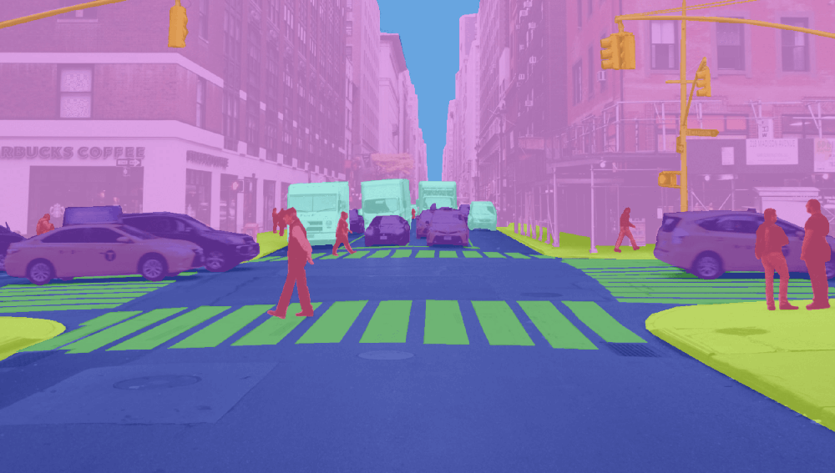
Image Segmentation for Self-Driving Cars
Ujwal L Shankar

Slide 2
Description of the Problem Statement your project was trying to solve
Proposed Solution
Results (can include model accuracy, website demo, etc)
Optional - Code Overview

Slide 3
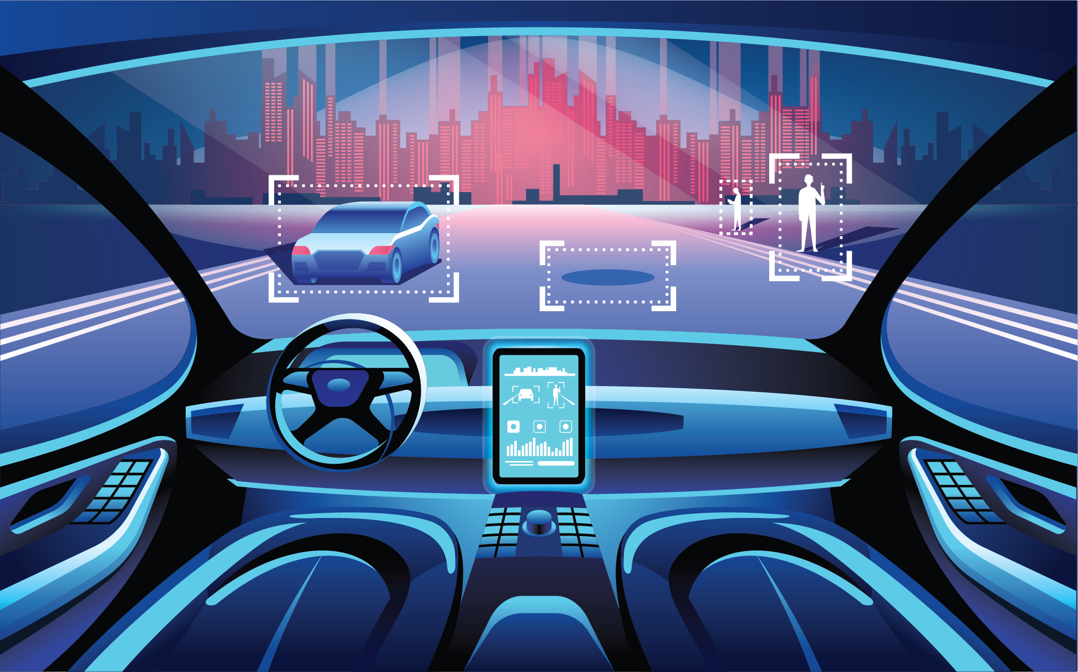
Problem Statement

Slide 4
Problem Statement
Self-Driving cars
Detect
Differentiate
Locate objects in an image, even if overlapping
Dynamic Environment

Slide 5

Proposed Solution
Computer Vision
Notes:
Computer Vision is a field of artificial intelligence (AI) that enables machines to interpret and make decisions based on visual information from the world, similar to how human vision works. It involves the automatic extraction, analysis, and understanding of useful information from a single image or a sequence of images

Slide 6
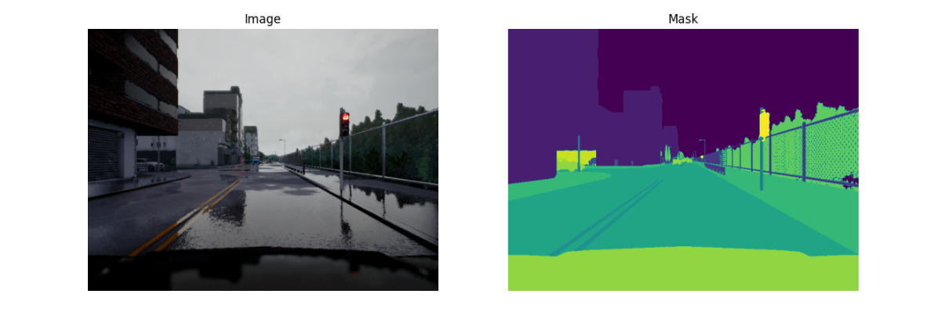
Image Segmentation
Notes:
Region of Interest
It is not feasible to process the entire image altogether; thus, we divide the image into different segments. A picture is the combination of pixels, or we can say pixels are the building blocks for a photo. Each pixel has some attributes. Pixels in an image can either be the same or can differ from other pixels depending on the features. Pixels having similar attributes will be masked with the same color, and pixels with different characteristics will have a different color.

Slide 7
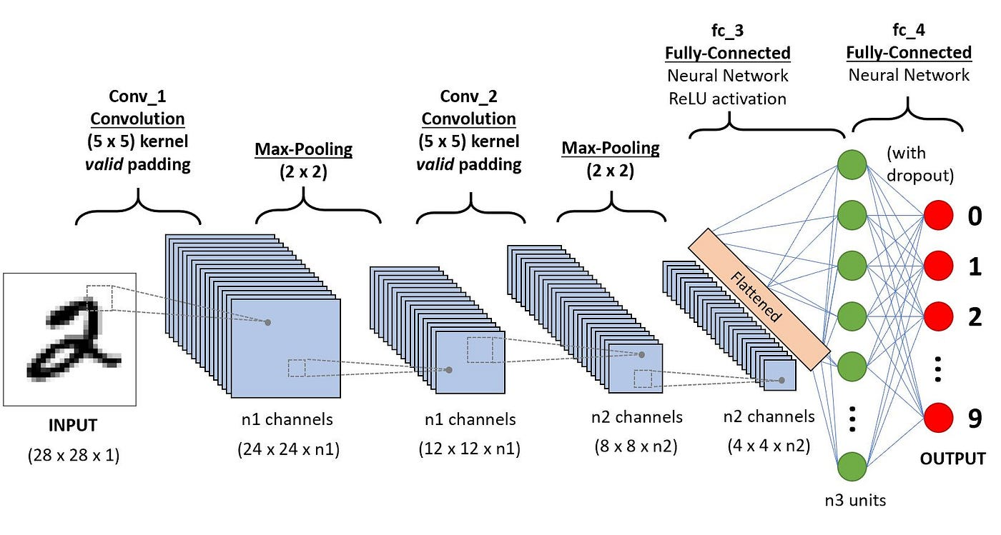
Notes:
Convolutional Neural Networks (CNNs) are a class of deep neural networks specifically designed to process and analyze visual data.
key components of CNN: convolutional layers, Pooling layers and Fully connected layers.
Key steps: Data collection, preprocessing, augmentation, deciding model architecture, training the model and testing.

Slide 8
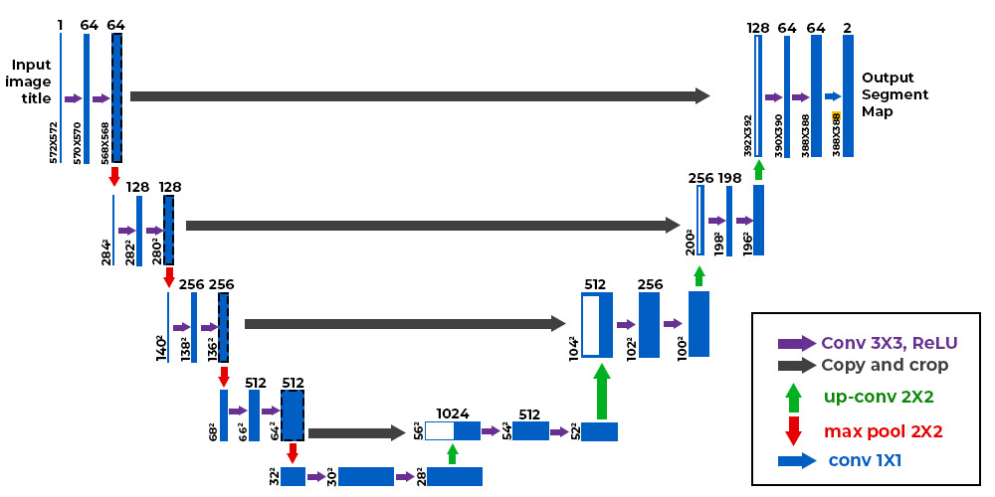
U-Net Architecture
Notes:
Specifically for image segmentation. It is known to yield precise predictions even with relatively smaller data sets and its architecture is in the shape of the letter “U”.2 main parts: encoder and decoder. and bridge between them
Skip connections in U-Net architecture help generate better semantic features by providing additional information to the Decoder.

Slide 9
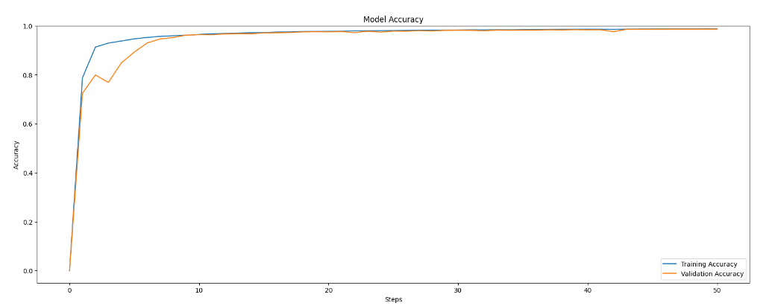

Results

Slide 10
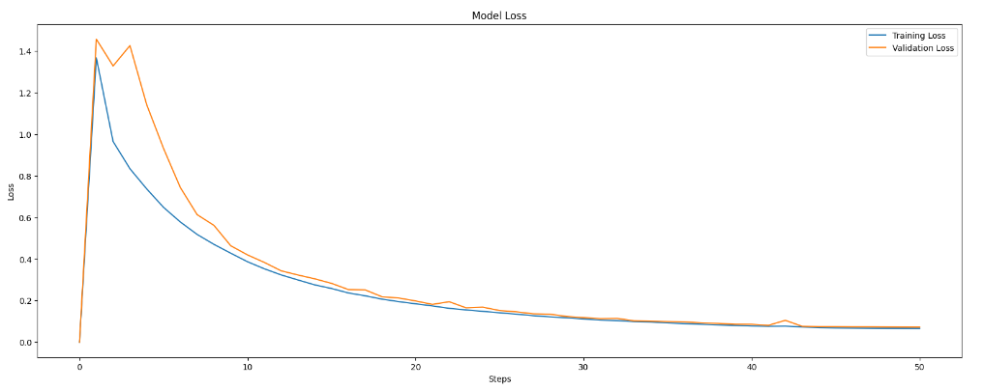

Slide 11
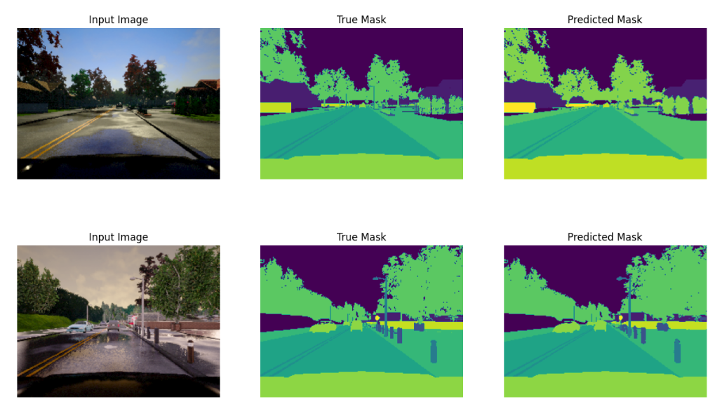
Output

