Slide 1
ProofPilot
Step-level formative feedback for propositional logic proofs
Project progress report | Artificial Intelligence (Theory)
Team: CVS Ujwal, Keshav Raj
Repository: https://github.com/ujwal2311/proofpilot.git
Report built from commit e0b3aca (pushed, CI-verified green -- see slide 6)
ProofPilot | 1

Slide 2
1-2. Problem Statement and Objectives
AI-drafted -- review and rewrite in your own words
AI-drafted -- review and rewrite in your own words
Problem Statement
Objectives
When a student works through a propositional-logic proof -- turning an English argument into premises, converting them to clauses, and resolving step by step -- the two places they actually go wrong are translation (misreading “unless” or “only if”) and the proof steps themselves (picking an irrelevant clause, or claiming a conclusion that doesn’t follow). In a classroom, a teacher can mark the final answer right or wrong, but checking every intermediate step for each student isn’t possible at scale, so a student who makes a mistake early often doesn’t find out until the grade comes back -- by which point the specific misunderstanding is gone. ProofPilot addresses this by giving step-level feedback as the student works: it reads a plain-English argument, builds the proof with the student rather than for them, and tracks which skills (translation, clause selection, relevance) the student has and hasn’t mastered, adjusting what it asks next. This matters because formative feedback -- feedback given during the work, not after it -- is what lets a student correct a misunderstanding before it hardens into a habit.
• Parse a plain-English argument of arbitrary length into logical facts without hardcoded vocabulary, refusing (by name, with a rephrasing hint) any sentence it cannot confidently translate, rather than guessing.
• Verify, using resolution refutation cross-checked against truth-table entailment, whether a stated conclusion actually follows from the student’s premises -- correctly, on a benchmark of randomly generated problems.
• Generate a step-level hint at each stage of the proof, using breadth-first search over the remaining clauses, within a bounded and deterministic search budget.
• Track per-skill mastery with Bayesian Knowledge Tracing and use it to decide, after each answer, whether to keep practicing or move on -- measurably reducing how often a simulated learner is released before mastery, compared to a fixed-length baseline.
ProofPilot | 2

Slide 3
3-4. Literature Review and Limitations
Theme | Papers (verified citation) | Key finding | Gap
Knowledge tracing & student modeling | Corbett & Anderson (1995); Baker et al. (2008); Pardos & Heffernan (2010); Pavlik et al. (2009); Piech et al. (2015); Khajah et al. (2016); Pelánek (2017); Bull & Kay (2007) | Classical BKT, extended with contextual/individual parameters, matches deep-learning tracers on the benchmarks tested. | [STUDENTS WRITE]
ITS & tutoring effectiveness | VanLehn (2006, 2011); Kulik & Fletcher (2016); Ma et al. (2014); Bloom (1984) | ITS approach human-tutor effect sizes (~0.7-0.8 SD); exact gains vary by outcome-measure type. | [STUDENTS WRITE]
Feedback & formative assessment | Black & Wiliam (1998); Hattie & Timperley (2007); Shute (2008); Brown & Burton (1978) | Specific, timely, non-evaluative feedback that names the error outperforms a single grade. | [STUDENTS WRITE]
Logic-proof tutoring & hint generation | Robinson (1965); Barnes & Stamper (2008); Stamper et al. (2013) | Resolution is the proof method; data-driven/MDP-based hints measurably help students persist through logic-proof tutors. | [STUDENTS WRITE]
Help-seeking & misuse detection | Aleven et al. (2006) × 2 papers found; Baker et al. (2004) | Student help-seeking and gaming behaviour can be modeled and detected from interaction logs. | [STUDENTS WRITE]
Theoretical background | Doignon & Falmagne (1999); Russell & Norvig (2020) | Formal knowledge-space theory and standard course material (logic, search) underpin the design. | [STUDENTS WRITE]
23 of 24 seed citations verified, 1 ambiguous (Aleven et al. 2006, two papers found, pick one). 25-30 required — more still needed.
ProofPilot | 3

Slide 4
5. Methodology: Architecture and Workflow
parse
→
facts
→
consistency
→
entailment
→
relevance
→
proof
Above: the 6-step INTERNAL pipeline (docs/HLD.md §7). Not the only "stage" count -- three numbers, kept separate rather than flattened to one (FACTS.md §9):
3 UI screens • 5-value state machine (read/facts/translate/prove/explain -- translate now universal, HLD v2.12) • 6-step internal pipeline (above)
React frontend
FastAPI (4 endpoints)
app/ (shared edge)
core/ (15 modules)
Render, post actions,
persist to localStorage
→
Stateless HTTP adapter:
parse body, call app, return JSON
→
load+validate, prepare,
render, mint clause ids
→
Pure Python, zero web
imports, 6-stage pipeline
Implementation strategy (FACTS.md §9)
Added 2026-10-25 (FACTS.md §2)
• core/ imports nothing outside the standard library -- unit-testable from literals.
• app/ is the only layer allowed to read a data file, validated at startup.
• api/ and cli.py are thin adapters: zero logic, zero wording of their own.
• frontend/src reads state.stage directly -- no client-side copy of the stage.
• 8 new grammar phrases (HLD v2.13): necessary/sufficient-for, implies, not-both, whenever, provided/given-that, otherwise.
• Prove screen: symbol legend + per-clause plain-English rendering (clause_english).
• All 3 stage tabs independently browsable -- view-only, never calls the API.
• A Back button beside the tabs, same view-only navigation.
ProofPilot | 4

Slide 5
5. Methodology: Algorithms and Syllabus Mapping
Component | Algorithm | Module(s)
Parsing | Controlled-grammar keyword scan → AST → clauses (textbook 3-step CNF algorithm) | core/english.py, core/cnf.py
Entailment | Truth-table enumeration, cross-checked against resolution (940/940 agreement) | core/entail.py
Proof search | Exact breadth-first search over clause sets, bounded work budget, rule-based fallback | core/search.py
Mastery tracking | Single-skill Bayesian Knowledge Tracing, 3 skills (CLASH, RESOLVE, STRATEGY) | core/bkt.py
Syllabus-unit mapping (README.md, verbatim)
Syllabus unit | Topic | Where implemented
Unit 2 — Search | Breadth-first search | core/search.py
Unit 4 — Logic | Resolution, refutation | core/logic.py, core/cnf.py
Unit 5 — Uncertainty | Bayes' rule, Bayesian Knowledge Tracing | core/bkt.py
ProofPilot | 5

Slide 6
6. Code Repository and Build Record
Fact | Value
Repository URL | https://github.com/ujwal2311/proofpilot.git
Licence | MIT
Total commits | 95 (git log --format=%H | wc -l)
Latest commit (this deck) | e0b3aca -- pushed, CI-verified green
Push status | Pushed. origin/main is at e0b3aca; CI confirmed green for this exact commit.
CI status (last 20 pushes) | 17/20 succeeded; 3 consecutive failures on 2026-10-23 (missing data/eval/*.json in git), fixed 2026-10-24 -- every push since, including all of tonight's, is green (gh run list --branch main --limit 20)
progress-v1 tag | points at fef68ba, 2026-10-24/25 (git tag --list progress-v1)
AI_USAGE_LOG.md entries | 37 dated entries, one per development phase/sprint block/gate
Commits with Co-Authored-By: Claude | 81 of 95 (git log --format=%B | grep -c "Co-Authored-By")
Every figure above is sourced to the exact command that produced it (docs/report/FACTS.md §1) — re-run any of them to re-check.
ProofPilot | 6

Slide 7
7. Experiments: Stopping-Rule Simulation
Policy | Premature-release % | Mean exercises | Mean over-practice
baseline (fixed-N) | 21.00 | 8.00 | 4.45
adaptive-matched | 2.60 | 7.57 | 2.67
adaptive-mismatched | 4.80 | 11.51 | 3.78
Seed 20261012, N=500 simulated learners per arm (python scripts/run_experiments.py --write)
• The adaptive-mismatched arm uses MORE exercises than the baseline (11.51 vs 8.00) and is NOT budget-matched to it. The correct claim: it still keeps premature release low (4.8%) at roughly 50% more practice than the matched arm — not that it beats the baseline at an equal budget.
• “The simulation tests only the stopping rule under the model’s own assumptions” (HLD §14 item 9, verbatim) — not evidence that students learn more.
• One BKT-tracked skill is simulated per learner, not three, because the three real skills update independently under identical dynamics.
• The mismatched arm's “true” slip/transit parameters are a labelled design decision, not a fit to real data.
ProofPilot | 7

Slide 8
8. Experimental Analysis and Current Progress
Item | Status
Tests | 864/865 passed (1 skipped by default: 400-case slow sweep, needs PROOFPILOT_SLOW=1, passes with nothing skipped in CI's dedicated slow job). Both PYTHONHASHSEED=0 and 4242 green.
Differential testing | 940/940 agreement between truth-table entailment and resolution (100%). Unchanged since v2.9 -- regression-checked tonight, still 7/7 passing.
Mutation testing | 82/82 (Phase 6a core modules, 2026-10-11, 416-test suite) PLUS a separate 43/43 (every module built since, run for the first time: session.py, tutor.py, config.py, formula.py, translation.py, narrate.py -- 842-test suite, 2026-10-25). Two different scopes at two different suite sizes -- do not add them.
Search latency | Deepest bank proof (5 steps): 12.7 ms. Deepest budget-answered proof (7 steps): 691 ms. 8+ steps fall back to a rule-based hint. Unchanged since v2.9 A3.
Evaluation sets | data/eval/*.json now committed to git and wired (scripts/ai_eval_tfl.py): the 15-item simple tier agrees 15/15 with ProofPilot's own entailment check. The 15-item stress tier has a different schema (no conclusion/expected_follows) -- counted, not scored.
Pilot (E5) | Not run. Tooling ready; template.csv has a header row only.
M2 (translation coach) | Core modules built (formula.py, translation.py, narrate.py, 6/6/3 mutants caught) plus the evidence-mapping wiring (tutor.translate_trigger, session.record_translation) and a design change making Translate universal (HLD v2.12). The real check -- a reference-formula renderer, diagnosis messages, the API handler, the frontend step -- is DEFERRED by explicit decision, not an oversight: it would cross a core budget cap and worsen an already-over-ceiling bucket (HLD v2.12 change log has the numbers). Every exercise today auto-skips Translate, restoring exact pre-change behaviour.
Analysis of results | [STUDENTS WRITE: your interpretation]
Next | The M2 Translate check (deferred above, budget decision needed) → the pilot session → data/heldout_paragraphs.json (human-written, post-freeze) → report prose.
ProofPilot | 8

Slide 9
9. References (APA)
Aleven, V., McLaren, B., Roll, I., & Koedinger, K. (2006). Toward meta-cognitive tutoring: A model of help seeking with a cognitive tutor. IJAIED, 16(2), 101–128.
Aleven, V., McLaren, B. M., Sewall, J., & Koedinger, K. R. (2006). The Cognitive Tutor Authoring Tools (CTAT): Preliminary evaluation of efficiency gains. ITS 2008, 61–70.
Baker, R. S., Corbett, A. T., & Koedinger, K. R. (2004). Detecting student misuse of intelligent tutoring systems. ITS 2004, 531–540.
Baker, R. S. J. d., Corbett, A. T., & Aleven, V. (2008). More accurate student modeling through contextual estimation of slip and guess probabilities in BKT. ITS 2008, 406–415.
Barnes, T., & Stamper, J. (2008). Toward automatic hint generation for logic proof tutoring using historical student data. ITS 2008, 373–382.
Black, P., & Wiliam, D. (1998). Assessment and classroom learning. Assessment in Education, 5(1), 7–74.
Bloom, B. S. (1984). The 2 sigma problem. Educational Researcher, 13(6), 4–16.
Brown, J. S., & Burton, R. R. (1978). Diagnostic models for procedural bugs in basic mathematical skills. Cognitive Science, 2(2), 155–192.
Bull, S., & Kay, J. (2007). Student models that invite the learner in: The SMILI framework. IJAIED, 17(2), 89–120.
Corbett, A. T., & Anderson, J. R. (1995). Knowledge tracing: Modeling the acquisition of procedural knowledge. UMUAI, 4(4), 253–278.
Doignon, J.-P., & Falmagne, J.-C. (1999). Knowledge spaces. Springer.
Hattie, J., & Timperley, H. (2007). The power of feedback. Review of Educational Research, 77(1), 81–112.
Khajah, M., Lindsey, R. V., & Mozer, M. C. (2016). How deep is knowledge tracing? EDM 2016.
Kulik, J. A., & Fletcher, J. D. (2016). Effectiveness of intelligent tutoring systems. Review of Educational Research, 86(1), 42–78.
Ma, W., Adesope, O. O., Nesbit, J. C., & Liu, Q. (2014). Intelligent tutoring systems and learning outcomes: A meta-analysis. J. Educational Psychology, 106(4), 901–918.
Pardos, Z. A., & Heffernan, N. T. (2010). Modeling individualization in a Bayesian networks implementation of knowledge tracing. UMAP 2010, 255–266.
Pavlik, P. I., Cen, H., & Koedinger, K. R. (2009). Performance factors analysis. AIED 2009, 531–538.
Pelánek, R. (2017). Bayesian knowledge tracing, logistic models, and beyond. UMUAI, 27(3–5), 313–350.
Piech, C., et al. (2015). Deep knowledge tracing. NeurIPS 28, 505–513.
Robinson, J. A. (1965). A machine-oriented logic based on the resolution principle. Journal of the ACM, 12(1), 23–41.
Russell, S. J., & Norvig, P. (2020). Artificial intelligence: A modern approach (4th ed.). Pearson.
Shute, V. J. (2008). Focus on formative feedback. Review of Educational Research, 78(1), 153–189.
Stamper, J., Eagle, M., Barnes, T., & Croy, M. (2013). Experimental evaluation of automatic hint generation for a logic tutor. IJAIED, 22(1–2), 3–17.
VanLehn, K. (2006). The behavior of tutoring systems. IJAIED, 16(3), 227–265.
VanLehn, K. (2011). The relative effectiveness of human tutoring, intelligent tutoring systems, and other tutoring systems. Educational Psychologist, 46(4), 197–221.
24 distinct citations verified (25 rows -- one seed citation resolved to two genuinely different 2006 Aleven et al. papers); 25-30 required by the brief. Confirm you have read each one before submitting; find and verify 2-6 more.
ProofPilot | 9

Slide 10
10. Contribution Statement and AI Disclosure
Role | CVS Ujwal | Keshav Raj
Literature review | to be confirmed by students | to be confirmed by students
Methodology & design | to be confirmed by students | to be confirmed by students
Implementation | to be confirmed by students | to be confirmed by students
Experimentation | to be confirmed by students | to be confirmed by students
Analysis | to be confirmed by students | to be confirmed by students
Code/design review, testing | to be confirmed by students | to be confirmed by students
Report preparation | to be confirmed by students | to be confirmed by students
AI disclosure
Tool | Purpose / extent | What humans did
Claude Code (Opus 5 / Sonnet 5) | Wrote core/app/api/cli/frontend, tests, tooling, HLD | 81/95 commits carry Co-Authored-By: Claude (Opus 5 or Sonnet 5)
claude.ai chat (web) | Ideation, design review, prompt drafting | [STUDENTS WRITE]
AI-generated evaluation sets | data/eval/*.json, 15 items each, labelled "AI-generated (Claude)" | [STUDENTS WRITE]
Pilot forms | docs/pilot/*.md drafted by Claude Code, sprint S8 | [STUDENTS WRITE]
ProofPilot | 10

Slide 11
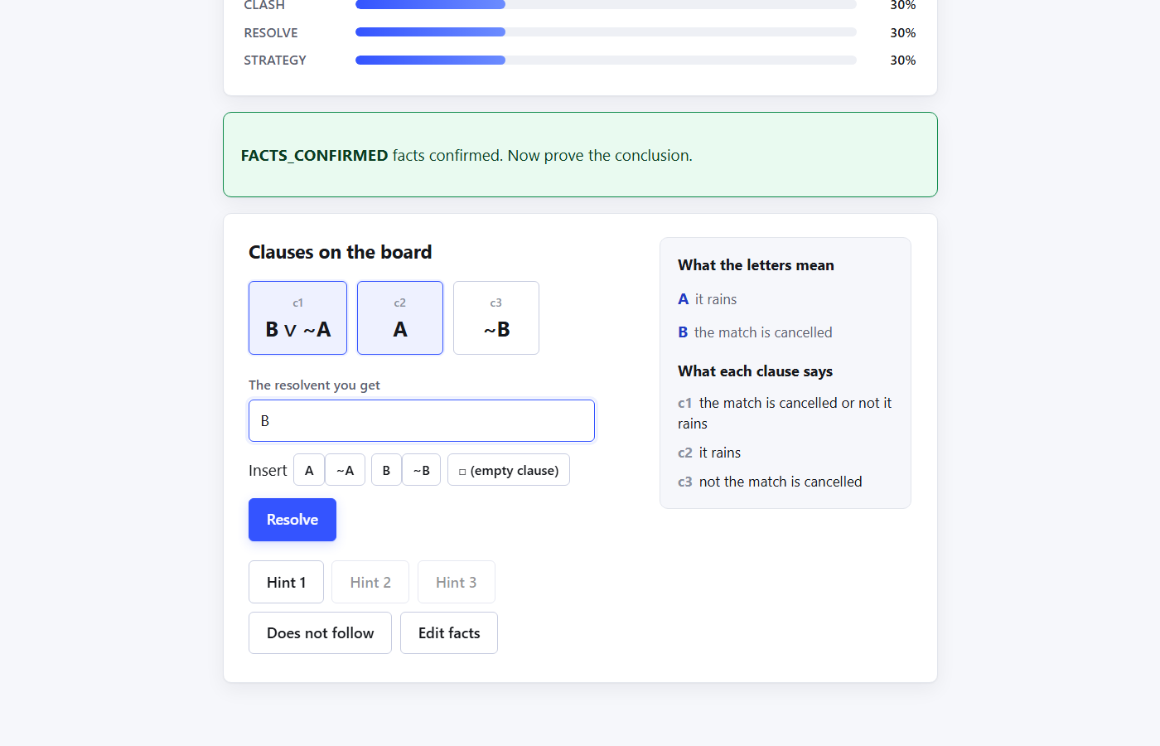
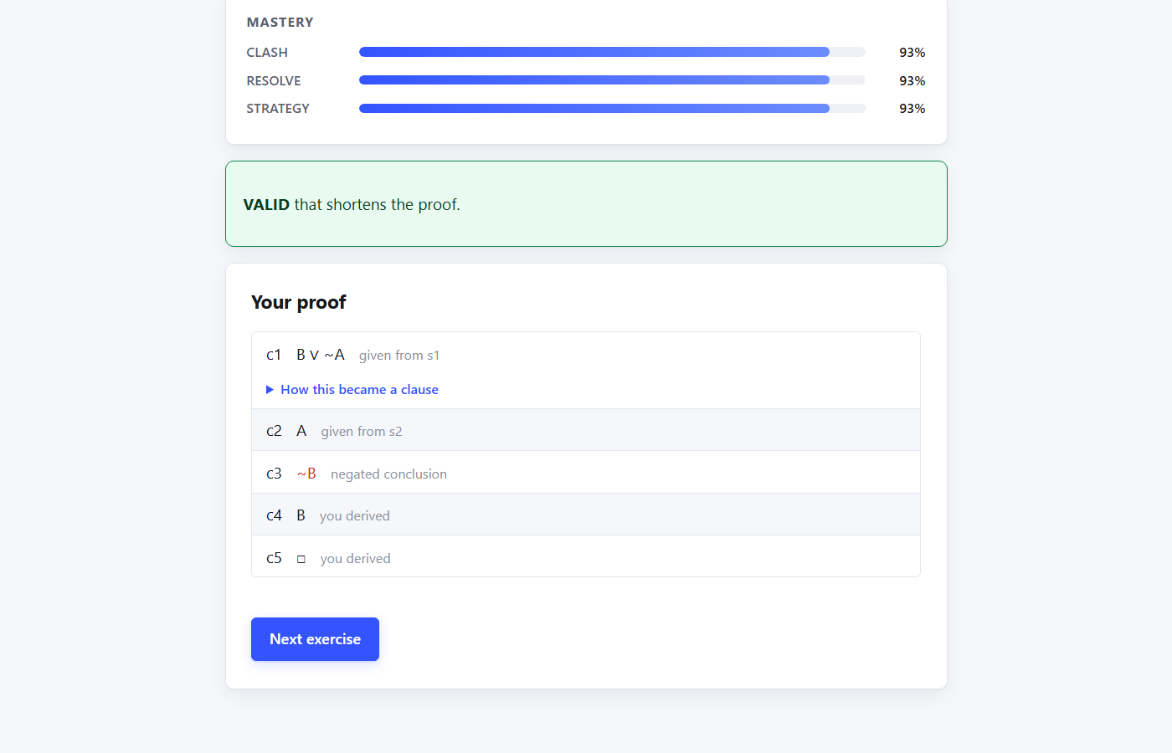
Appendix: Interface, Live Run 2026-10-25
Prove screen: symbol legend + plain-English clauses
Explanation screen: completed proof trace
ProofPilot | 11

